Slide 1
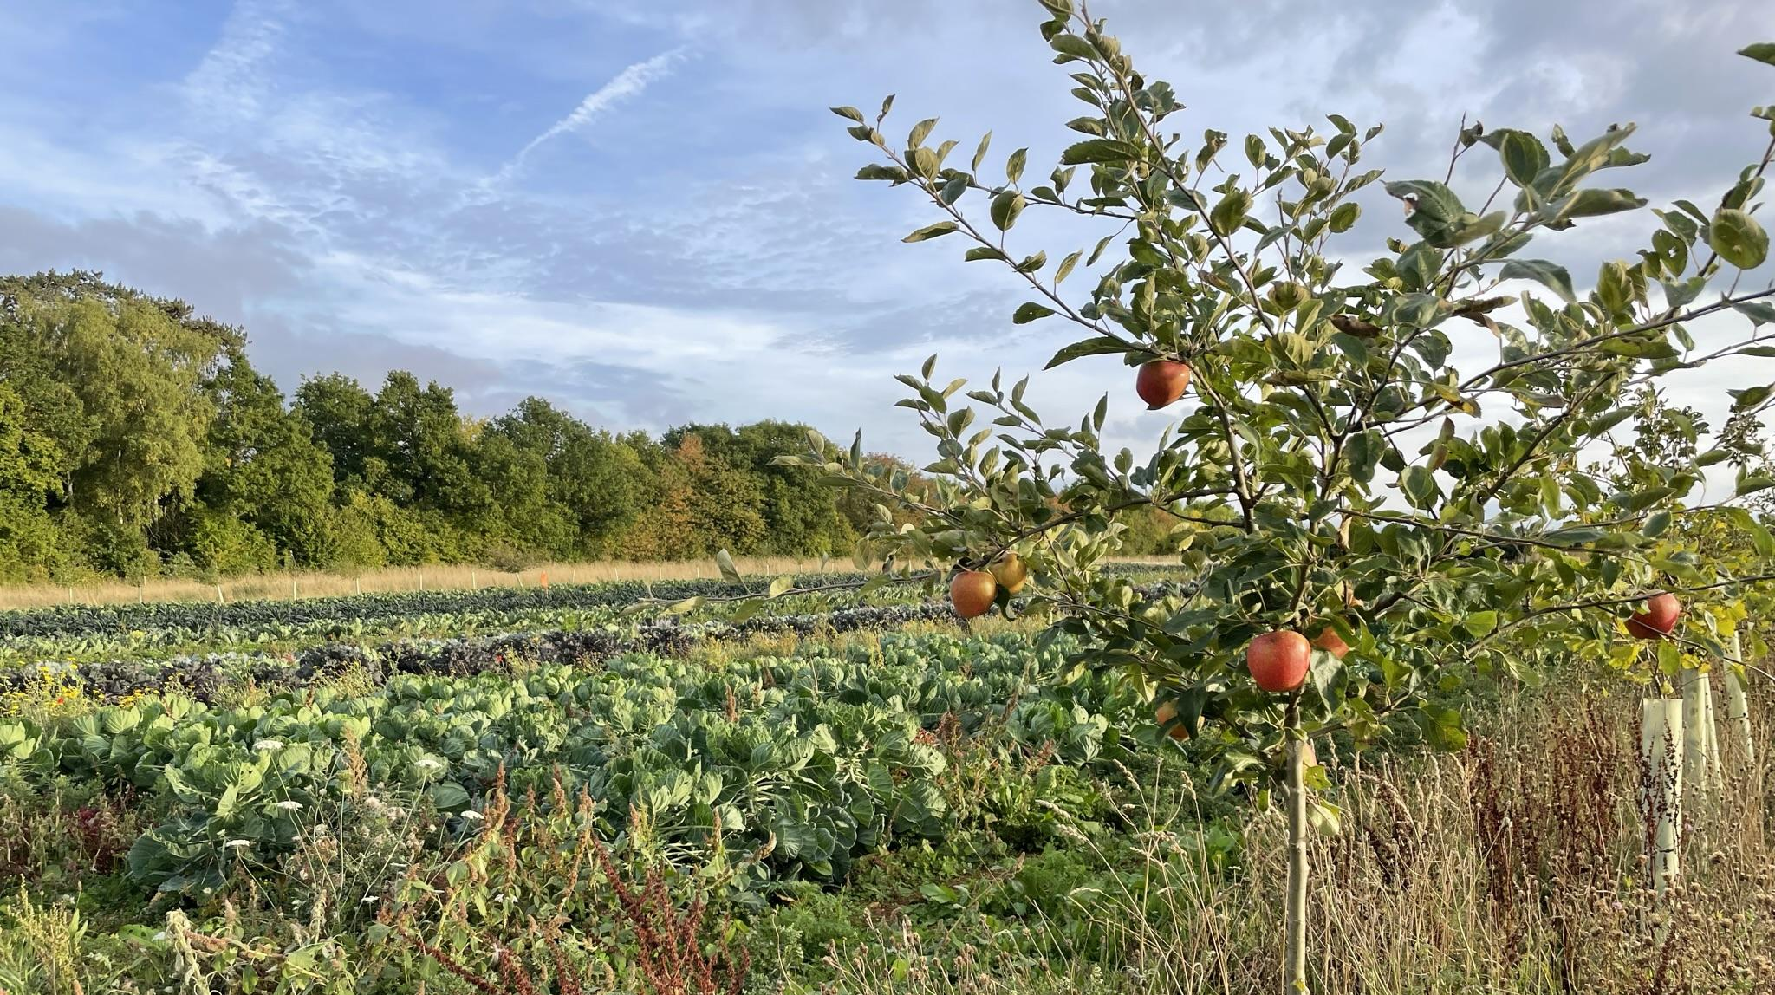
SILVOHORTICULTURE
Andy Dibben &
Ben Raskin

Slide 2
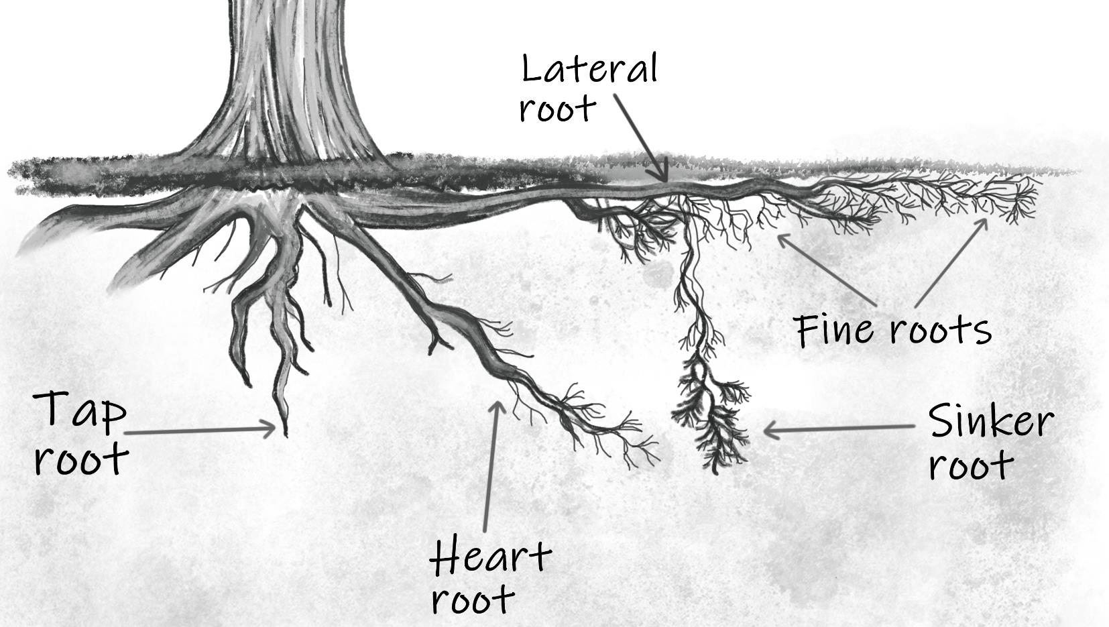
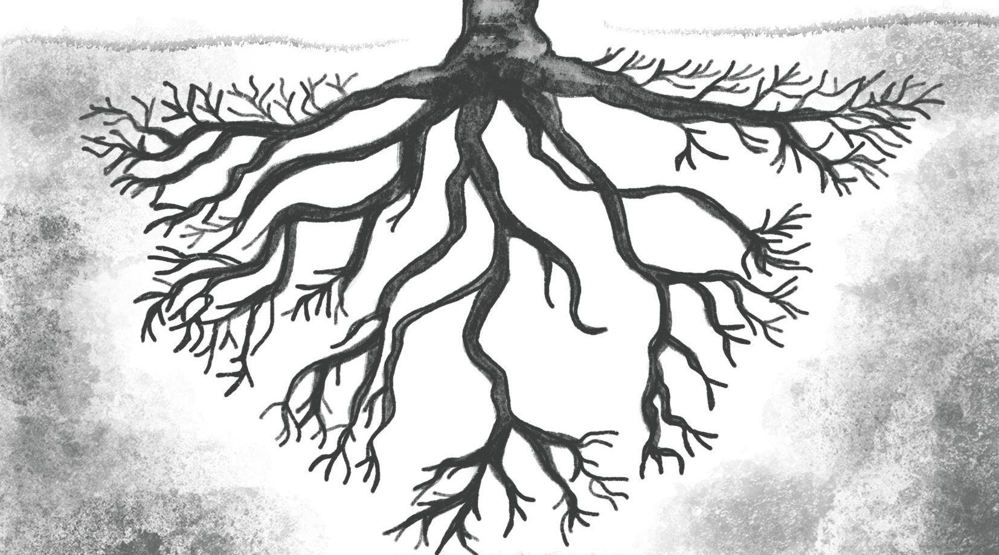
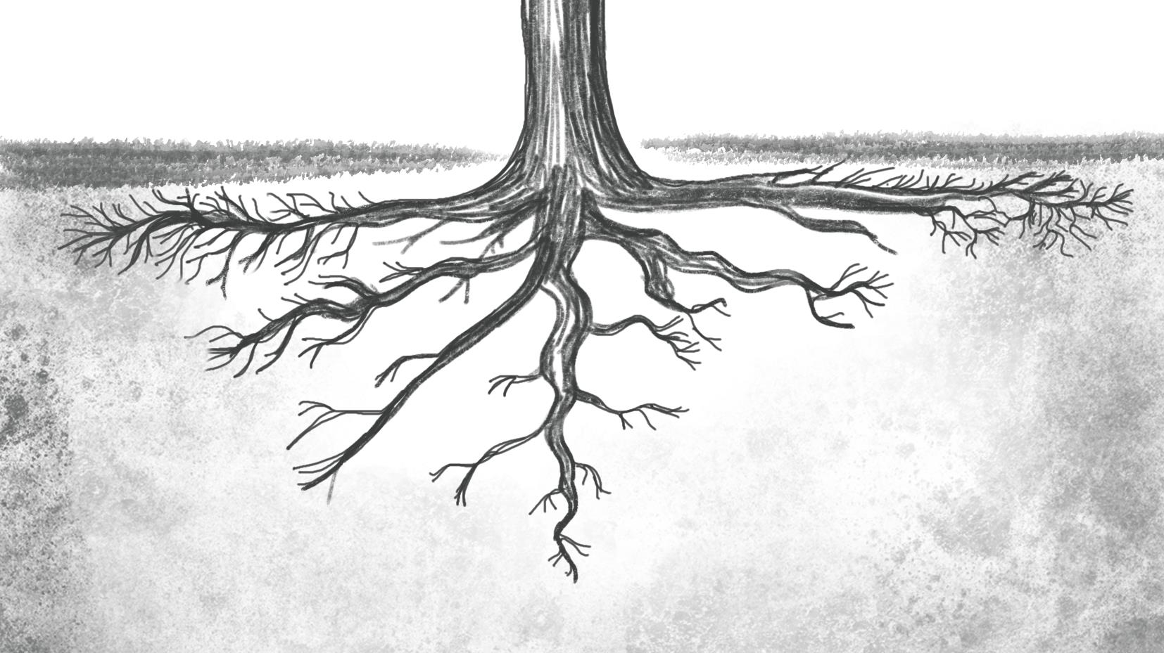
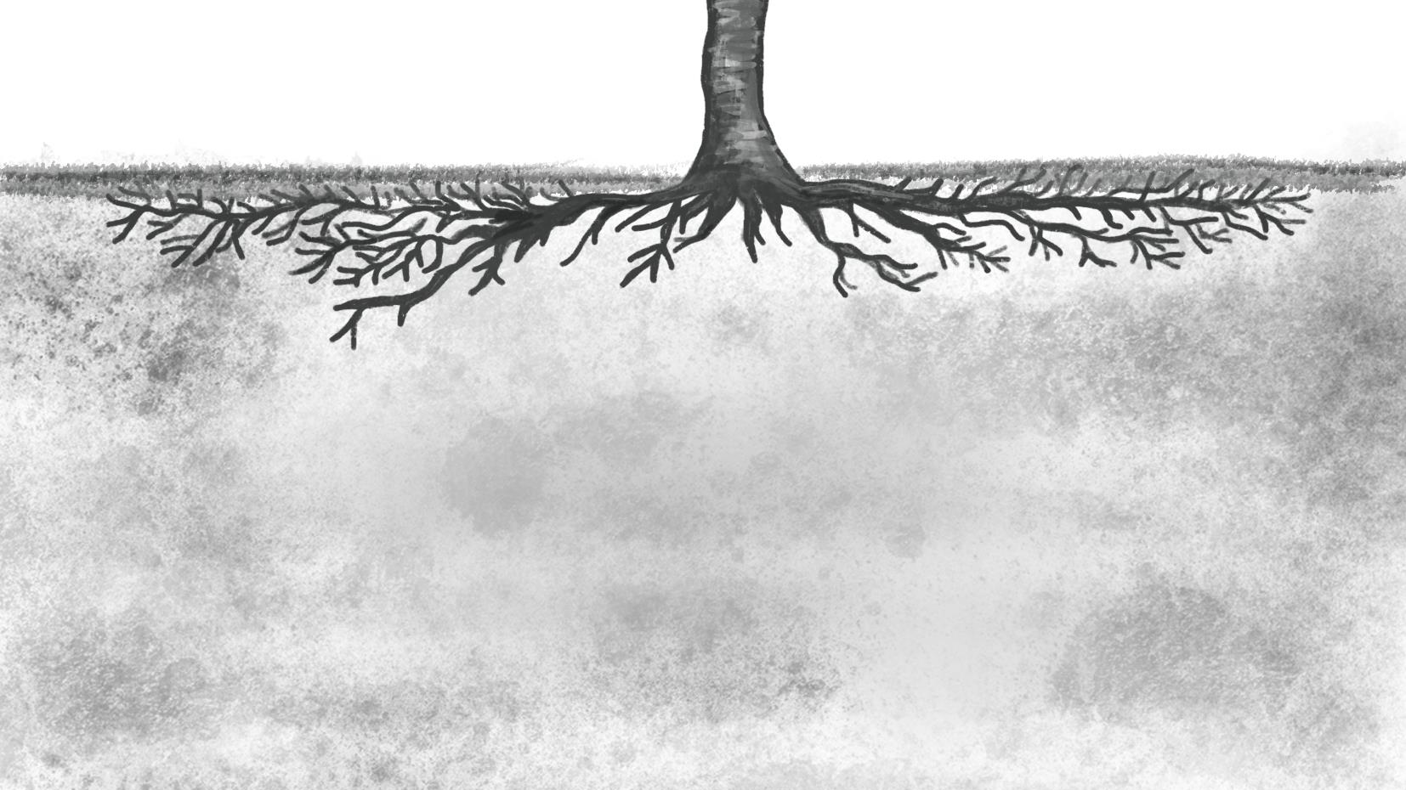
Heart
Tap root
Lateral

Slide 3
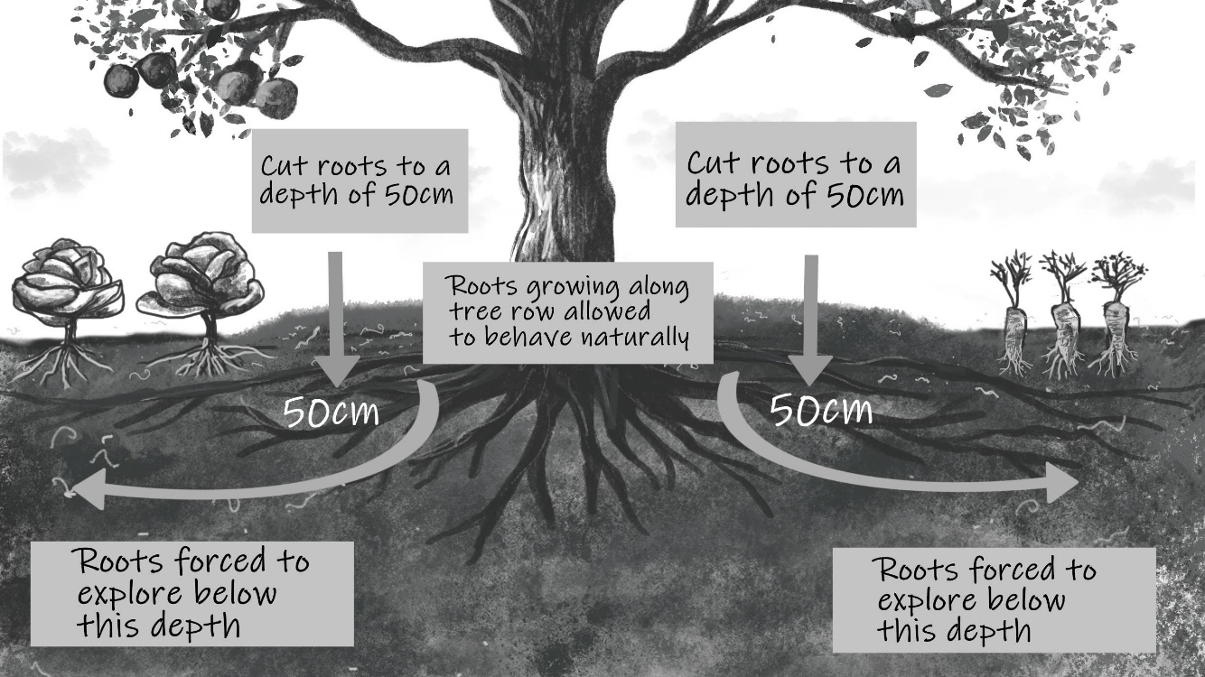

Slide 4
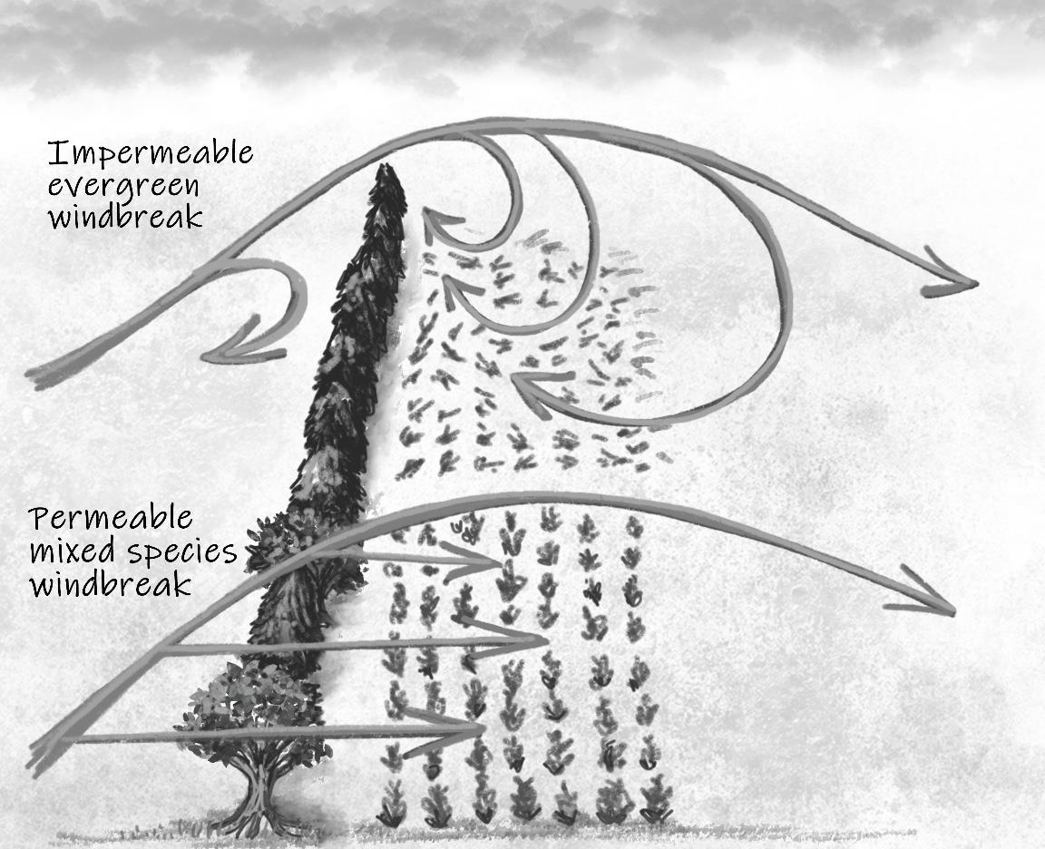

Slide 5
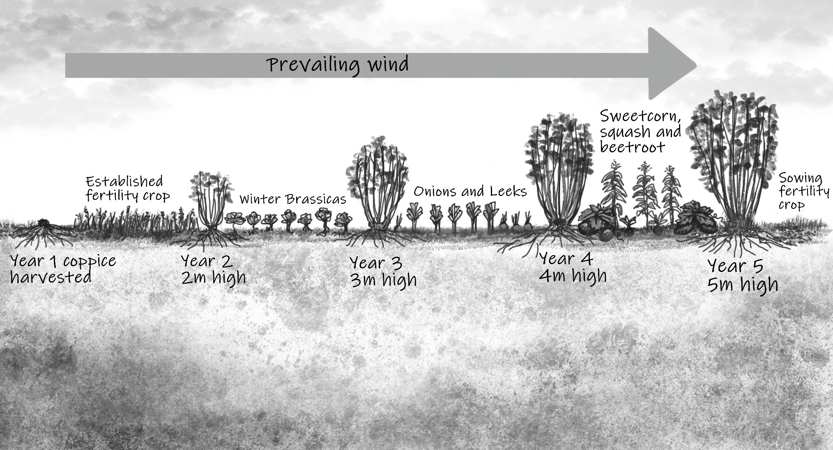
WIND
Height of tree x 10 = Distance of effective wind reduction downwind from trees.
Height of tree x 2 = minimum width of alleys

Slide 6
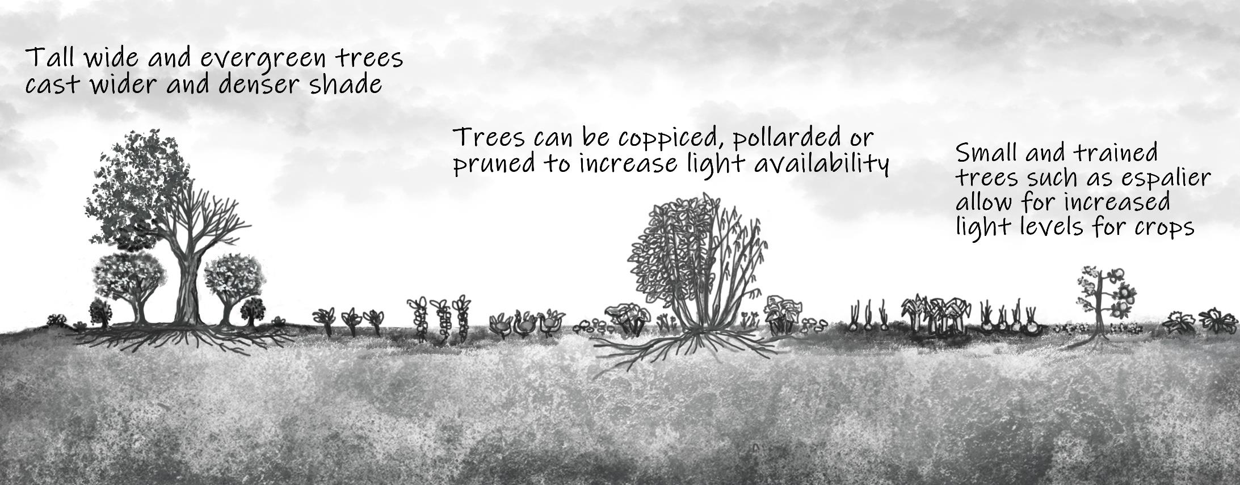

Slide 7
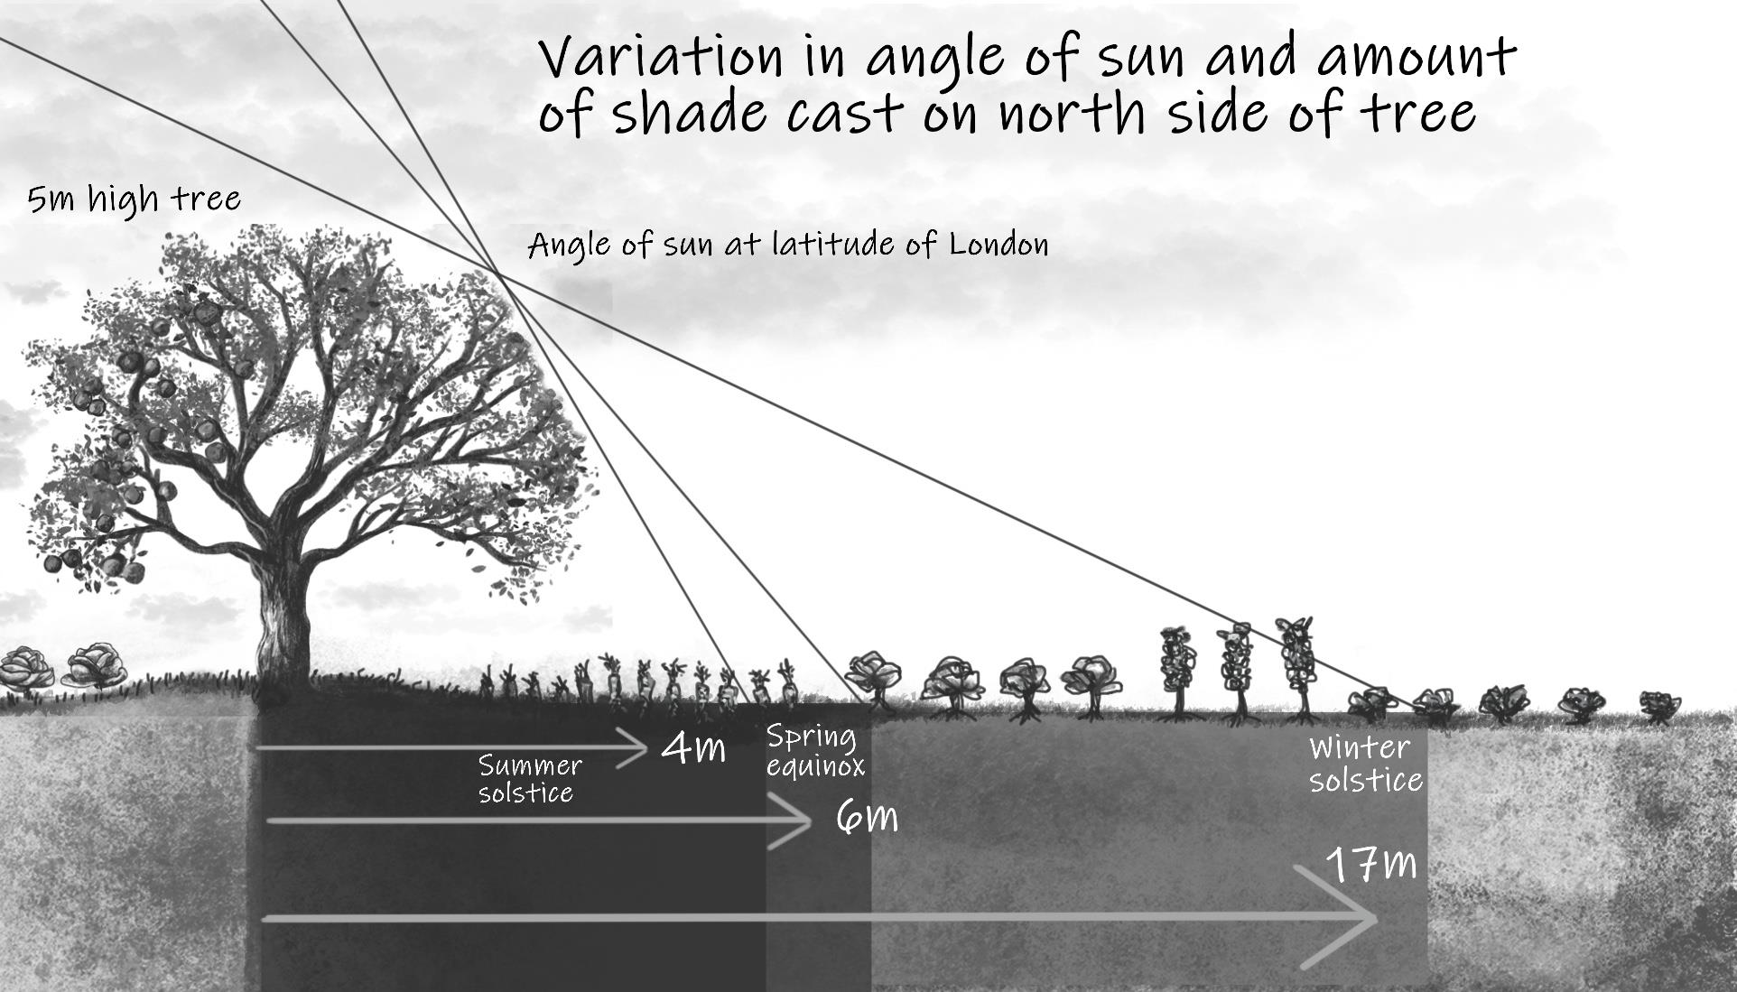

Slide 8

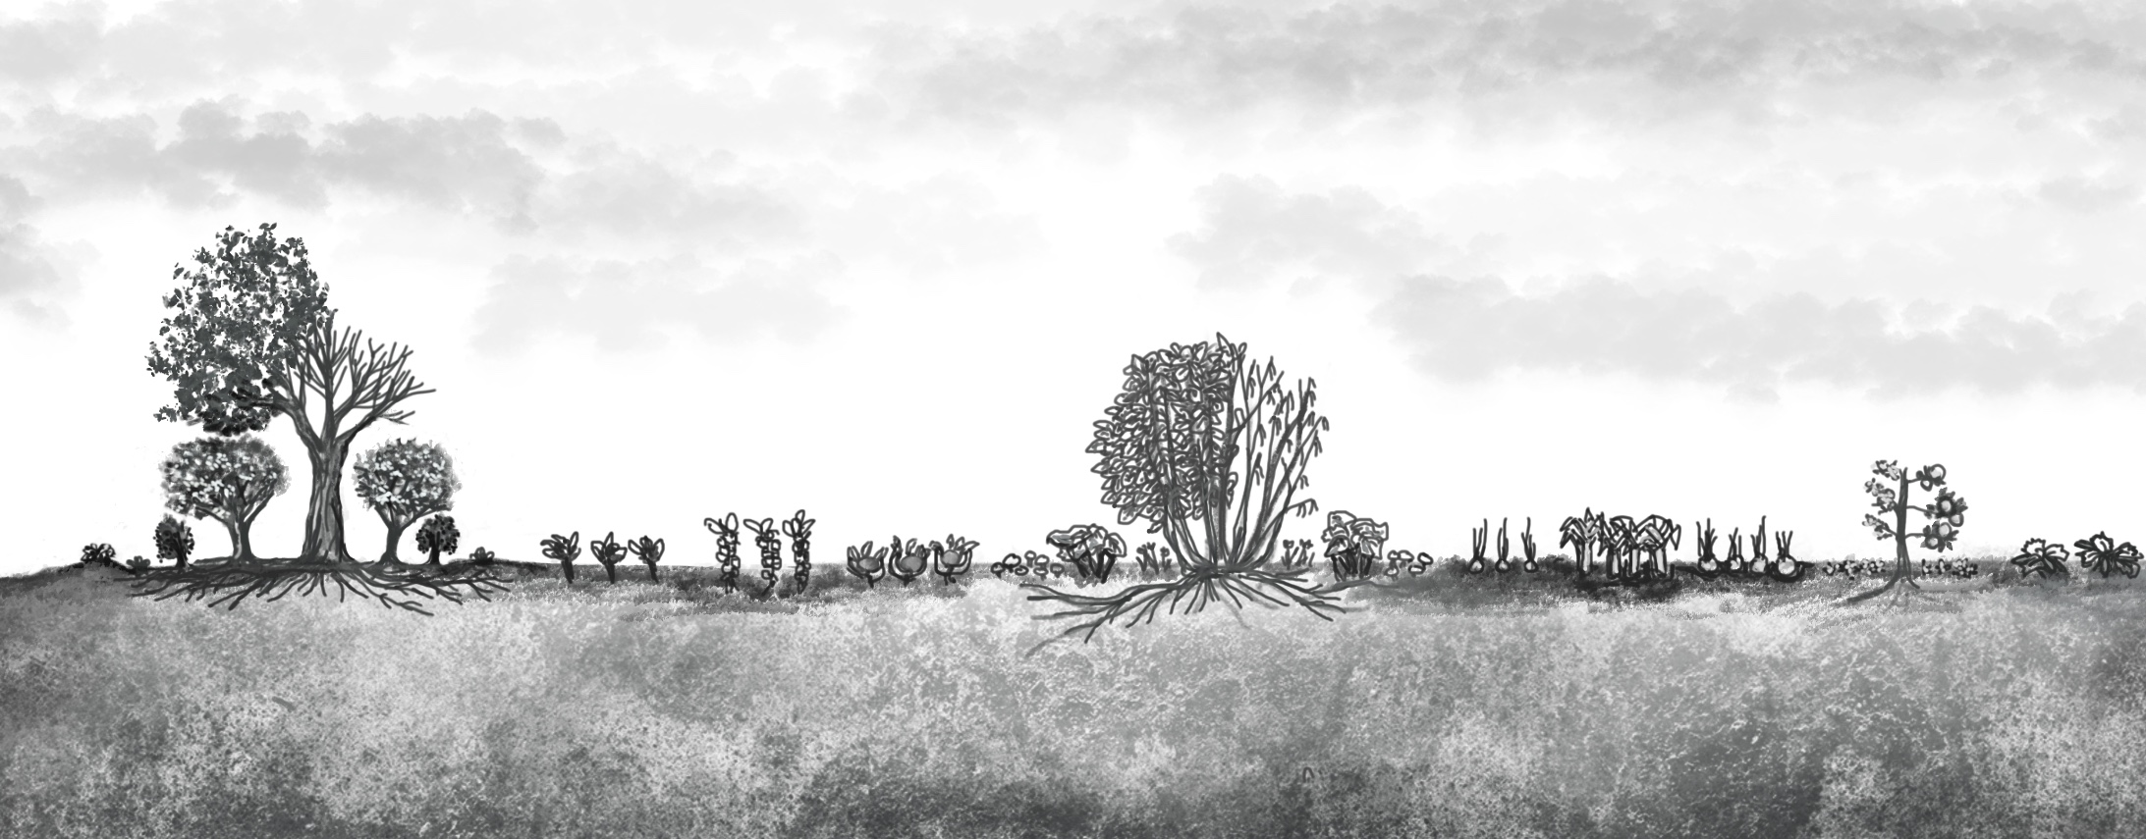
Mature Tree
Young Tree
Sapling

Slide 9
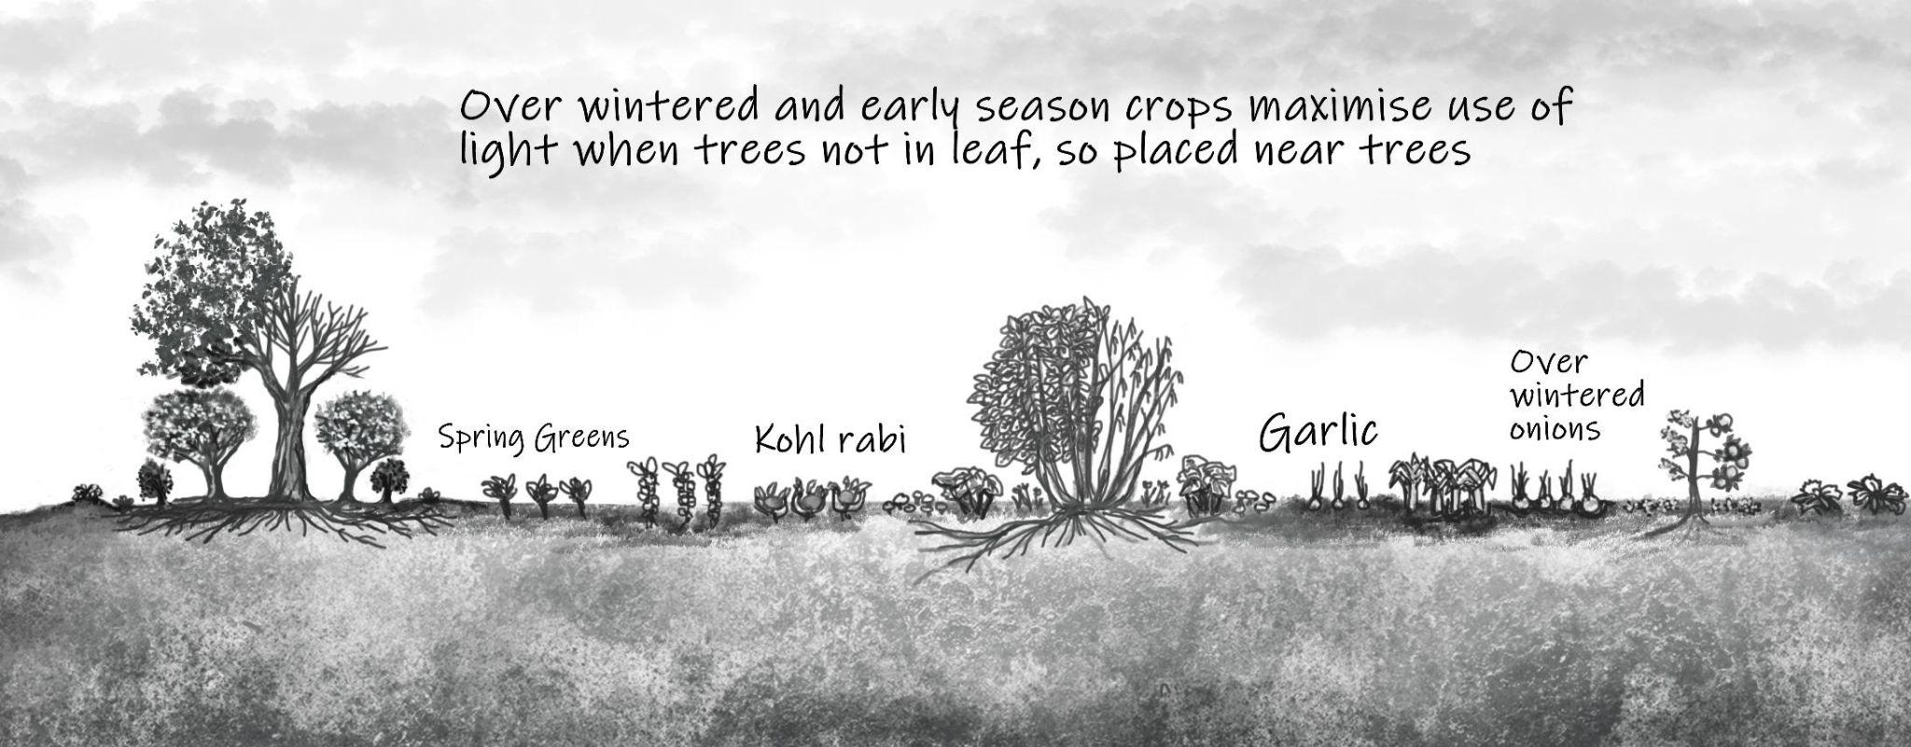
Notes:
Everyone here of course knows about rotations, but that mostly assume maximum light from the sky
Perhaps a bit of it going on with undersowing but otherwise we think mainly of plant families and disease and nutrient requirements
Bring trees into the equation and we have to understand that third dimensional consideration and how it changes over time -
That happens on a seasonal basis as trees come into leave and out again
Also happens on an annual basis as trees grow, and potentially get cut down

Slide 10
Timber
Coppice
Edible
Floristry
Wood Chip
Medicinal
Climate resilience
Crop protection
Reduce inputs

Slide 11
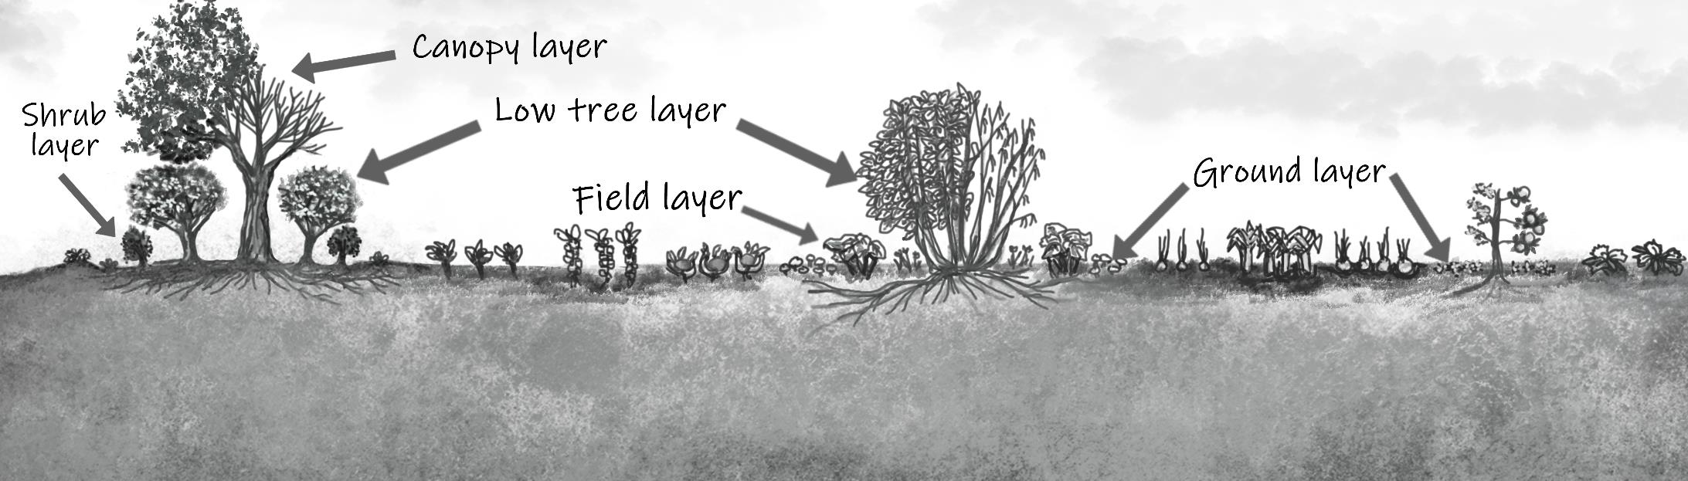
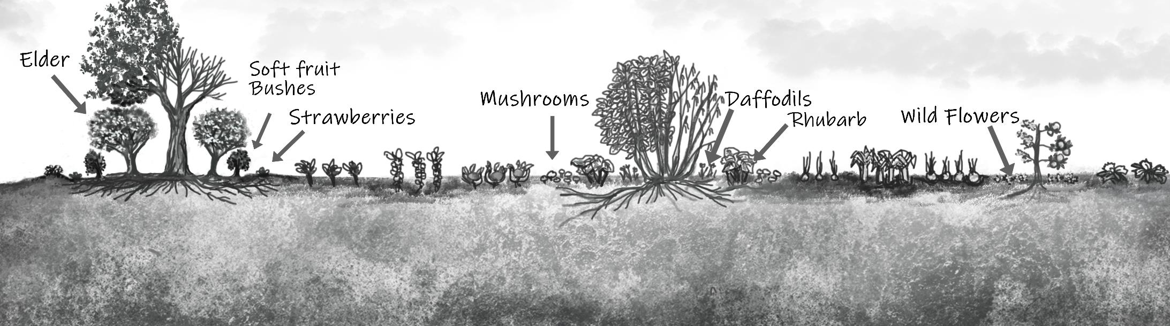
Understorey

Slide 12
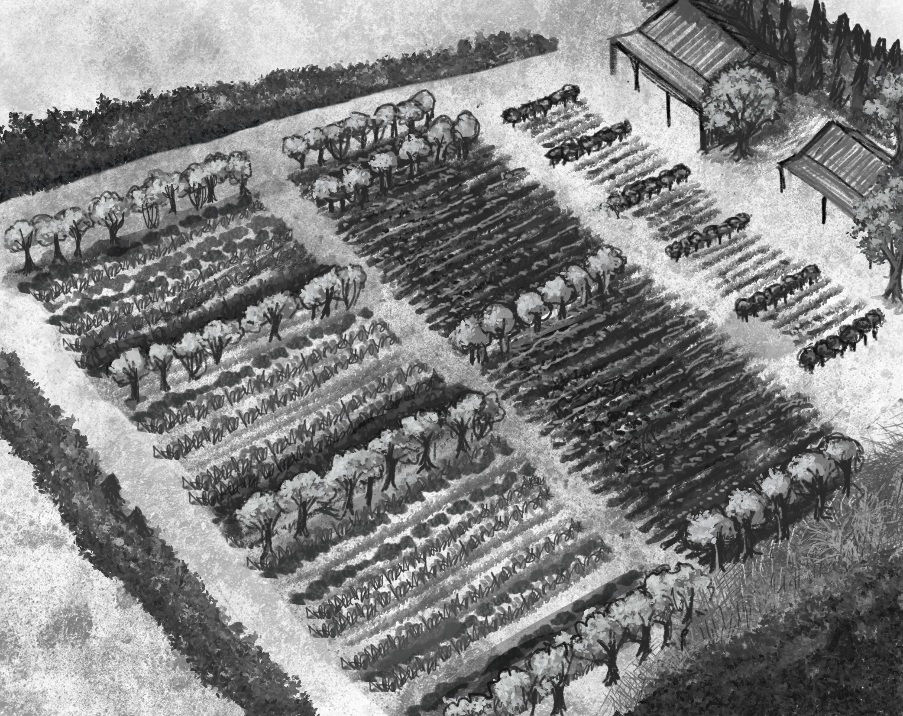

Thank you

