Slide 1
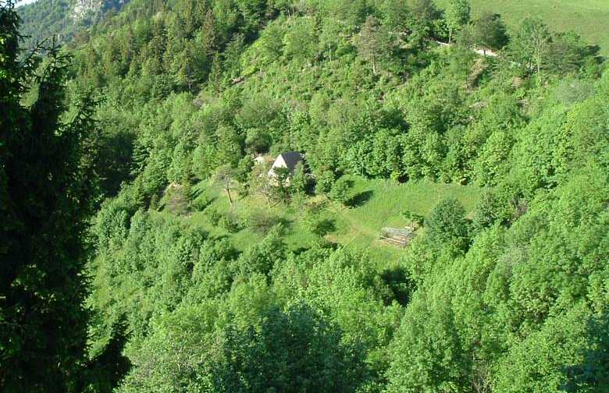
Woodland Crofts
Jamie McIntyre
Woodland Crofts Partnership/
Scottish Crofting Federation
ORFC
10 January 2025

Slide 2
What is a woodland croft?
“A woodland croft is a registered croft with sufficient tree cover overall to be considered a woodland under UK forestry policy”
But not a legal definition - ‘woodland croft’ a description only
A woodland croft is just a croft like any other
(Crofting Commission)
Notes:
Will go cover crofting and forestry aspects in a bit more depth, starting with crofting
Woodland aspect means subject to forestry regulations
Conscious many people will know something of crofting, but is a complicated subject, and has been much change in last 5 years
But first a bit more on the background
People who focus in on the criteria for woodland ( ‘20% canopy cover’) are probably looking at the wrong model………
- Crofters Commission do not recognise woodland crofts as distinct from any other – just crofts

Slide 3
What is unique about a woodland croft?
The only state-sanctioned model of living & working in woodlands in the UK
On paper, at least………….
Supported in legislation & policy, both national (Scottish Government) and local (Local Authorities)
Notes:
Will go cover crofting and forestry aspects in a bit more depth, starting with crofting
Woodland aspect means subject to forestry regulations
Conscious many people will know something of crofting, but is a complicated subject, and has been much change in last 5 years
But first a bit more on the background
People who focus in on the criteria for woodland ( ‘20% canopy cover’) are probably looking at the wrong model………
- Crofters Commission do not recognise woodland crofts as distinct from any other – just crofts

Slide 4
Woodland Cover in the UK
Scotland – 19%
Wales – 15%
England – 10%
Northern Ireland – 9%
UK overall – 13.5%
cf European Union – 39%
Notes:
Will go cover crofting and forestry aspects in a bit more depth, starting with crofting
Woodland aspect means subject to forestry regulations
Conscious many people will know something of crofting, but is a complicated subject, and has been much change in last 5 years
But first a bit more on the background
People who focus in on the criteria for woodland ( ‘20% canopy cover’) are probably looking at the wrong model………
- Crofters Commission do not recognise woodland crofts as distinct from any other – just crofts

Slide 5
We need more trees & woodlands:
Carbon sinks
Construction (carbon storage & materials substitution)
Ecosystem services (re air quality, flood risk etc)
Biodiversity
Health & well-being
Provide shade, reduce soil & nutrient loss etc etc
But…….
Notes:
Will go cover crofting and forestry aspects in a bit more depth, starting with crofting
Woodland aspect means subject to forestry regulations
Conscious many people will know something of crofting, but is a complicated subject, and has been much change in last 5 years
But first a bit more on the background
People who focus in on the criteria for woodland ( ‘20% canopy cover’) are probably looking at the wrong model………
- Crofters Commission do not recognise woodland crofts as distinct from any other – just crofts

Slide 6
Policy & support systems are siloed
Forestry or agriculture or development
Increasing forest cover is a challenge within that context
Answer: integrate woodlands with other land uses
Forestry and agriculture and development
Woodland crofts deliver such integration of land use & activities
Notes:
Will go cover crofting and forestry aspects in a bit more depth, starting with crofting
Woodland aspect means subject to forestry regulations
Conscious many people will know something of crofting, but is a complicated subject, and has been much change in last 5 years
But first a bit more on the background
People who focus in on the criteria for woodland ( ‘20% canopy cover’) are probably looking at the wrong model………
- Crofters Commission do not recognise woodland crofts as distinct from any other – just crofts

Slide 7
We (the WCP, including SCF) believe:
More woodland should imply more woodland crofts
But more woodland crofts implies more croft creation…..
……A pathway towards (wood)land justice?
This is now happening in Scotland, spearheaded by community landowners
Notes:
Will go cover crofting and forestry aspects in a bit more depth, starting with crofting
Woodland aspect means subject to forestry regulations
Conscious many people will know something of crofting, but is a complicated subject, and has been much change in last 5 years
But first a bit more on the background
People who focus in on the criteria for woodland ( ‘20% canopy cover’) are probably looking at the wrong model………
- Crofters Commission do not recognise woodland crofts as distinct from any other – just crofts

Slide 8
New community-owned woodland crofts:
(existing or in development in bold, under consideration in italics)
Langamull (NW Mull)
Tiroran (SW Mull)
Kilfinan (Tighnabruaich)
Ardochy (Invergarry)
Fiunary (Morvern)
Orbost (DCT)
Longrigg (Strontian)
Inverlael (Broompower) etc
Lots of private ones too!
Notes:
8

Slide 9
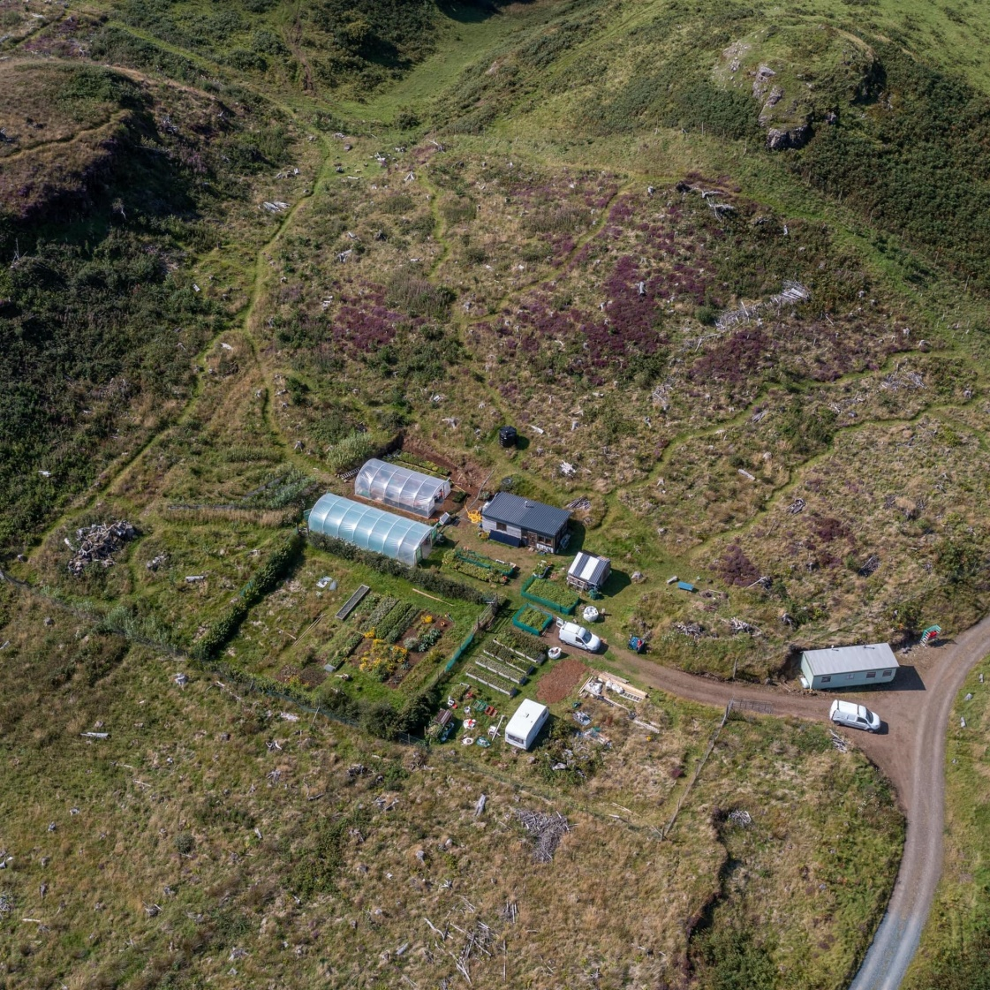
© Andy Robinson
Langamull, Isle of Mull
Notes:
9
Owner occupied
Occupier took on croft as tenant 50+ years ago
Semi-natural oakwood (Sunart Oakwoods) and ‘always’ has been
Co-operative management with neighbours (eg machinery group)
Chainsaw mill, tractor, winch, timber trailer; woodfuel and some milling timber
All private woodland crofts
Plus – Mull woodland crofts, example of community woodland crofts (hear more from Ian later)

Slide 10
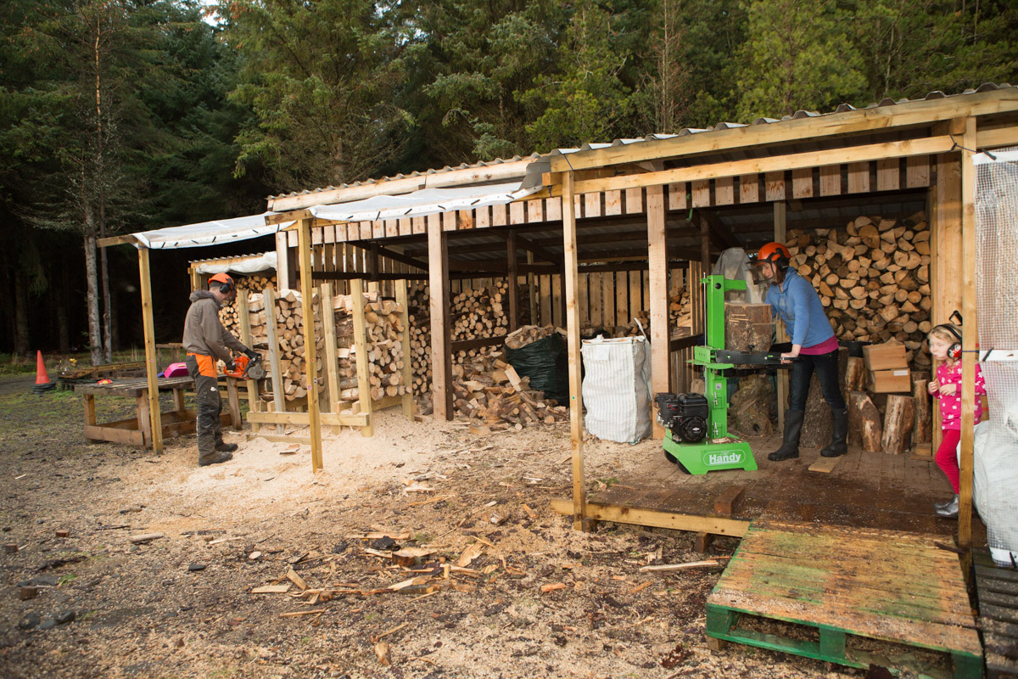
© John MacPherson
Cogle Wood, Watten
Notes:
10
Around 8ha
Created by the landlord for the tenant
- Mostly plantation woodland (conifer & broadleaved) plus a small field as pictured

Slide 11
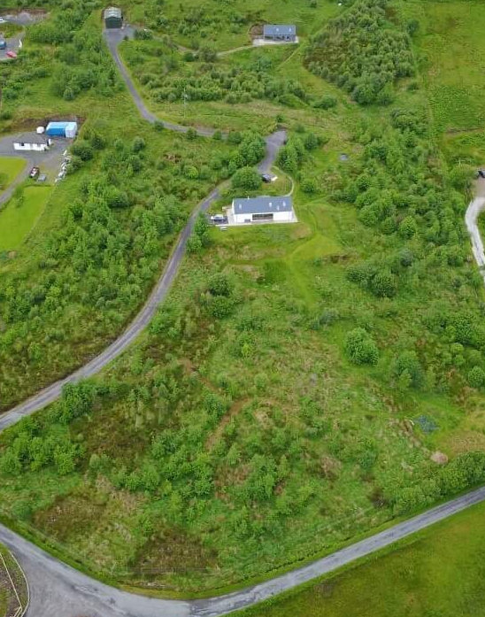
Druimfearn, Skye
© Phil Knott
Notes:
11
Owner occupied
About 6ha of which around 3ha planted up (ie 50%). Mixed NBL + SP regen
Future timber & woodfuel resource
Income supplemented by growing vegetables, raising poultry, selling eggs

Slide 12
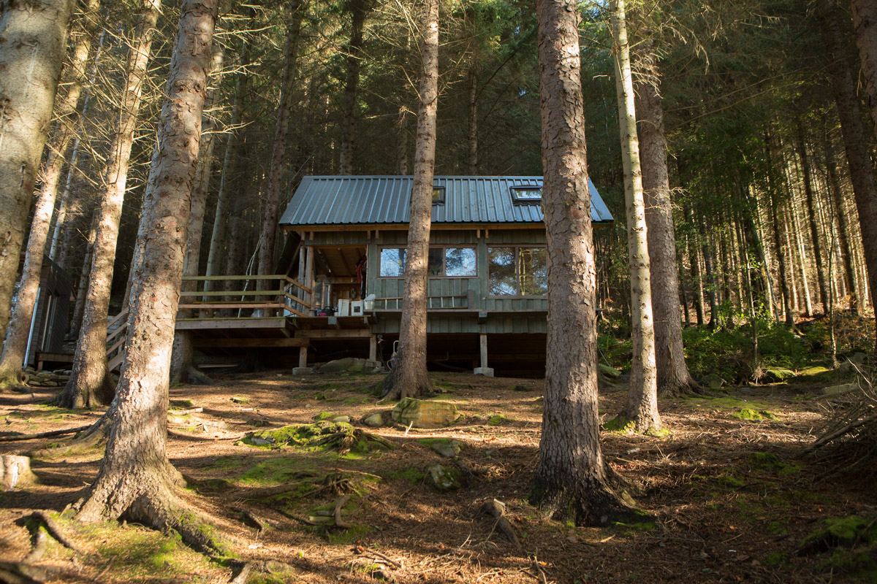
© John MacPherson
Leckmelm Wood, Ullapool
Notes:
12
Around 8ha
Created by the landlord for the tenant
- Mostly plantation woodland (conifer & broadleaved) plus a small field as pictured

Slide 13
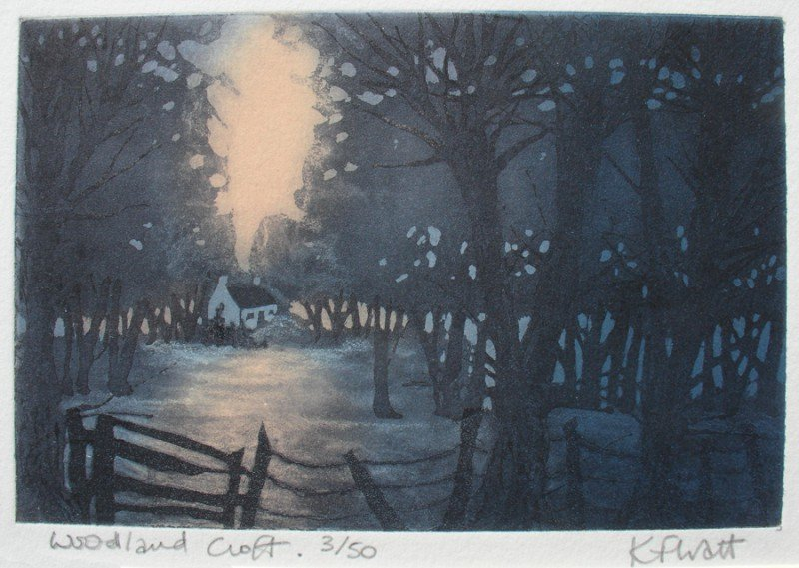
info@woodlandcrofts.org
www.woodlandcrofts.org
Twitter: @woodlandcrofts
(plus Facebook & Instagram)
& FB woodland crofting group
Notes:
13

