Slide 1
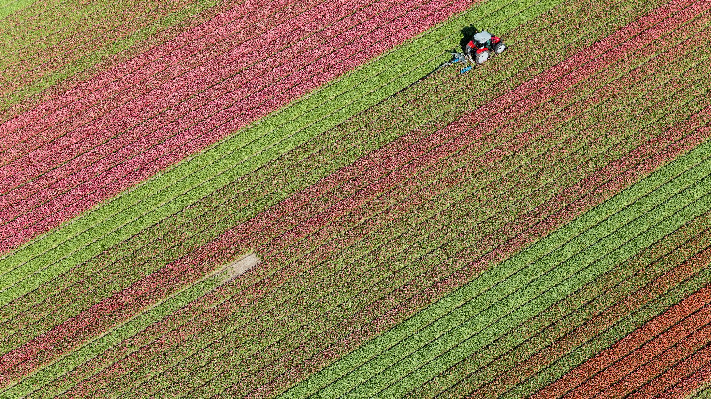
Local Powers and Levers Driving Agroecology

Slide 2
Local powers and levers driving agroecology
The role of local authorities

Slide 3
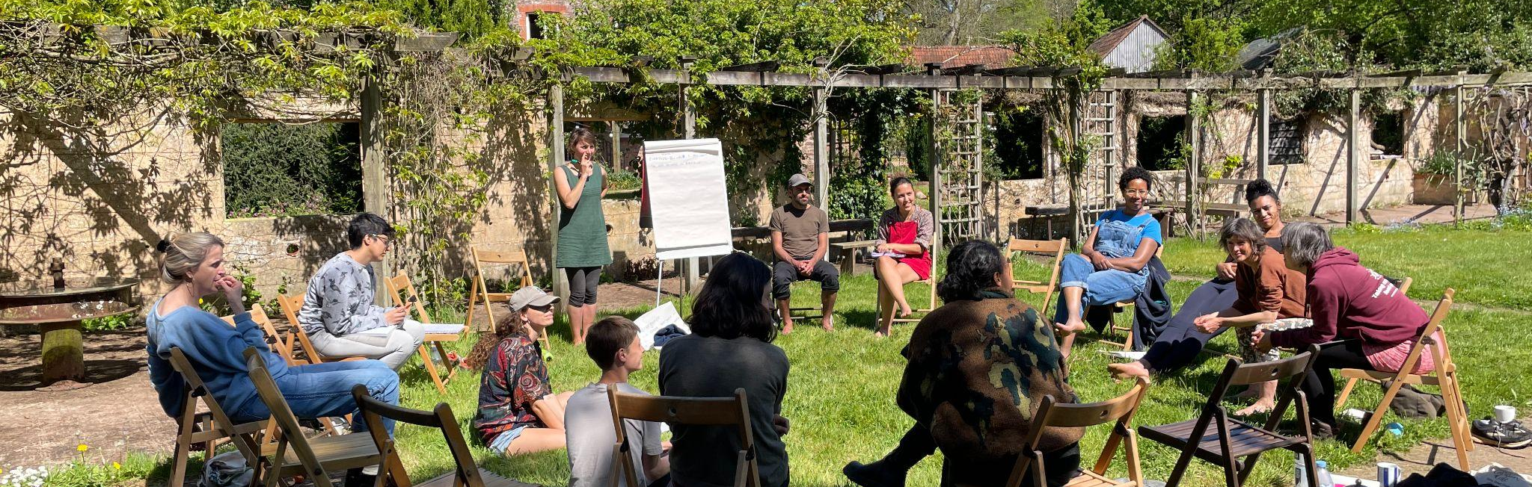
With land we can
Reimagining what we can do with land, together
Notes:
Who are we, shared assets? A think and do tank that works to reimagine the land system.
Working to support models of land use and management which promote autonomy, justice, participation, and equity.
We’re also an organisation that dedicates a lot of attention to how we organise:
- we are a self-managing and 4 day week organisation
- and believe in autonomy, and having a good place to work.
We do work with people and with the land and also do a lot of work on ourselves and our workplace: trying to mirror what we want to see in the world

Slide 4
Drivers for local authorities

Slide 5
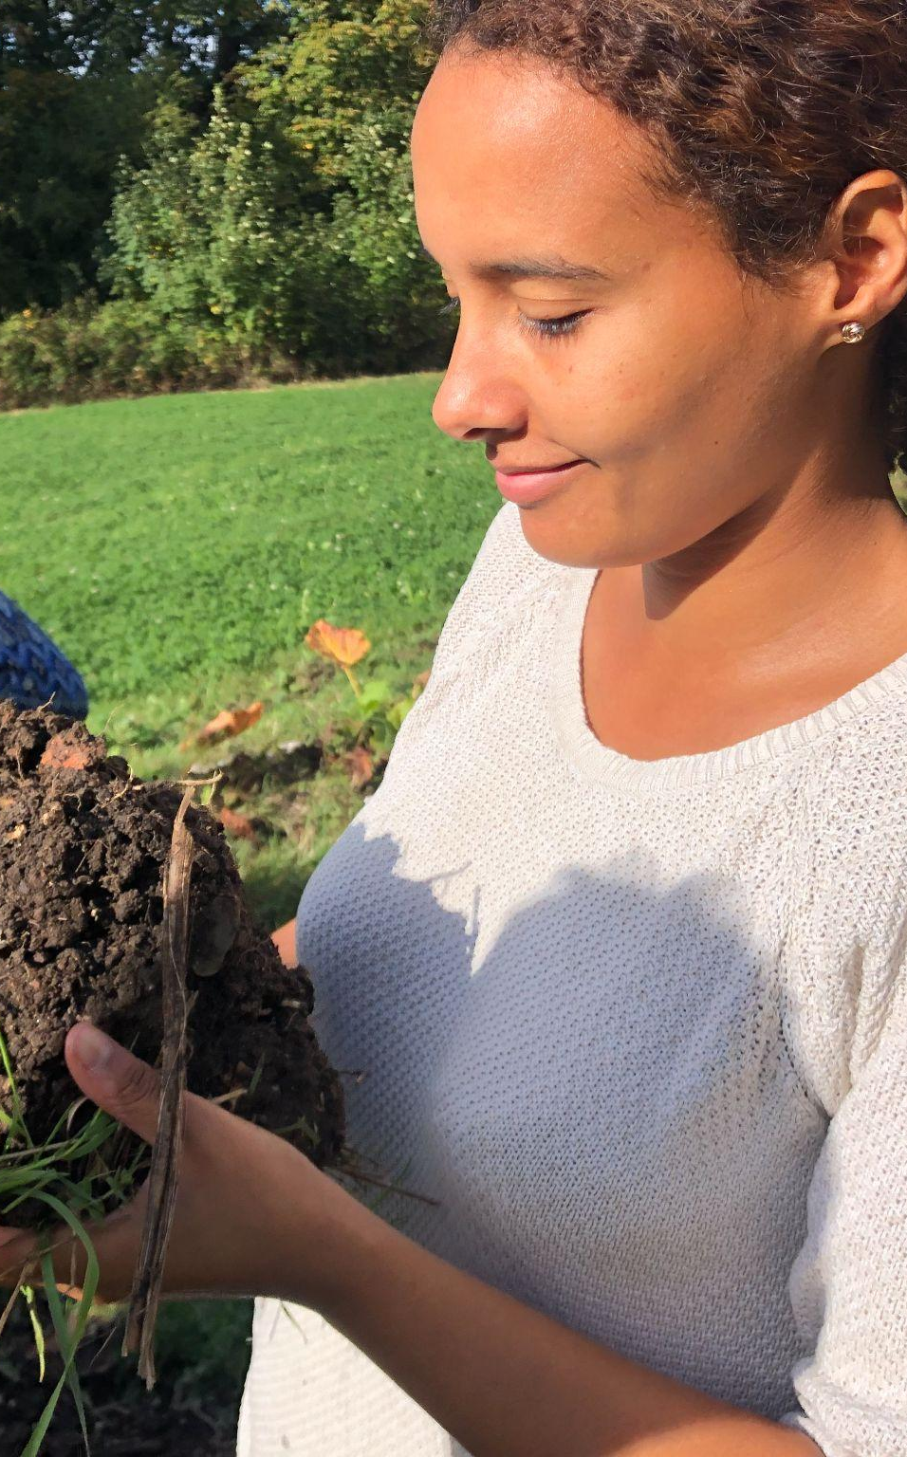
Key policy drivers for agroecology
Public health
Climate change
Nature restoration and biodiversity
Local economic development and resilience

Slide 6
Roles of local authorities

Slide 7
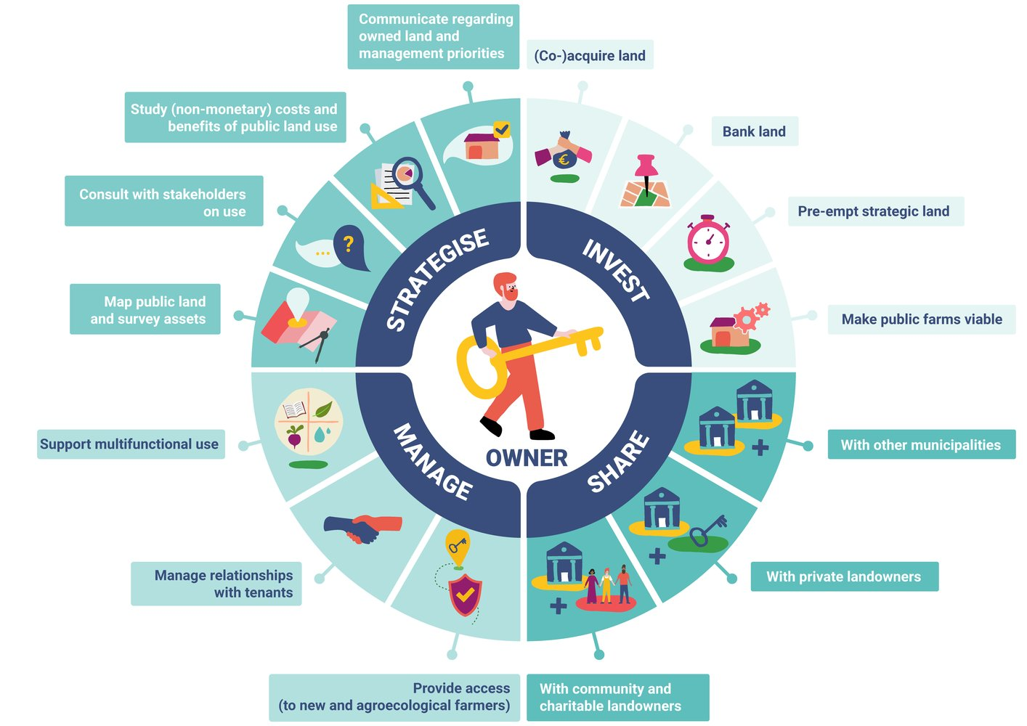
OWNER

Slide 8
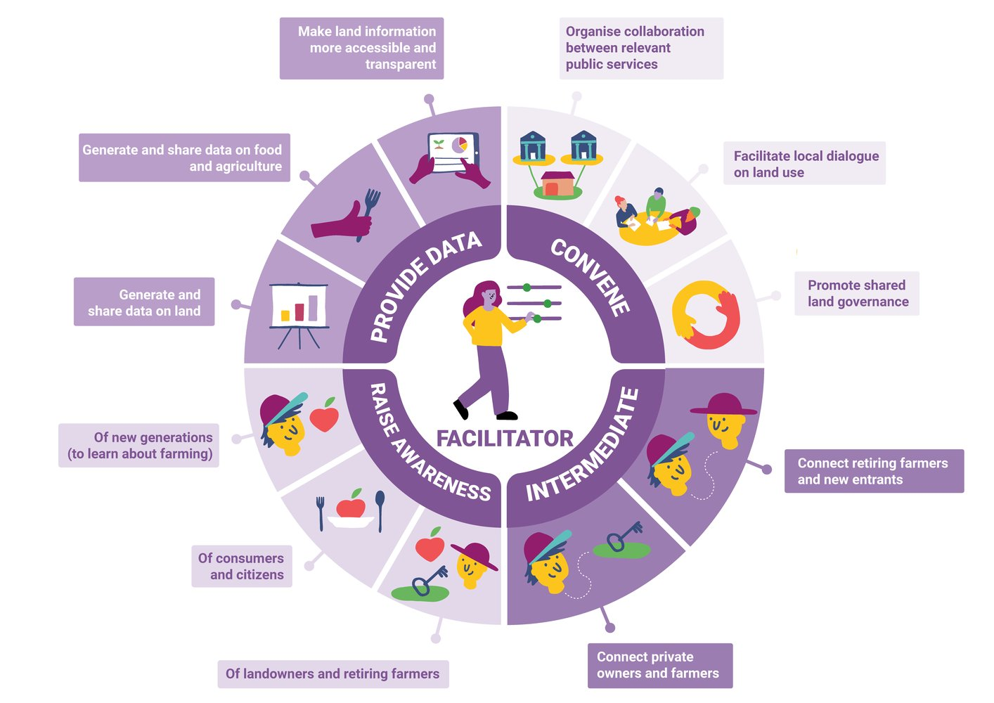
FACILITATOR

Slide 9
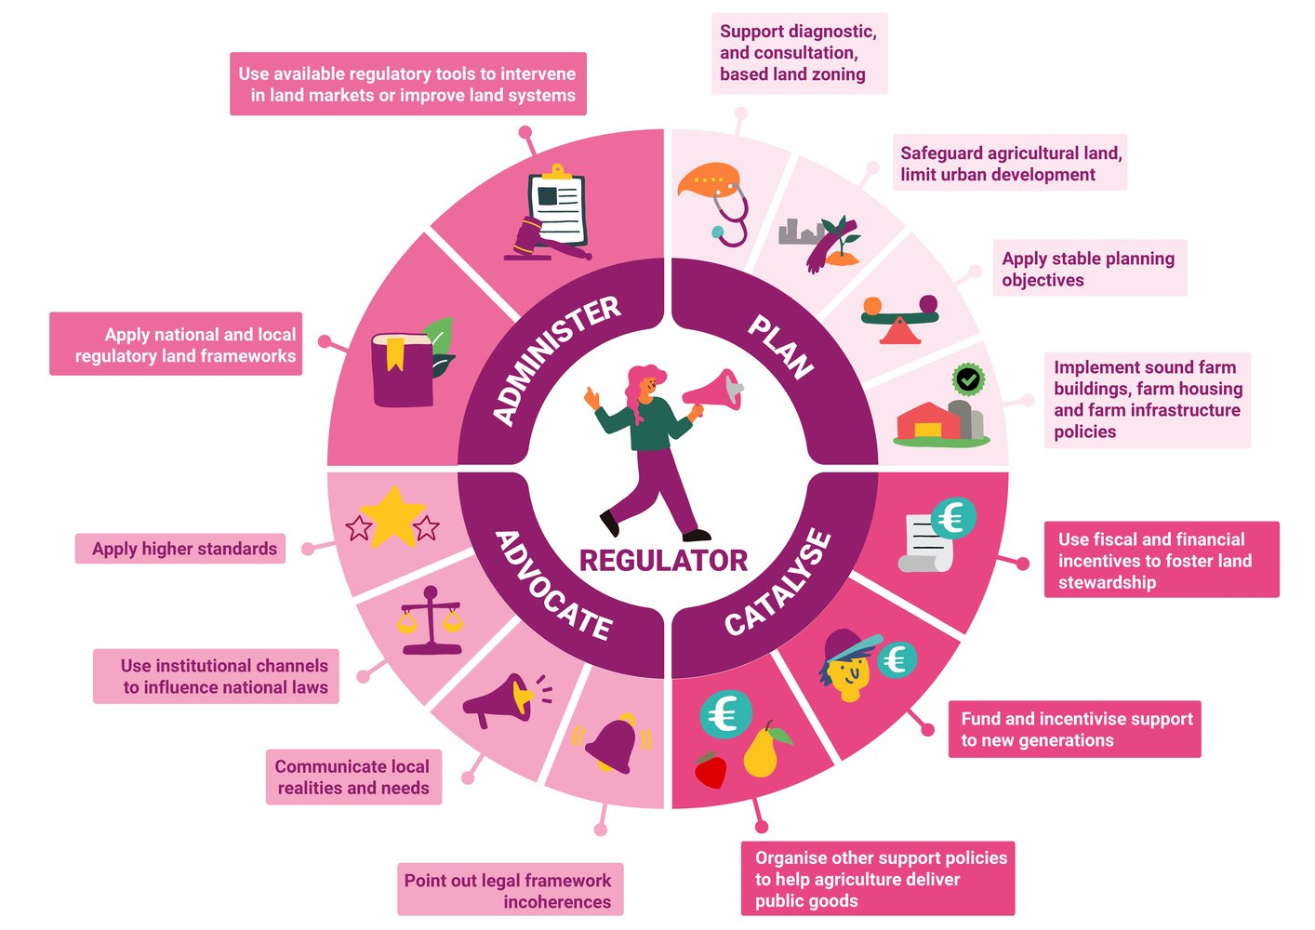
REGULATOR

Slide 10
Challenges

Slide 11
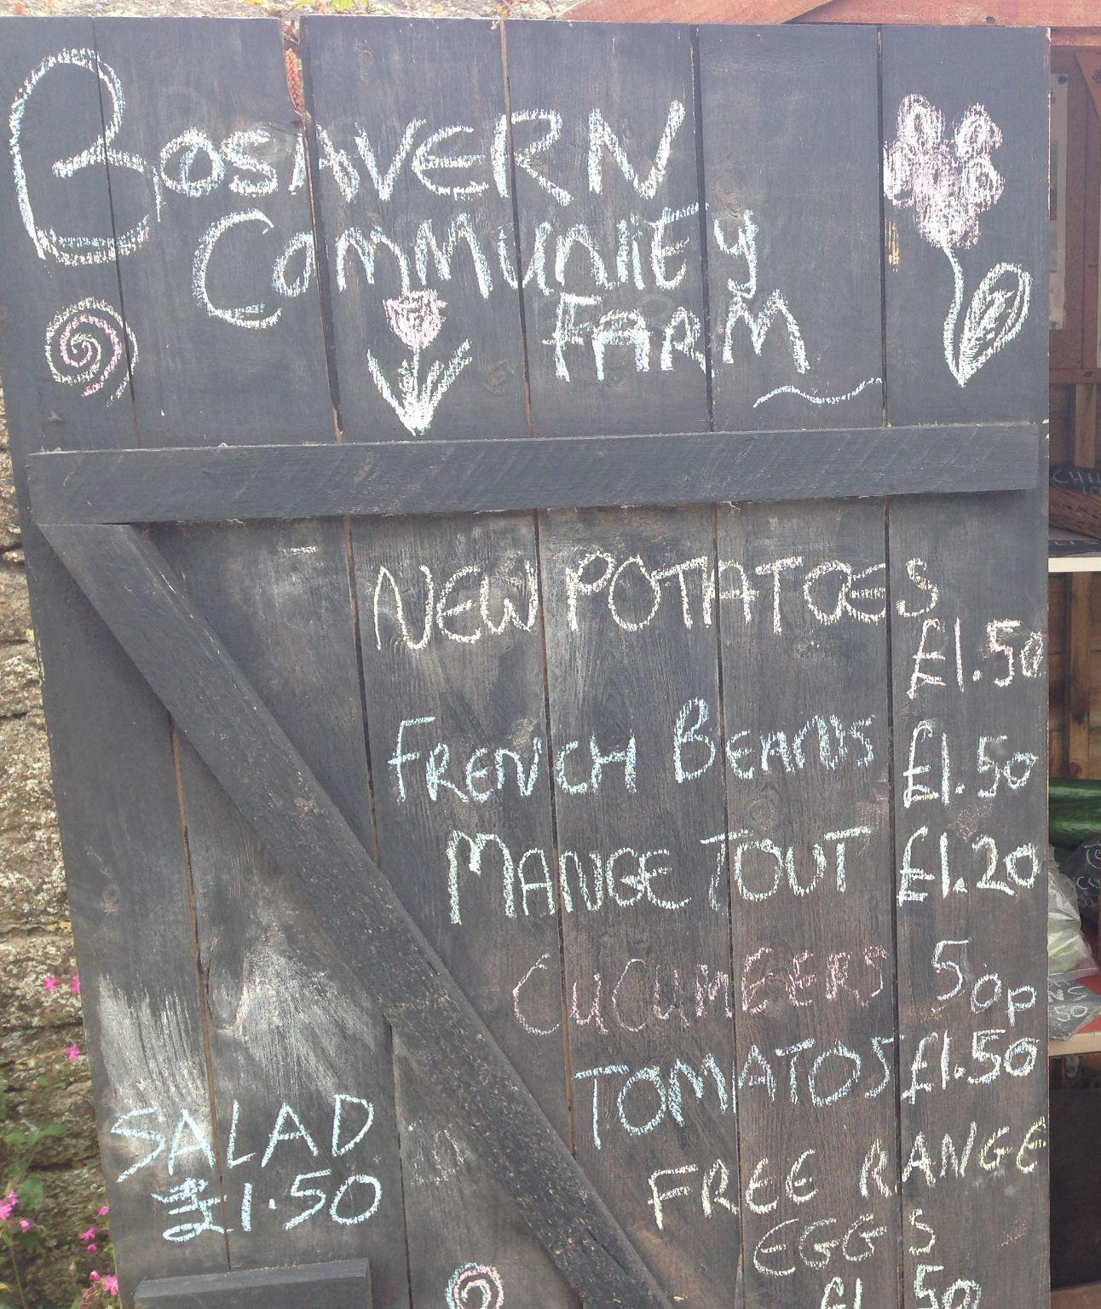
Challenges
Farming seen as a low value activity
High value of land and assets
Pressures on public finances
Competing priorities for land use
Changing political priorities
High reliance on personal interests / relationships

Slide 12
Thank you!

Slide 13
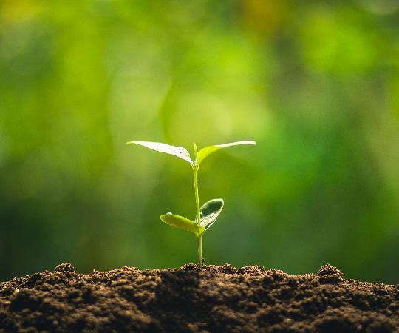


Charlotte Molyneux
Team Manager
Business Support and Innovation

Slide 14
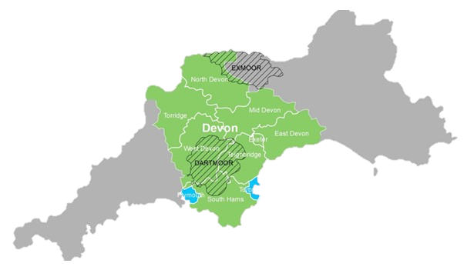




Background
Two tier local authority
  Devon County Council
  8 District Councils
Plus 2 unitary authorities
  Plymouth
  Torbay
2 National Parks, 5 AONBs
4 Food Partnerships

Slide 15


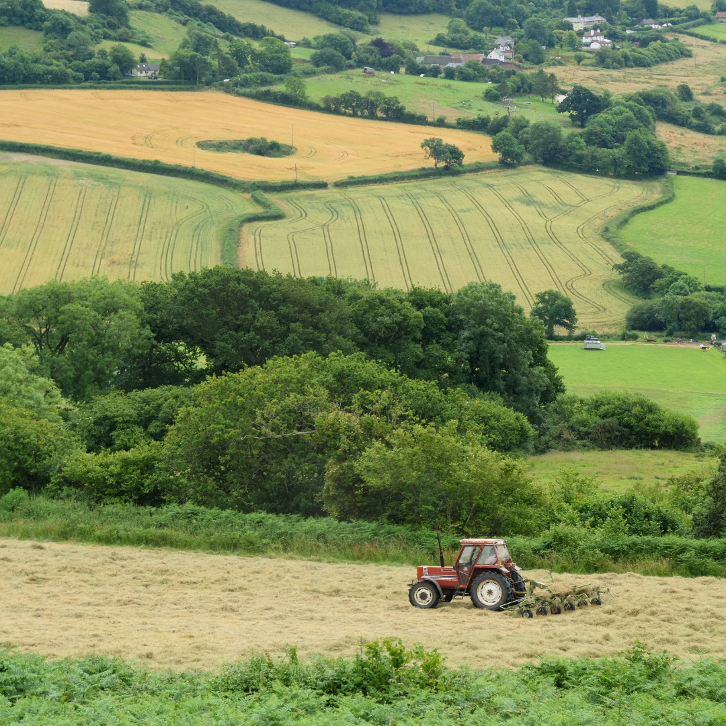
Farming Support Projects
Future Farming Resilience Programme
Defra Funded Programme providing business support to 2,633 farms across the Great South West
Devon County Council is the only local authority in the country delivering this programme
Supporting innovation in farming
Set up the Devon Agri Tech Alliance network to connect farmers, industry, and researchers
Hosting agri-events programme in locations around the county
County Farms Estate Research
65 fully equipped residential dairy and mixed livestock farms totalling 9,570 acres
Commissioned the University of Exeter to deliver the county farms future opportunities research project

Slide 16
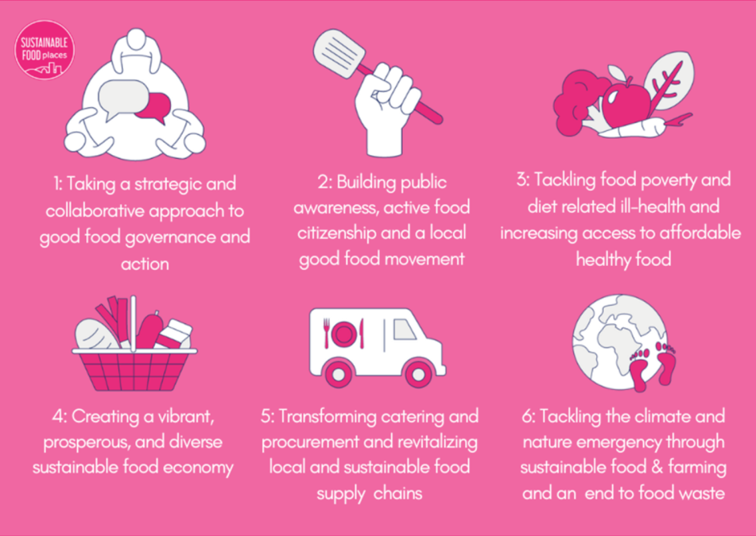
Devon Food Partnership
Formed following the increase in food-related activity during the Pandemic
Devon County Council (Business Support and Innovation) acts as a facilitator but the Partnership is led by its members
Members of the Sustainable Food Places (SFP) movement, working around the Six Key Themes

Slide 17





Timeline
Feb 2021
DFP established and joins SFP movement
Feb 2023
Devon’s Good Food Strategy launched
Nov 2023
SFP Bronze Award achieved
2021
2022
2023
2024
2025
Throughout 2022
Strategy writing process (themed meetings)
2023
Three working groups formed
May 2024
Every Bite Counts launched

Slide 18
Devon’s Good Food Strategy
Structured around SFP Six Key Themes
Identifies strategic priorities for Devon’s food system for 5 years
Launched at an in person event in 2023 to bring stakeholders together and encourage action/collaboration
To be delivered by all food stakeholders (not just the Partnership)
Annual reporting on progress

Slide 19
Partnership Structure
Facilitation Team
  Partnership facilitated from within Devon County Council Business Support and Innovation Team
  Full time coordinator and part time Partnership lead
  Funding from DCC Public Health and BSI Teams
Public and wider stakeholders
Working Groups
Steering Group
Facilitation Team

Slide 20




Partnership Structure
Steering Group
  Formed from initial webinar in 2021
  Representative group of key stakeholders from across the local food system (including Council Departments)
  Monthly themed meetings
  Opportunity to shape Partnership direction, share updates, and explore ideas for collaboration
Steering Group
Food Insecurity Working Group
Food Economy Working Group
Food in Schools Working Group

Slide 21
Partnership Structure
Working Groups
Emerged organically from steering group meetings and other conversations
Bi-monthly meetings
Chaired by external partners with DFP admin support
Independent workstreams linked to Devon’s Good Food Strategy
Report back to the Steering Group at each meeting
Steering Group
Food Insecurity Working Group
Food Economy Working Group
Food in Schools Working Group

Slide 22

Wider Stakeholder Engagement
External comms: website, monthly newsletter, Facebook, and Instagram
Every Bite Counts: local food campaign to encourage consumers to eat more local produce
Working with other projects, partnerships, and organisations:
Devon Agri-Tech Alliance
Food Drink Devon
Devon Climate Emergency

Slide 23
Cross Sector Collaboration
Successes
Bringing together people who wouldn’t otherwise connect (particularly within the Council)
Acting as a connector and platform for information exchange across the local food system
Enabling collaborative work and joining up
Challenges
Engaging with district level authorities
Maintaining resilience and capacity across the Partnership
Sourcing long-term, sustainable funding (particularly for activity)

Slide 24
Contact
info@devonfoodpartnership.org.uk
www.devonfoodpartnership.org.uk

Slide 25
Henri Greig
Co- Founder of Pipers Farm
Devon Food Partnership

