Slide 1
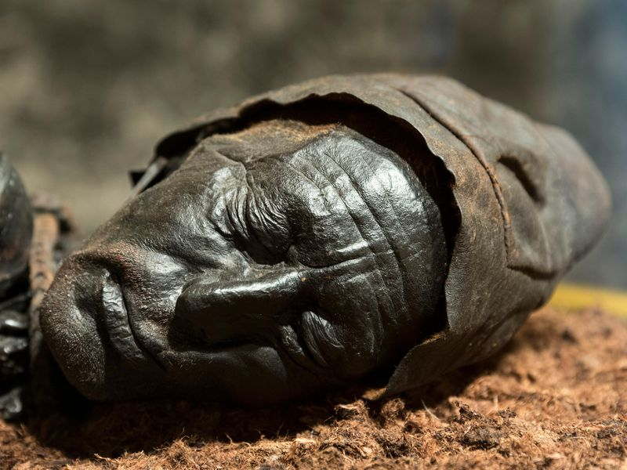
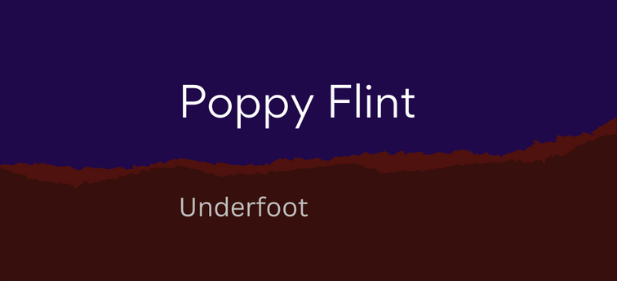
Workshop by Jude Allen from Soil Voices in collaboration with Poppy Flint from Underfoot
Notes:
Hello, my name is Jude Allen, and I have come up from Devon. I run a project called Soil Voices

Slide 2
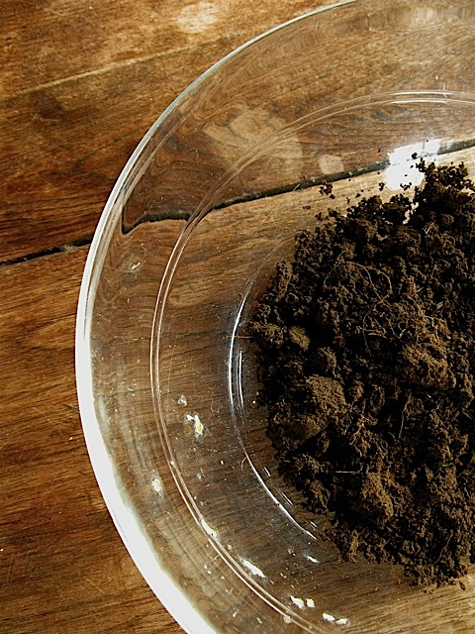
Today-
Quick introduction to the project
Why soil stories?
Some soily voices
Notes:
This presentation will cover several elements – firstly, a whistle stop overview of what the Soil Voices project is about and has achieved so far, and secondly, some thoughts on why voices and stories are important

Slide 3
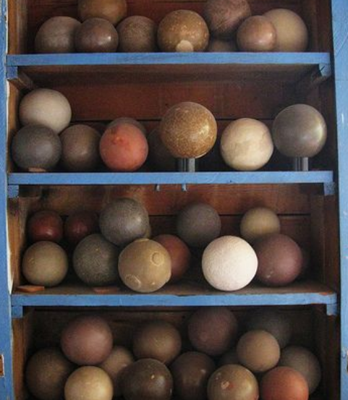
Getting your creativity in gear …
One minute to write down as many uses for soil that you can think of

Slide 4
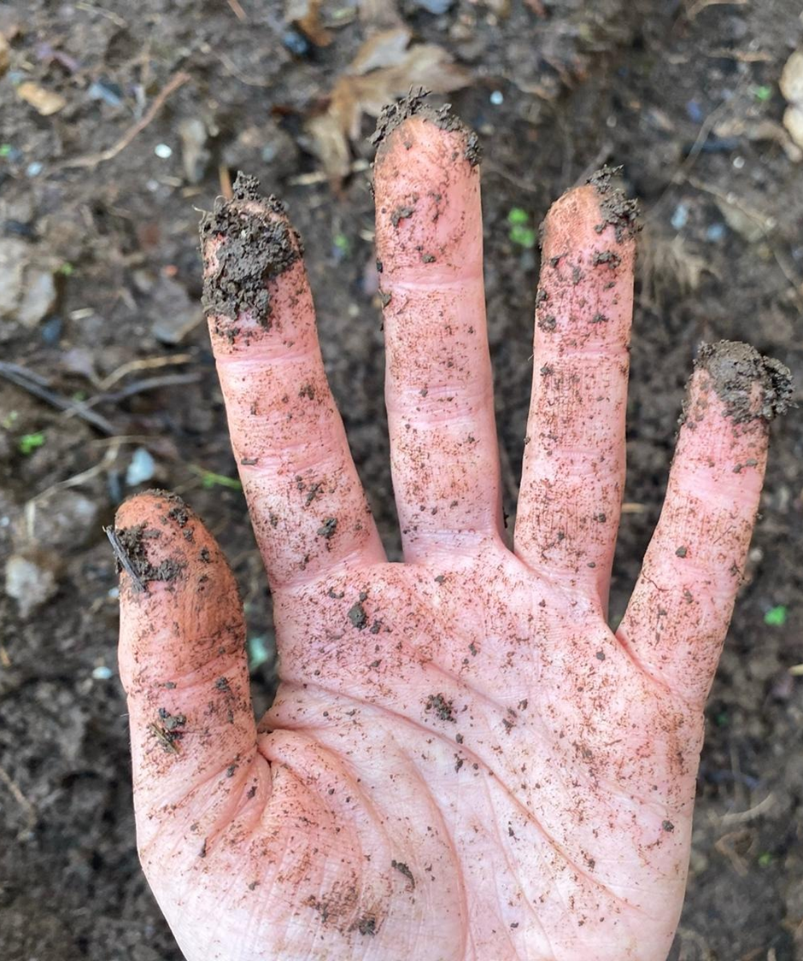
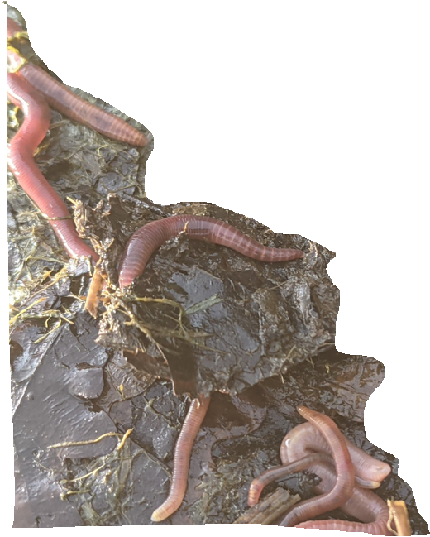
Jude Allen
Collecting and curating oral and written accounts of people’s individual soil experiences.
Website: https://soilvoices.org/
Creative workshops
Encouraging people to think about the importance of soil?
Notes:
, to include farming and gardening practices, childhood memories, and emotional responses to the soil, exploring how cultural narratives have shaped and continue to shape our attitudes to and understanding of soil

Slide 5
Poppy Flint - Underfoot
https://poppyflint.com/

Slide 6
Soil – by Roger McGough
we've ignored eachother for a long time and I'm strictly an indoor man anytime to call would be the wrong time I'll avoid you as long as I can When I was a boy we were good friends I made pies out of you when you were wet And in childhood's remembered summer weather We roughandtumbled together We were very close just you and me and the sun the world a place for having fun always so much to be done But gradually I grew away from you Of course you were still there During my earliest sexcapades When I roughandfumbled Not very well after bedtime But suddenly it was winter And you seemed so cold and dirty That I stayed indoors and acquired A taste for girls and clean clothes
we found less and less to say you were jealous so one day I simply upped and moved away I still called to see you on occasions But we had little now in common And my visits grew less frequent Until finally One coldbright April morning A handful of you drummed On my fathers waxworked coffin at last it all made sense there was no need for pretence you said nothing in defence
And now recently While travelling from town to town Past where you live I have become increasingly aware Of you watching me out there. Patient and unforgiving Toying with the trees. we've avoided eachother for a long time and I'm strictly a city man anytime to call would be the wrong time I'll avoid you as long as I can
Notes:
https://www.youtube.com/watch?v=DTbBEY2seGY

Slide 7
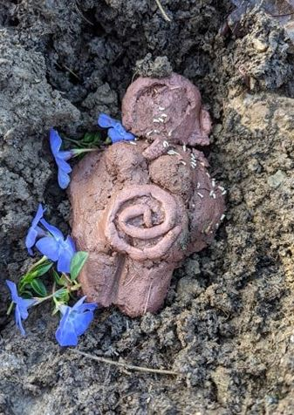
Child’s reflections
Notes:
A child's response about what the soil might say intentional off-grid community – home-educated
Ran a series of workshops with them and it was so interesting to see how immersed and at home they were in the landscape around them – and knowledgeable ( compare to somerset kids of same age)

Slide 8
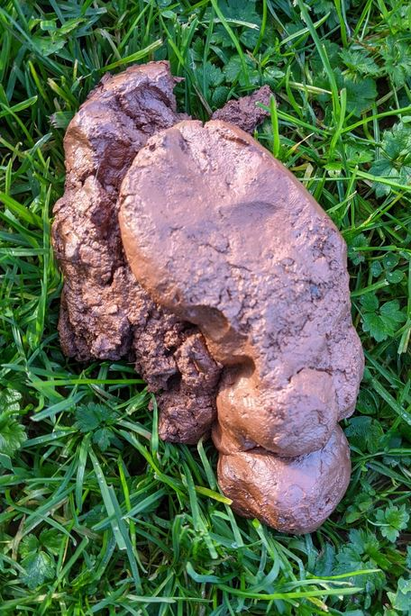
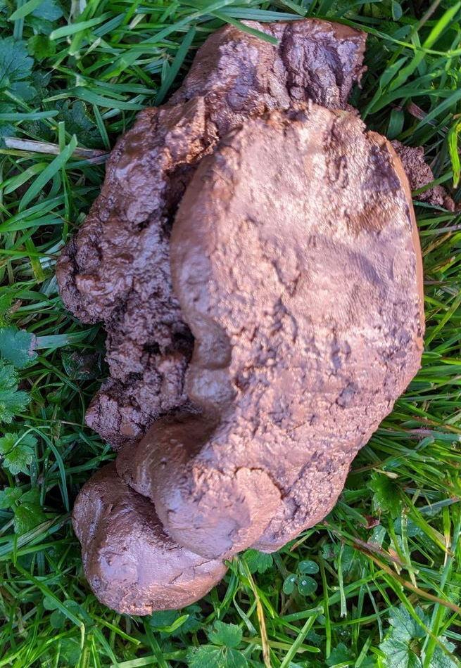
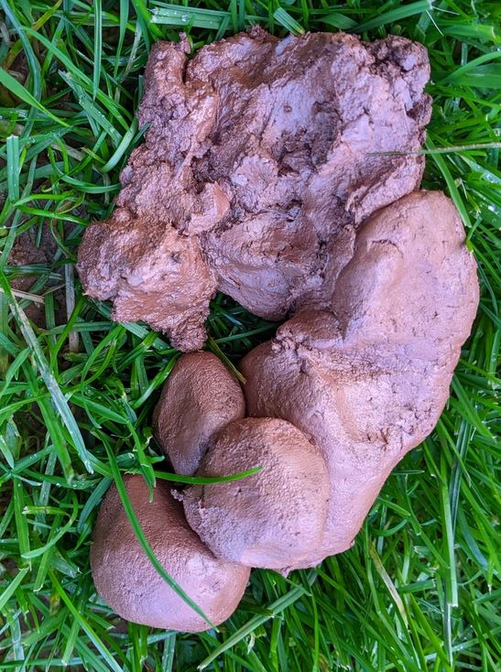
Why stories?
Notes:
In the creation myths of so many cultures, the first humans are made from mud or clay. Whether we were shaped from mud by Allah or Prometheus; or whether we came into being after red earth was flung into the primordial void by the African goddess, Amma; whether the clay that formed us was mixed with blood, wool, spit, or the sound of the voices of birds, none of this really matters. The important thing is that - across the entire globe - such deep connection between humans and soil is recorded in story and myth. Many of these stories tell us we have been shaped by a higher being, however – although higher beings may or may not exist, I suggest that our materiality, the stuff of us, is culturally embedded in the ground beneath our feet. It is arguable, that such connection is not only mythological, but literal – for example – thinking about the soil biome and how it functions as an extension of our human gut biome – the soil, arguably, being the first point of digestionxxxx – a vehicle that both provides life by feeding us and holding our death as we are buried within it . As Tim Ingold says humans are ‘people of the soil who bury their dead’. We come from the earth and would ever return to it.
So – why story? – why is story important? Joan Didion, writes that ‘we tell ourselves stories in order to live.’ Noah Harari, in his book Sapiens, cites the use of story as a social function, enabling millions of strangers to cooperate and work towards common goals. Stories are something that bind us together. Historically, such stories have been spoken and have made sense of the world and how we fit into it, and have been passed down through generations, connecting us to both nature and - according to Jules Petty - also ‘celebrat[ing] the fundamental value of agriculture to communities and economies, sustaining food production without damage to the environment’. The stories that have bound us to each other have also bound us to the soil.
Didion, Joan, ‘The White Album’, https://www.reachcambridge.com/wp-content/uploads/Friday-5th-August-Afternoon-Session-Oversharing-Joan-Didion-The-White-Album.pdf [accessed 24/07/2022]
Petty, Jules, Agri-Culture: Reconnecting People, Land and Nature (Routledge, 2002), p.7

Slide 9
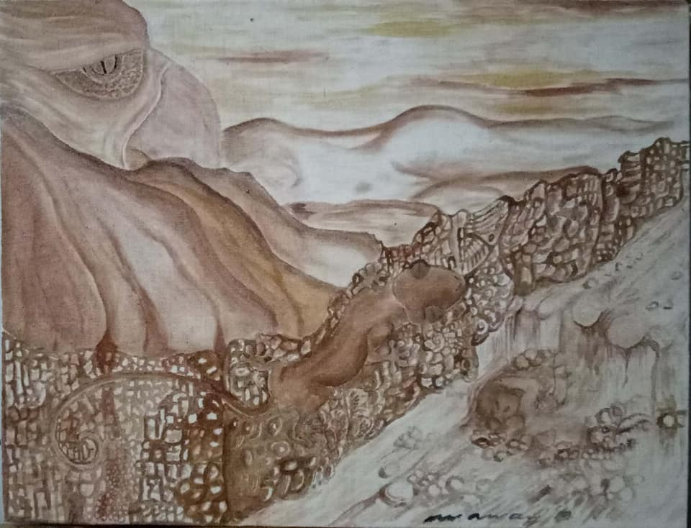
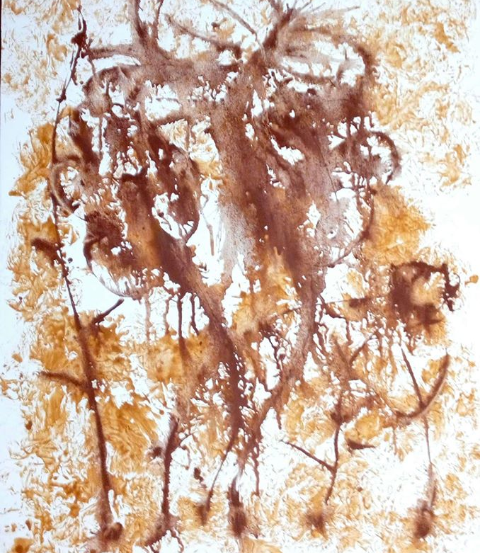
In the Bukidnon region, Philippines, the Talaandig visual artists paint their daily lives and their aspirations for the environment. They have realized soil can be used to express their imagination.
“Sumusobra na sa kapabayaan yung mga tao. Nakakalimutan nya yung pinaka-main at pinaka”
Translation: People have become negligent. They have forgotten the basic reason why nature exists. It is to sustain life.
Salima Saway
Bulaklak at Paru-Paru by Waway Saway

Slide 10
Anna Stankiewicz - GL16 7ET
They Tear Me Open -
They tear me open with their ploughs
Again, and again
My tears in stormy gullies
Washed away
They pile them high with their machines
Heavy and loud
What use is a mountain of sadness?
They never learn.

Slide 11
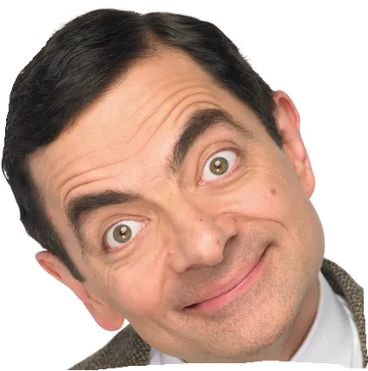
‘Soil’, by Mr. Bean
Never boil soil.
Notes:
Soil in poetry Oxford Real Farming conference – and also Wolverhampton lit fest – connecting adults to soil and getting them to pay attention.

Slide 12
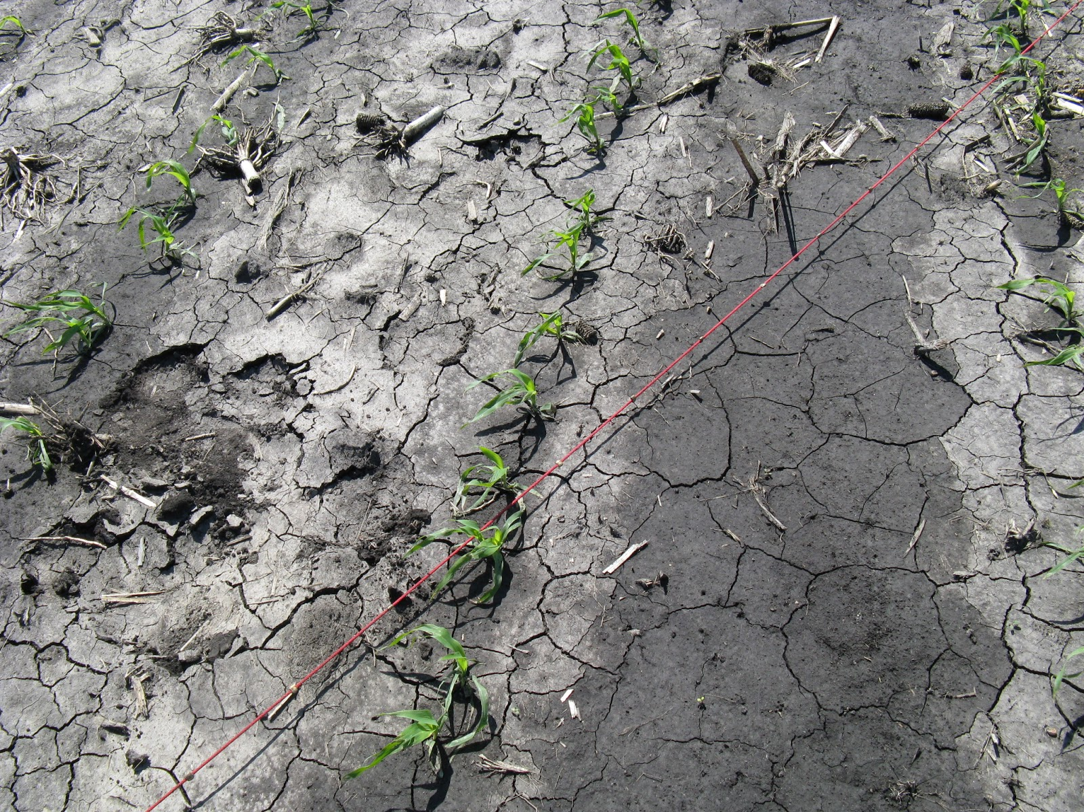
If the way we think about soil becomes compacted, where is the space for story?
Notes:
In the Spell of the Sensuous, David Abram laments the onset of the phonetic alphabet, arguing that non-pictorial letters no longer represented the non-human world around us, but rather are associated purely with a gesture or sound of the human mouth. Our texts thus, are no longer ‘windows opening on to a more-than-human field of powers, but [functioned]solely as mirrors reflecting the human form back upon itself.’ If we apply such thought to the soil, it seems as if at the same time we have stopped reading the soil, we have, in neglecting it, have also destroyed it, obscuring the depths of it from our view – either by compacting it, covering it with the concrete and tarmac of our cities, or poisoning it it whith chemiclas - we have rendered it impenetrable – no longer living within it, but on top of it. And the stories we tell to make sense of how we fit into the world are not the stories we have read from the soil, but rather those of shopping malls and celebrities, of sports and box-sets. Our cultural discourse has become exclusively human, and the soil – along with the rest of the natural world has lost its voice. ( e.g. kids)

Slide 13
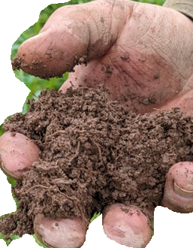
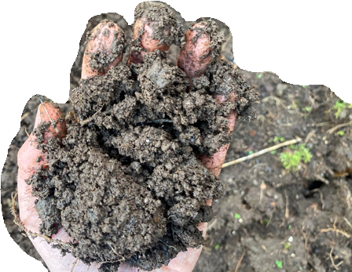
Finding Your Soil Voice
Pick up some of your soil and roll it about in the palm of your hand.
Maybe shut your eyes.
Rub it between your fingers.
How does your soil feel?
Think carefully.
Think texture, temperature, damp or dry?
Open your eyes and make some notes.

Slide 14
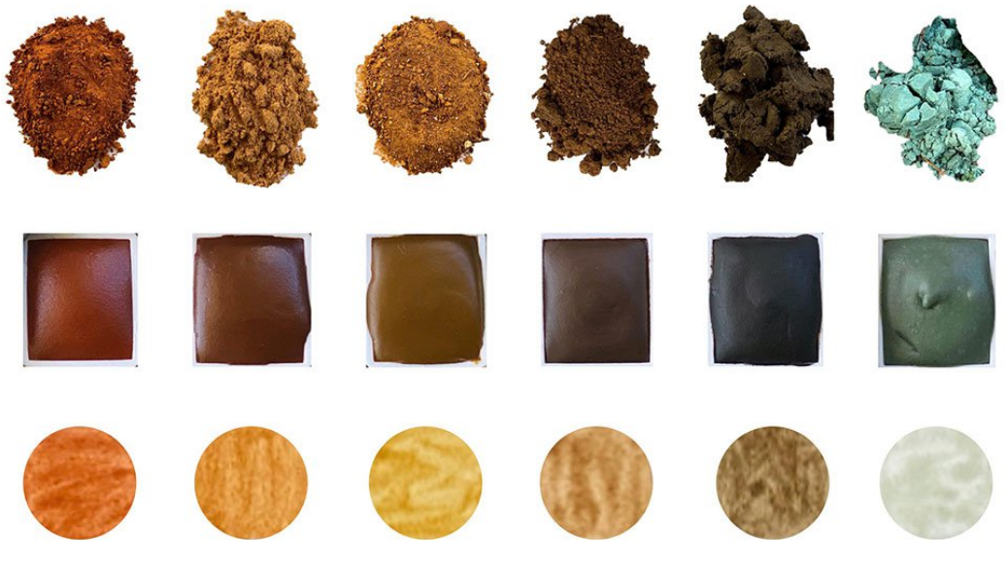
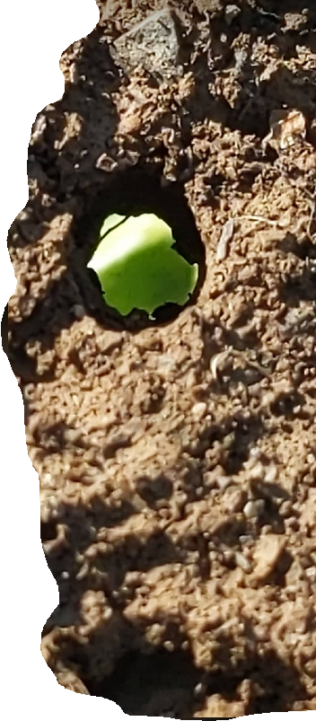
Finding Your Soil Voice
Open your eyes and look very closely at your pot of soil.
How does your soil look? What can you see?
Think about colours and shapes and textures.
It is probably not just brown.
Make some notes.

Slide 15
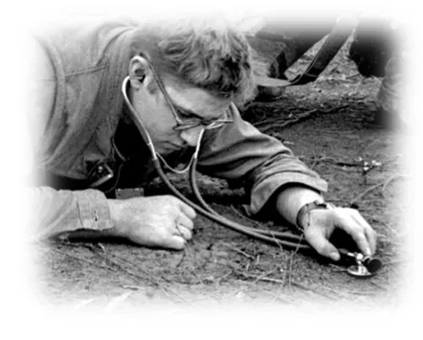
Finding Your Soil Voice
How does your soil sound?
You can rub it between your fingers.
If your soil could speak, what might it say?
Listen and think carefully!
Make some notes.

Slide 16
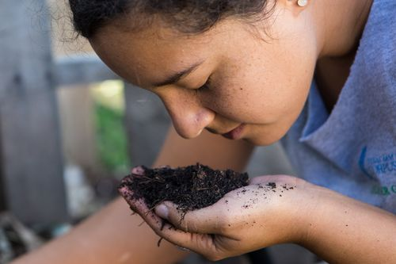
Finding Your Soil Voice
How does your soil smell?
Smell it in the pot, then cup some in your hand – does it smell different in your hand?
Shut your eyes and take a long slow sniff!
Breathe in and out – try slowly and then fast and then slow again.
Make some notes.
DON’T do this
(just IMAGINE!)
What might it taste like?
Think carefully and shut your eyes if you need to
Notes:
Does it remind you of anything?
Does it smell warm or cold / damp or dry?
Sweet or sour, or something else?
Does it smell of an emotion?
Is it alive?

Slide 17
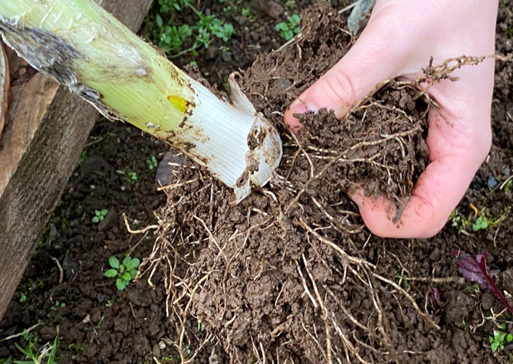
Finding Your Soil Voice
Let’s discuss:
How does touching, smelling and looking at the soil make you feel?
Shut your eyes and think about emotions – happy , sad, weird, inspired – anything else?
Make some notes.

Slide 18
An invitation
A story about the soil?
A story written by the soil?
A letter to the soil?
A diary entry of a worm?
A poem?
Can you add a picture or a photo?
Could you make a little video on your phone?

Slide 19
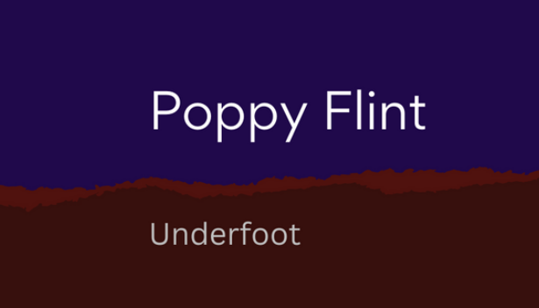
Share your stories with us via:
Email - soilvoices@gmail.com
Twitter - @soilvoices
Instagram- @soilvoices
Website: https://www.soilvoices.org/
Soil Voices is part of Our Living Soil project: http://ourlivingsoil.art/home
poppyflint@gmail.com
https://poppyflint.com/project/underfoot/

Slide 20
References
Rob Gumba, ‘The Talaandig’s Soil Paintings And What They Are Really Telling Us’, https://lokalidadmag.wordpress.com/2020/03/20/the-talaandigs-soil-paintings-and-what-they-are-really-telling-us/

