Slide 1
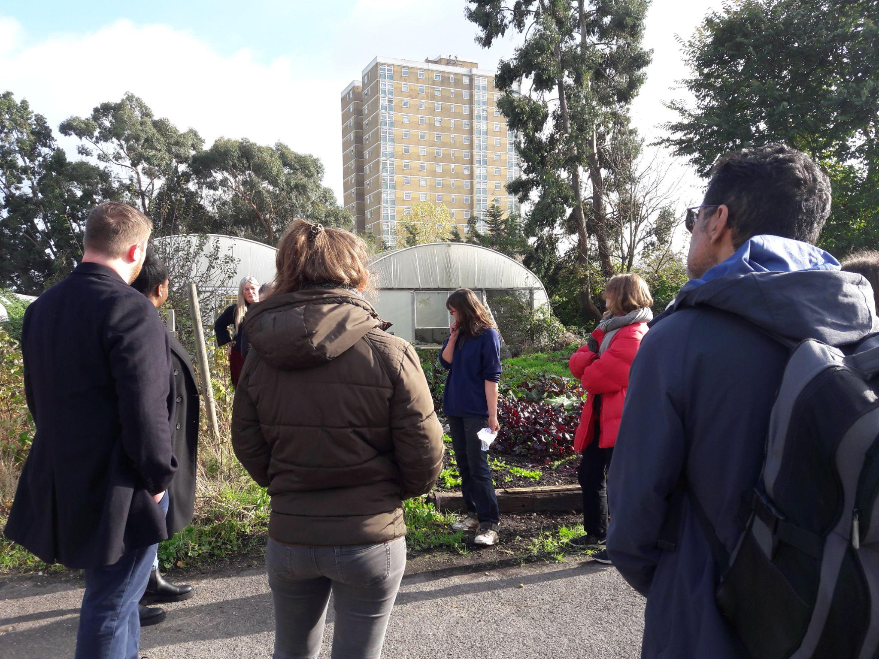
Fringe Farming’s
Peri-Urban Practitioners Forum

Slide 2
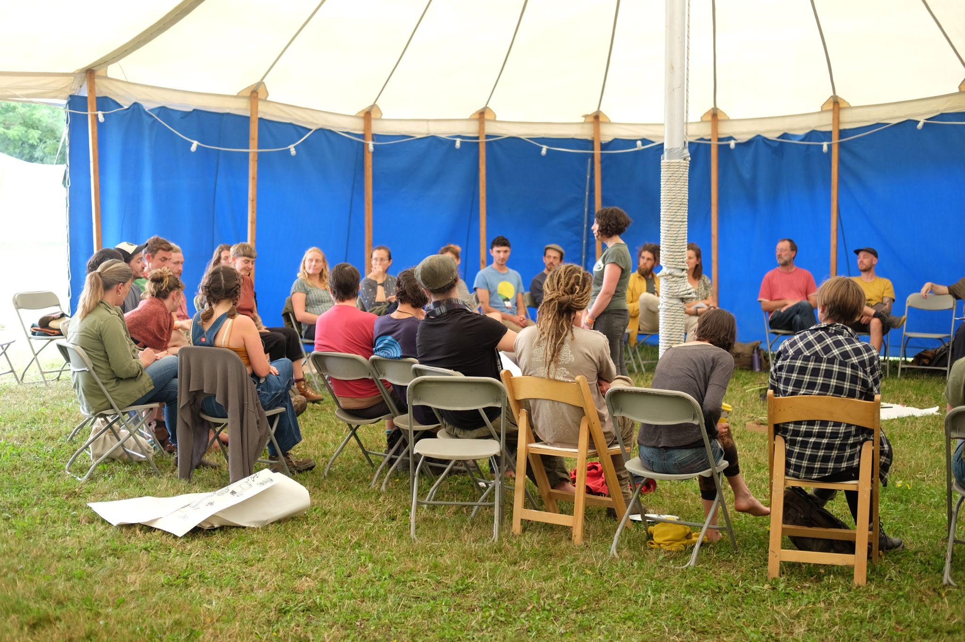
PUPF 1: At the Land Skills Fair (July 2022)
- Networking
- Overcoming adversity
- Political strategising

Slide 3
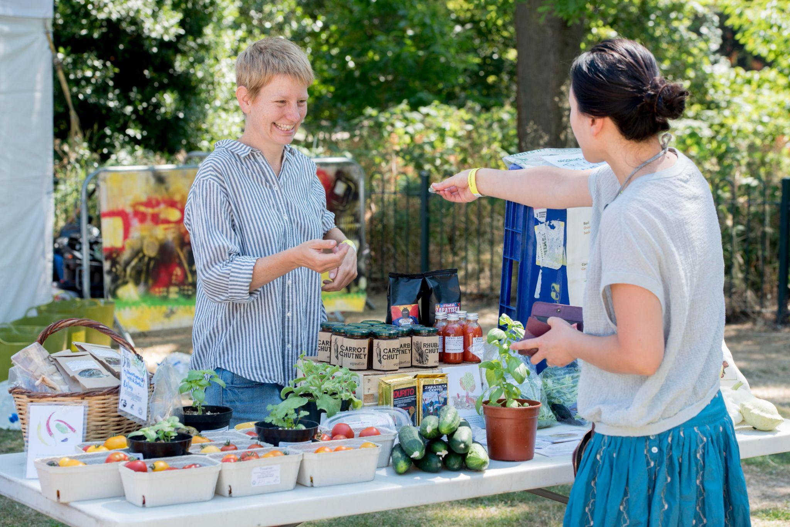
PUPF 2: Accessing Urban Markets (Online forum - September 2022)
Talks about Tamar Food Hub and Pennine Cropshare, followed by questions and discussion

Slide 4
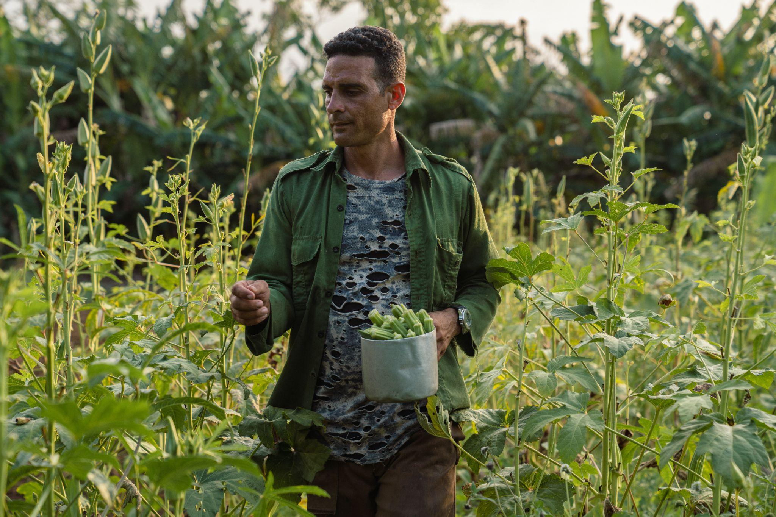
PUPF 3: Opportunity out of Crisis: Learning from the Cuban Experience (online - December 2022)
Three speakers, including one Cuban
How did Cuban peri-urban agriculture arise out from crisis following collapse of Soviet Union in the 1990’s?
How can we apply these insights to UK peri-urban agriculture ?

