Slide 1
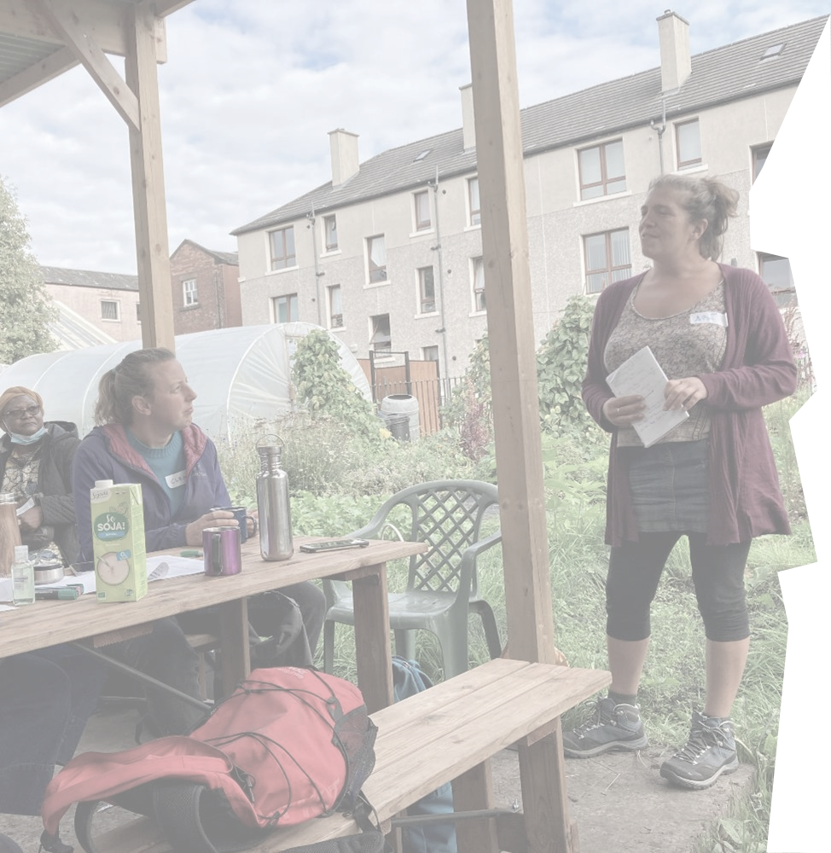
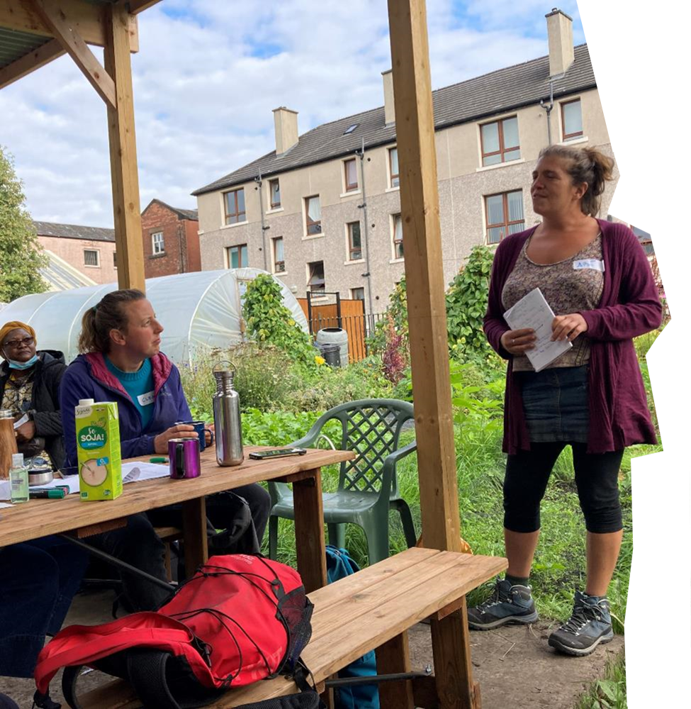
Fringe Farming:
Peri-urban agroecology in the UK
Aryo Feldman - aryo@sustainweb.org
Glasgow Fringe Farming event – WashHouse, Glasgow
(Credit: Rob Logan)

Slide 2
“Organic farming can’t feed the world”

Slide 3
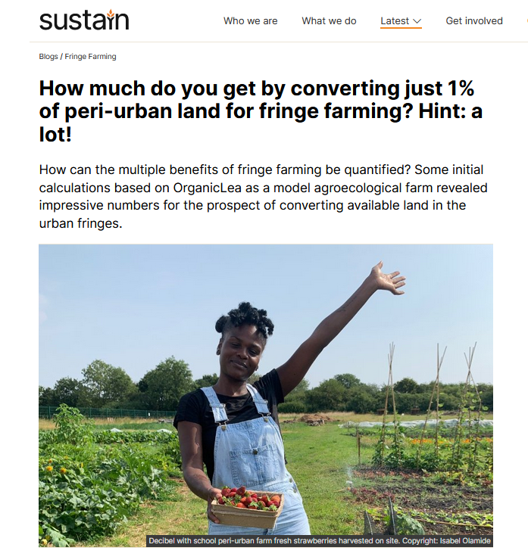
sustainweb.org/blogs/oct22-quantify_benefits_fringe_farming/
Notes:
Converting just 1% of peri-urban land to agroecological market gardening* would lead to over 530K tonnes of fruit and vegetables, or £3B in value of production, and 160K FTE jobs.

Slide 4
Local food – connect food producers and consumers in the same geographic region, to develop more self-reliant and resilient food networks
Agroecological food systems
Shorter supply chains
Decentralised
Diversification

Slide 5
Local food – connect food producers and consumers in the same geographic region, to develop more self-reliant and resilient food networks
Agroecological food systems
Shorter supply chains
Decentralised
Diversification
Horizontal decision-making
Farmer empowerment
Food sovereignty - a food system in which all actors involved control the mechanisms and policies of food production & distribution
Notes:
https://youtu.be/Ab82gAfh554

Slide 6
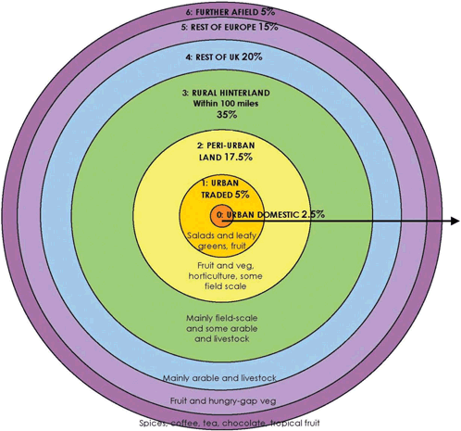
The peri-urban
The Food Zones model
growingcommunities.org/food-zones

Slide 7
The peri-urban
The Food Zones model
Urban domestic - 2.5%
Urban traded – 5%
Peri-urban - 17.5%
Rural hinterland – 35%
Rest of UK – 20%
Rest of Europe – 15%
Further afield – 5%
growingcommunities.org/food-zones

Slide 8
The peri-urban
The Food Zones model
Place of potential
Place of tension
growingcommunities.org/food-zones

Slide 9
The peri-urban
The Food Zones model
Place of potential
Place of tension
“Countryside next door”
growingcommunities.org/food-zones

Slide 10
Number of annual premature deaths attributed to low vegetable diets in the UK: 18,000*
The Fringe Farming project
Build connections between urban and rural areas with multiple agroecological benefits
Increase access to fresh fruit & veg across the UK
Support local food infrastructure
Converting 0.65% more agricultural land to horticultural production would meet national fruit and veg demand**
*Veg Facts 2021 - Food Foundation
**Veg Facts 2020 - Food Foundation

Slide 11
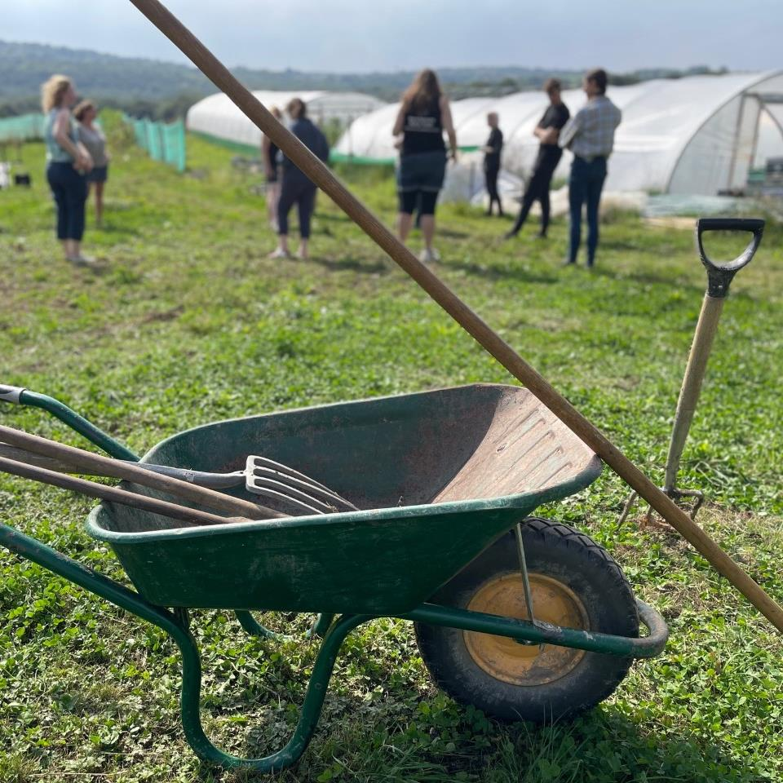
What’s been happening?
Year 1 – local meetings to form action plans, practitioners’ forums
Year 2 – engaging with local action plans, national policy
Year 3? – forging political alliances, lobbying action, devolved nations
Fringe Farming partners’ gathering – Regather Farm, Sheffield (Credit: Rob Logan)

Slide 12
Context - critical issues
Public health
Climate emergency
Cost of living crisis

Slide 13
Context - critical issues
Public health
Climate emergency
Cost of living crisis
Lack of diversity in farming
Land competition
BIG, BOLD
STAT WITH
SOME NUMBERS
Proportion of farm-holders younger than 35 years old:
3%*
*Agriculture in the UK, 2017

Slide 14
Lobbying local & national policies
Maintain and expand land access by local authorities and other public institutions

Slide 15
Lobbying local & national policies
Maintain and expand land access by local authorities and other public institutions
Delivering an integrated package
Land
Resources
Skills training
Market

Slide 16
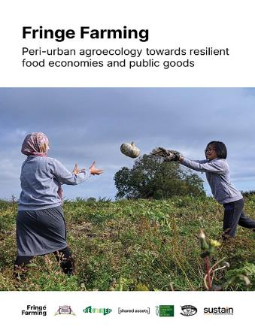
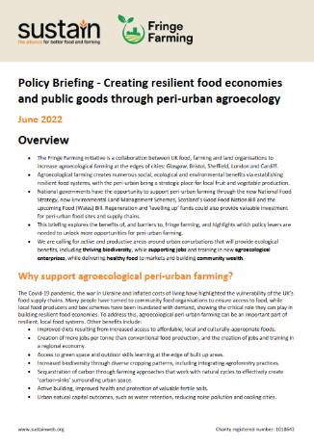
Policy recommendations
Our national & local policy recommendations in full
www.sustainweb.org/publications/feb22-fringe-farming/
Policy briefing
www.sustainweb.org/assets/policy_briefing_fringe-farming-Jun22.pdf
www.sustainweb.org/fringe-farming/

Slide 17
Policy recommendations
www.sustainweb.org/fringe-farming/

Slide 18
Fringe Farming resources
www.sustainweb.org/fringe-farming/

