Slide 1
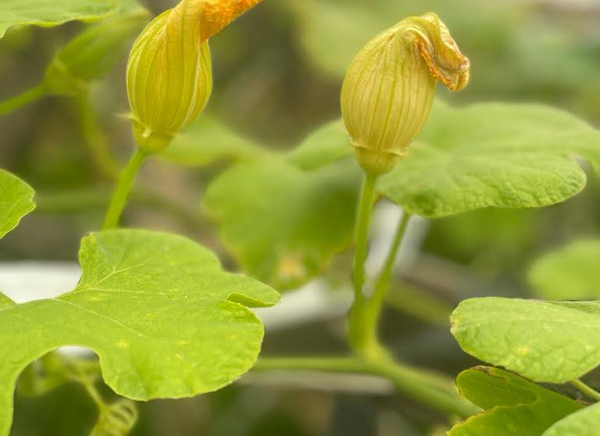
The Great Granton Gourd
Aka Fig-leaf gourd/Cucurbita Ficifolia
Lisa Houston (Edinburgh Agroecology Coop + Granton Community Gardeners)
For ORFC 2022

Slide 2
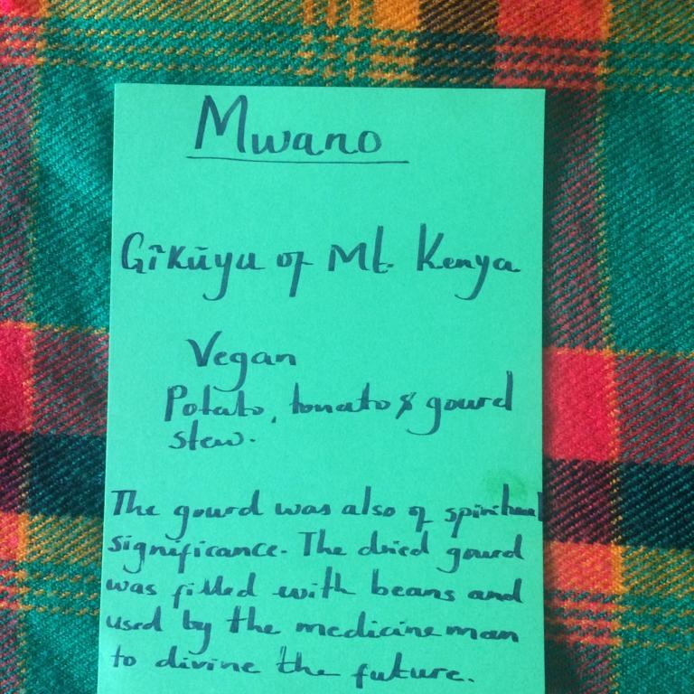

Slide 3
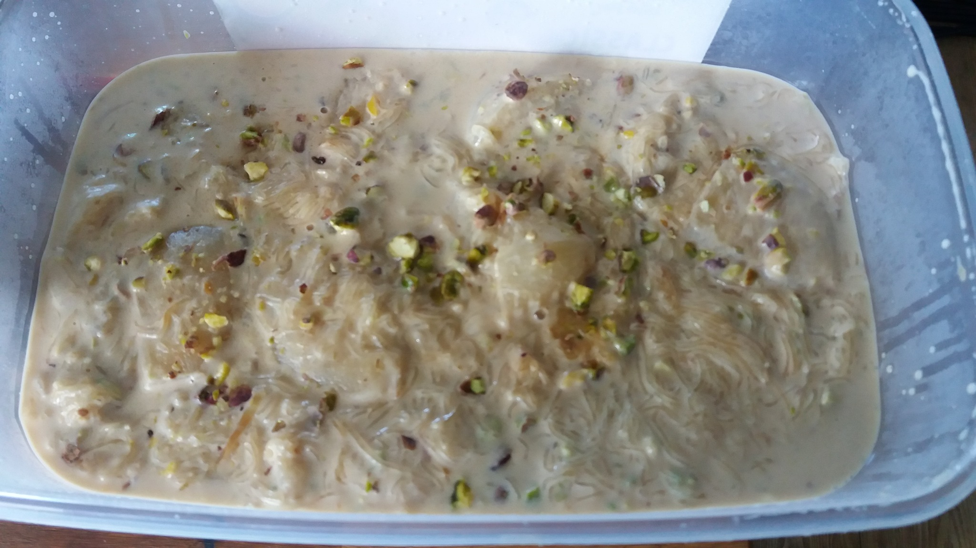

Slide 4
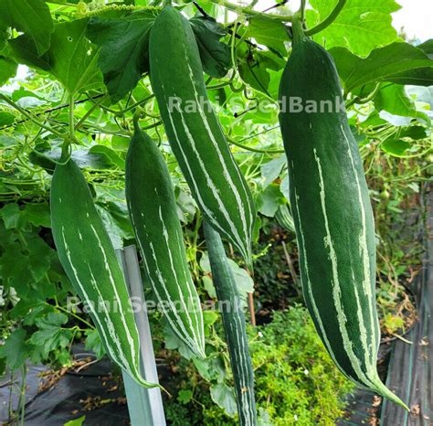
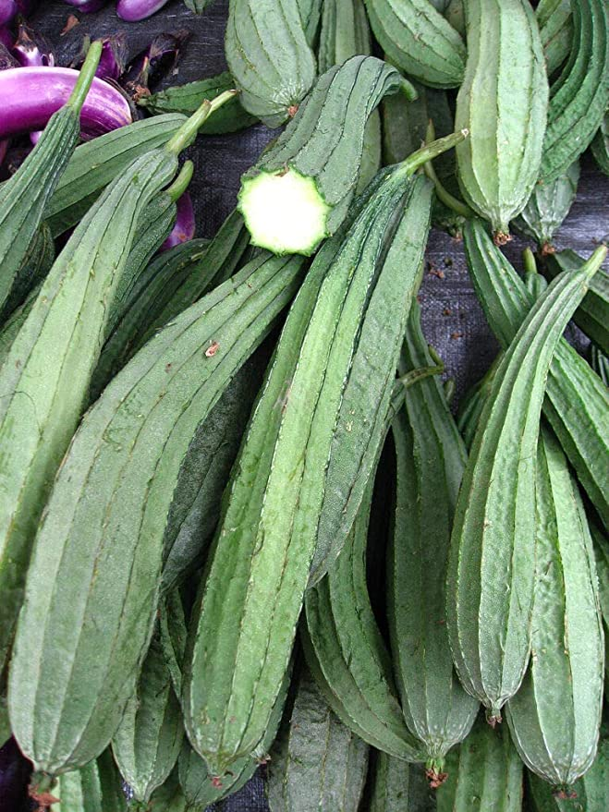
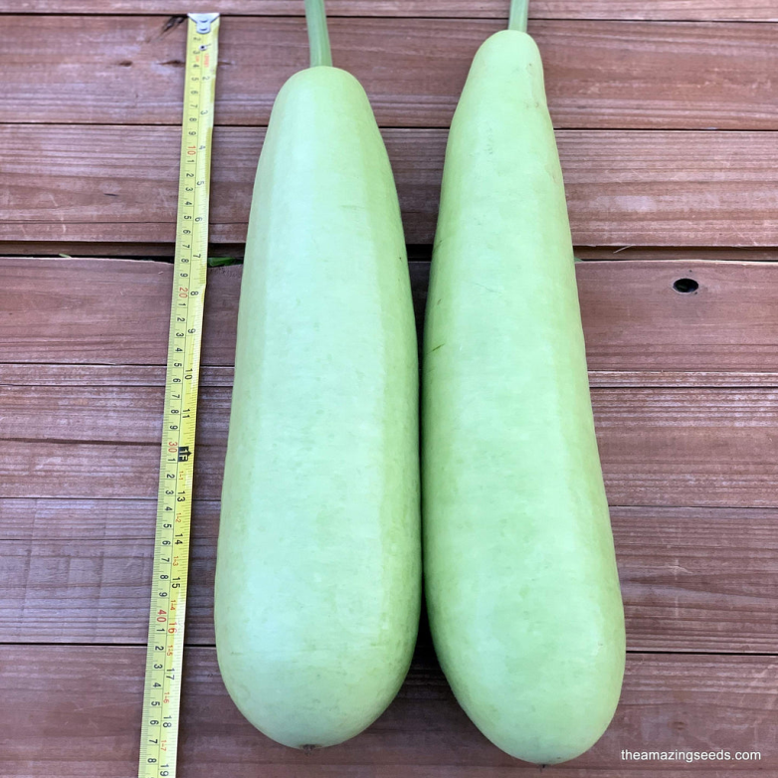
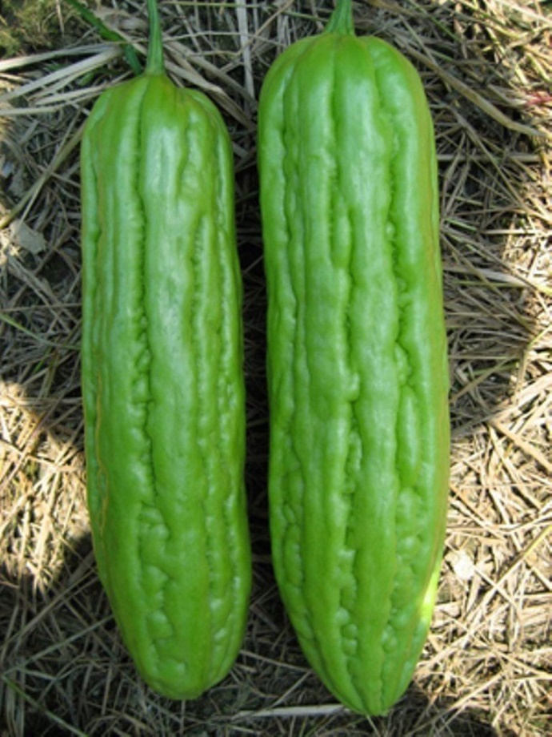
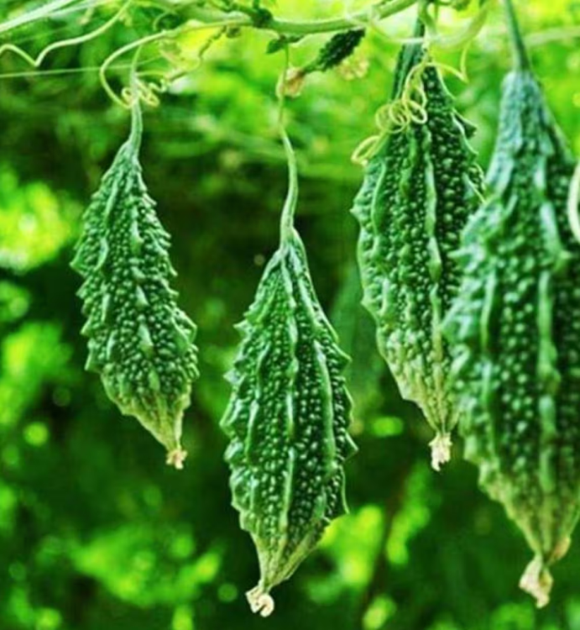
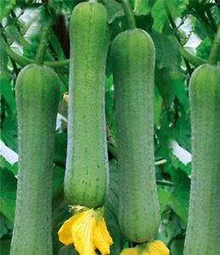
Wonderful World of Asian Gourds

Slide 5
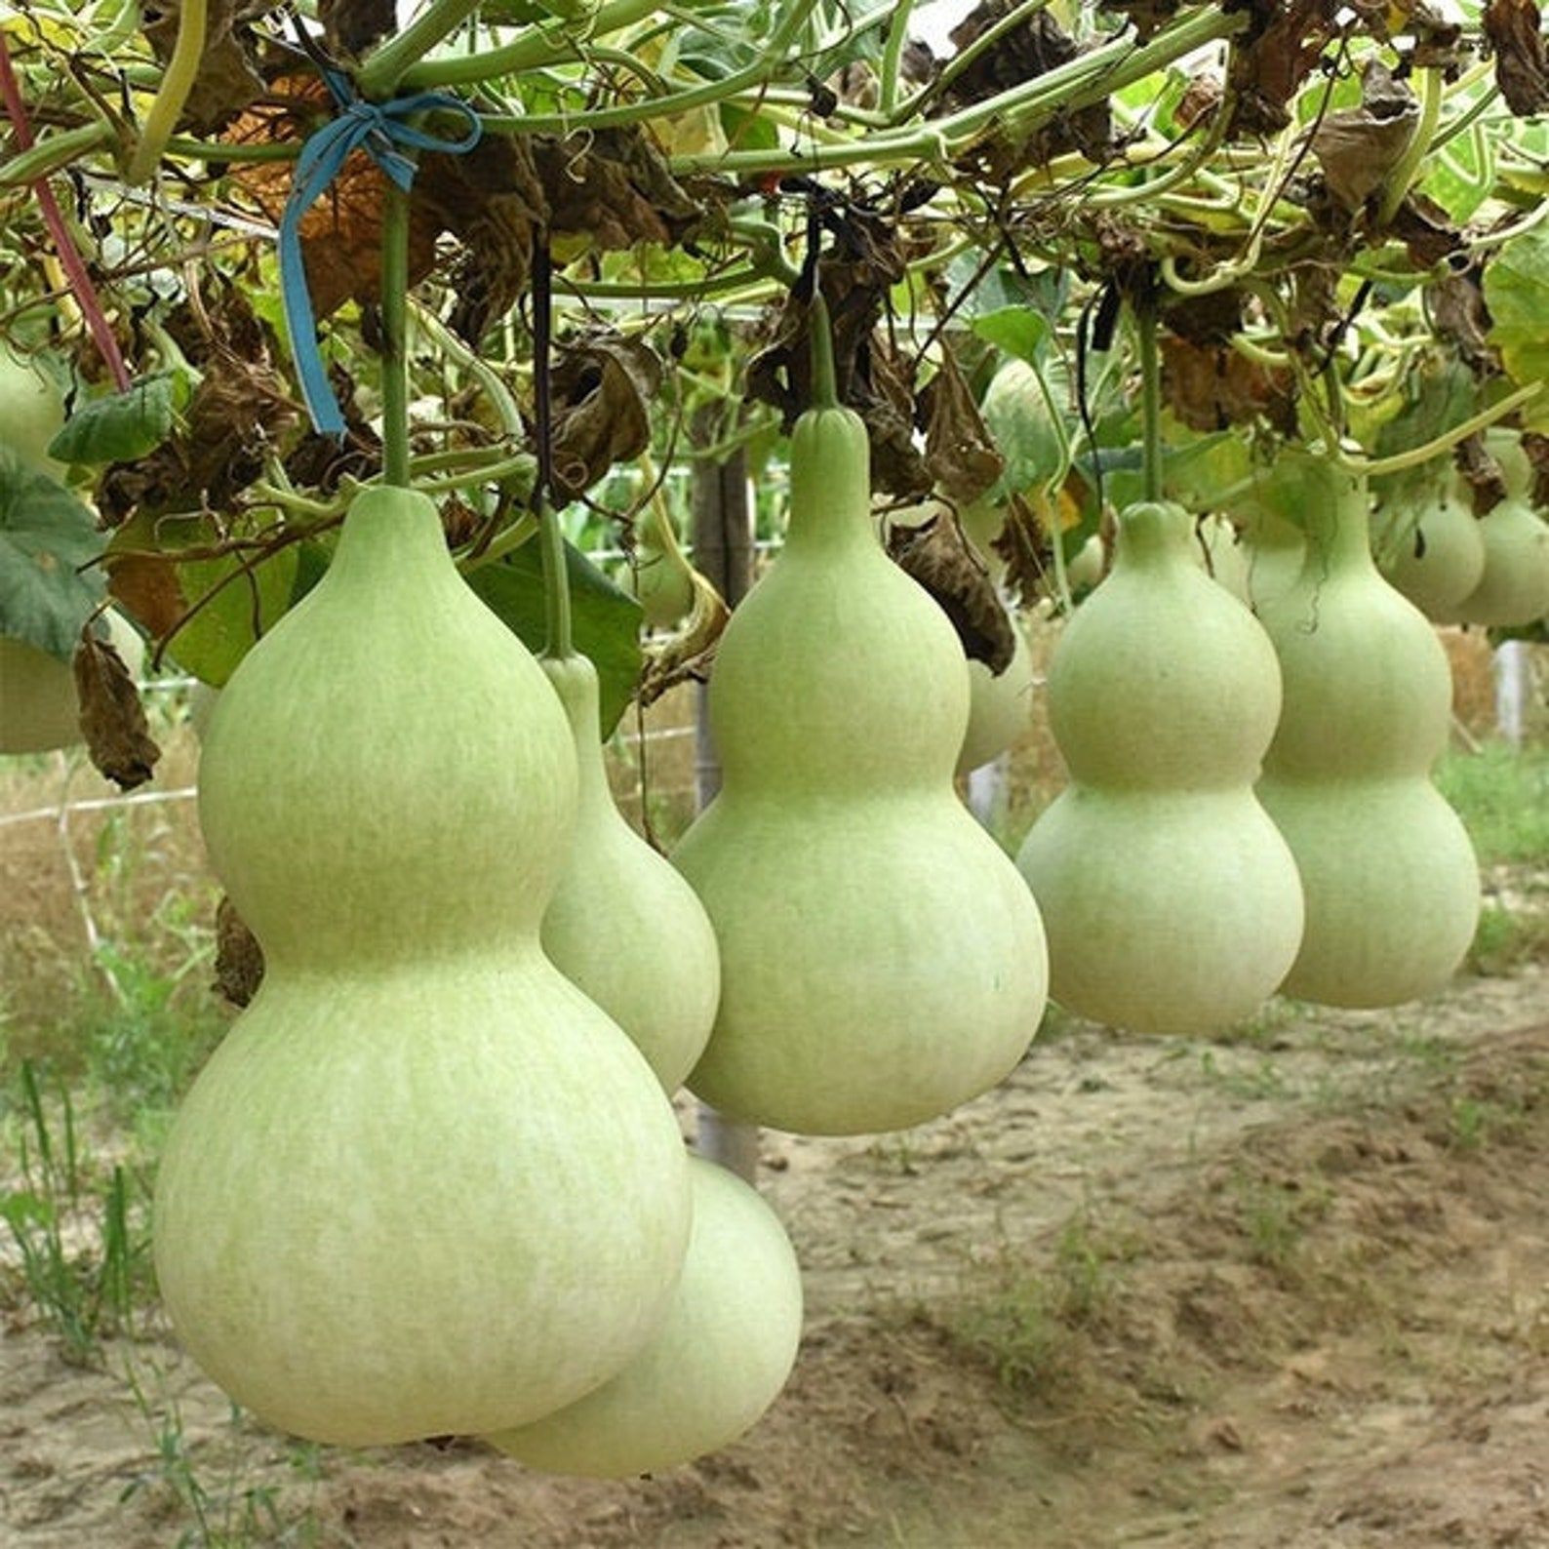
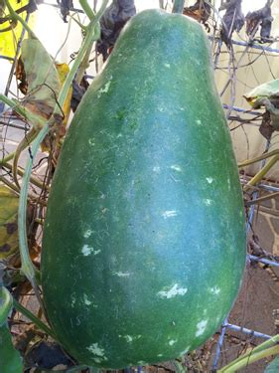

Slide 6
Thank You
The Great Granton Gourd
Coming Soon to The Scottish Seed Hub

