Slide 1
Participatory Guarantee Systems (PGS)
Oxford Real Farming Conference
2023

Slide 3
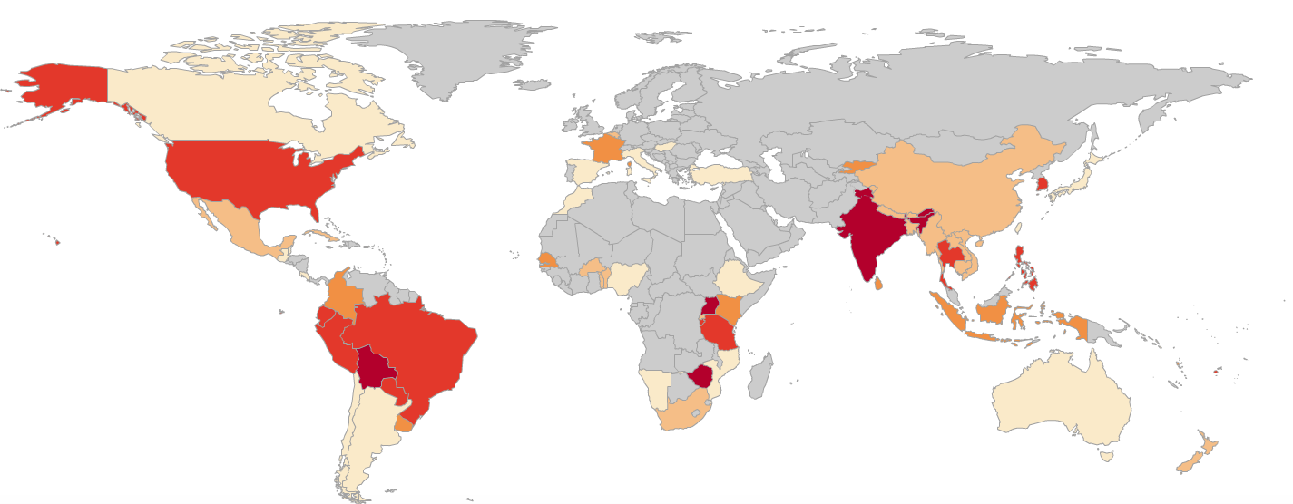
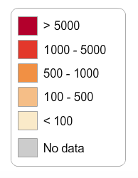
PGS Worldwide (number of producers involved)
More than 242 initiatives in 78 countries
More than 1.2 million producers certified
Asia and Latin America are the regions where PGS is most wide-spread
Source: IFOAM – Organics International

Slide 12
PGS in 2.5 min https://youtu.be/VfRmaqWaB5A
<iframe width="560" height="315" src="https://www.youtube-nocookie.com/embed/VfRmaqWaB5A" title="YouTube video player" frameborder="0" allow="accelerometer; autoplay; clipboard-write; encrypted-media; gyroscope; picture-in-picture" allowfullscreen></iframe>

Slide 14
SHOULD PGSs be supported in UK?
What is the (regional) context?
What are the needs of stakeholders?
What are the challenges?
What are the opportunities for PGS?

