Slide 1
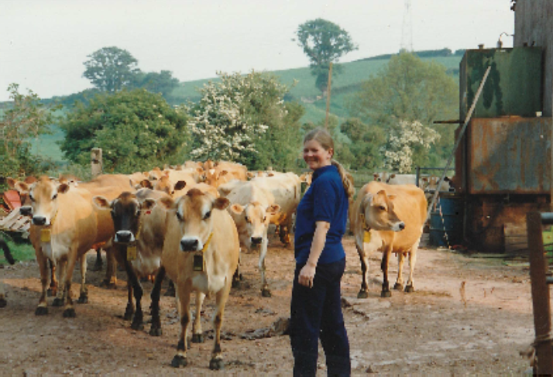
55 years in Devon – a farming and wildlife journey
.

Slide 2
The slurry store!!!!!

Slide 3
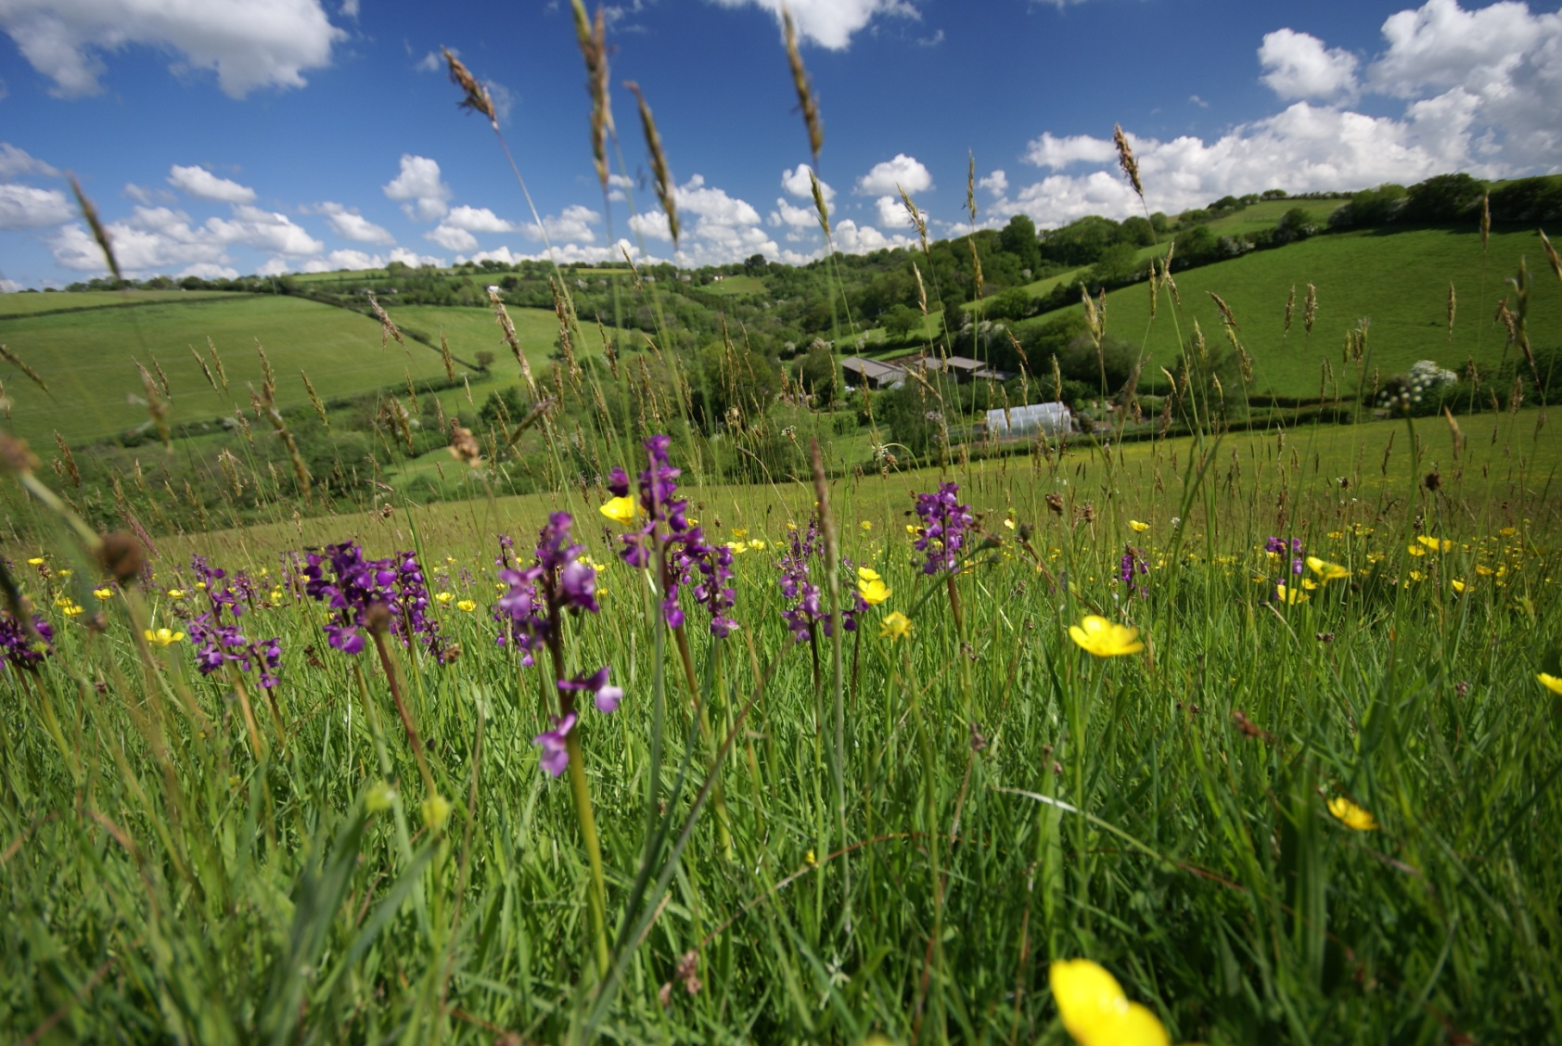
Deer Park Farm

Slide 4
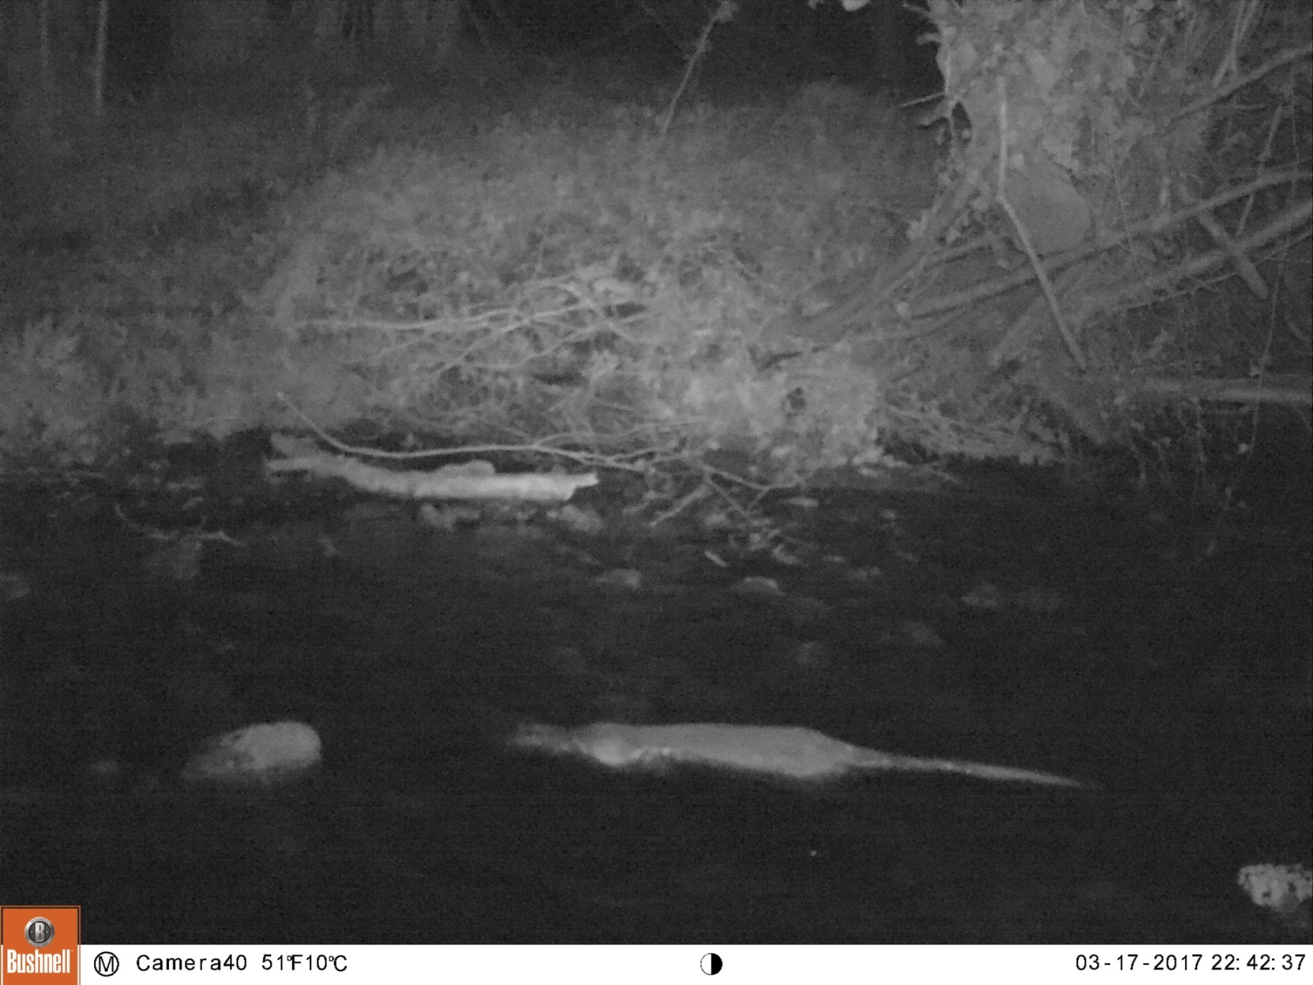
An Otters in the Brook at night

Slide 5
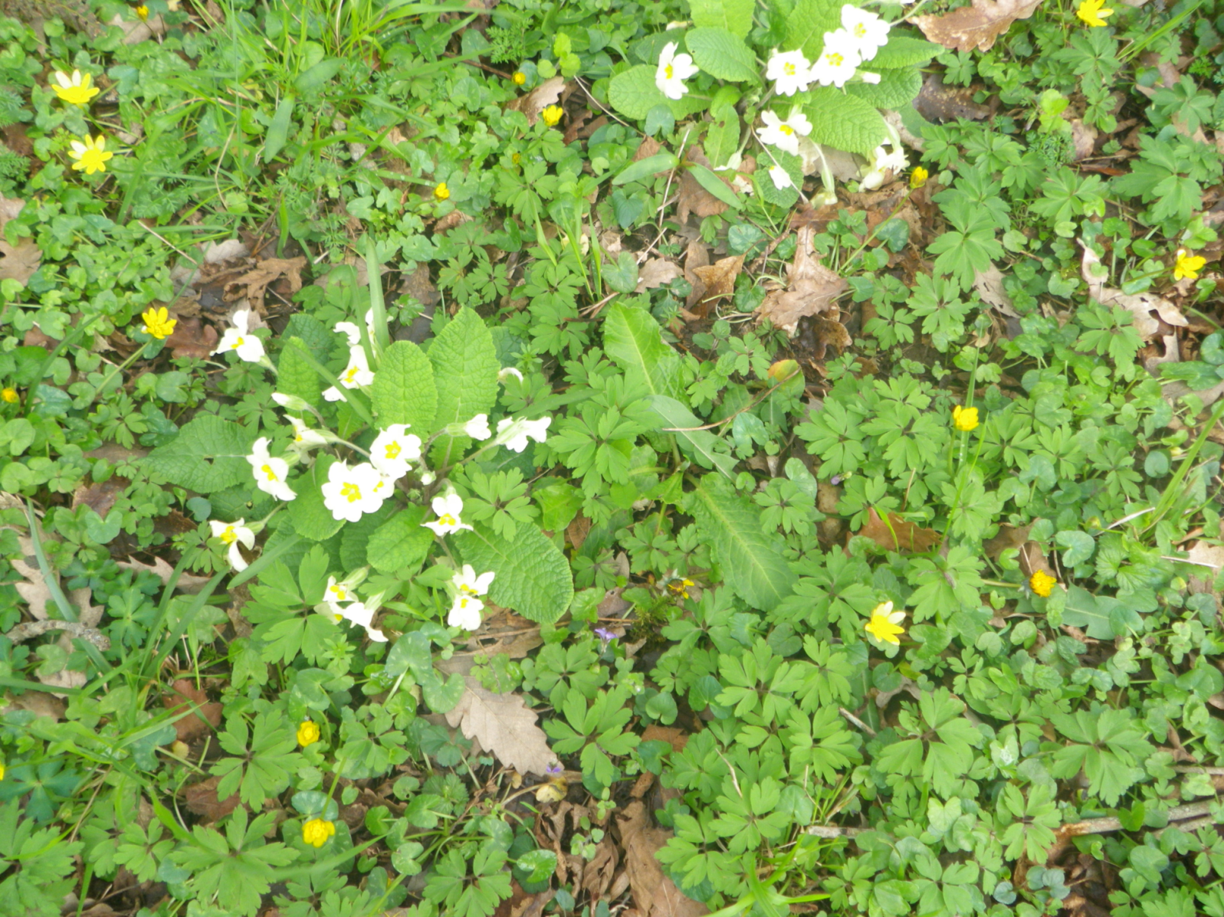
Ancient woodland flowers

Slide 6
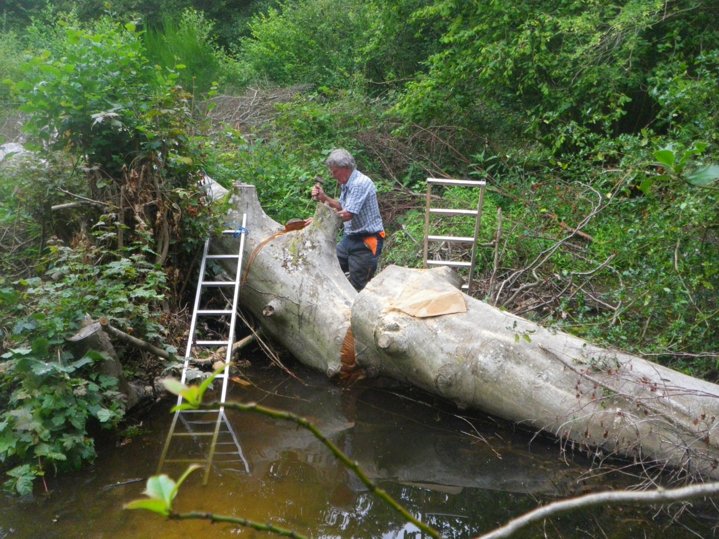
Self-sufficiency and DIY rule!

Slide 7
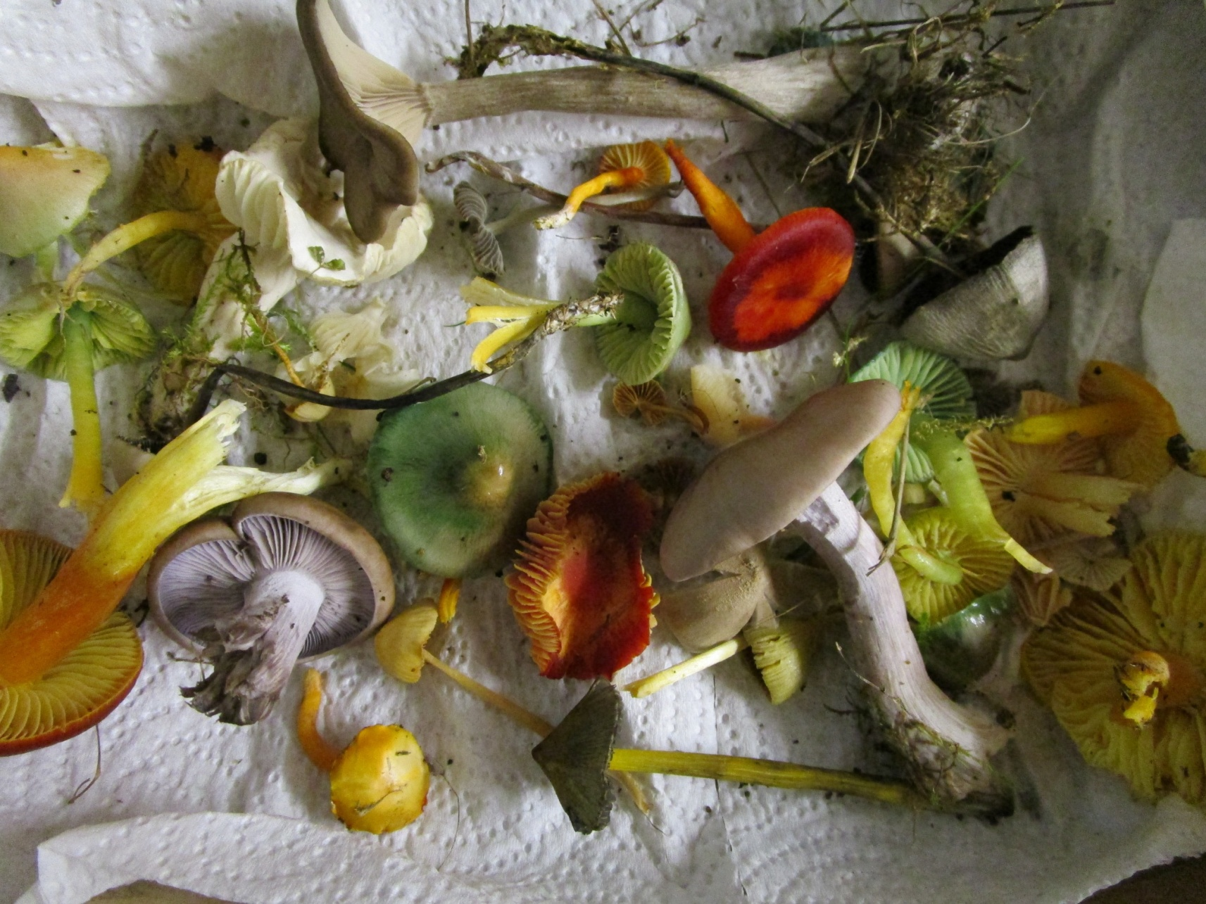
Rare waxcaps and other grassland fungi

Slide 8
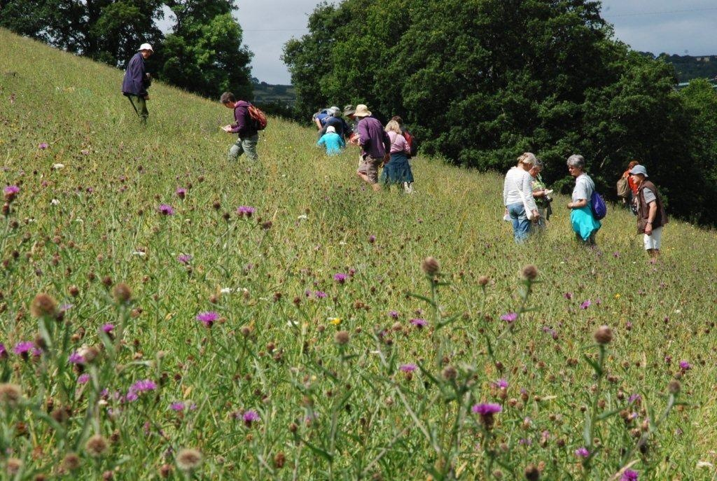
Wildlife walks on the farm

Slide 9
