Slide 1
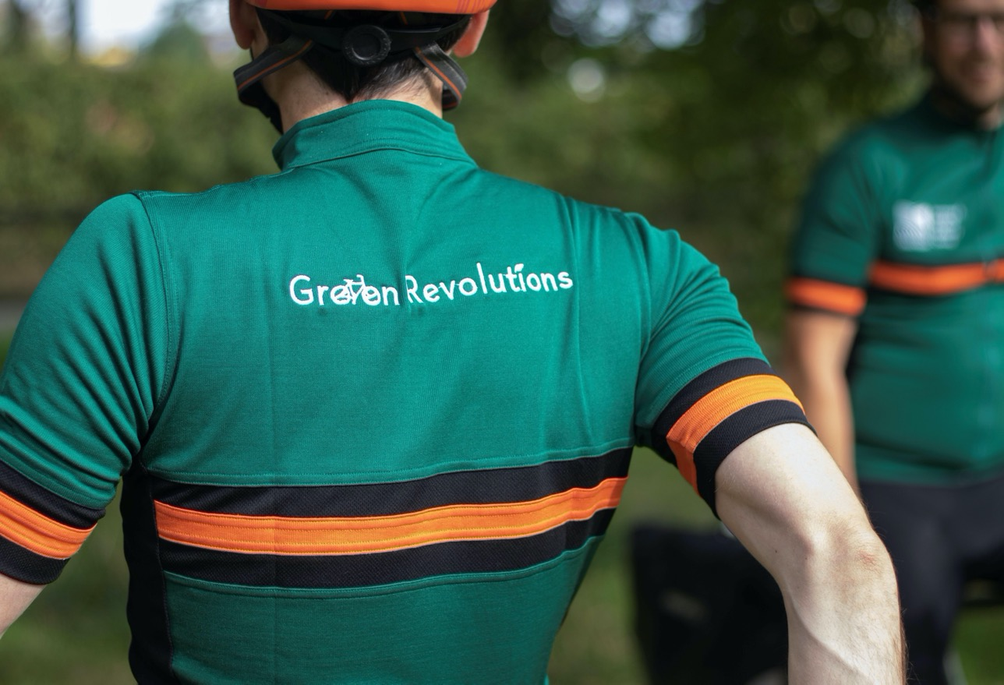

Slide 2
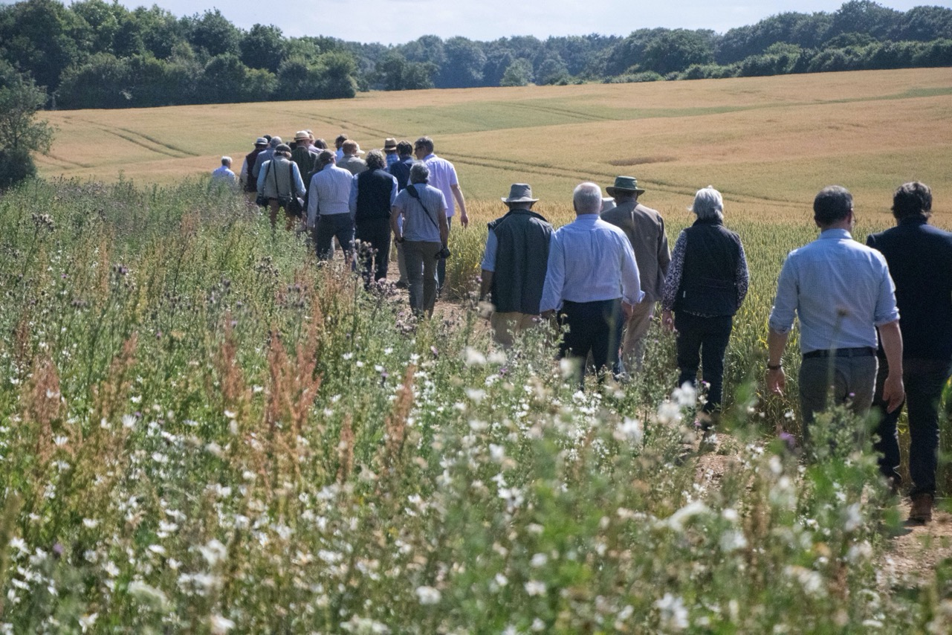
“A Better Environment For All”

Slide 3
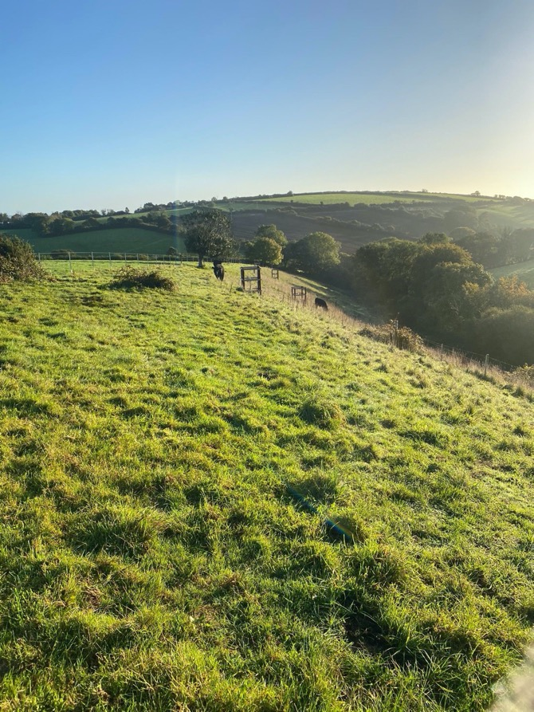
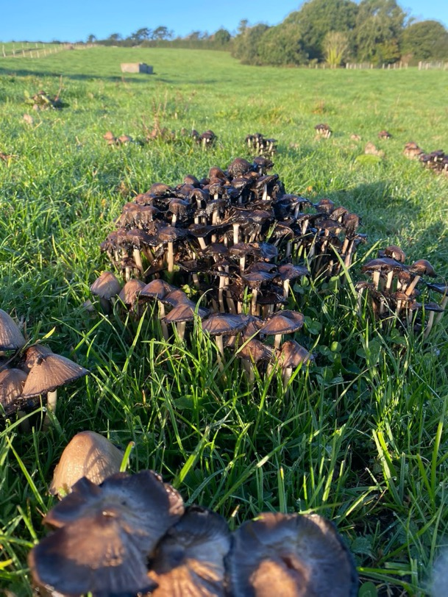
Bridget Whell, Leyonne Farm

Slide 4
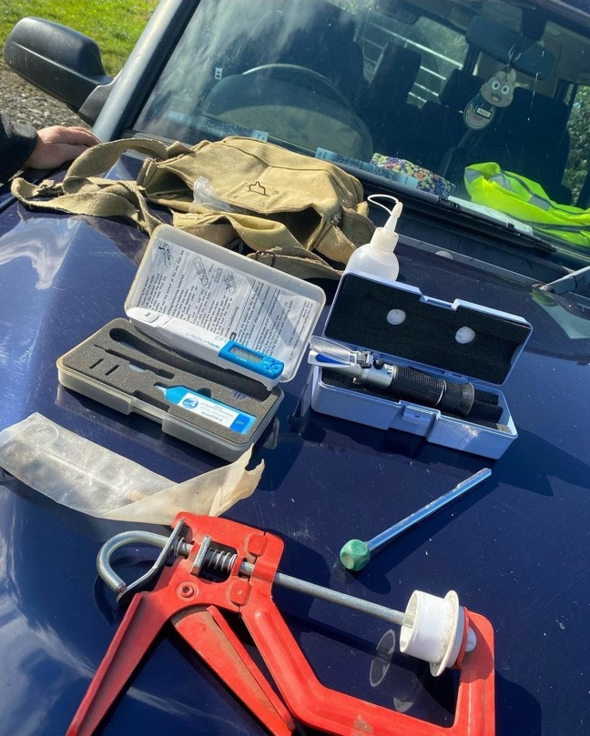
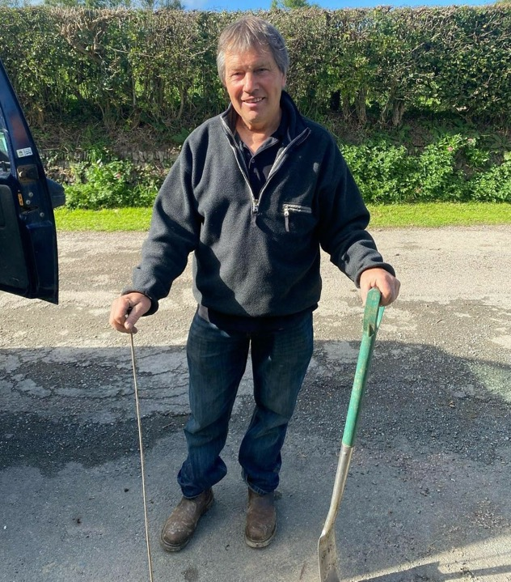
Martyn Howard, Lower Northcott Farm

Slide 5
John Whetman and Audrey Compton, Deer Park Farm

Slide 6
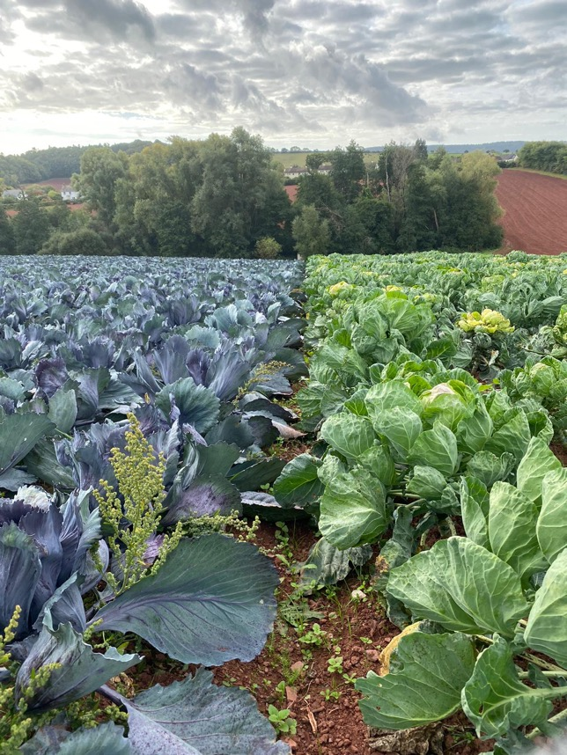
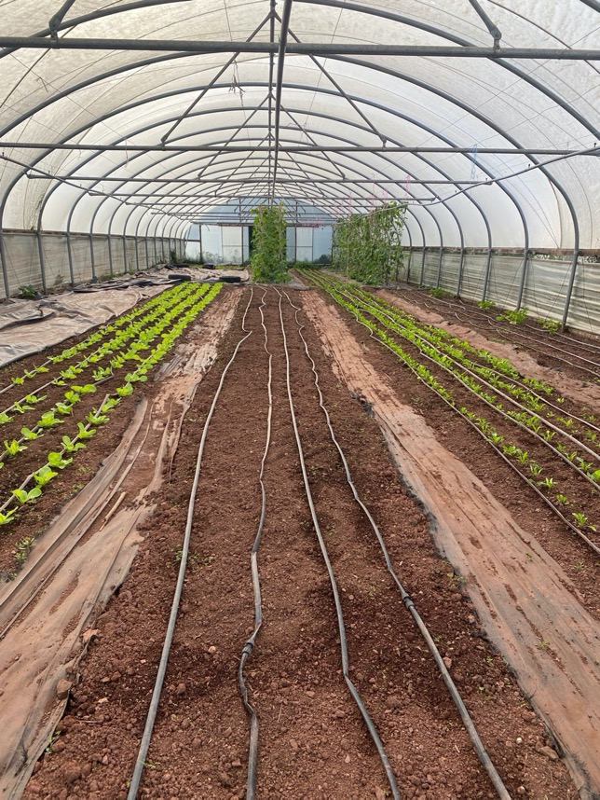
Martin Bragg, Shilingford Organic

Slide 7
David Brewer, Wood Advent Farm

Slide 8
Anthony Bellamy, Pawlett Hams

Slide 9
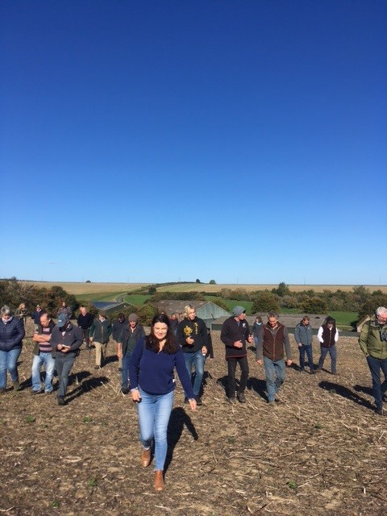
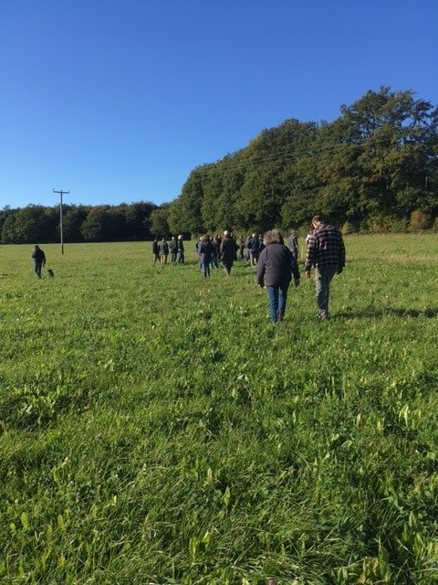
Dougal Hosford, Travellers Rest Farm

Slide 10
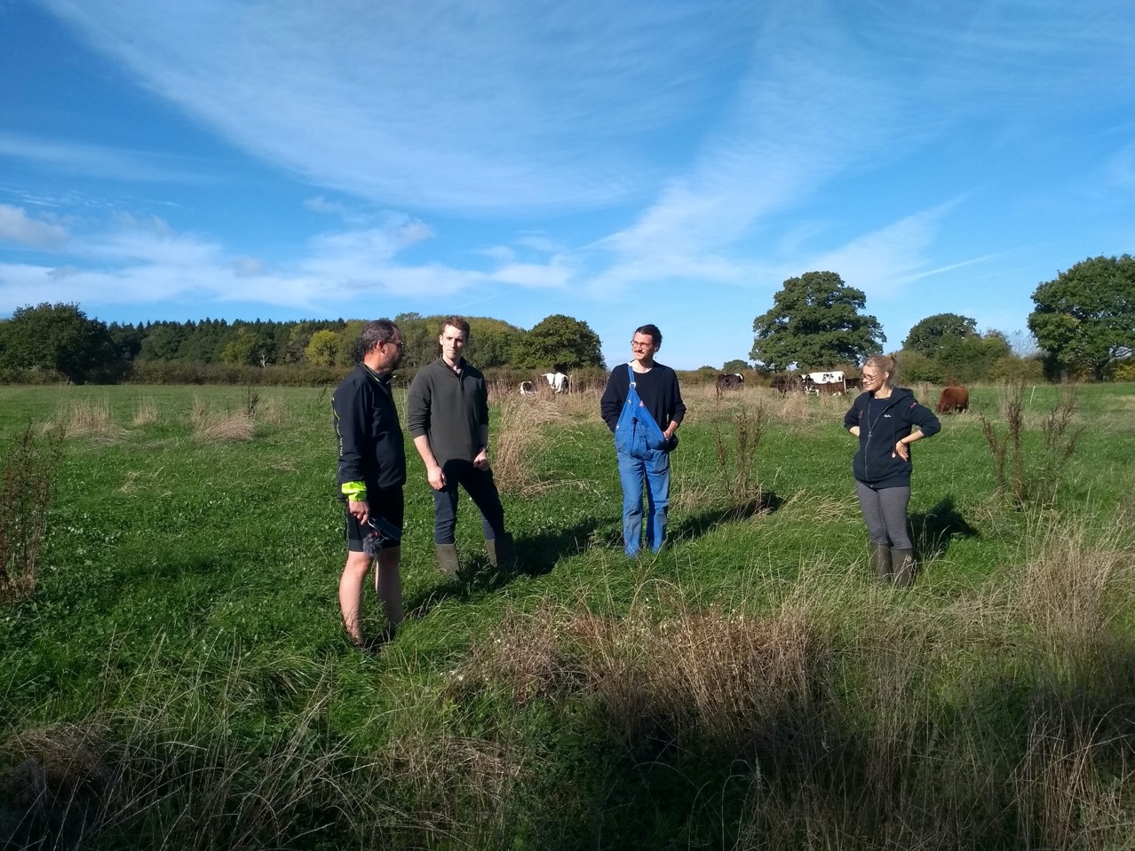
Hannah Steenbergan, Holt Farm

Slide 11
Ashton Hawker, Gardener's Farm

Slide 12
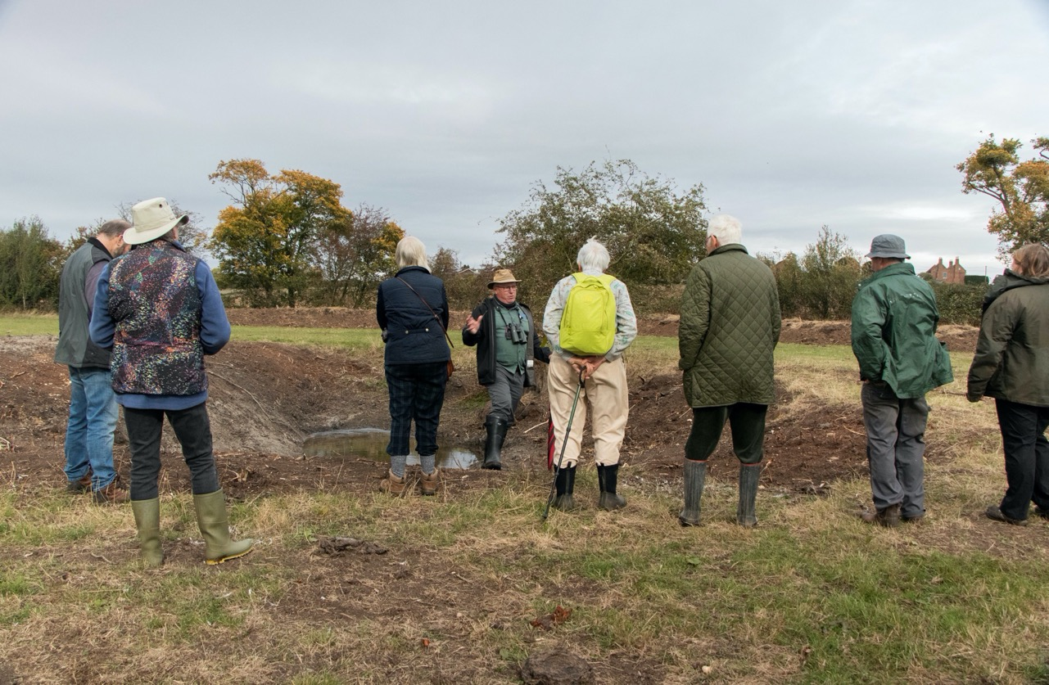
Debbie Wilkins, Coombe Hill Meadows

Slide 13
Total kilometers cycled : 537km
Number of farms and projects visited: 10
Hours of cycling: 33.5 hrs.
Average speed: 16 km/hr.
Mechanicals: 3 punctures and one seized front hub!
Pasties Eaten: Can you have too many?

