Slide 1
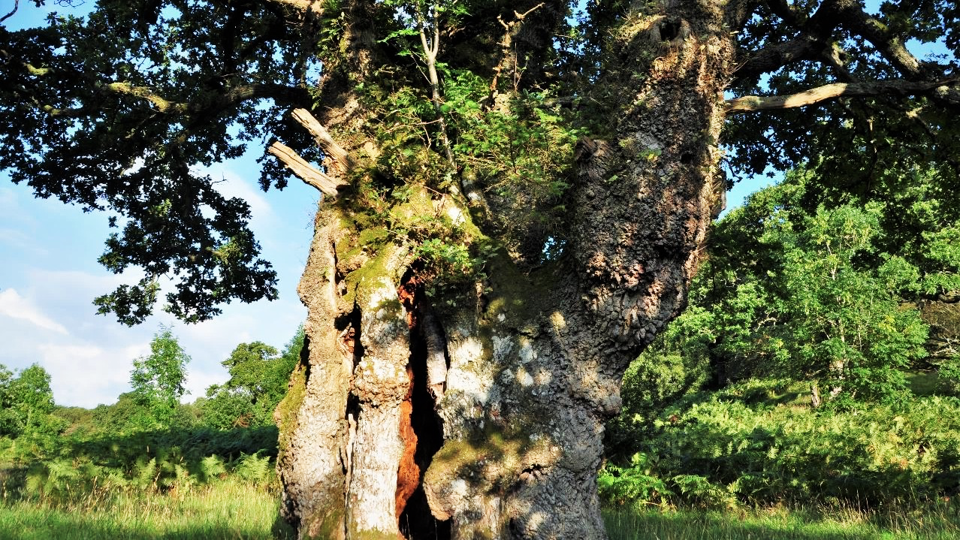
Living Legends
Recognising the heritage and nature value of ancient trees on farms
Dr Emma Gilmartin
Liz Fleming-Williams

Slide 2
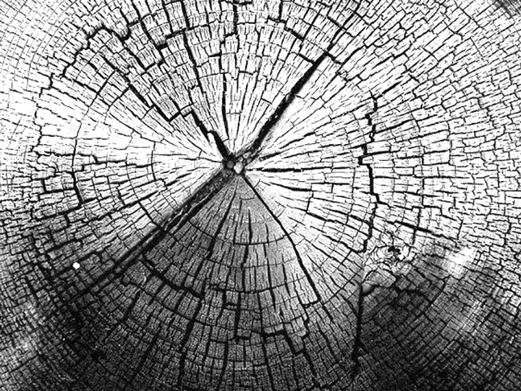
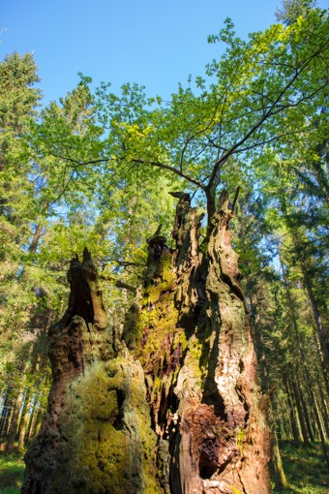
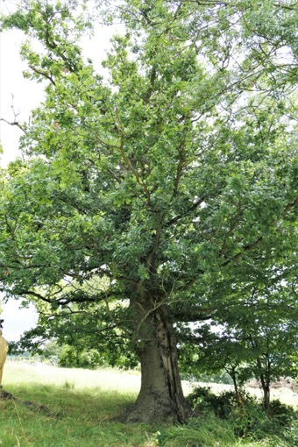
What are ancient and veteran trees?
Ancient trees
trees that are very old
in number of years
(relative to others of their species)
- in the ancient phase of their lives
Veteran trees
trees that have some of the features of ancient trees, but are not yet considered ancient

Slide 3
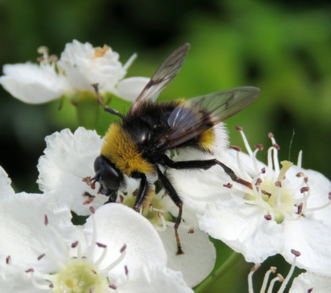
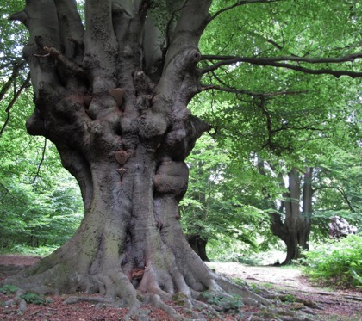
What are ancient and veteran trees?
Steven Falk
Irreplaceable habitats
and
cultural heritage

Slide 4
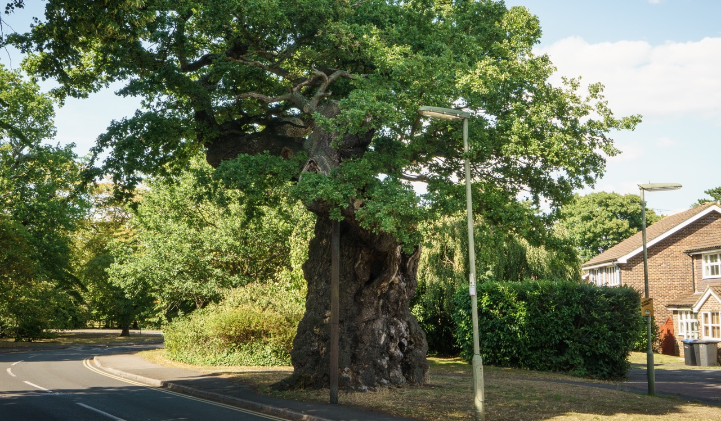
Where are they found?
Where are they found?
Where are they found?
Where trees have had the space and opportunity to live on
Tessa Chan/ WTML

Slide 5
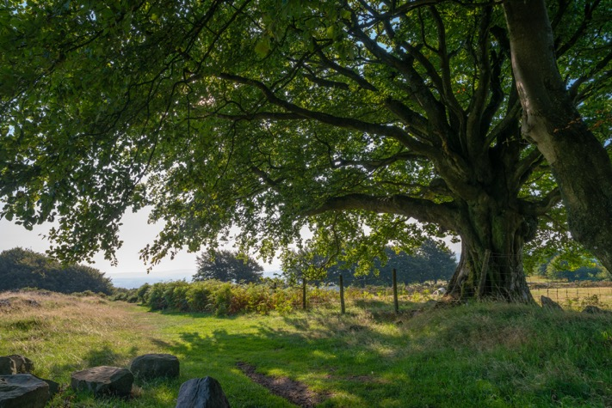
Where are they found?
UK-wide
In towns and cities, churchyards and woodland.
On farms
In pastures, hedgerows, orchards, around farm buildings.
Mark Zytynski/ WTML

Slide 6
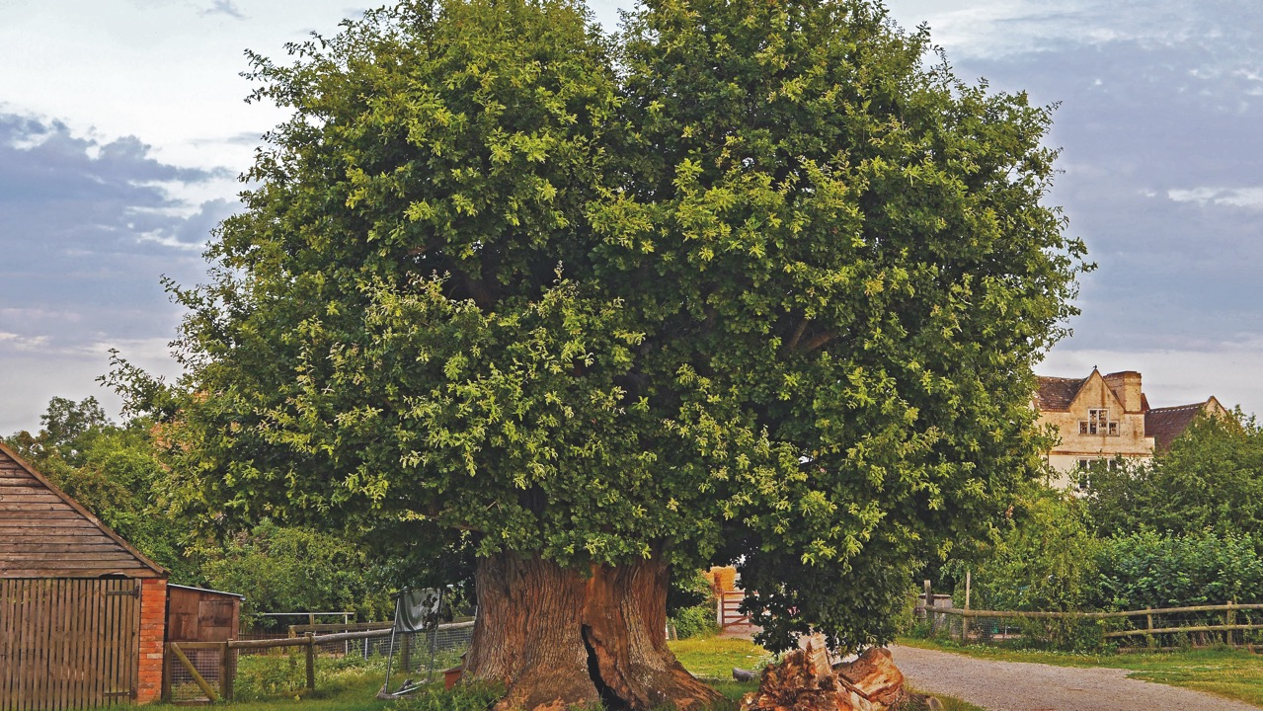
Julian Hight/ WTML

Slide 7
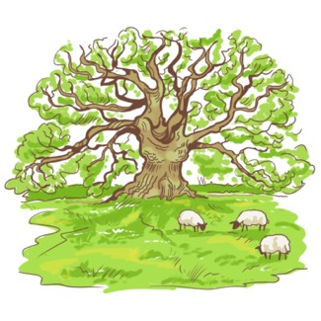
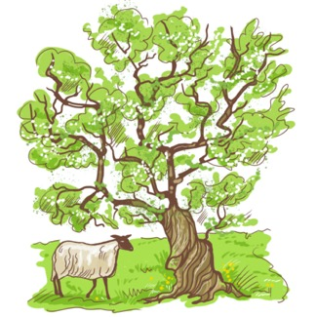
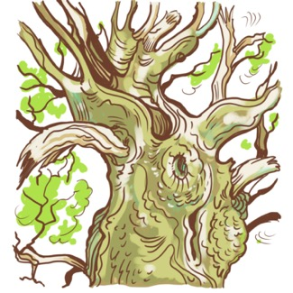
Recognising ancient and veteran trees
Old
Large
Full of features

Slide 8
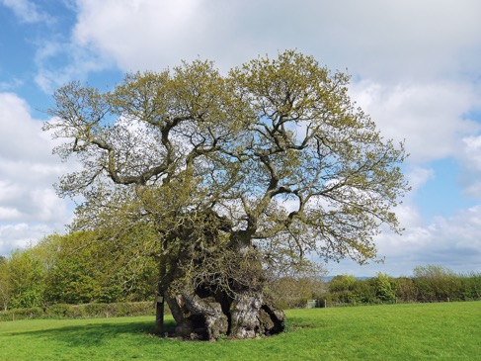
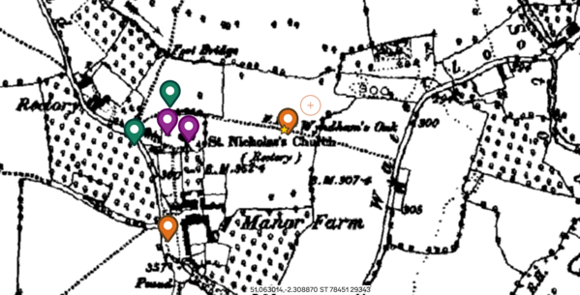
Recognising ancient and veteran trees
Old
Use maps or other evidence
‘Old’ and squat appearance

Slide 9
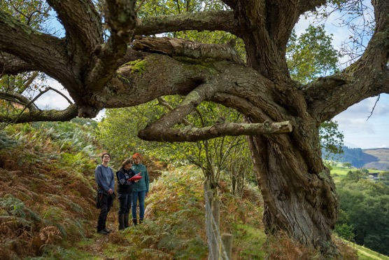
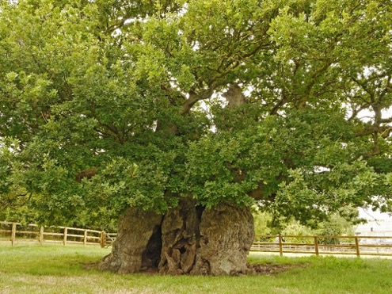
Recognising ancient and veteran trees
Large
Felix Cannadam
Stand-out trees
Exceptional size

Slide 10
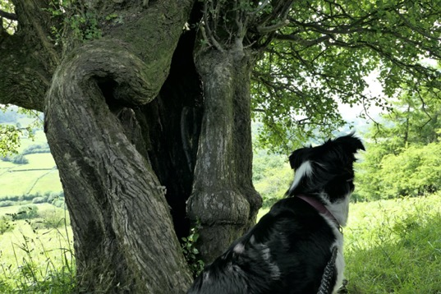
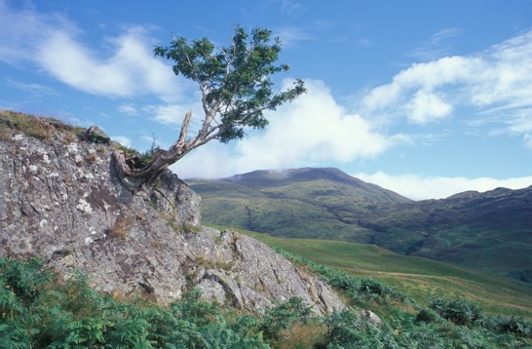
Recognising ancient and veteran trees
Large, but!
Niall Benvie/ WTML
Don’t overlook small-statured species
Remember growing conditions affect size

Slide 11
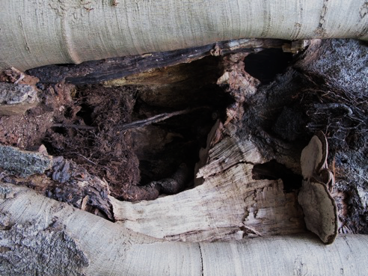
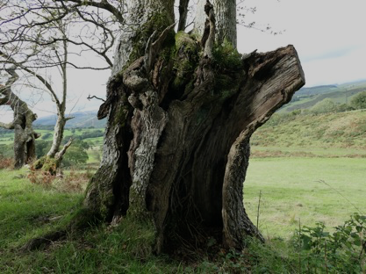
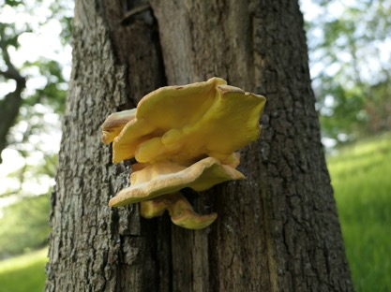
Recognising ancient and veteran trees
Full of features
Trunk and branch hollowing
Fungus fruiting bodies
Significant wood decay

Slide 12
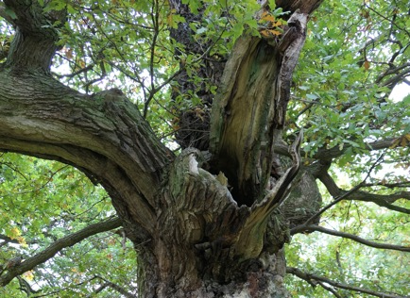
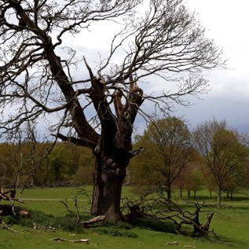
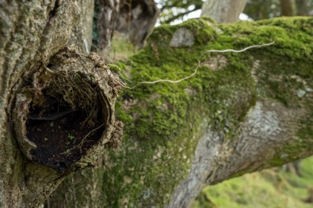
Recognising ancient and veteran trees
Full of features
Rot holes and water pockets…
…and sap runs, flaking bark, and other nooks and crannies.
Decaying wood in the crown
Decaying wood on the ground

Slide 13
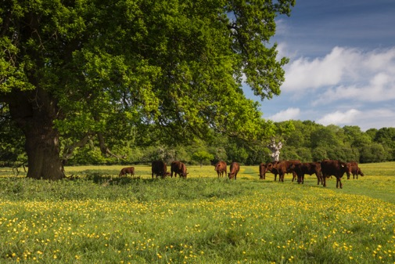
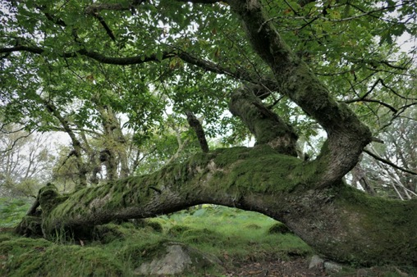
Best practice
Space and opportunity to grow old:
Allow the crown adequate spreading room
Protect the surround ground to prevent root and soil damage
Let survival strategies play out over tree time

Slide 14
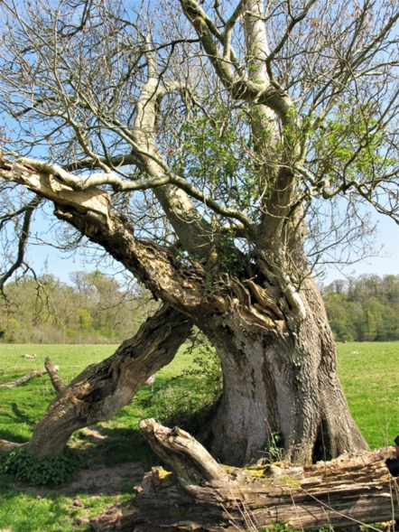
Best practice
Value decaying wood habitats
Keep dead trees
Leave fallen branches uncut and where they lie

Slide 15
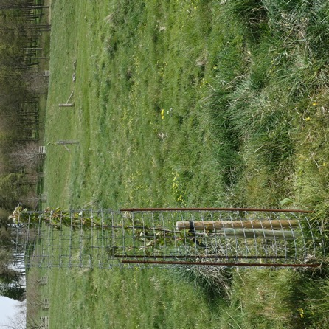
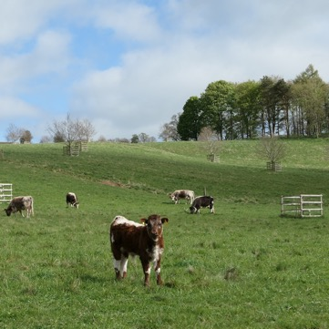
Best practice
Look to the future
Protect existing mature trees
Plant or establish successor trees nearby (but not under existing veterans)

Slide 16
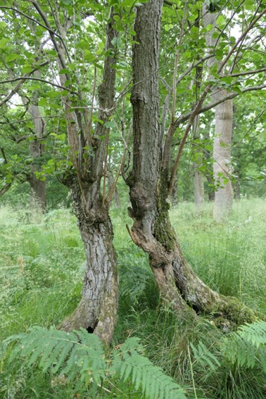
In summary
Look for trees that are
Old
Large
Full of features
(Record to our
Ancient Tree Inventory)
Our guiding principles are
Give trees space and opportunity to grow old
Value decaying wood habitats
Look to the future

Slide 17
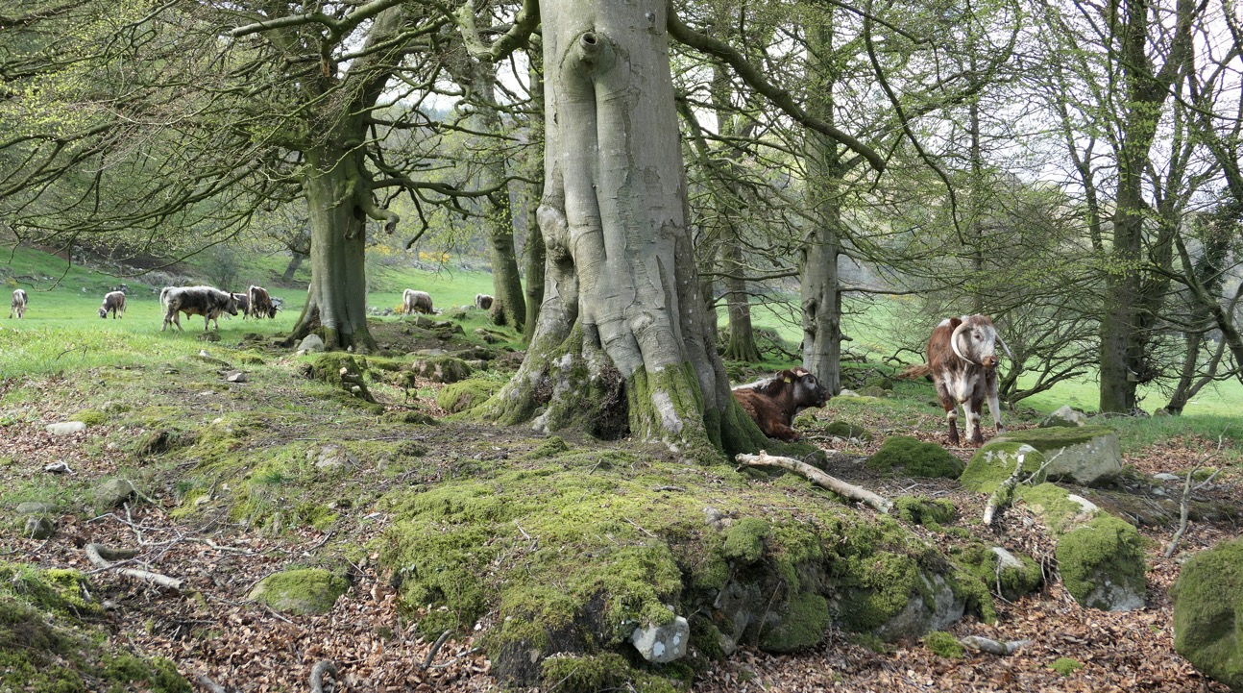
Thank you
for listening

