Slide 1
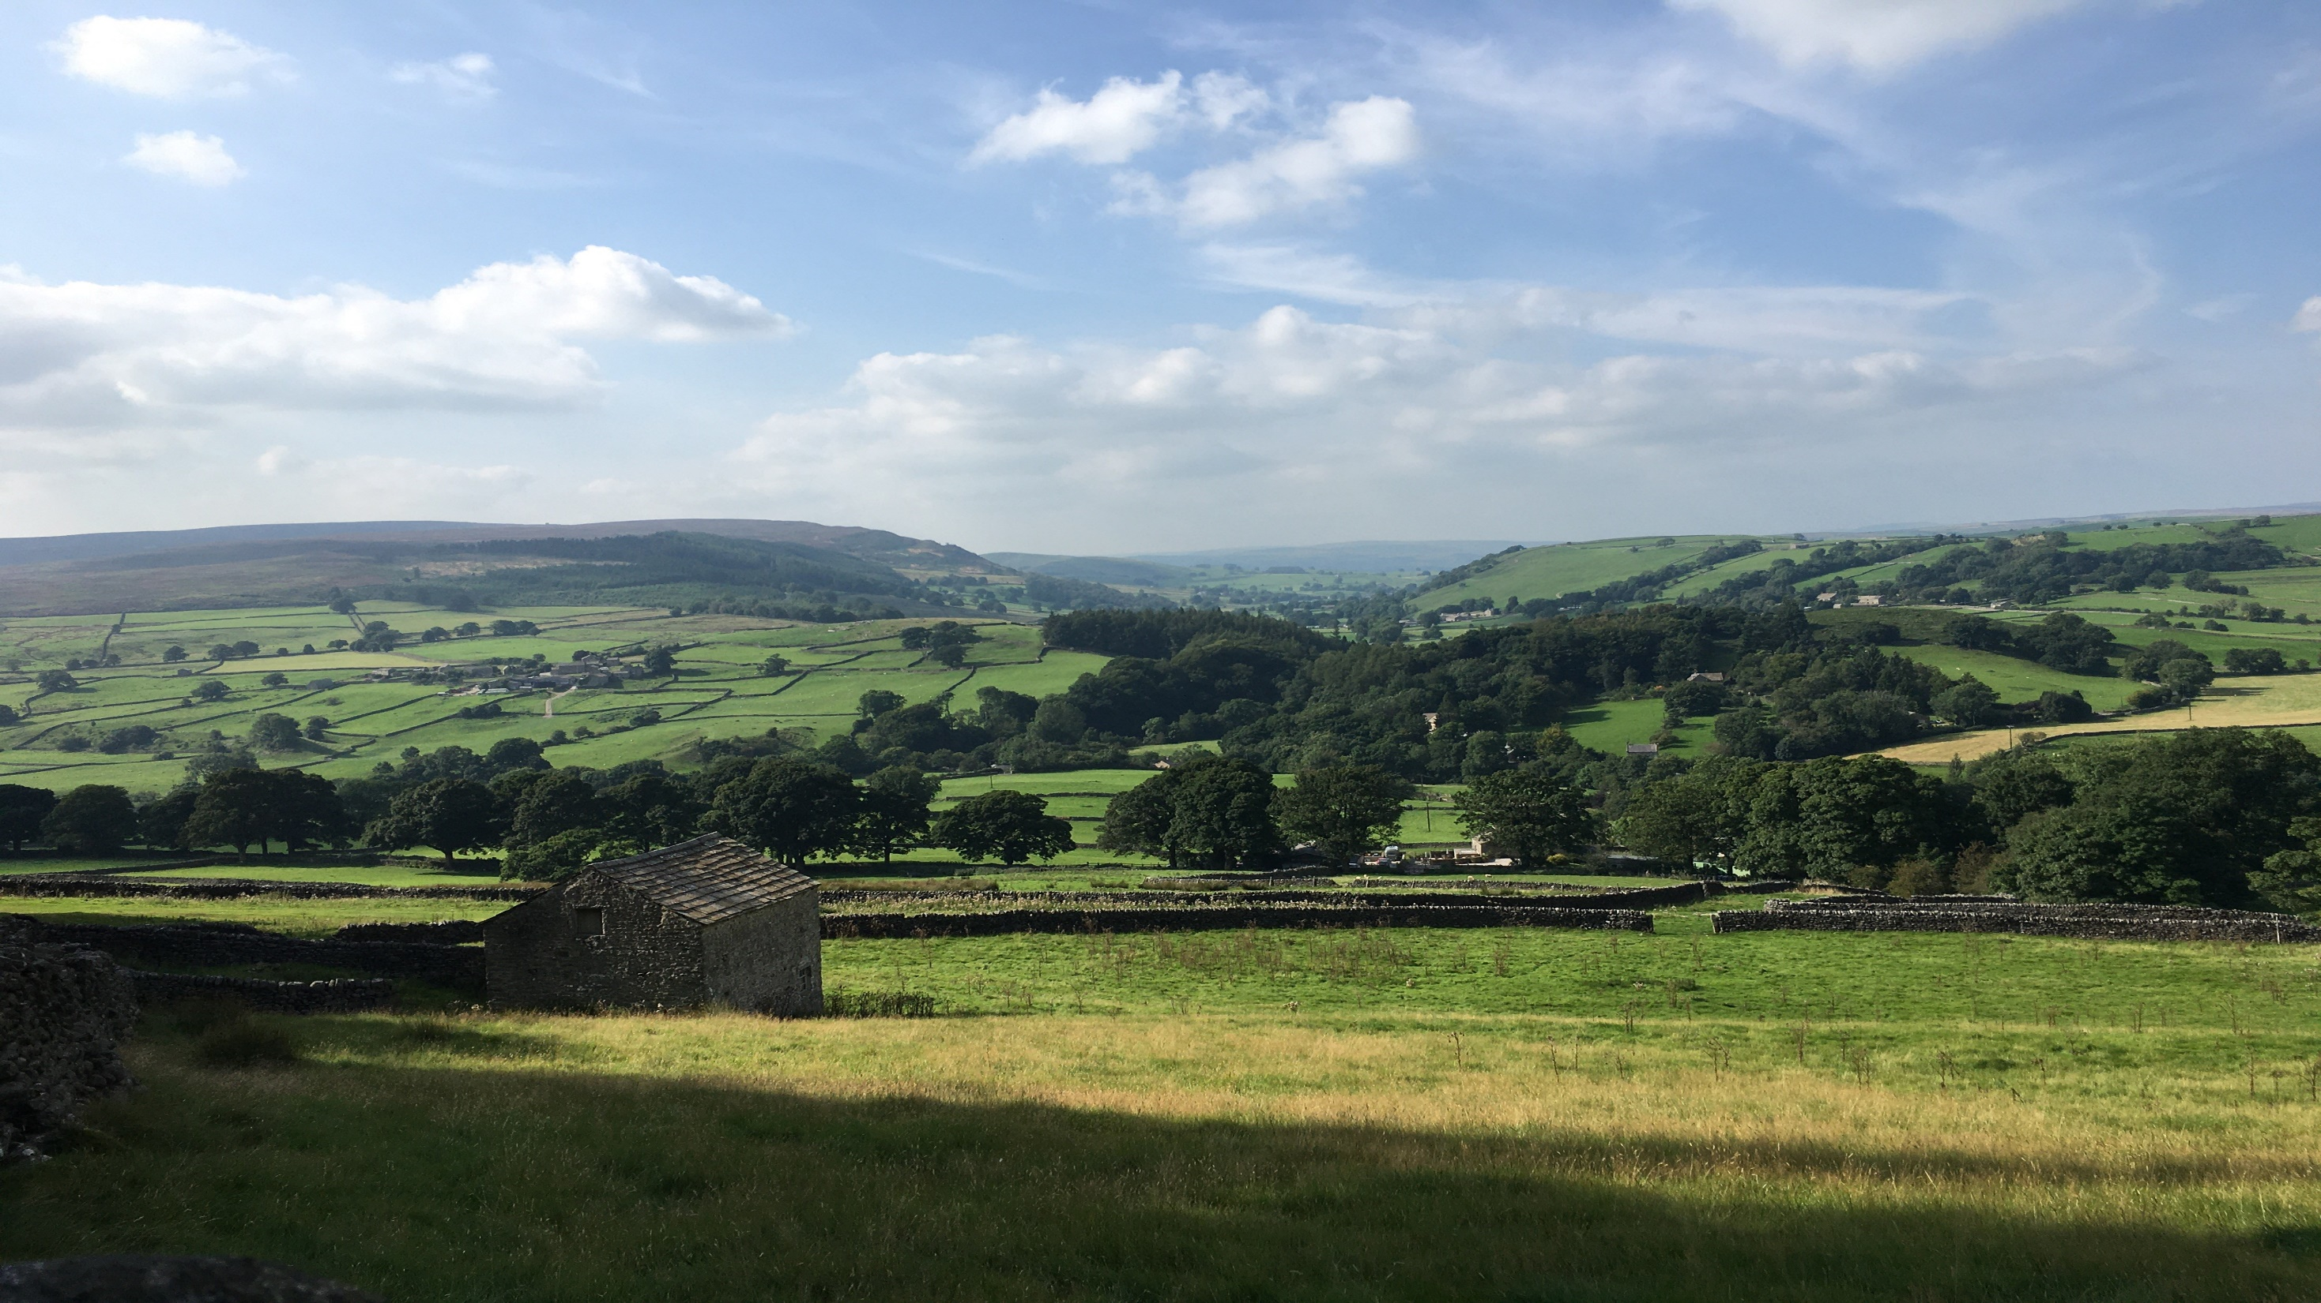




State of the Four Nations: Food and farming policy across the UK
Amy Willoughby (chair), Katie Palmer, Kerry Melville, Pete Ritchie, and James Woodward
^{ORFC 2023}

Slide 2
State of the Four UK Nations
Main Issues | England | Scotland | Wales | Northern Ireland
Food Bill | Lagging | Leading | Looming | Lagging
Agri reform | Leading | Looming | Looming | Lagging
Food insecurity | Looming | Leading | Leading | Looming
Universal Free School Meals | Lagging | Leading | Leading | Looming
Healthy Eating | Lagging | Looming | Looming | Looming
Trade deal standards | Lagging | X | X | X
Public procurement | Looming | Looming | Looming | Looming
Local food systems | Looming | Looming | Leading | Looming

