Slide 1
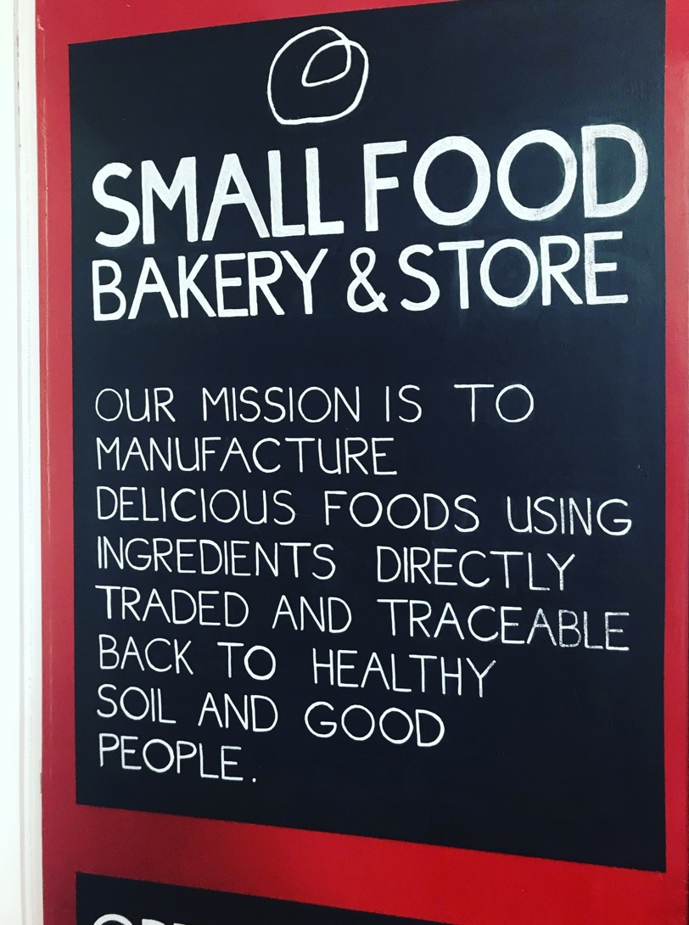
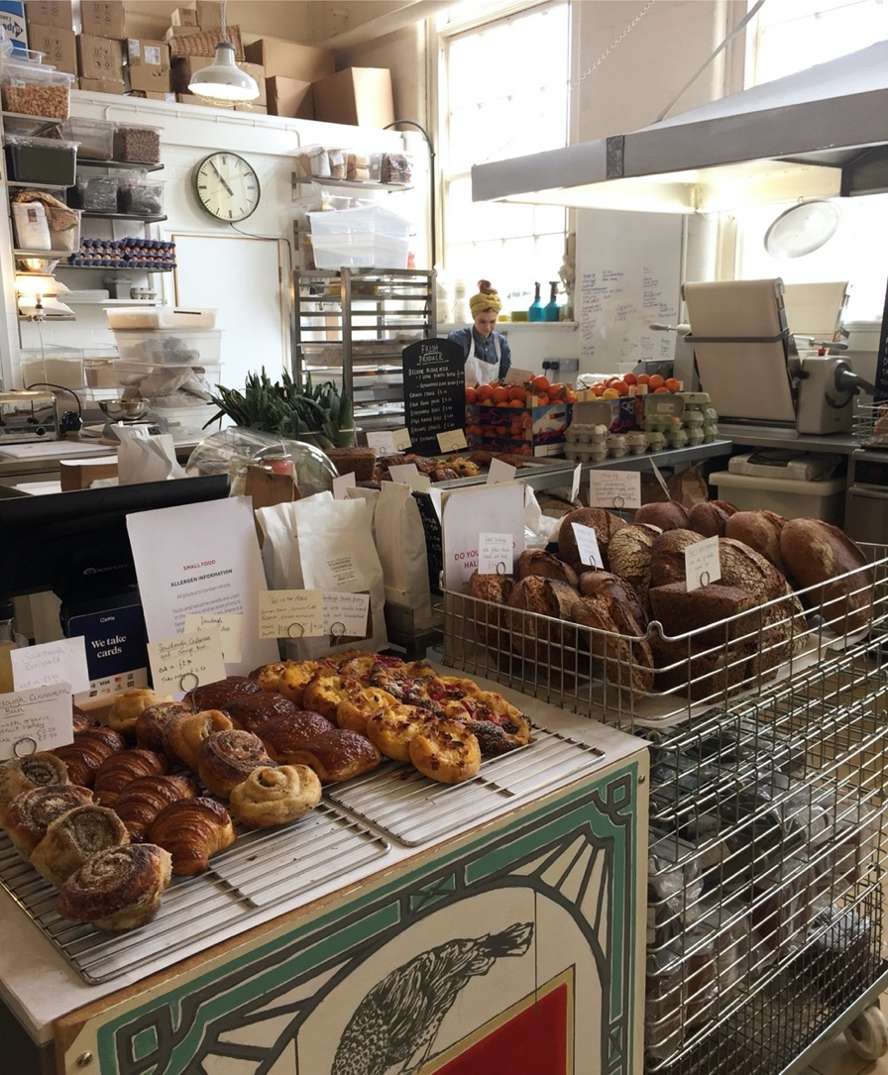

Slide 2
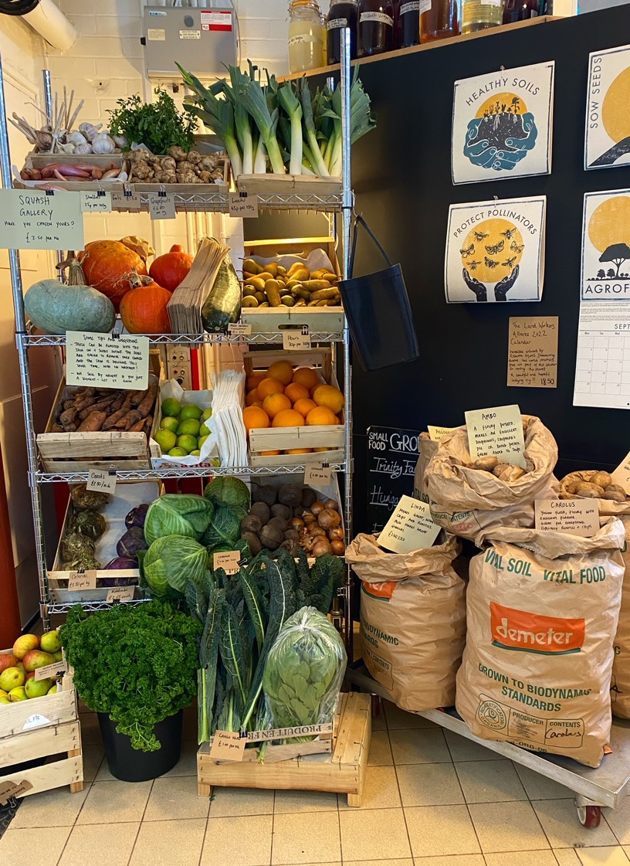
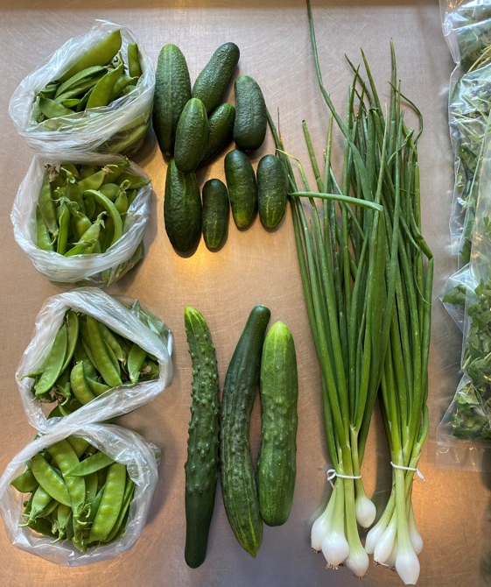
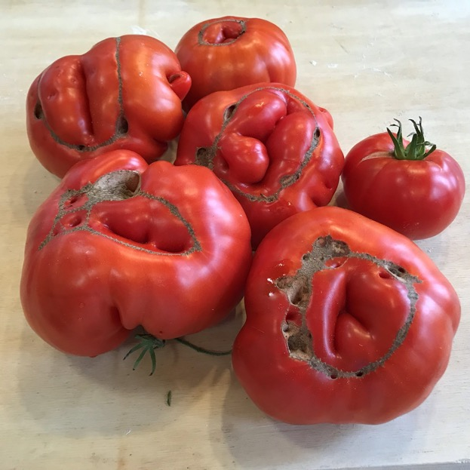

Slide 3
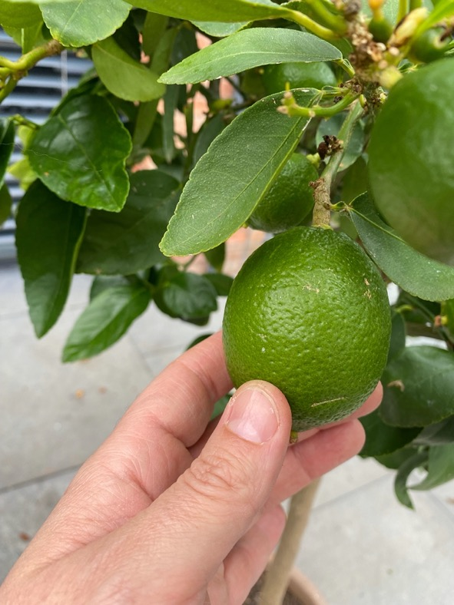
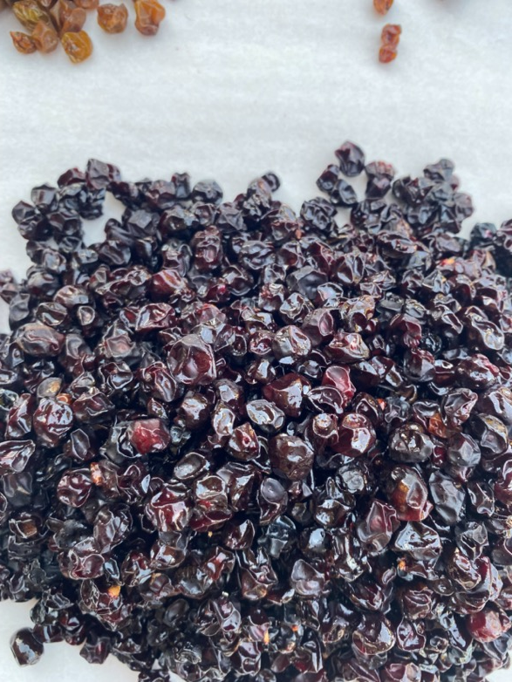

Slide 4
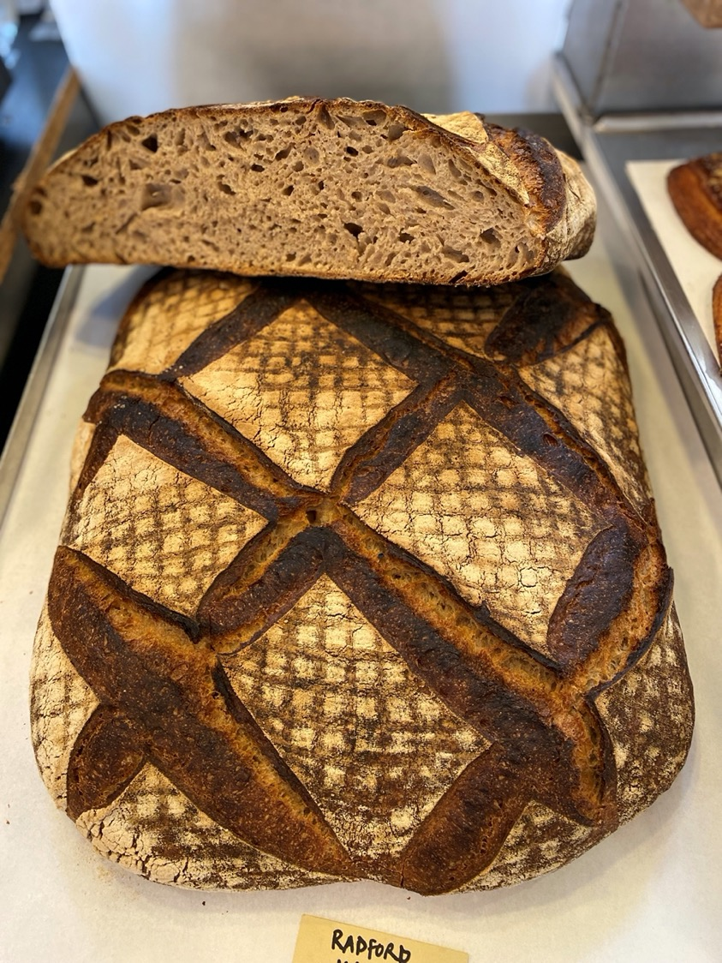
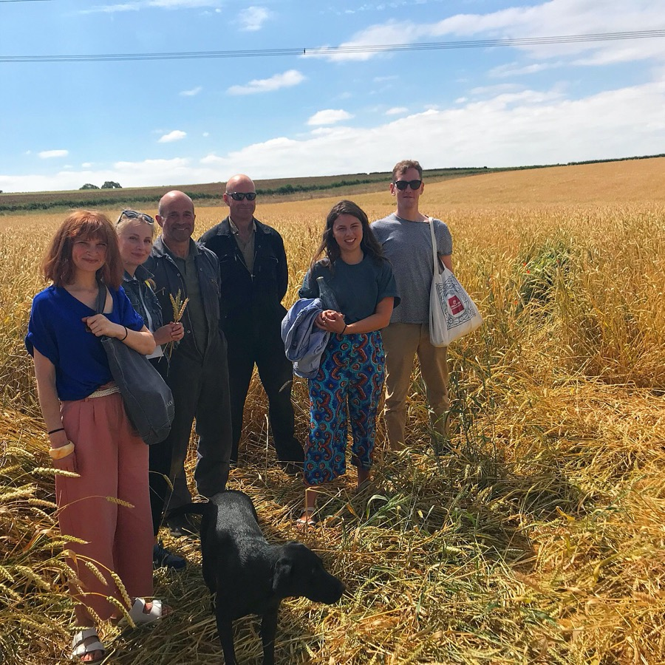
Notes:
We spend time on farms
We have learnt so much. It changes our intentions, our motivations and our perspective as bakers
Feedback loops are our biggest advantage over the big food system. When our network has a problem ,we solve it really quick.
Everyone round the table means different perspectives, smashing through assumption, committing to the problem and internalising the work. Diversity at every level –a diversity of minds = resilience.

Slide 5
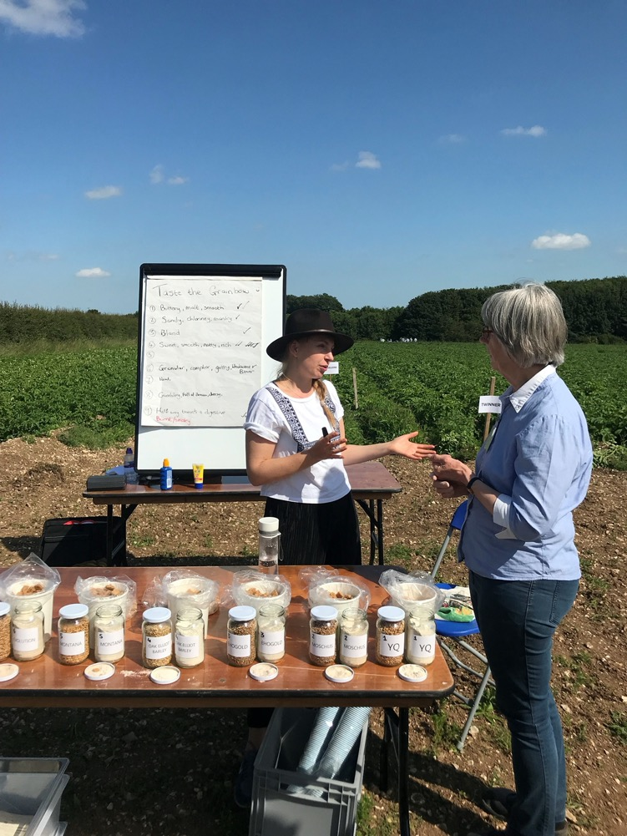

Slide 6
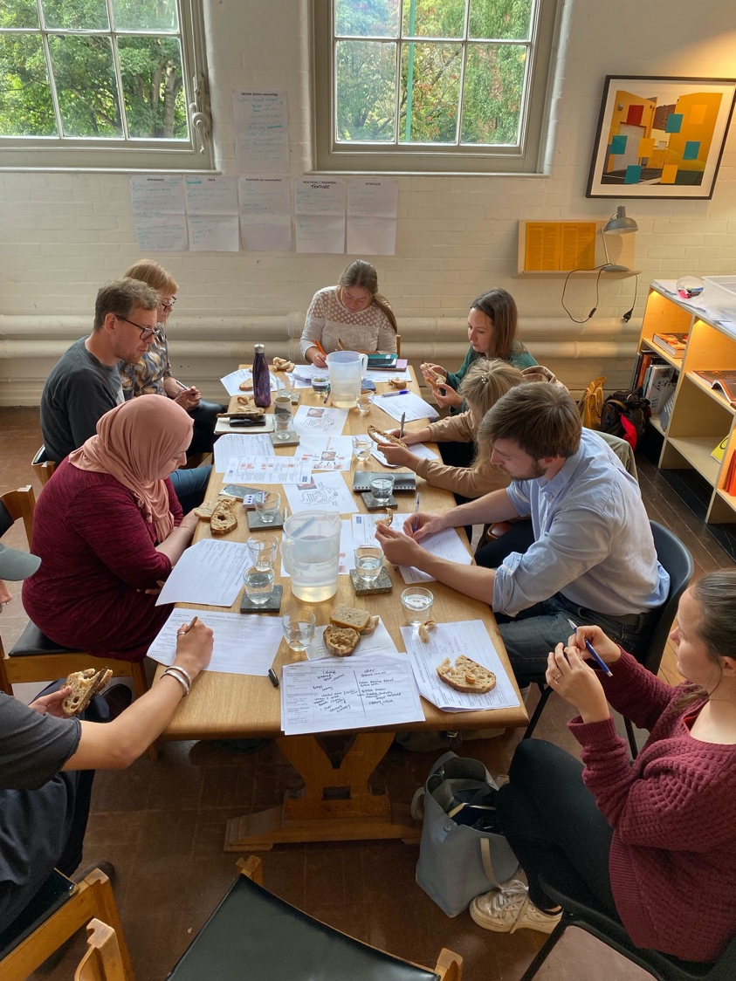
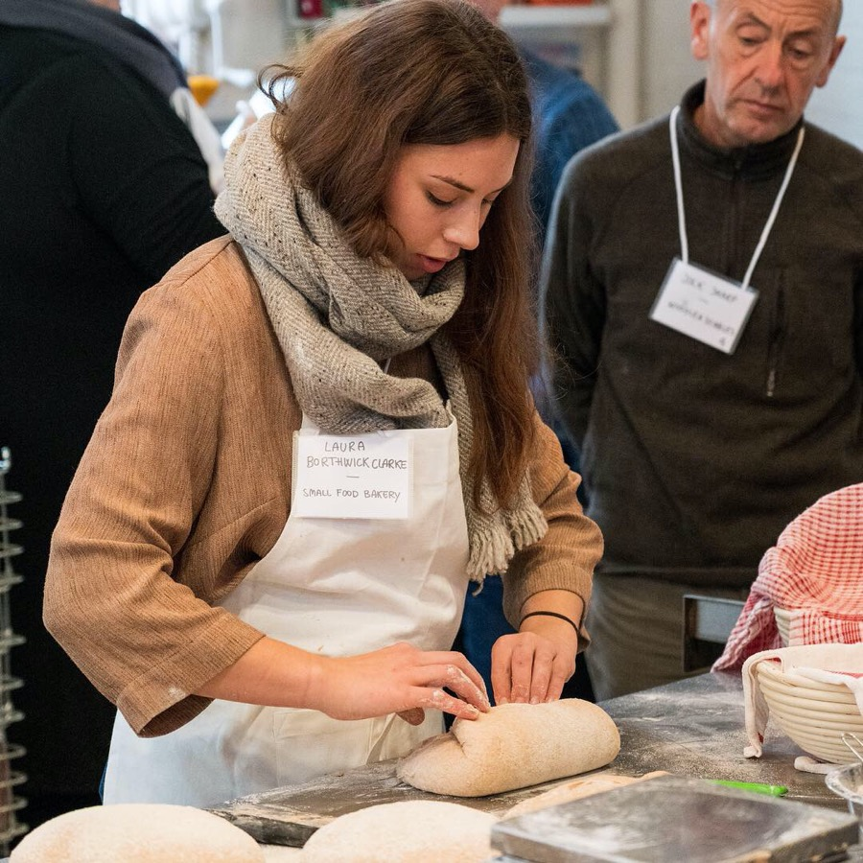

Slide 7
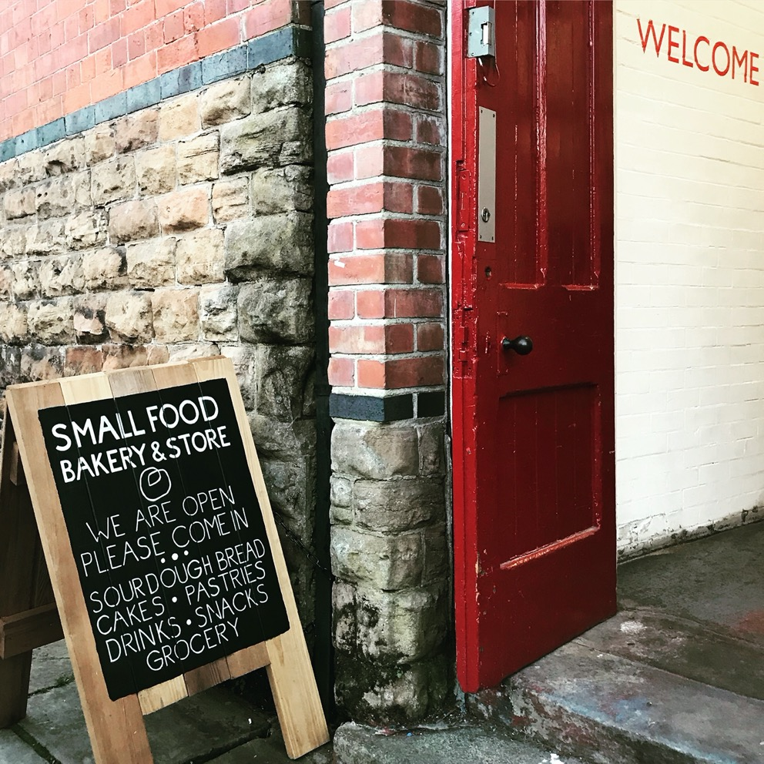
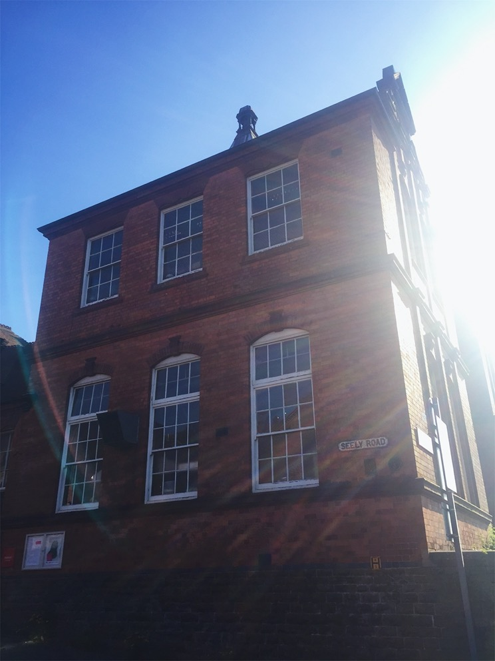
Notes:
So back to the bakery - ill just introduce Small food bakery to you – in an old school building on the edge of the city
Now a complex of studios and offices used by artists, makers and creative businesses called Primary
I was invited to take a lease on this space three years ago - as a cook and baker with a view to converting the old school kitchen into something that could serve the local community

Slide 8
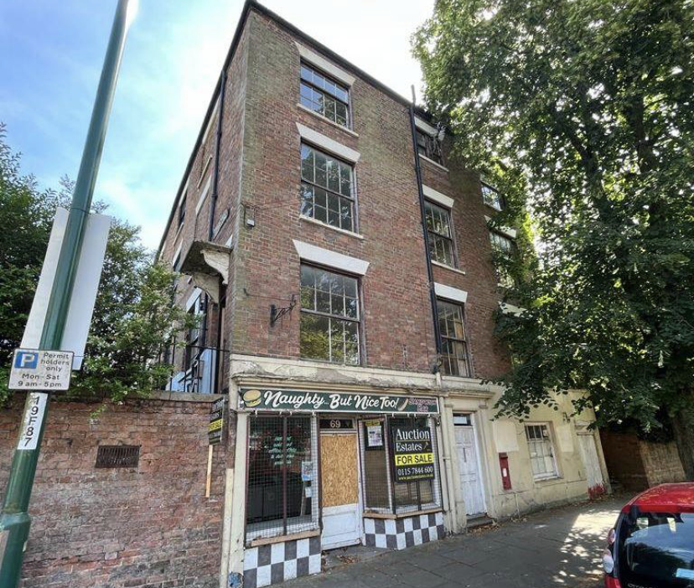

Slide 9
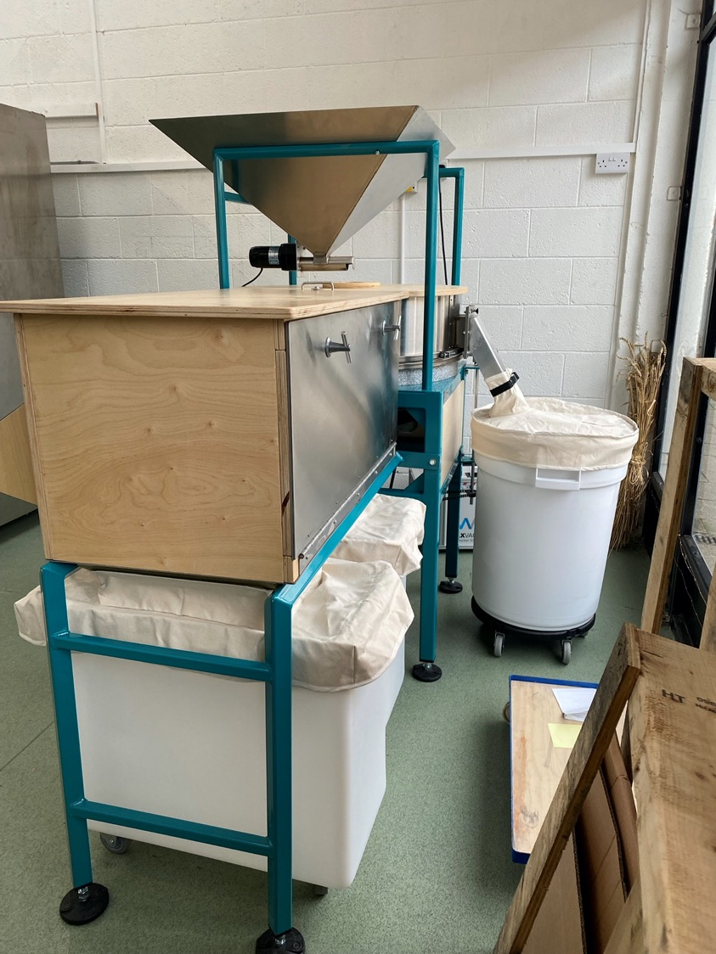

Slide 10
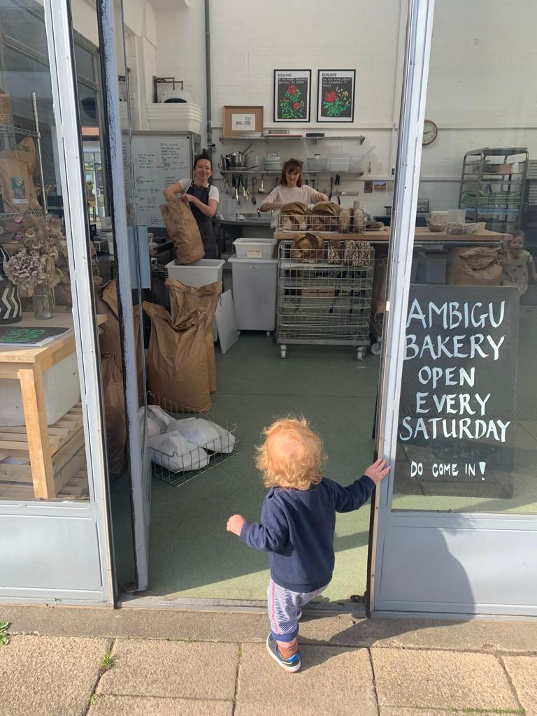

Slide 11
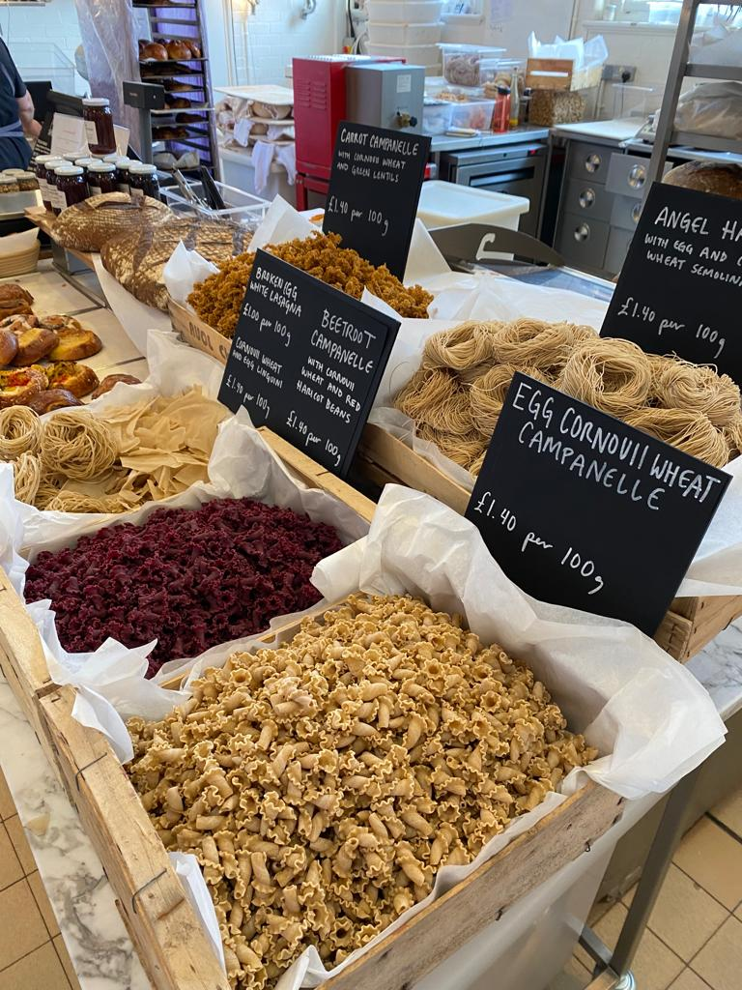
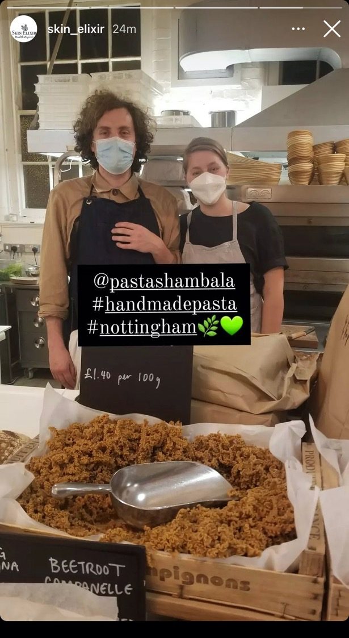

Slide 12
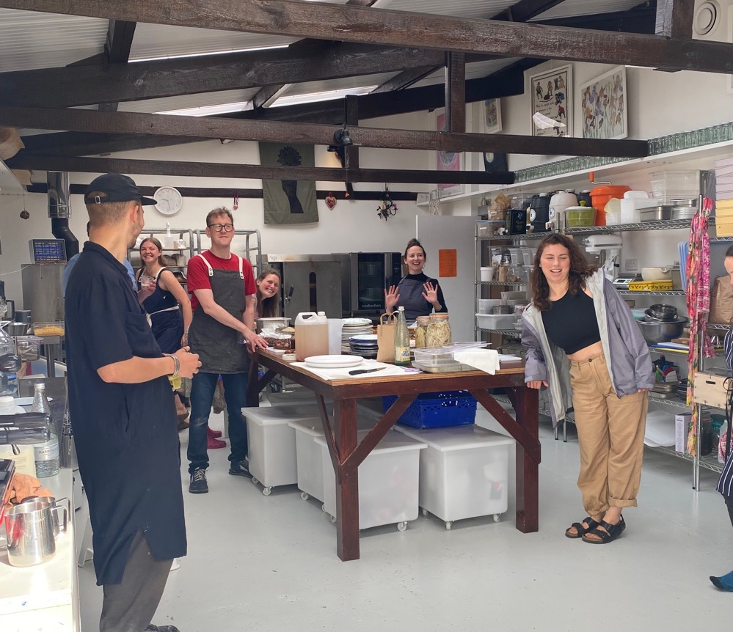
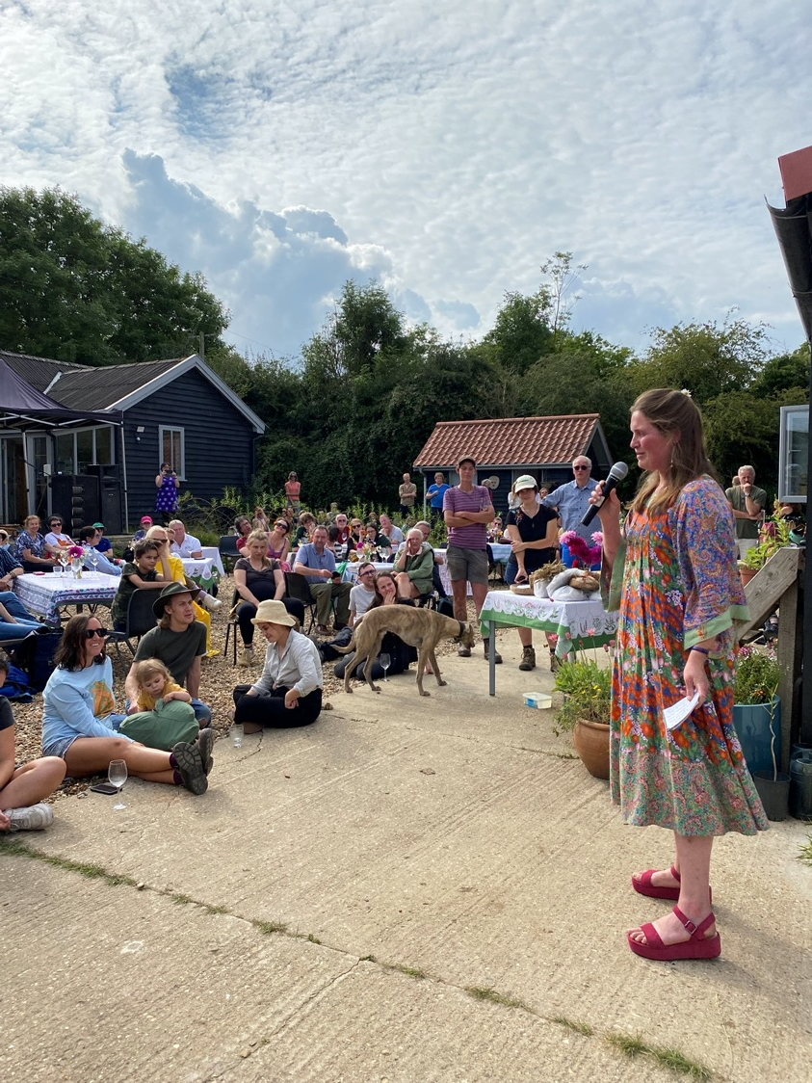

Slide 13
‘As we make bread, we make ourselves’
Tara Jenson

