Slide 1
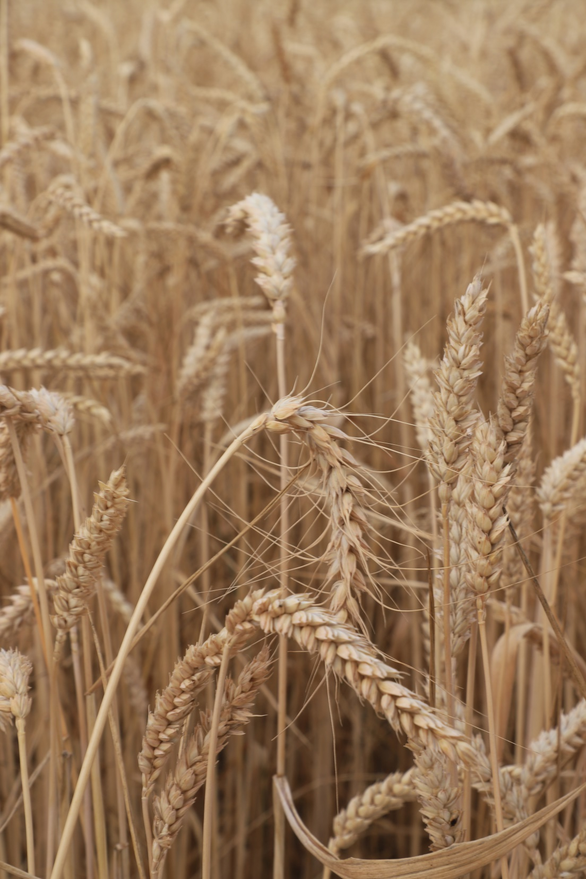
John Turner
Turners of Bytham

Slide 2
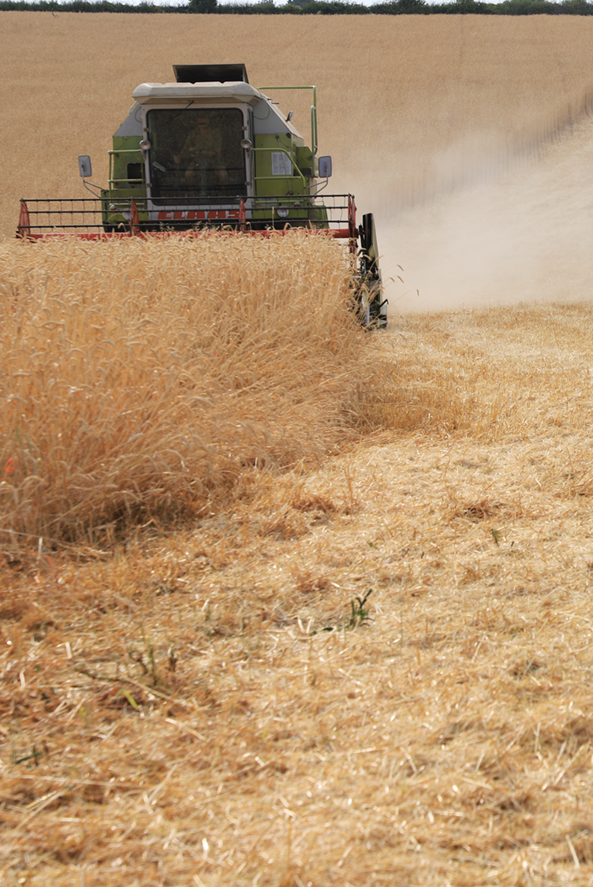
130 ha (325a) s.w. Lincolnshire
Mixed, rotational farm
Organic (since 2001)
Working with Heterogeneous crops since 2017
Wakelyns ORC “YQ”
Oak Farm Populations (I & II)
Cornovii

Slide 3
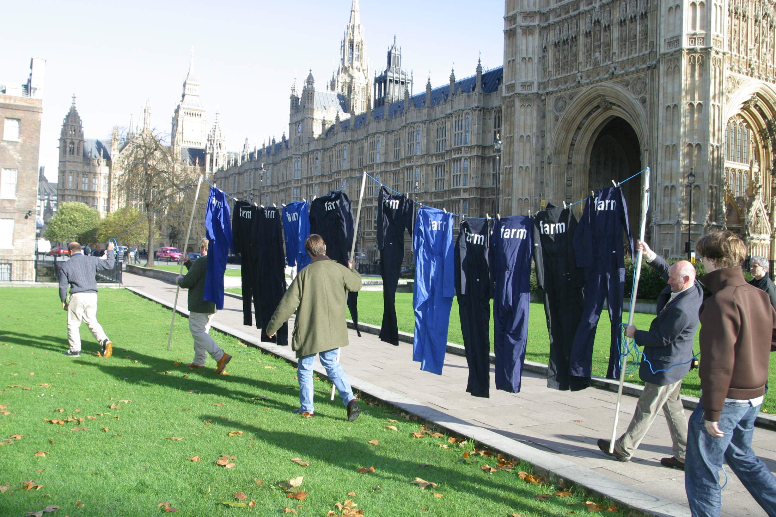
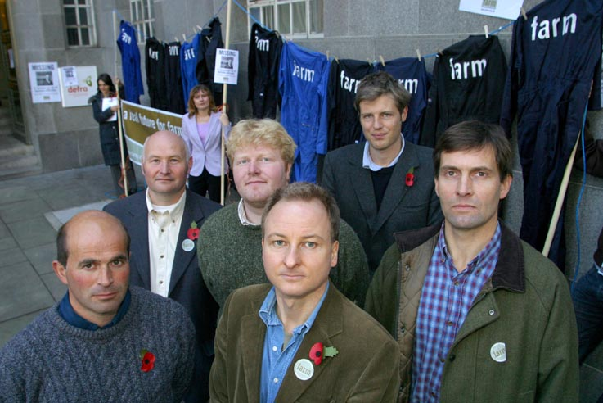
2002

Slide 4
2003
Farming that feeds the nation
Farming that’s profitable
Farming that holds together rural communities and their culture
Farming that maintains the countryside and its wildlife
Farming that offers opportunities for new entrants

Slide 5
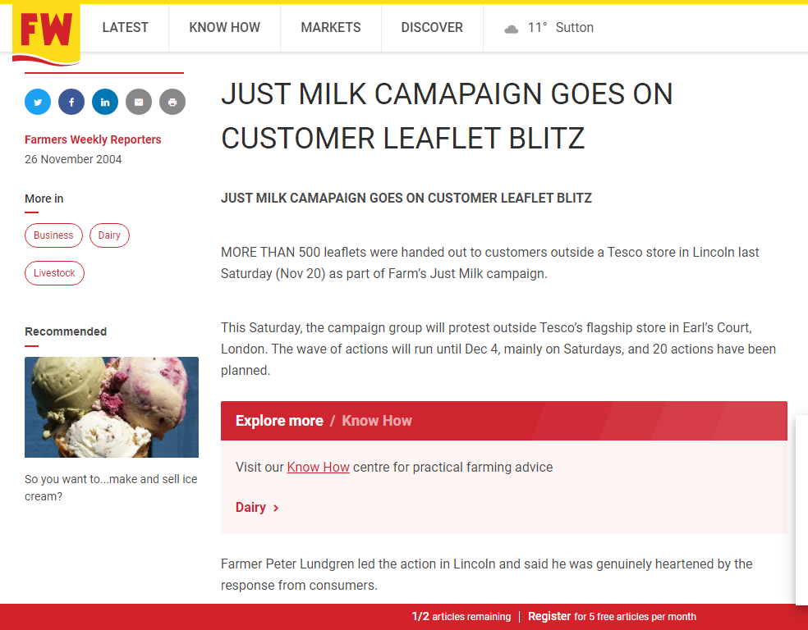
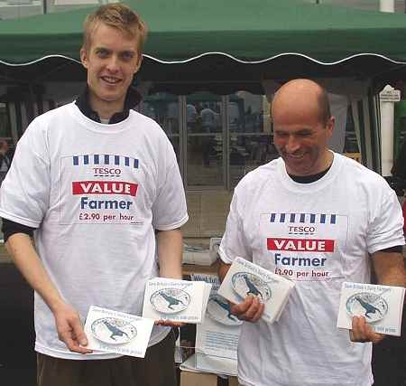
2004
“Just Milk”
Targeted Tesco & customers
“Cost plus” pricing demand
Dairy event presence

Slide 6
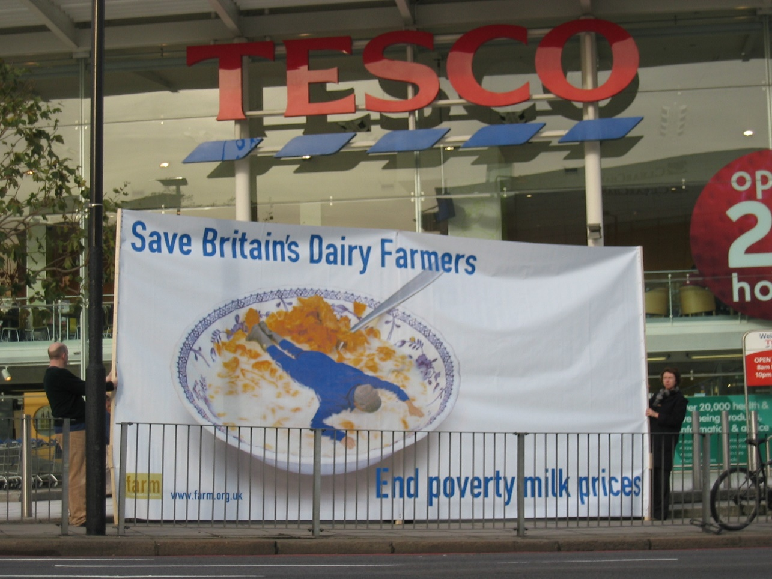
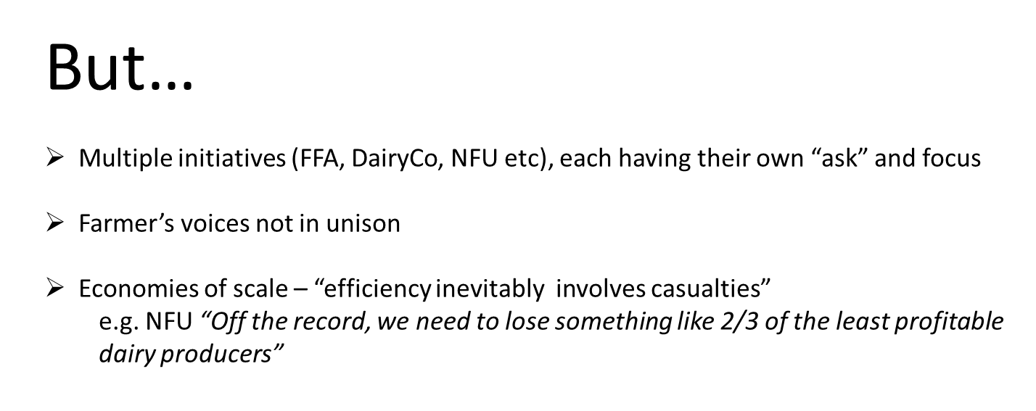

Slide 7
ere endeth the first lesson…..
When do we want it?
Deliverable
“Front Foot”
Coordinated
What do we want?
Detail – rooted in practice
Consistent
Cohesive
Coherent
What else?
Seek the path of least resistance
Know & own your space
“Campaigns are only as strong as the experience they are rooted within”

Slide 8
“Dog-Eat-Dog” (predominant) supply chain
Grower
Merchant
Processor
Retailer/Wholesaler
“Commonplace” (human-scale) supply chain
Grower
Artisan Processor
Specialist Retailer / Wholesaler
Artisan Produce

Slide 9
“A proper community ..is a commonwealth: a place, a resource, an economy. It answers the needs, practical as well as social and spiritual, of its members - among them the need to need one another. The answer to the present alignment of political power with wealth is the restoration of the identity of community and economy.”
Wendell Berry, The Art of the Commonplace

Slide 10
Policy
Certification
(Red Tractor, Organic etc)
Environmental Health
EHO
Food Standards
Agency
Artisan Processor
Grower
Health & Safety Executive
Advertising Standards
Authority
Specialist Retailer / Wholesaler
Artisan Produce
Plant & Seeds
Legislation
Environmental Stewardship
UK Levy Bodies & Research Councils

Slide 11
Policy
“Dog-eat-Dog”
“Common Wealth”
Environmental Health
EHO
FSA
EHO
??
Safety at work
??
HSE
??
Advertising Standards
ASA
UK Levy Bodies & Research Councils
??
R & D
Certification
(Red Tractor, Organic etc)
??
Product Quality
Genetic Resources
Plant & Seeds
Legislation
??

Slide 12
Heterogeneous Grains
Ideal for Organic & Low-input farming..
Diverse
Variable
Requires adaptive:
Processes
Skills
Experience

Slide 13
Heterogeneous Grains
Responsible, Human-Scale food chains..
Bespoke, online register

Slide 14
Heterogeneous Grains
Responsible, Human-Scale food chains..
Quality testing to underpin standards

Slide 15
Heterogeneous Grains
Responsible, Human-Scale food chains..
Levy to support R&D based upon produce sold

Slide 16
Policy
Certification
(Red Tractor, Organic etc)
Environmental Health
EHO
Food Standards
Agency
Health & Safety Executive
Financially robust
Responsible
Advertising Standards
Authority
Plant & Seeds
Legislation
Environmental Stewardship
UK Levy Bodies & Research Councils

Slide 17
Policy
Certification
(Red Tractor, Organic etc)
Environmental Health
EHO
Food Standards
Agency
Artisan Processor
Health & Safety Executive
Grower
Artisan Produce
Advertising Standards
Authority
Specialist Retailer / Wholesaler
Plant & Seeds
Legislation
Environmental Stewardship
UK Levy Bodies & Research Councils

Slide 18
Plant Varieties and Seeds Act 1964
Protects Plant Breeder’s Rights
Aims to deliver consistent, high productivity crops
Crops grown on a field scale need to be listed on the National Seeds Listing
Criteria for listing based on DUS & VCU

Slide 19
Plant Varieties and Seeds Act 1964
DUS
Distinct
Uniform
Stable
VCU
Value for Cultivated Use

Slide 20
Provision for Commercial Experiment
EU 2014 / 150
EU 2018 / 1519
EU 2021 / 1189
Since January 2021, the UK offers no legal provision for the sale or exchange of Heterogeneous seed

Slide 21
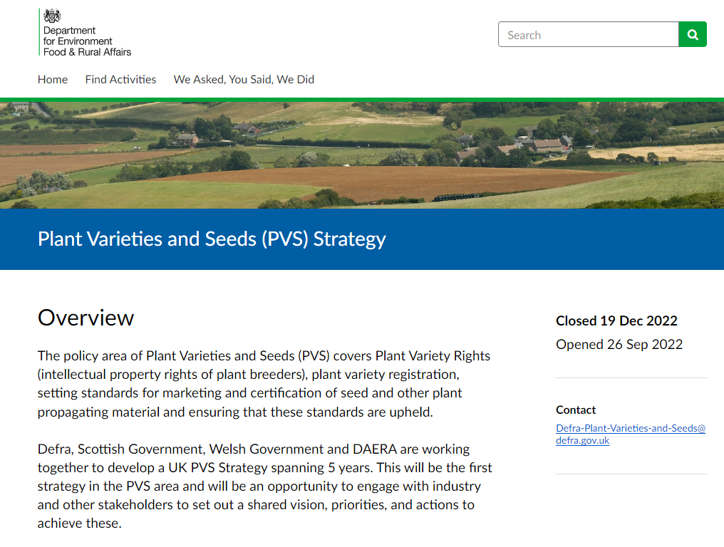

Slide 22
He opportunity…
When do we want it?
January 2021 ideally !!
5 growing seasons lost already & counting..
What else?
Wide-Ranging PVR review to be published within the next 12 months
What do we want?
A space for the artisan to flourish
Equivalence with the opportunities EU legislation offers
To build on proven success
“Policy should first and foremost be about internal organisation. Government is a last resort”

Slide 23
Thank you!
John Turner
Turners of Bytham
www.turnersofbytham.co.uk

