Slide 1
Why Convert to Community Supported Agriculture (CSA)?:
A session for landowners, larger farms and market gardeners

Slide 2
The Community Supported Agriculture (CSA) Network UK
What is Community Supported Agriculture?
CSA is good for people, good for planet and good for producer
Community supported agriculture (CSA) is a partnership between farmers and consumers in which the responsibilities, risks and rewards of farming are shared.
CSA consists of a community of individuals who pledge support to a farm operation so that the farmland, in essence, becomes the community's farm, with the growers/farmers and consumers providing mutual support and sharing the risks and benefits of food production.
www.communitysupportedagriculture.org.uk
Notes:
Community Supported Agriculture (CSA) is an innovative farming model which provides fair, stable incomes for farmers and increases access to locally-produced food while strengthening communities and increasing understanding of how sustainable farming protects, restores and enhances biodiversity and addresses climate change.
CSA farms in the UK share the following characteristics:
They are agroecological
CSA farms are businesses whose main aim is to produce food, flowers, fibre or fuel. This differentiates them from other land-based projects e.g. therapeutic, social, educational or otherwise charitable enterprises who also distribute produce. This does not mean CSAs cannot do other work and many CSAs do successfully support educational, therapeutic or other social activities alongside food production.
Intrinsic community investment and a sharing of the risks, rewards and responsibilities of farming. This is most often through a subscription model of commitment to buy produce for a whole season rather than on an adhoc basis but can also be through labour and or ownership of the business and/or land
CSA is a hyper local direct distribution model and CSAs produce most of what they sell themselves although they may supplement by buying-in. They have an extremely short supply chain, supplying members within their locality

Slide 3
The Community Supported Agriculture (CSA) Network UK
CSA helps to address increasing concerns about the lack of transparency, sustainability and resilience of our food system. It is one of the most radical ways that we can re-take control and ownership of our food system.
CSA farms in the UK share the following characteristics:
Agroecological
Viable businesses
Intrinsic Community Investment
Local direct sales model with majority of produce from farm itself
Most CSAs in the UK are horticultural but there are also flower, livestock, poultry, egg, fish, herb and fuel CSAs.
www.communitysupportedagriculture.org.uk
Notes:
Community Supported Agriculture (CSA) is an innovative farming model which provides fair, stable incomes for farmers and increases access to locally-produced food while strengthening communities and increasing understanding of how sustainable farming protects, restores and enhances biodiversity and addresses climate change.
CSA farms in the UK share the following characteristics:
They are agroecological
CSA farms are businesses whose main aim is to produce food, flowers, fibre or fuel. This differentiates them from other land-based projects e.g. therapeutic, social, educational or otherwise charitable enterprises who also distribute produce. This does not mean CSAs cannot do other work and many CSAs do successfully support educational, therapeutic or other social activities alongside food production.
Intrinsic community investment and a sharing of the risks, rewards and responsibilities of farming. This is most often through a subscription model of commitment to buy produce for a whole season rather than on an adhoc basis but can also be through labour and or ownership of the business and/or land
CSA is a hyper local direct distribution model and CSAs produce most of what they sell themselves although they may supplement by buying-in. They have an extremely short supply chain, supplying members within their locality

Slide 4
The Community Supported Agriculture (CSA) Network UK
About us:
The only organisation dedicated to supporting and promoting CSA in the UK
A multi-stakeholder co-operative for CSA farms as well as organisations and individuals who support them across the UK
Over 200 farm members, representing over 50,000 people eating from CSA,
enormous growth in demand in the last 18 months
Emerged from a five-year project run by the Soil Association through the Lottery
funded Making Local Food Work (MLFW) programme.
In 2013 the CSA Network UK was launched
Member growth
Our Mission
The Community Supported Agriculture (CSA) Network UK supports and promotes CSA farms to flourish across
the country, working towards a fair, sustainable and resilient food system.
Our Vision
A thriving CSA in every neighbourhood across the UK
www.communitysupportedagriculture.org.uk

Slide 5
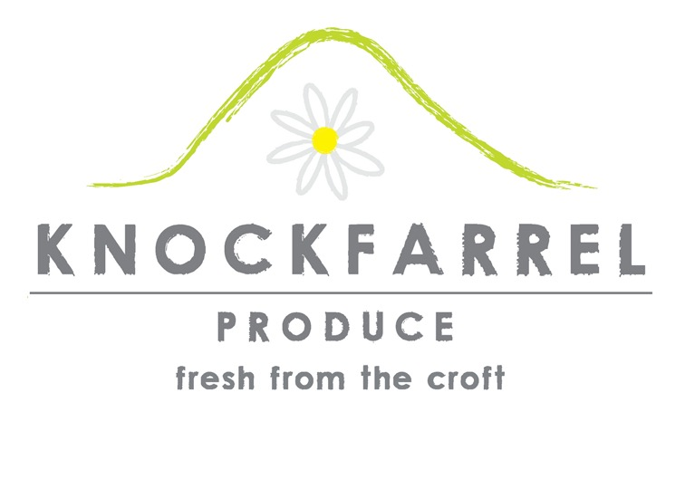
Knockfarrel Produce

Slide 7
KN

Slide 8
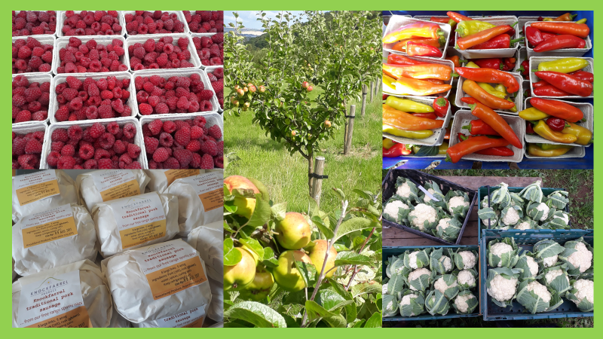

Slide 10
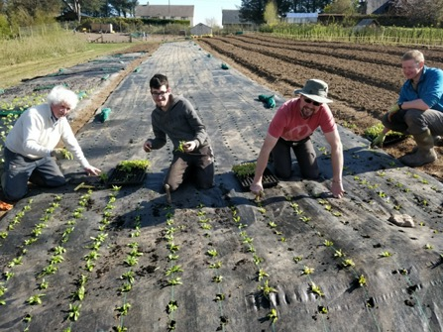
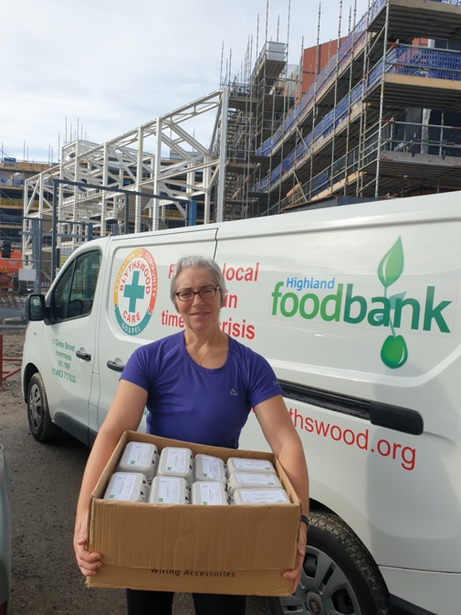
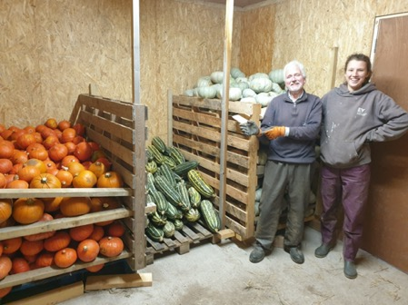

Slide 11
2021 croft outputs
 | output | Market value | Social value
Carbon negative net CO2E lock up | -72 tonnes CO2E | £0 | £9,000 (Stern)
Jobs created FTE | 3.2 jobs FTE | £0 | £16,400 (HIE, SE)
Healthy food 25% of diet base | 220 local families | £140,00 | £12,600 (ISU, CCF)
Subsidy BPS, AECS, FWP |  | £2,542
Profit |  | £228!
Total value | £180,770 | £142,770 | £38,000

Slide 12
Knockfarrel Produce CSA?
Why transition to CSA?
Routes we are exploring…
Post covid transformation
Success of soft loan from customers
Ageing crofter!
Shared management to assist new hands
Realise full social value of what we do
Customer co-operative
Social enterprise leasing business
Community land buy-out by members

Slide 13
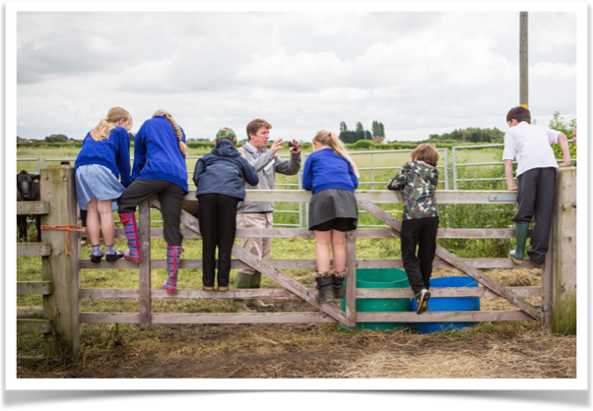
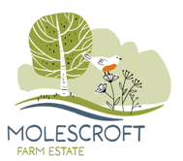
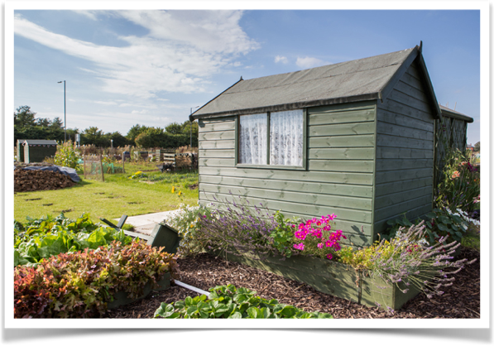
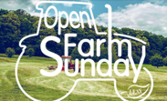
May 2014
Notes:
I came back to the family farm in my late 20’s. It wasn’t something which had interested me as I wanted to make my own way in the world. Unfortrunatley I had a bad head injury which meant I couldn’t drive so I ended up back at my parents and fell into working on the farm. I started lots of school visits as most of my friends knew v little about where their food came from so I thought it was something useful I could give back to the world. Unfortunatley a few years later I had acute liver failure – nobody knows why but I had to have an emergency liver transplant and ended up in hospital for 6 months. Once I got better I found I had a renewed enthusiasm for trying things and set up some allotments on the farm. This led me to look at what other community interaction would work – I have always felt uncomfortable with the concept of land ownership and whilst I think we do do a good job of looking after land land, I want to share it more. I read about CSA’s in the newspaper and decided to apply for a Nuffield Scholarship to study them. Partly because I wanted to go to Japan and this would mean I could!
Even when I left hospital it took a long time to get well enough to even to walk 10 yards but eventually I made it back to work AND with a renewed enthusiasm for getting things done - most people only get to have regrets on their deathbed when it is too late - I was lucky that I had a second chance. The first thing was starting OFSD - up 1,000 children visit the farm over the week before OFS. This year we already have the 3 days booked up for June 2015. Next thing I had considered doing and hadn’t due to fear of failure was some allotments on the farm. Massive success - 4 acre field of which 2.5 acres are allotments. 70 let and about 60 on the waiting list. I had expected them to be educational but hadn’t appreciated the wildlife benefits and how much people would love their plots.
I also thought about a Nuffield Scholarship - could have done it on arable but I wanted something new so thought about the allotments. I wanted to find a way to make use of the general enthusiasm for allotments and our waiting list. The allotments which had been given back had been through lack of time - working parents with little free time. I read an article in the paper about a project in Athens called Gine Agrotis - ‘Be a farmer’. This was whereby members of the public could rent 1/4 acre off a farmer and specify what veg they wanted growing. They paid at the start of the season and got a weekly supply of veg. The food was half the price of the supermarkets and the farmers were making a better return too with no risk of market fluctuations. The website was inundated with emails - 6000 members of the public signed up and 800 farmers. This was a form of Community Supported Agriculture - or CSA for short.

Slide 14
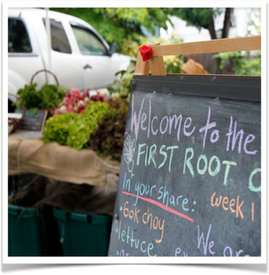
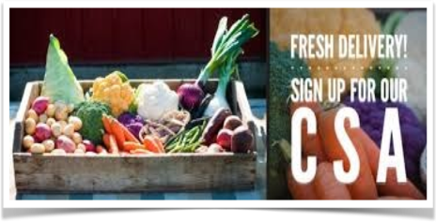
Food Chain Revolutions
Is Community Supported Agriculture
a viable alternative?
Tamara Hall
Notes:
Hello my name is Tamara Hall and today I want to tell you a story which includes some background to my Nuffield study and then my favourite Nuffield visits.

Slide 15
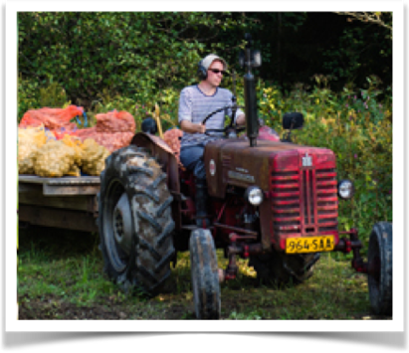
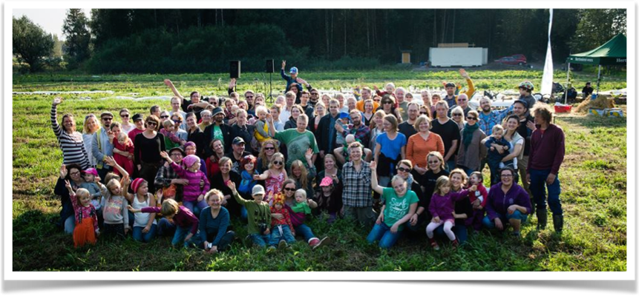
Helsinki, Finland
Ruokaosuuskunta
‘City in a field’
Notes:
I loved Finland and met a couple of lovely PHD students who were involved with this CSA - for ease of pronunciation - called ‘city in a field’. What was striking here was how fashionable it was - the CSA members were not tree huggers but forward thinking young people - we met in a bar in the middle of Helsinki. I was struck by how CSA’s need to keep accessible to every day people to succeed.

Slide 16
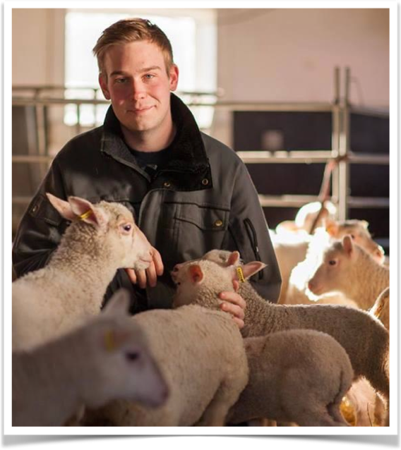
Mulhuttan,
Sweden
Adam Arnesson
Notes:
Adam was the sort of visit I expected to find from my Nuffield travels.
His twitter name is @Ekobonden, which means ‘the organic farmer’ and through twitter account he now sells all the farms lamb via meat boxes. The meat sells for less than in the supermarket but the farm’s profits are double what they were when they sold to market. He was charming and helpful, a fantastic farming ambassador who had recently run ‘@sweden’ on twitter for a week. This had further publicised what he was doing. He was essentially marketing all the meat from their farm whilst studying at University and ensuring a small farm producing high quality meat was now viable.
He put the success of marketing via twitter down to who uses twitter; people working in media and advertising who valued what he was doing and producing.

Slide 17
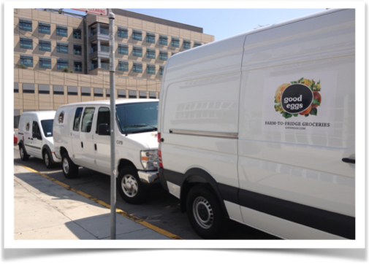
San
Francisco,
US
Good
Eggs
Notes:
America was mostly a shock of the quality of food in large Walmarts - there were some great locally owned coops but the cheaper end of the market was very poor quality almost entirely processed food. This definitely helped the CSA’s as the alternative was so poor.
One visit I thought was interesting was Fresa’s Chicken drive-thru - they had a farm which produced pasture-fed chickens. Rather than complaining that the likes of KFC wouldn’t pay enough for their chickens the set up their own successful drive-thru. It sold fantastic healthy, freshly prepared food.
I think as farmers we get confused by what the public wants. The want convenience and affordability. They often get poor quality as part of the convenience package but only because there is nothing else provided.
It was the same with the food trucks in the US - fast food doesn’t need to be processed and unhealthy, but it does need to be fast.

Slide 18
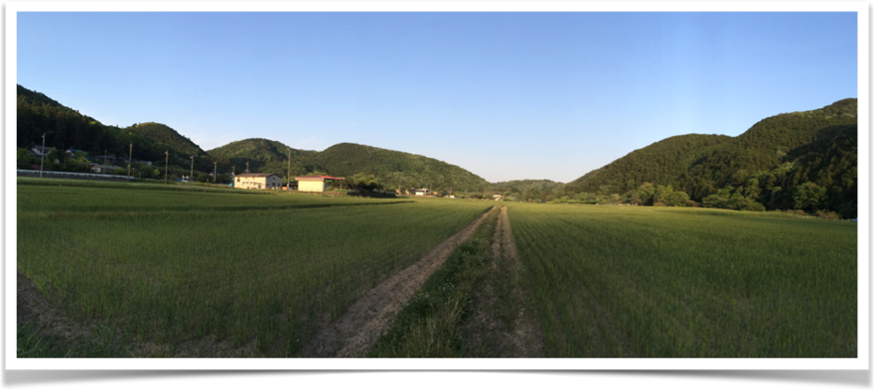
Fukushima, Japan
Teikei’s
Notes:
Started around the same time as CSAs in the US. The Japanese are very community minded however it was often the older generation who were CSA members.
Japan has many CSA’s called Teikei’s (Taykays). The word means cooperation. I was quite surprised to see how small most of the Teikei’s were after Japan and also they were often the older generation who were members. One notable point was that I visited Fukushima after the tsunami and power plant disaster - stayed in a fantastic farm stay where we were treated like royalty - even at breakfast we kept getting up and then another course would arrive! The family we stayed with were struggling with the aftermath of the radiation - all the food they produced has to be scanned and was destroyed if it had a certain amount of radiation. He had to give up growing shitaki mushrooms as they take in a lot of radiation. We watched a recording of a documentary about the issues he had suffered - Tatsuhiro and his wife had adopted a baby and the baby was taken away from them because of the risk of radiation poisoning. It was heartbreaking to watch.

Slide 19
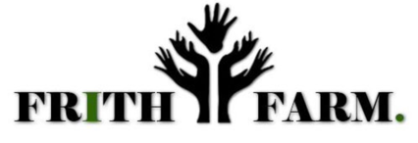
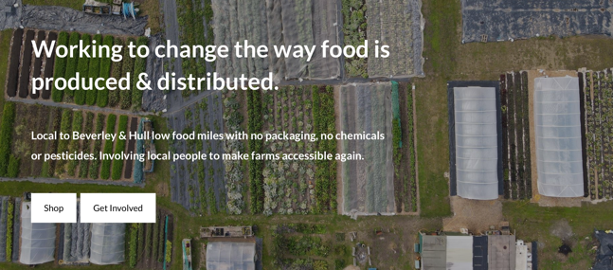
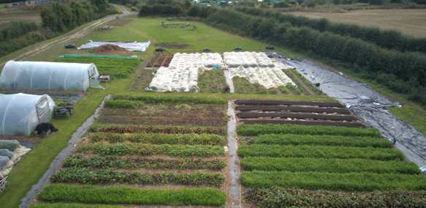
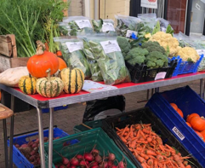
Notes:
Came back from travels and luckily met some people at a local food event in Hull who were also interested in CSA’s/veg boxed, namely Ben Allwood. Ben has since left to run their own farm, Allwood Farm in East Sussex. We are now on the third person running the farm, Reggie.
We do not charge much rent for the field so it would be more profitable even in Stewardship however since FF started we have opened a children’s nursery on the farm so it has been invaluable for the children to visit. We also pay Reggie to help with school visits and I we can do more of this when we start our next Stewardship agreement.
I was asked why we do the CSA as land owners – it is giving something back, allowing new entrants a chance to get into producing food. Pus often things I have done on the farm without an eye on the profit, such as the school visits and dog walking fields have actually been profitable – the school visits gave us a great relationship with a small local mill who came to help, along with other businesses who also helped on the day. Even the direct drilling on the main farm we thought was high risk but actually it is improving the land faster than I expected and there hasn’t been such a
To reduce inequality we need money staying where it is spent - not taken out by shareholders - local food has an important part to play.
We need more people working in agriculture, not less

Slide 20
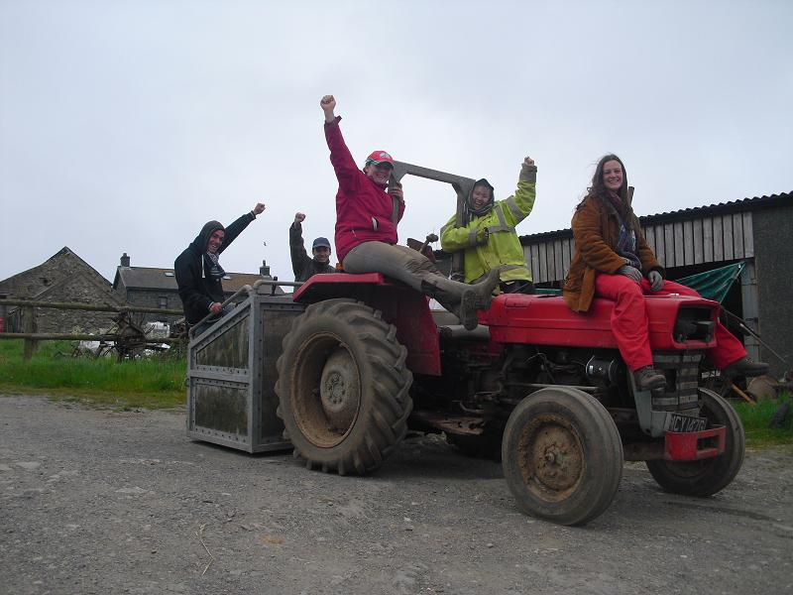

Slide 21
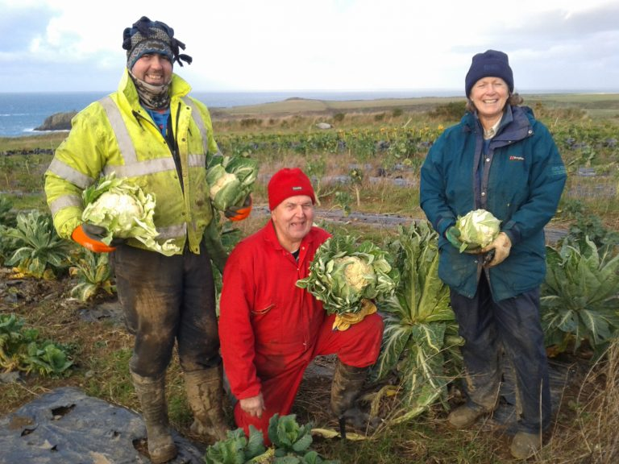

Slide 22
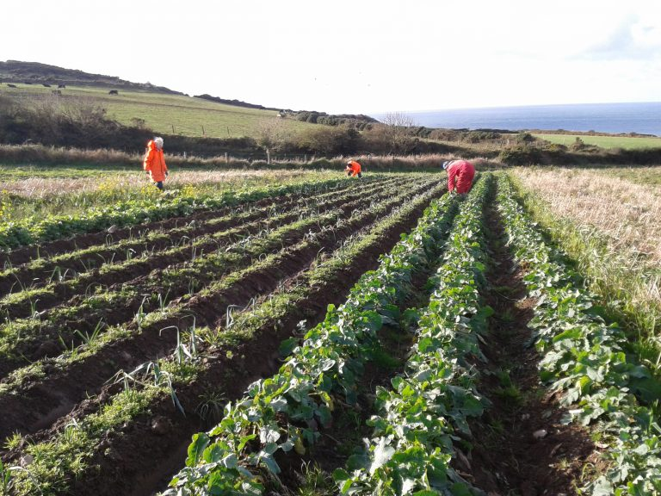

Slide 23
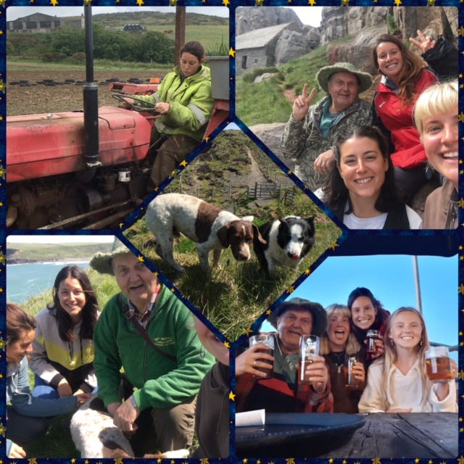

Slide 24
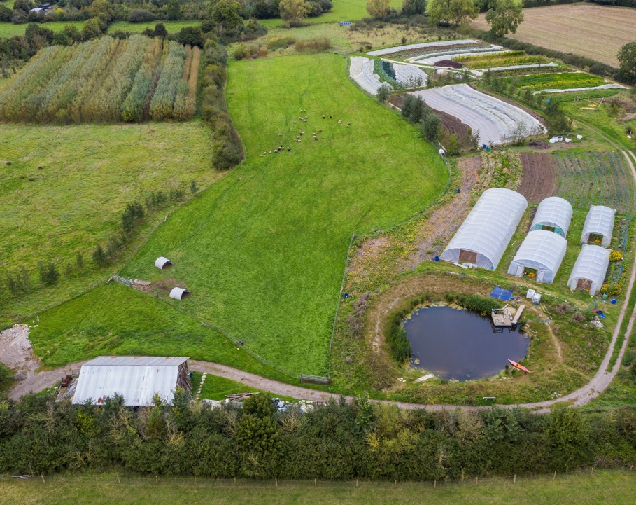
Plotgate Community Farm
Somerset

Slide 25
The Community Supported Agriculture (CSA) Network UK
Question time…
www.communitysupportedagriculture.org.uk
Notes:
Community Supported Agriculture (CSA) is an innovative farming model which provides fair, stable incomes for farmers and increases access to locally-produced food while strengthening communities and increasing understanding of how sustainable farming protects, restores and enhances biodiversity and addresses climate change.
CSA farms in the UK share the following characteristics:
They are agroecological
CSA farms are businesses whose main aim is to produce food, flowers, fibre or fuel. This differentiates them from other land-based projects e.g. therapeutic, social, educational or otherwise charitable enterprises who also distribute produce. This does not mean CSAs cannot do other work and many CSAs do successfully support educational, therapeutic or other social activities alongside food production.
Intrinsic community investment and a sharing of the risks, rewards and responsibilities of farming. This is most often through a subscription model of commitment to buy produce for a whole season rather than on an adhoc basis but can also be through labour and or ownership of the business and/or land
CSA is a hyper local direct distribution model and CSAs produce most of what they sell themselves although they may supplement by buying-in. They have an extremely short supply chain, supplying members within their locality

