Slide 1
Thank you for your interest in our story
Rev Dr Gordon Gatward
Patron
Emma Masefield
Autism Centre Manager
Pennyhooks Farm Trust

Slide 2
An Introduction to Pennyhooks
Pennyhooks Farm- Matt's Story

Slide 3
What is Care Farming?
Care for the land
Care for the animals
Care for the people

Slide 4
Who is Pennyhooks Farm Trust?
Pennyhooks
Farm
Trust

Slide 5
How does Care Farming work at Pennyhooks?
Care for the land
Care for the animals
Care for the people

Slide 6
Who is a Pennyhooks Student?
Criteria
Age range
3 strands

Slide 7
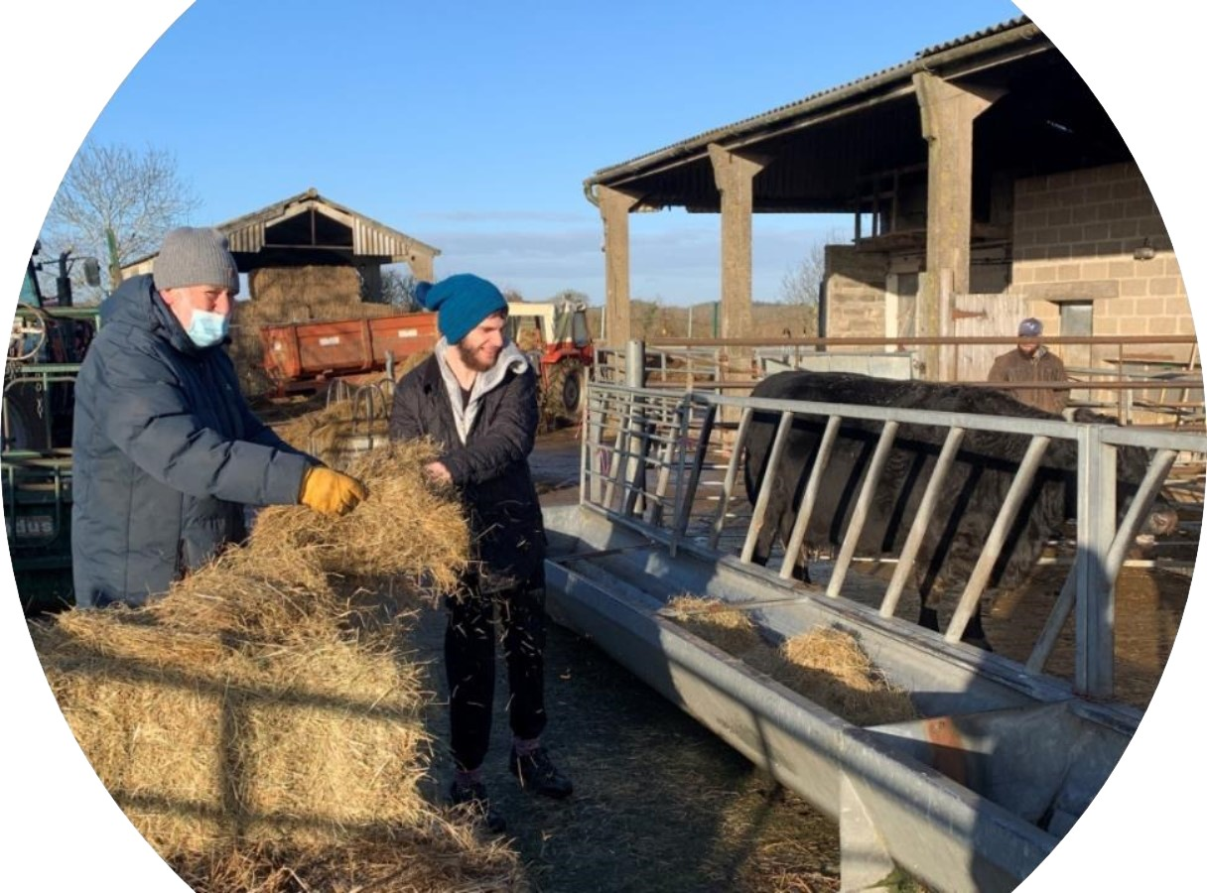

Slide 8
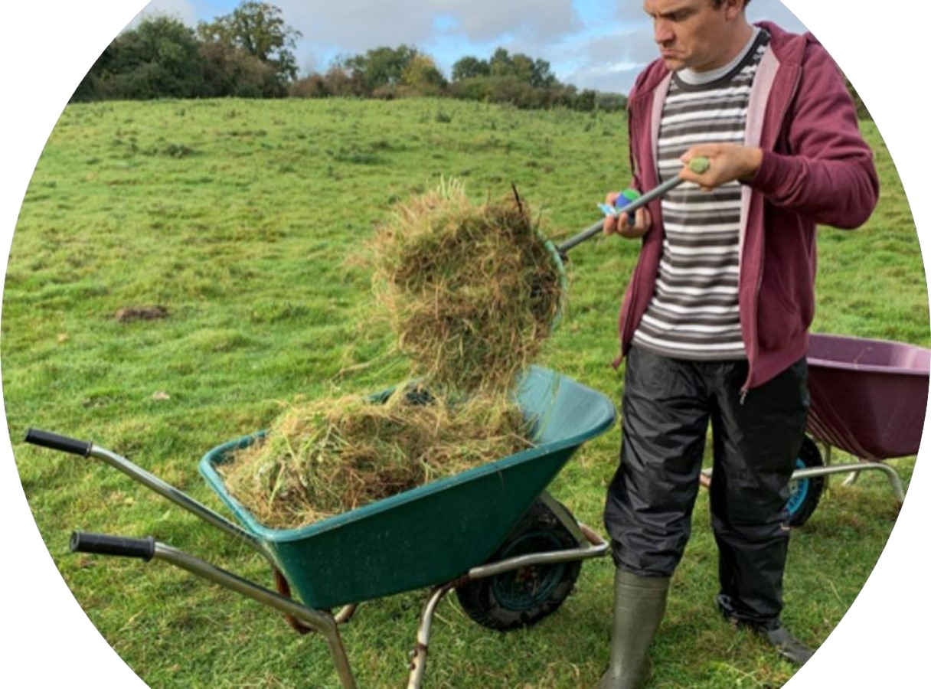

Slide 9
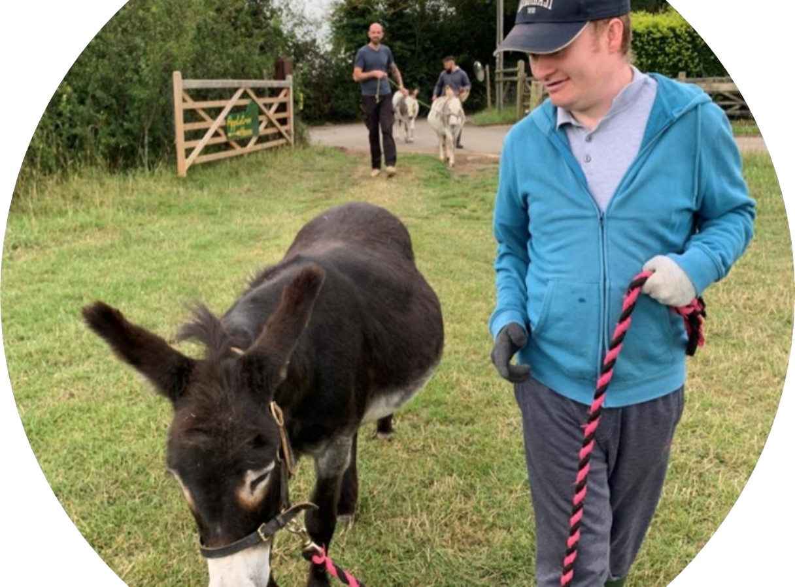

Slide 10
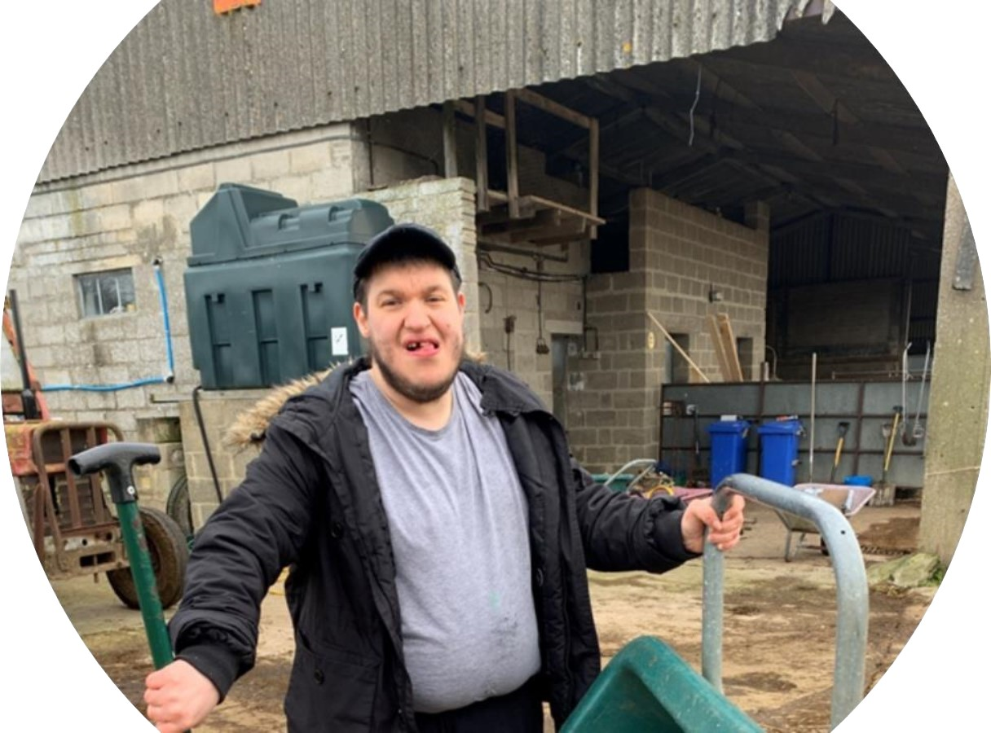

Slide 11
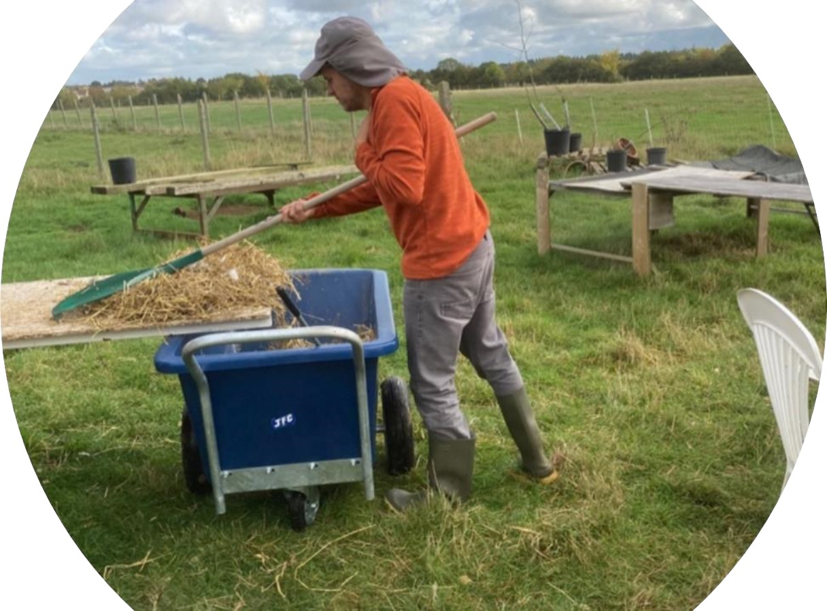

Slide 12
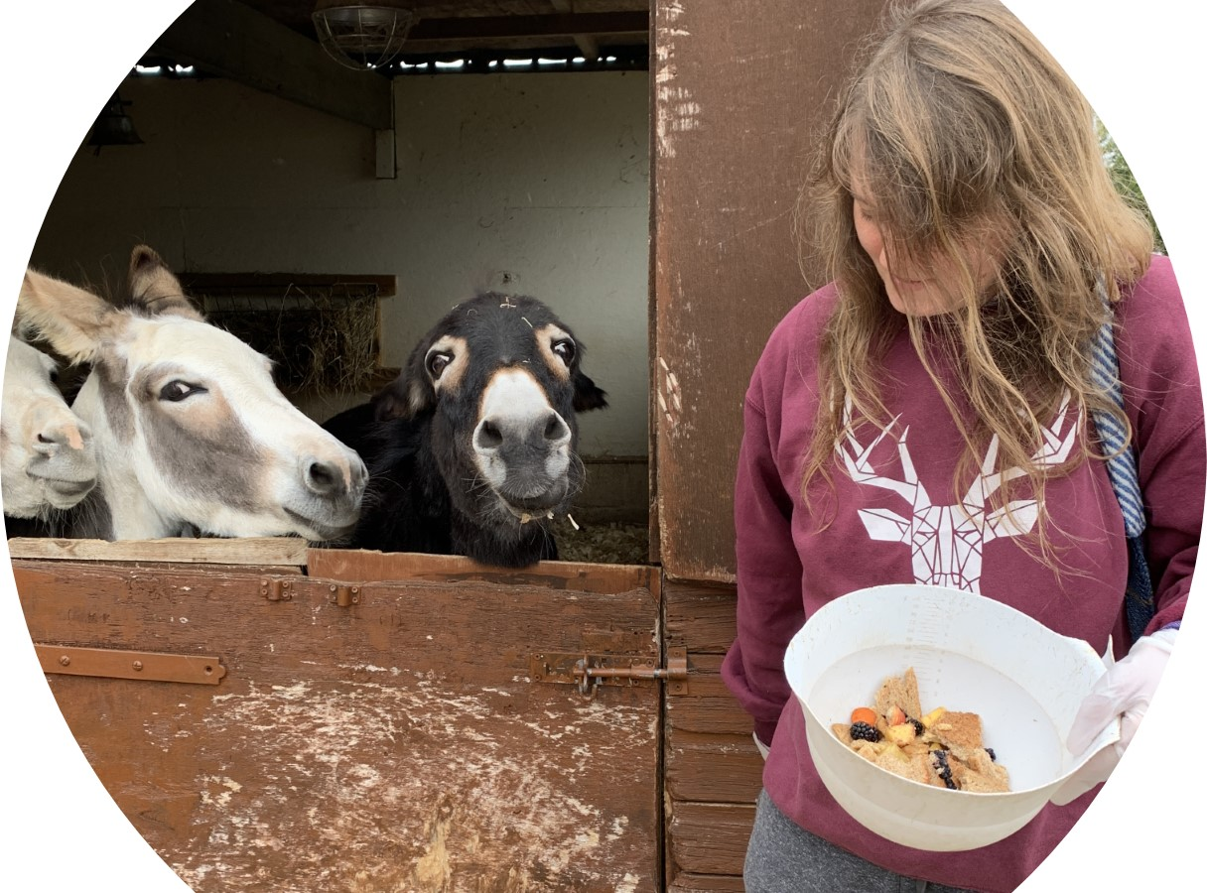

Slide 13
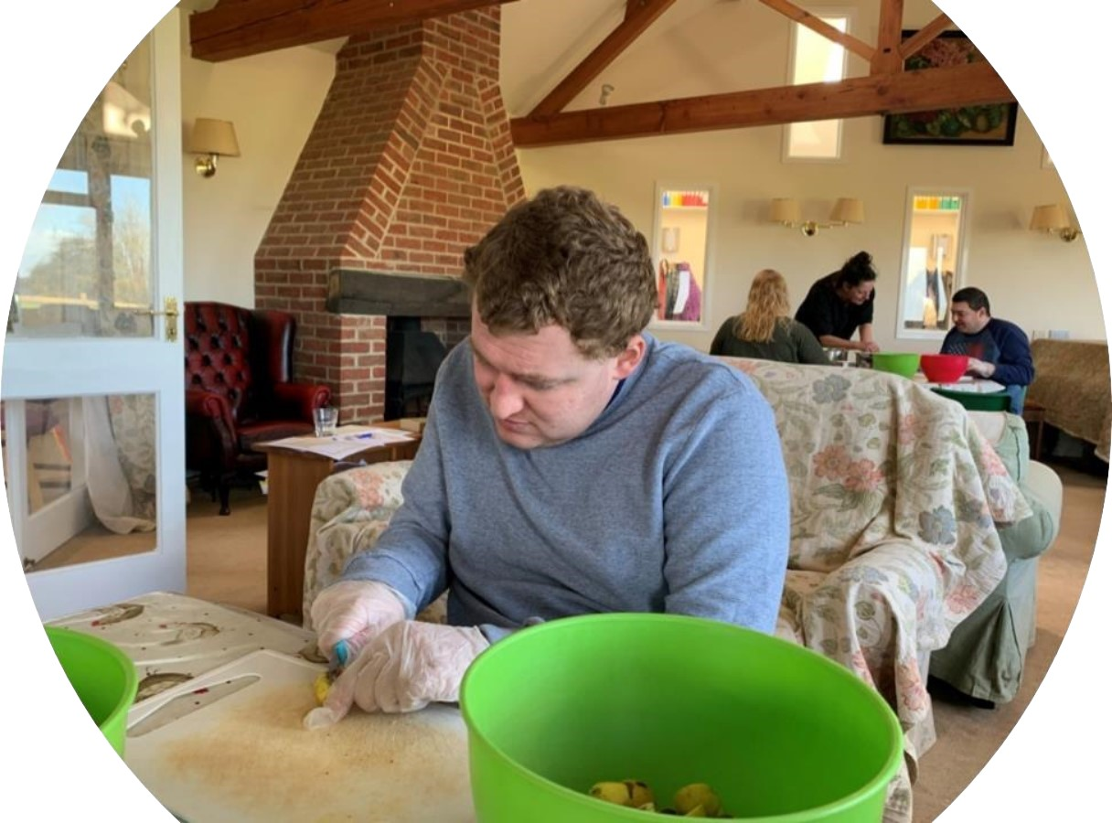

Slide 14
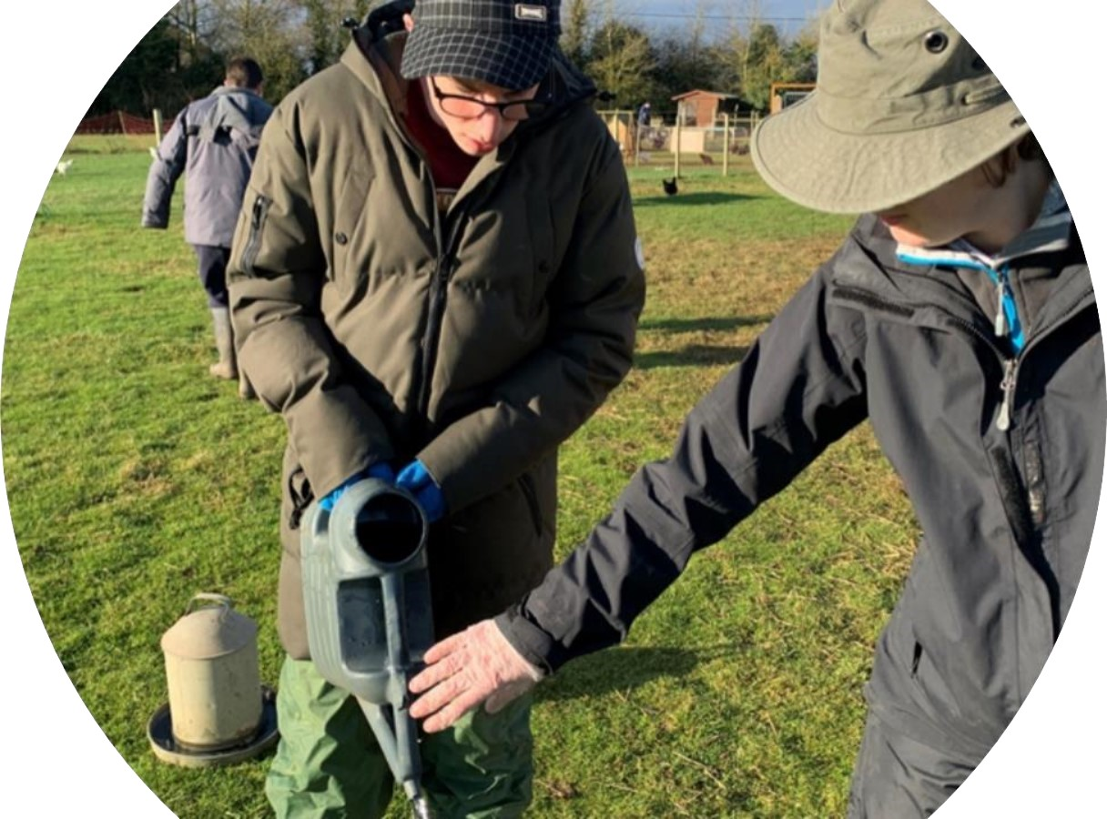

Slide 15
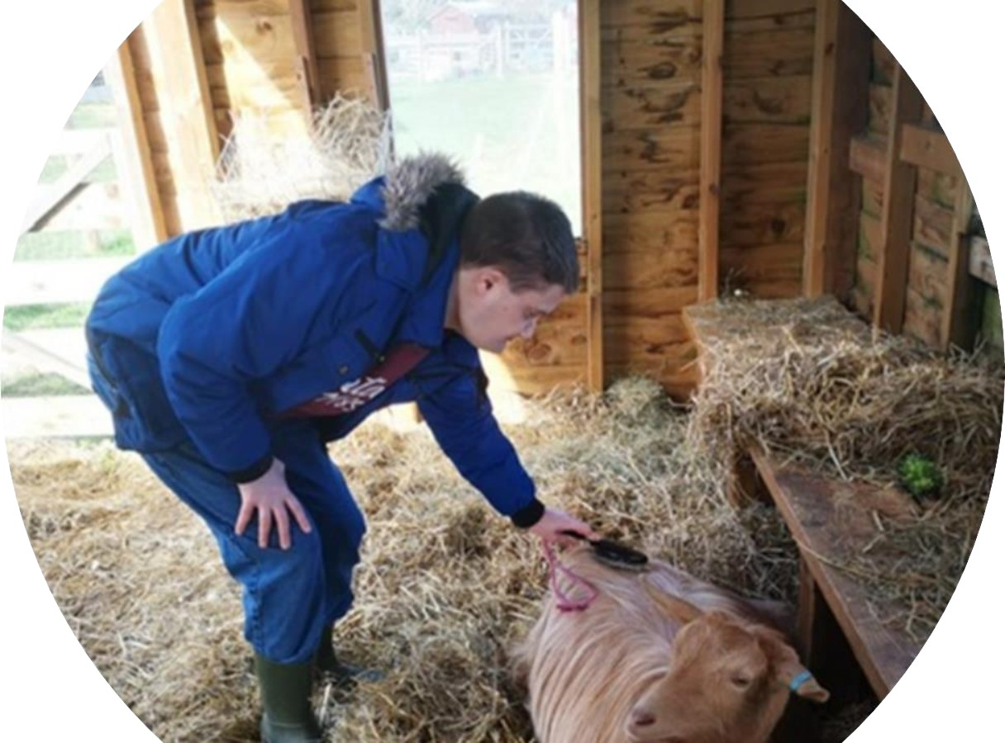

Slide 16
Pennyhooks Provides
Access to work training for those who are able to learn transferable skills that can take them into full employment.
Work opportunities that are within an environment that provides supported work with adapted facilities.
Opportunities for those who need to develop self esteem and confidence to be able to re-engage with education

Slide 17
Challenges
Recognition – of the right sort
Funding
Working with strengths and needs

Slide 18
Pre-Pandemic
https://pennyhooks.com/

Slide 19
The Future for the autism service
Regathering and Continuation of Service
Expansion of Service
Training Hub
Living Accommodation

Slide 20
The Future for Pennyhooks Farm Trust
Pennyhooks
Farm
Trust
Notes:
Maintenance and development of our natural capital
Archaeology
Ecology
Increase of board and board skills

Slide 21
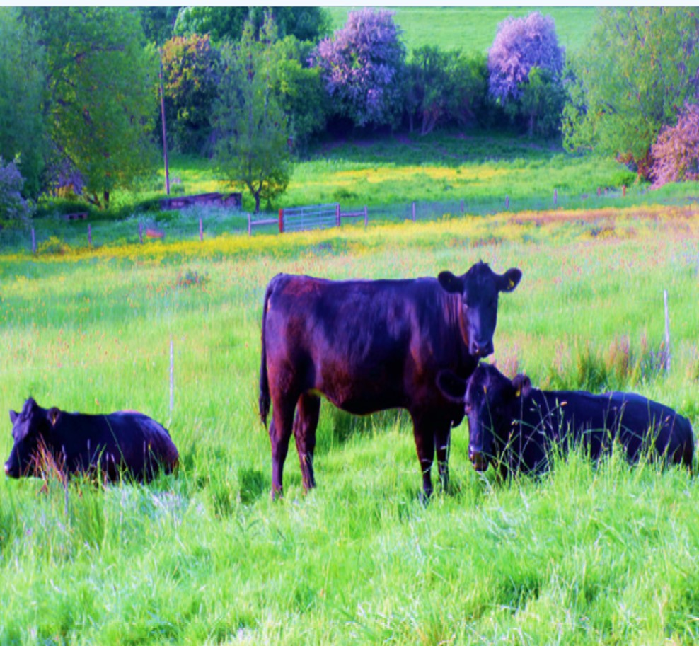
Thank you for your interest in our story

