Slide 1
Climate Friendly Sheep Farming

Slide 2
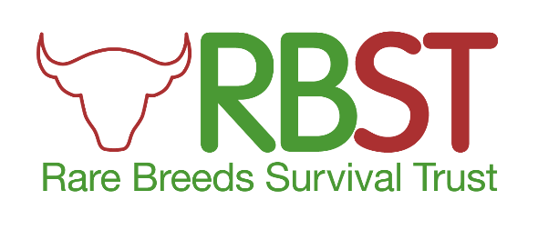
Introduction
UK sheep breeds have a significant economic, environmental and cultural impact
Although the data is complicated and incomplete, we recognise that there is a significant issue with GHG emissions from sheep farming
Therefore
- aimed to help fill knowledge gap by looking at carbon content of wool
- Identify steps sheep farmers can take to help mitigate their impact
Registered Charity No. 269442

Slide 3
Sheep farming in UK
Approx 35 million sheep
total sheep meat produced was 288,600 tonnes
national income of £2,510million
sheep farming supported 34,000 on farm jobs and 111,415 jobs in related sectors (2015 figures)
Significant diversity of breeds and attributes
Registered Charity No. 269442

Slide 4
Environmental and Cultural impacts
Provide environmental benefits in terms of improving soil structure, the removal of plant material through grazing or browsing, nutrient enrichment of the soil through dunging and urination, disturbance of the ground by trampling hooves, physically breaking larger vegetation
Significant role in moorland restoration where need control grasses so heather can rejuvenate
Strong links to improved insect diversity
Highlighting stocking density and having a grazing regime is key.
Many breeds have strong local connections, helps in creating locally focussed brands
Registered Charity No. 269442

Slide 5
THE BREEDS
Registered Charity No. 269442

Slide 6
Primitive
Celtic – long tailed came from near east through the Mediterranean into southern Britain then spread north – Soay ,
Viking – northern short tailed, came to Britain from Asia via Scandinavia and Russia Hebridean, North Ronaldsay – horned black faced
North Ronaldsay – east seaweed feet and legs of dead sea birds
Self sufficient – little trouble lambing, very hardy, with a natural resistance to parasites and disease, can extract goodness from the coarsest grasses and vegetation
Also economic, tastes like game well flavoured low in saturate fats than modern breeds though smaller than other breeds smaller portions satisfy
Registered Charity No. 269442

Slide 7
Registered Charity No. 269442

Slide 8
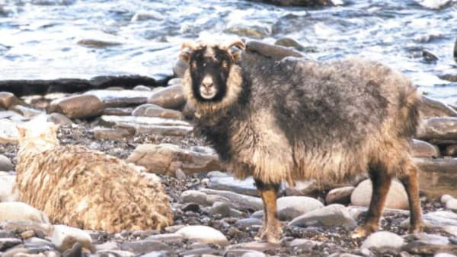
Registered Charity No. 269442

Slide 9
Longwools
Romans brought longwools to England, having selectively bred them since at least second century BC. Very different to the little Celtic sheep, being twice the size
The Roman sheep formed a common ancestor to our modern longwool breeds
Descendants from Leicester longwool – Border Leicester, Wensleydale, Teeswater, Bluefaced Leicester
Moorland longwools – Whitefaced Dartmoor and Dartmoor
Devon and Cornwall – produced huge amounts of wool
Cotswold and Lincoln – rare ,big
Registered Charity No. 269442

Slide 10
Registered Charity No. 269442

Slide 11
Modern Breeds
Origin of modern breeds
Medieval sheep farming was highly developed and focussed on wool, but no selection or breeding. The sheep were made up of types, rather than breeds.
Breeding becomes more significant in 18 Century to meet the need provide meat for the emerging industrial towns.
20 Century sees the introduction of imported breeds
Modern breeds
Hill Breeds - Welsh Mountain (several types), Swaledale, Scottish Blackface, Cheviots, Rough Fell, Dalesbred, Derbyshire Gritstone, Herdwick.
Upland Breeds - Female hill breeds mated with breeds such as Bluefaced Leicester, Border Leicester, Teeswater, Wensleydale, Devon & Cornwall Longwool.
Lowland Breeds - Texel, Suffolk. Charollais, Clun Forest, Romney, Oxford/Hampshire/Dorset Down.
Registered Charity No. 269442

Slide 12
Sheep Breeds – takeaways
We have a very diverse variety of sheep, with different origins and histories
The original groups have been improved to create different breeds to meet different needs.
These breeds are adapted to different locations and altitudes and so have very different traits
This diversity needs to be acknowledged in any study of their impacts and how to address them.
Registered Charity No. 269442

Slide 13
SHEEP AND GHGS
Registered Charity No. 269442

Slide 14
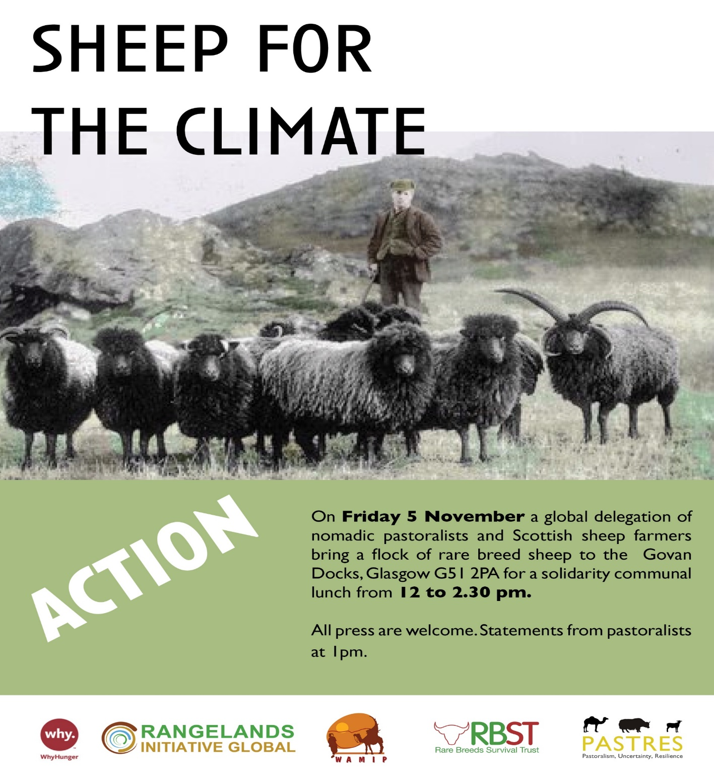
Registered Charity No. 269442

Slide 15
GHG emissions from sheep farming
Lamb production systems are associated with three main greenhouse gases (GHGs):
Methane - produced as a by-product of digestion via enteric fermentation and manure management practices.
Nitrous oxide - emitted from soil following nitrogen fertiliser and manure applications - deposition of urine and dung onto grasslands
Carbon dioxide - energy use on farm (e.g. fuel) and during production of animal feeds.
Registered Charity No. 269442

Slide 16
The information challenge
Likely that variation will be present between lowland, upland and hill sheep systems as available forage, forage quality and animal size, breed and behaviour will all be changeable, but the are significant areas of uncertainty:
Variability - environmental factors vary across different altitudes and areas of the country
Life Cycle Assessment (LCA) methodology used to measure the environmental impacts over full life cycle, including production, transportation, use and disposal, have to cater for all these variables.
Carbon storage in grasslands is also an important function supported by grazing systems but varying methodologies
GWP* vs GWP₁₀₀ accounting methods
Registered Charity No. 269442

Slide 17
GHG content of wool
RBST commissioned research from NTU – Longwood breeds, with other breeds used as a control
Provisional findings show the levels of Carbon, Nitrogen, and Hydrogen found in the fleece of various sheep breeds
Levels of carbon across current samples 44.3% - 48.5% carbon, nitrogen 11.6%- 15.1% and hydrogen 6.1%-7.3%.
Results show the level of carbon stored within the fleece can vary between individuals in a flock. A selection of animals taken who share the same grazing throughout the year on the same paddock system exhibit a variance between 45.5% - 47.7%
From samples tested the majority of fleeces composed of 47% carbon were female animals
A 3-3.9 carbon to nitrogen ratio has so far been exhibited within samples.
Registered Charity No. 269442

Slide 18
GHG sequestration by sheep farming
Sequestration implies a long term process
In agricultural systems this will primarily be through soil carbon stocks and long terms woodlands
Registered Charity No. 269442

Slide 19
Wool processing and emissions – 1
Registered Charity No. 269442

Slide 20
Wool processing and emissions - 2
Registered Charity No. 269442

Slide 21
Sheep and GHGs
Registered Charity No. 269442

Slide 22
WHAT SHEEP FARMERS CAN DO
Registered Charity No. 269442

Slide 23
What can sheep farmers do?
What can sheep farmers do:
Diet
Health
Management
Breeding
Thanks to Innovation for Agriculture, who have led the way on much of this work
Registered Charity No. 269442

Slide 24
Diet
Feed Additives – 4
Altering the fermentation process in the animal’s rumen can reduce the amount of methane being produced.
This can be done using different additives, including seaweed.
Some foods such as fats and oils do the same
Low cellulose diets - 1
If animals are fed a lower amount of cellulose, they will produce a lower amount of methane
Low cellulose grasses exist – but there is a risk metabolic acidiosis
Replacing imported soya as an animal feed – 4
Land used to grow animal feed, such as soya, creates significant GHGs.
Replacing soya with local alternatives- rapeseed, peas and beans seaweed etc - using less land would reduce this.
Registered Charity No. 269442

Slide 25
Health
Improving Health – 3
Improved health results in animals using feed more efficiently.
Sick animals tend to have poorer FCRs – particularly Neospora, Infectious Bovine Rhinotracheitis (IBR) and Parasitic Gastroenterits (PGE)
Registered Charity No. 269442

Slide 26
Management
Grass-legume mixes in pasture – 2
Nitrogen fixing legumes help reduce emissions by reducing the need for artificial fertiliser.
They also increase the level of protein being fed to the livestock.
Registered Charity No. 269442

Slide 27
Breeding
Genetic improvement – 3
Genetic selection can reduce emissions.
Reducing the amount of feed reduces the number of overall emissions.
Selecting animals for higher growth rates reduces the number of animals needed to produce a particular quantity of product.
Ruminants will reach slaughter weight more quickly, and so in their lifetime will emit less methane and consume fewer outputs.
This requires experimenting with breeding strategies and investment in data recording technology.
Registered Charity No. 269442

Slide 28
THANK YOU!
Registered Charity No. 269442

