Slide 1
t
the
(
Bridging Gap
Transitioning ‘from food aid to food trade’ that provides healthy, affordable, nature and climate-friendly food for all.

Slide 2
What is the problem?
Healthy food out of reach
The poorest fifth of UK households would spend 47% of their income on food to meet the Government-recommended healthy diet.
This compares to 11% for the richest fifth. (Broken Plate, 2022)
Climate and nature emergency
Over 70% of UK land is used for farming
30% of our greenhouse gas emissions arise from the food system
A third of the food we produce goes to waste
A broken food system
“…The people who are struggling to put food on the table are infuriated that their needs are used to justify and prop up a food system that is doing so much damage” (Hungry for Health, 2022)
Currently food that is
good for people and planet,
benefits communities and supports livelihoods is
more expensive than
food that is bad for health
and produced in ways that damage the planet.
Notes:
Previous content from slide to talk to:
Healthy and sustainably produced food is out of reach for too many people, even though given the choice many would buy food that is good for them and for the planet.
At present, this gap is reinforced by the food system that does not meet people’s needs on either side of the gap. ‘
Junk Food Cycle - added value’ makes food more heavily processed, promoted and usually less healthy.
Good (healthy and sustainable) food and good health – as well as participation in localised food systems with access to land and sustainably produced food – are becoming perceived as middle class/ for those with better income, more choice and better health, whilst low incomes and health inequalities are structurally baked in.
The gap needs to be bridged within the good food movement itself; we all share the vision of a healthy and sustainable food system for all, and now we have the opportunity to work together to find the solutions that work.

Slide 3
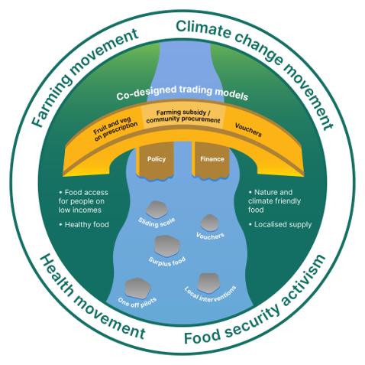

Slide 4
Notes:
Hello, ARC, We are one of the partners on the Bridging the Gap Project
We run an initiative called the Rose Vouchers for Fruit & Veg Project which uses financial incentives to improve access to healthy food to low income communities.

Slide 5
Notes:
As a charity our vision
Give people access

Slide 6
Notes:
What’s the problem ARC is trying to address. Food insecurity has been rising for over a decade but following the pandemic & now COLC getting much worse. 8 million struggling to put food on the table.
At the same time we have a diet related ill health epidemic that is a huge burden on the NHS – costing billions.
But impact on society at large is also massive, it limits life chances and increases and excacerbates inequality
Many factors but key is . Food that is good for you is three times more expensive that food that is not.
But because of food insecurity millions are now reliant on the surplus food system to feed their families. Important service but mainly packaged and processed
Not only does it remove agency but it also removes people from the food economy.
So whats our response….

Slide 7
Notes:
2014 inspired by work in US where they were using financial incentives to improve access to healthy food, we launched the RVP.
Targeted at HS families – govt benefit
Hackney – our plan was to replicate US model where it worked with farmers markets by working with Julie at GC.
but following focus groups with potential participants across london we struck a problem with FM. Not close to where low income communities resided, food very expensive and not culturally appropriate, people said that they didn’t think they would feel welcome there. However, they did tell us that traditional retail markets were places that they already used. At this point the charity pivoted.and launched with Ridley Road & GC. Surprise!
Since then we’ve been building it out and testing the approach in communities across UK

Slide 8
Notes:
Nine years on we’ve grown to 8 areas, supporting 2800 families every week
1.7 million in vouchers since
Continued with traditional retail despite numerous attempts at finding ways to link with CNFF supply chain.
Over that time we’ve gathered huge amount of evidence that shows the project works for people’s health and wellbeing.
But it all works for the local economy

Slide 9
Notes:
It’s not just health, it’s the economic benefit. Everyone should have access to a healthy, local food economy. Rose Vouchers promote and protect these important points of access by keeping money circulating in the local economy. £3.11

Slide 10
Notes:
So what have we learned in this time.
Actually, much of it reinforced things I learned nearly 20 years ago when I started working on food access in East London and where I first met Sarah.
At that time we talked about the four A’s of food access and I think they are as relevant today as they were then.
Markets are great at meeting all four of these criteria. The rest of the food economy is not so good. In fact, at times in seems to excel at the opposite.
Physical access a challenge and the UK litred with food desserts.
Prices going through the roof but the bad food so much more affordable 15 v 13 percent
cultural acceptability in supermarkets geared to the dominant culturual tastes, confusing lables and contradictory health statements

Slide 11
Notes:
We’ve always held the ambition to the square the circle in a way that we set out to do originally. We’ve learnt a lot in 8 years, but we’ve failed to make direct link between financial incentives and CNFF

Slide 12
Notes:
So our plan is to test ways of doing this
Great to be working again with Julie and GC after all these years.
We are excited to be exploring how financial incentives can be used to improve access and drive the economic development of the CNFF system.
Of course, we are partial to trialling direct financial incentives – putting the incentive in the hands of people who need the access but with the spend supporting development of the supply chain for CNFF.
We have recently started piloting a new initiative called F&V on Prescription with GPs and community health practitionairs – could we extend this to include CNFF.
We don’t want to compete with and take income away from existing retailers so maybe we should be testing in areas with porr access – food deserts.
But there are still a number of challenges that ARC and the partnership are trying to wrestle with.

Slide 13
Notes:
Definition – I’ve been interested in this conference to hear organic, agroecology, regenerative. How can we assess what supply chain is the right fit to this project?
Transitioning traditional retail markets
Cultural acceptability – celeriac!
Supply chain ready?
Sustainable funding mechanism…
Despite these, we are super excited to be working on this. It’s been a lifelong ambition to link the issues of equity and sustainability in the food system, and this project gives us the ability to test some approaches that might work and help us understand how we transition to a more sustainable and just food system.
Thanks

Slide 15
Overall aim
To help build the supply of climate and nature friendly food while simultaneously making that food more accessible to those on low incomes.
Notes:
So I thought I’d start with this statement – which is how I’ve been thinking about the aims of the BtG programme over the last year or so since the funding application was developed and subsequently accepted
- read statement
So for all the reasons that Sarah went into, this is currently - mission impossible.

Slide 16
Notes:
The current economic paradigm means it is simply not possible to bridge the gap between the price of climate and nature friendly food (proxy: organic) and industrially produced food (proxy: large scale conventionally produced and/or highly processed).

Slide 17
So the upshot is that – despite the greatest efforts and desire of food retailers and traders like Growing Communities and others us who prioritise climate and nature friendly farming – our food costs more and can be beyond the reach of many people on low incomes.
On the other hand, groups working mainly with people on low incomes struggle to provide any fresh fruit and vegetables, never mind produce that is climate- and nature-friendly.
Notes:
So retailers and traders miss out on and the opportunity to reach as wide a range of people as we would like
And food access groups and the people they serve, miss out on the opportunity to drive positive change in our farming systems

Slide 18
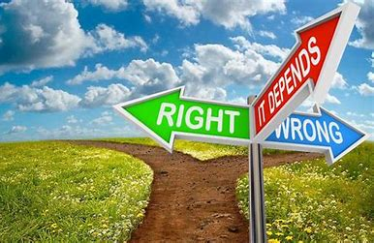
And that is a huge dilemma for all of us working in the food movement
How can we pay the farmers that are critical to all our futures on this planet a fair price for what they do and all the public goods they provide to us, while also making that produce accessible and affordable to all?

Slide 19
So, perhaps a better or more accurate way to think about the aims of the programme might be….
Notes:
To try to work out how to solve the problem and to campaign and advocate for the changes required, building the case for policy changes and fiscal measures that could come into play to support and grow the sector once the BTG programme has ended (which could be 7-10 years in total).

Slide 20
Slightly less….

Slide 21
Not easy……
Notes:
There’s been plenty of this going on so far and I’m sure they’ll be plenty more as move ahead.

Slide 22
Assumptions behind the programme
More Climate and nature friendly food supply
More people on low incomes people able to eat good food
Economic disadvantaged leads to disproportionate reliance on cheap/highly processed food
That this programme will succeed in uncovering mechanisms for overcoming the barriers to CNFF for people on low incomes
Notes:
That we need more CNFF supply for environmental reasons
That we need more people on low incomes to be able to eat good food for ethical reasons
That people who are economically disadvantaged are disproportionately reliant on cheap/highly processed food and are more likely to be malnourished as a consequence. Ethically that’s not great but it also has a public health cost.
That this programme will succeed in uncovering mechanisms for overcoming the barriers to CNFF for people on low incomes – focussing on the capacity of those who are economically disadvantaged to afford CNFF food but also on their opportunity to access and to cook CNFF or indeed any fresh food.

Slide 23
We are looking to run a series of pilot projects that will enable us to
explore those barriers of price, access and capacity
enable us to measure the impact of the of the BTG cash
designed in such a way that the evidence emerging from the pilot can be useful for the programme’s advocacy efforts.
Notes:
explore how to overcome those barriers of price, access and capacity
in a way that enables us to measure the impact of the of the BTG cash (environmental, social, health and economic)
Designed in such a way that the evidence emerging from the pilot can be useful for the programme’s advocacy efforts. both in helping shape the specific policy changes and fiscal measures we’ll be asking for and in adding weight and evidence to those calls.

Slide 24
Less project…..
More experiment?
Notes:
The pilots re not really about food provision now…. they are about demonstrating what could be done, if things changed.
As such, pilots could perhaps be usefully viewed as ‘simulations’ that are enabled to work by the addition of the BTG money and which are designed a bit more like scientific experiments than as projects

Slide 25
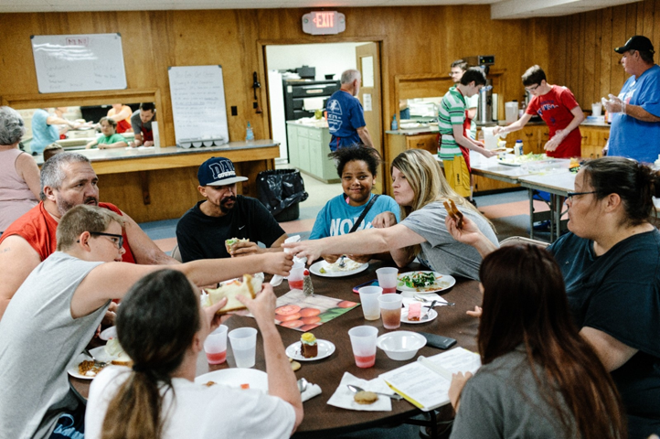
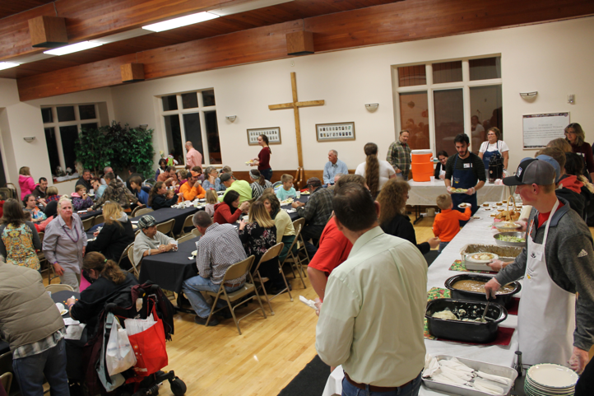
Community Procurement
Notes:
So at Growing Communities we’ve had a few preliminary ideas for potential pilots. The first one we’re calling Community Procurement. We would supply organic food from our farmers to community groups that are providing meals or ready meals to low-income or disadvantaged people. It would mean swapping in fresh food from the organic farmers in our supply chain for some of the food they are already providing through their projects. We’d pay the difference in that price through the programme, evaluate the benefits and advocate for how this could be paid for longer term.

Slide 26
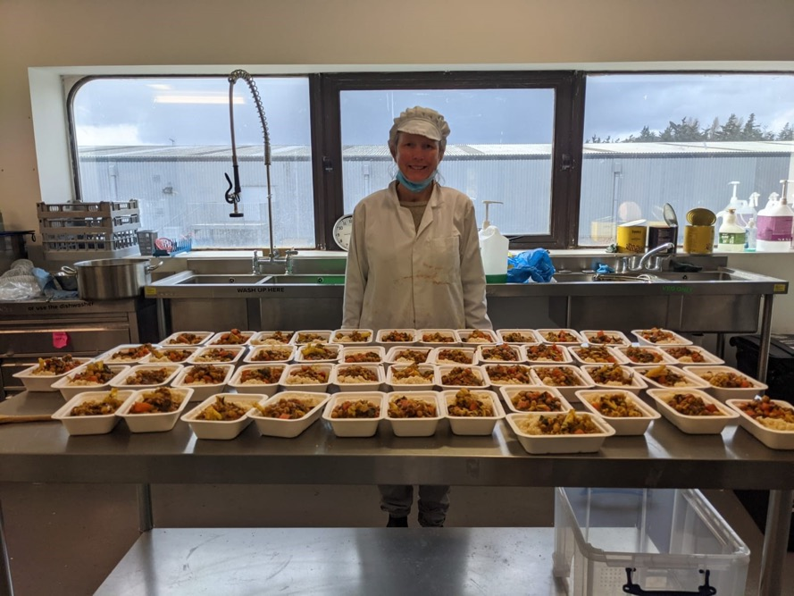
Solidarity Seasonal Ready Meals
Notes:
We’re also thinking around the idea of ready meals – with a low cost option subsidised by Bridging the Gap and a standard priced option sold via our farmers market in Hackney. We ran a small covid related project in Dagenham which provided low income households with a ready meal, the ingredients to make that meal, recipe cards and on on-line cooking demo so we’re building our thinking around that.

Slide 27
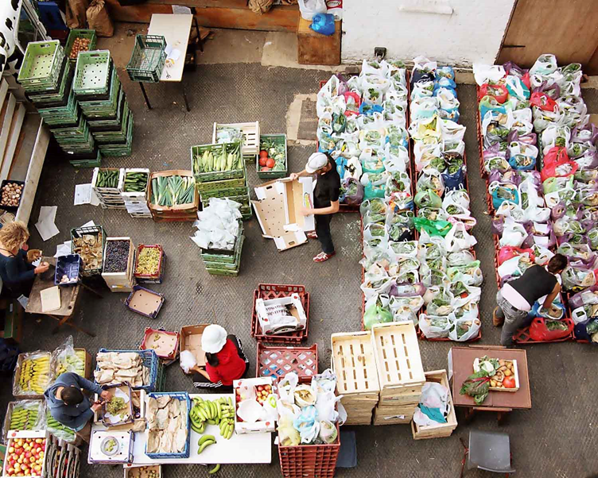
Box scheme leavers’ incentive:
Notes:
We’ve noticed - as I’m sure many other box schemes have – that the number of people leaving the scheme due to a 'change of financial circumstances' or 'can no longer afford’ is rising.
I was wondering if we could target those leaving the scheme and offer them a BTG discount in return for data and cooperation and build a potentially interesting pilot around that.

Slide 28
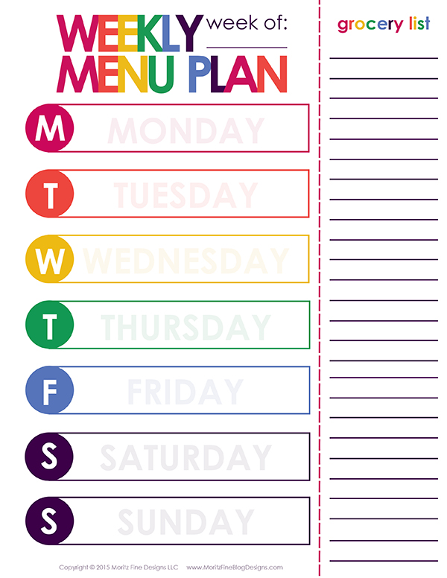
How much would a weekly CNFF menu cost?
Notes:
How much would a weekly CNFf diet cost? Work with eaters/families to devise a series of menus for say 4 different weeks. Cost it then test it. Then feed the results into a campaign for Universal basic income or into the welfare debate, or into the healthy start/food voucher debate or even into a 'rationing for the climate emergency type campaign’. Just some ideas.

Slide 29
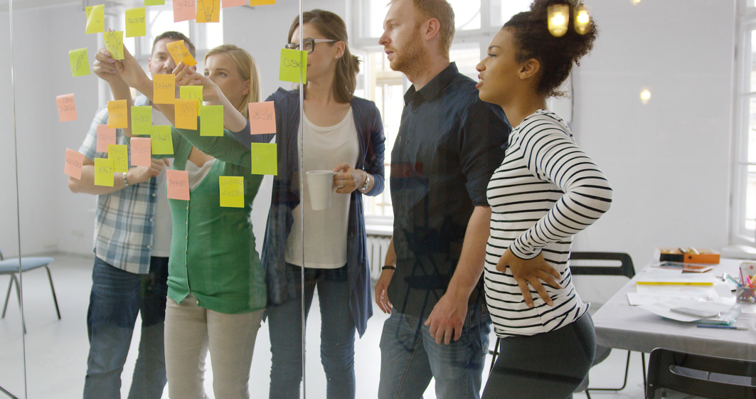
Work together to design and co-produce pilots
Notes:
Hannah and I are working on plans for a ‘design sprint’ starting later this month. The idea is to bring together a group of people with expertise and lived experience to help us to design our pilot. We may well end up merging or rejecting some of these ideas or come with some completely news ones – so I’m very much looking forward to that happening and excited to see what will emerge. .

Slide 30
Notes:
Before I finish, I wanted to have a very quick look at some of the policy and financial interventions that might emerge from this whole process and which the BtG programme could be advocating for in the future. And its worth noting that some of these policies are already being campaigned for so it would be more a matter of the programme adding voice and weight to those efforts.

Slide 31
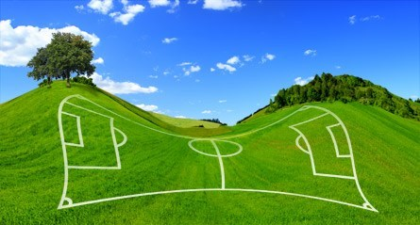
Notes:
All these policy suggestions are broadly related to a ‘levelling the economic playing field’ approach, aiming to reduce the price differential between industrial food and climate and nature friendly food.

Slide 32
What policies and financial interventions might fit the bill
Those that recognise and reward ‘public goods’
Public subsidies that reward health and environmental benefits of sustainable food production through ELMs and other mechanisms.
Costs of organic certification (fees and staff time) could be paid through the public purse not by individual producers and processors.
Targets and funding could increase the proportion of organic, seasonal and fresh produce in public procurement

Slide 33
Those that ensure enterprises can no longer externalise the negative impacts of their business
Carbon taxes that would work to shorten supply chains, reduce transport and distribution along with carbon/fossil fuel dependant inputs eg artificial fertilisers, pesticide and herbicides (with associated benefits for soil health and biodiversity). It could also work to disincentivise fossil fuel use on-farm resulting in a rethink of when best to use heavy machinery and automatization.
Regulation, incentives or taxation designed to reduce food waste and packaging that could lead to shorter supply chains and an increase in seasonal production and consumption.
Regulation and incentives to widen supermarket sourcing specifications that could lead to reductions in waste

Slide 34
Consumption side measures which recognise the health costs of poor nutrition and the fact that those on low incomes need more financial support if they are to eat well and healthily
Mechanisms such as a wider roll-out of the Healthy Start voucher system, (and an extension of the listed foods to enable purchase of sustainably produced foods)
A Beetroot Bond (carrot credit?) ie monthly dividend to spend on healthy, local food as put forward by the RSA
Increases in welfare (so decent diet can be affordable)
Increases in min wage or aligning the min wage and real living wage (ditto)
Universal basic income: which enables all citizens to afford basic foundation of decent food (housing and health) is provided

Slide 35
Perhaps a hypothecated tax/levy on ‘bad’ food could be introduced ….
Processed food/Junk food
Grain fed and/or processed meat
Food packaging
Food waste
Or all of these?
Something else?
and the proceeds invested somewhere else in the system that was more useful….eg into food access

Slide 36
The Accessible Veg Project
A pilot project exploring the barriers and benefits to CSA memberships for food insecure households
Picture: SLADE FARM ORGANICS
Notes:
Reaching people on low incomes
Accessible Veg project came out of an earlier project I ran where we that those households receiving a weekly veg bag ate more veg and legumes and less meat, fats and sugars compared to the average household. Almost 30% lower carbon emissions.
Can these benefits be extended to food-insecure households?
Looked at how direct-purchase veg bag schemes could address food insecurity
Projects/research around bridging the gap

Slide 37
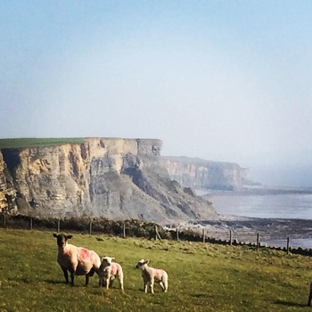
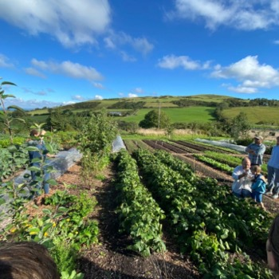
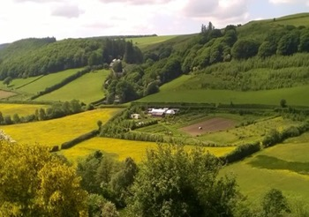
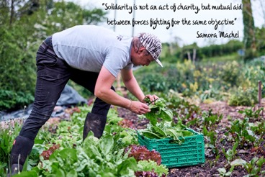
Project partners
Slade Farm Organics
Vale of Glamorgan
South Wales
https://www.sladefarmorganics.com/slade-farm-veg-bag
Ash & Elm Horticulture
Llanidloes
Mid Wales
https://www.ashandelmhorticulture.co.uk/
Henbant
Caernarfon
North Wales
https://www.henbant.org/
Glasbren
Carmarthen
West Wales
https://www.glasbren.org.uk/
Splice Child and Family Project Ltd Charity
https://www.spliceproject.co.uk/
Siop Griffiths Cyf
https://www.yrorsaf.cymru/en/Amdanom-Ni/
Notes:
Importance of co-production
-Worked with our partners to develop their approach to solidarity
-Quickly realized we needed to broaden our partnerships to include food charity organisations
-Each farm developed their own approach (and had their own unique challenges—hence the importance of co-production!)
-there are lots of ways to make veg affordable:
* membership subsidies
* gov’t or charity subsidies and other fundraising activities
* Time bank

Slide 38
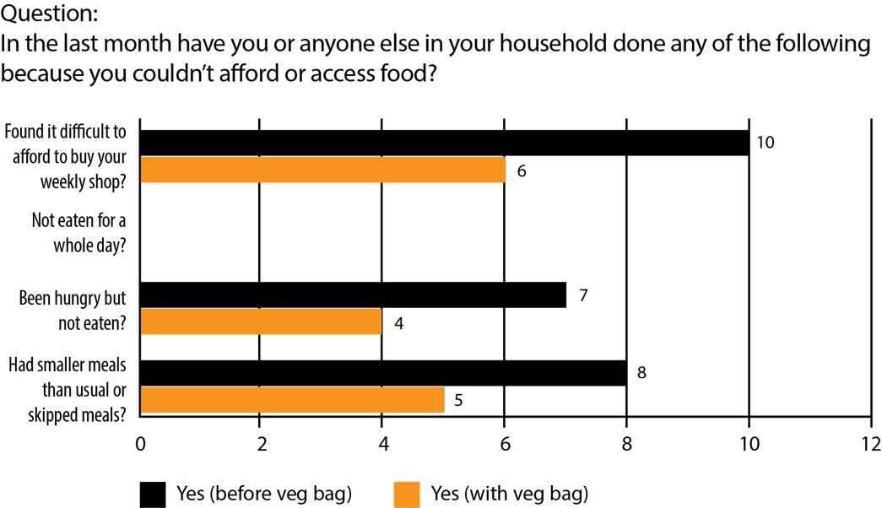
Impact of veg bags - Key findings
Food security: Receiving the veg bags improved the food insecurity of participants.
“Yeah, feels like I’m supporting the local farm. If I haven’t used all of the veg I give it to family and tell them where it comes from.”
(female participant, 37 years old)
Notes:
Results
Reduced food insecurity
Improved well-being→ importance of community, even if they didn’t actually ever visit the farm! 70% felt connected with the farm, even though 60% had never visited the farm
-Connection to epidemic of loneliness, weekly positive point of contact, enthusiasm at receiving a bag full of vegetables
-Pilot project identifies multiple non-food benefits of CSA membership, including increased wellbeing and sense of community and connection

Slide 39
Impact of veg bags - Key findings
Receiving the veg bag significantly improved the well-being of participants. In the pre and post interviews, participants were asked a short well-being questionnaire. On average, participants reported higher well-being after receiving the veg bags, which was statistically significant
Sense of community: Participants felt connected to the CSA farm and cause even when they did not visit the farm.
Notes:
Results
Reduced food insecurity
Improved well-being→ importance of community, even if they didn’t actually ever visit the farm! 70% felt connected with the farm, even though 60% had never visited the farm
-Connection to epidemic of loneliness, weekly positive point of contact, enthusiasm at receiving a bag full of vegetables
-Pilot project identifies multiple non-food benefits of CSA membership, including increased wellbeing and sense of community and connection

Slide 40
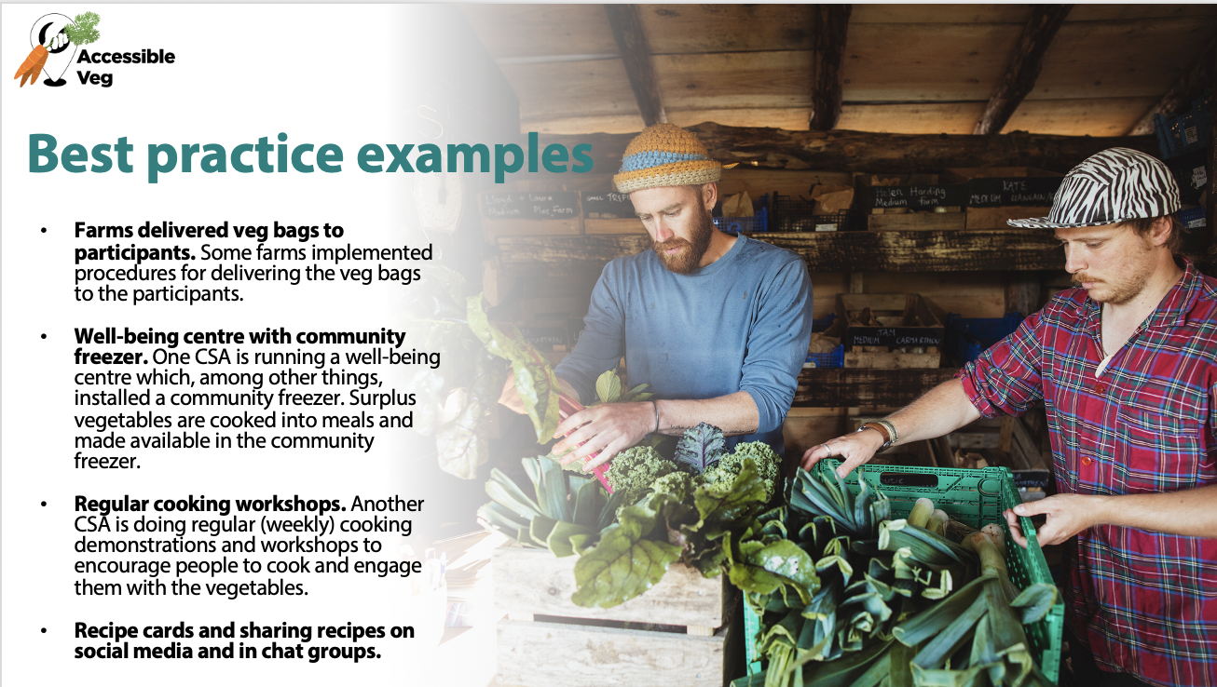
Notes:
Challenges the programme might face
Lack of information, knowledge, and confidence about using the vegetables
Lack of transport to collect veg bags as a side effect of poverty
Multi-layered mental health problems and other issues
Chaotic lives and many daily issues.
Mental health and other health problems
Stigma around being “needy” or “poor”.
How the programme can use these learnings
Importance of co-production
The benefits of relationships and connecting people to each other and to the food they eat—goes hand in hand. Building relationships can counter “imposter syndrome”—do not identify as someone who visits a farmers market or a farm and creates food aid with dignity

Slide 41
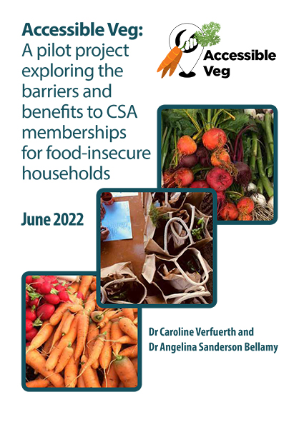
You can download a digital copy of the report at:
https://tgrains.com/accessible-veg-pilot-project/
For questions, you can contact Angelina Sanderson Bellamy at:
Angelina.sandersonbellamy@uwe.ac.uk

Slide 42
What is the solution?
Phase 1
Pilot interventions in existing supply chains in urban areas
Test, learn and adapt
Build evidence and support
Demonstrate
how to ‘Bridge the gap’
between people
on low incomes and NCFF, so everyone can enjoy a universally healthy, just and sustainable
food system
Phase 2
Embed structural change
Advocate change to policy makers
Notes:
By co-creating supply chain interventions to move from food aid to food trae
‘Bridging the gap’ entails a system-based, concerted co-created approach to grappling with tricky issues around food prices, incomes and affordability – for producers and consumers alike.
To make that possible we will:
Focus on urban areas as they are often the most complex to feed and arguably places where there are many lower income communities and divisions from food producing areas
we will test, model and quantify how better models might work with or without ongoing public subsidy or other fiscal measures. While solutions will be found through the food system, initially we will focus on existing supply chains and practitioners, where money is already flowing to see how we can stimulate and incentivize ways to bridge the gap, either from the consumer end or points along existing supply chains.
Many people in our movement are trying to make this work possible in some form – from solidarity veg boxes, voucher schemes, community shops and meal schemes – there is a lot already happening. We want to work with those motivated people and enterprises to integrate social justice and climate friendly farming.
We will take some time to work with advisors and experts to build a shared understanding of the problems, explore assumptions and challenge ourselves to come up with better, more robust solutions. This means that there are many questions to explore, and we look forward to answering these collectively with a ‘spirit of enquiry’.
Bridging the Gap will build the case for large-scale public policy support to bridge the affordability gap permanently, such as fruit and vegetable vouchers, community procurement, planet-friendly food schemes and community-owned food-growing enterprises. This approach should be viewed as an investment in climate and nature friendly food production and public health/well being, rather than a subsidy.
We will cultivate relationships with policy-makers throughout the process, at national and local authority level, helping to win understanding and commitments to action. In support of this, we will cultivate well-informed and vocal support from community activists, young people, school cooks, agroecological farmers and community workers; through asset and land managers, local authorities and regeneration teams; through to national governments, procurement and HM Treasury.
Building and bringing together the movement: We are not the only people thinking about or doing this work. This huge challenge will take a ‘family’ of organisations, citizens, interventions and will definitely include some failure. We hope that this programme will create a space to bring together all these voices, create shared vision and language and share experiences to make a stronger movement.

Slide 43
Experimental approach
Co-develop key concepts and themes with relevant stakeholders with diverse experiences
Partners propose and/or sponsor an idea for one or more interventions to ‘bridge the gap’
Refine this idea with local collaborators and the core team, based on feedback from co-advisors
Build in additional elements for customers or eaters e.g., cooking classes or farm visits
Run the intervention, following Board approval, collecting data and evidence of impact
Notes:
Investment in existing supply chains!

Slide 44
How will we collaborate?
Learning
Ensure change-makers understand, and play their part in mainstreaming solutions
Diversity
Interventions will be shaped by people with diverse and different experiences of food
Co-designing, producing and convening to catalyze the movement
Advocacy
Build the case for large-scale public policy support to permanently ‘bridge the gap’
Co-design and co-production
Define the problem, solutions and scope with experts in their field
Convening
Working parties, roundtables and other meeting of minds
Research and evaluation
Review and learning built in
Notes:
Co-design - co-design with experts to clearly define the problem, potential solutions and the scope
Convening and reaching out - to collaborate, plan and guide thematic initiatives, in a continuous process of action, review and learning.
Diversity - empowering marginalised voices to come through.
.

Slide 45
What questions remain?
The ‘problem’
What else is embedded into this gap?
How do we fully understand the gap from different perspectives?
How do we change the perception that organic is a middle-class luxury?
How do we make sure that food meets cultural, and accessibility needs?
How do we define Nature and Climate Friendly supply chains?
The solutions
How can we make community wealth building and resilience core to our transition to a fairer, sustainable food supply?
How can we ensure NCFF food is accessible to all without undermining livelihoods and ecosystem health?
What financial or policy interventions could work to Bridge the Gap?
How can we advocate for policy makers to see NCFF as a public good worth investing in?
Our movement
What spaces can we create for these questions to be tackled collectively?
Who needs to be involved or connected that are not now?
How do we involve practitioners and lived experience in the co-creation?
How can we broaden our movement to ensure low-income, diverse, urban communities can play an active part?
Notes:
Interventions are scalable
12 interventions can demonstrate changes
Finance will be an unlocking mechanism
Pilots will get NCFF to low-income families
There is NCFF produce that people want to swap into their diet
There are enough growers that want to get involved
Policy makers care and are convinced
Eaters care
Out of reach for people
Broken food system
Inequalities of wealth – becoming preserve of the middle class
Not sure about saying the movement is reinforcing the divide – divisive, not going to get as much support?
How can we broaden our movement to ensure low-income, diverse, urban communities in particular can play a more active part in bridging the gap between affordability and sustainable food, and the physical gap between communities of urban consumers and rural producers?
How can we make this food accessible to all, without undermining the need to maintain farming livelihoods and ecosystem health?
How do we put community wealth building and resilience at the centre of a transition to fairer and more sustainable supply?
Is there a role for a new form of ‘community procurement’ that could link these groups with farmers and producers

Slide 46
Questions for you
Thoughts or reflections? What are growers’ experiences of trying to reach people on lower incomes? How are traders experiencing this challenge? How can we bridge the divide in the movement? How can we build understanding and how do growers and farmers want to be involved?
Notes:
Interventions are scalable
12 interventions can demonstrate changes
Finance will be an unlocking mechanism
Pilots will get NCFF to low-income families
There is NCFF produce that people want to swap into their diet
There are enough growers that want to get involved
Policy makers care and are convinced
Eaters care
Out of reach for people
Broken food system
Inequalities of wealth – becoming preserve of the middle class
Not sure about saying the movement is reinforcing the divide – divisive, not going to get as much support?
How can we broaden our movement to ensure low-income, diverse, urban communities in particular can play a more active part in bridging the gap between affordability and sustainable food, and the physical gap between communities of urban consumers and rural producers?
How can we make this food accessible to all, without undermining the need to maintain farming livelihoods and ecosystem health?
How do we put community wealth building and resilience at the centre of a transition to fairer and more sustainable supply?
Is there a role for a new form of ‘community procurement’ that could link these groups with farmers and producers

Slide 47
How to get involved
www.sustainweb.org/bridging-the-gap
Sign up to our newsletter
Twitter: @bridging_gap_uk
bridgingthegap@sustainweb.org

