Slide 1
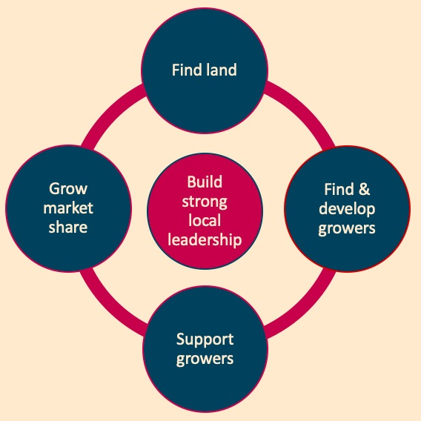
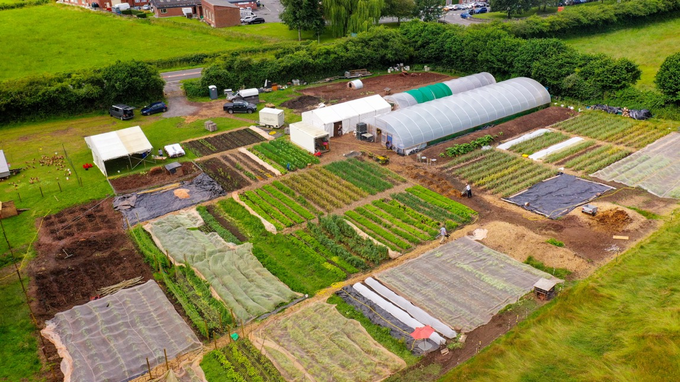
We are creating 1200 acres of regeneratively grown fruit & veg for local sale in and around Monmouthshire & the Brecon Beacons within 10 years.
OurFood1200.wales / EinBwyd1200.cymru

Slide 2
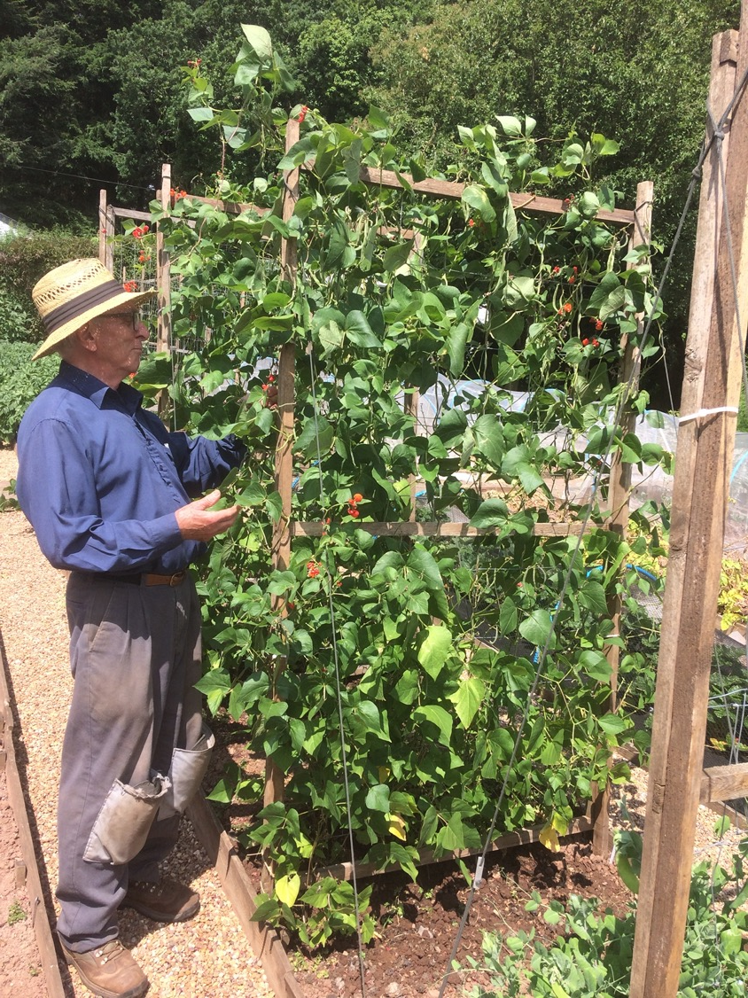

Slide 3
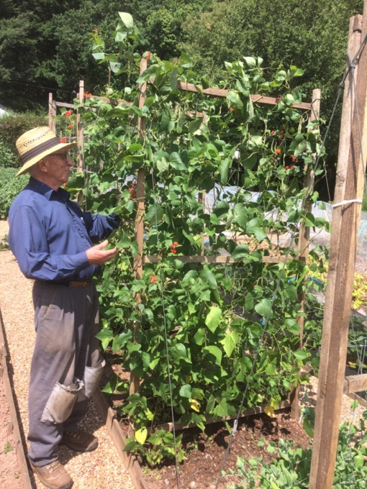
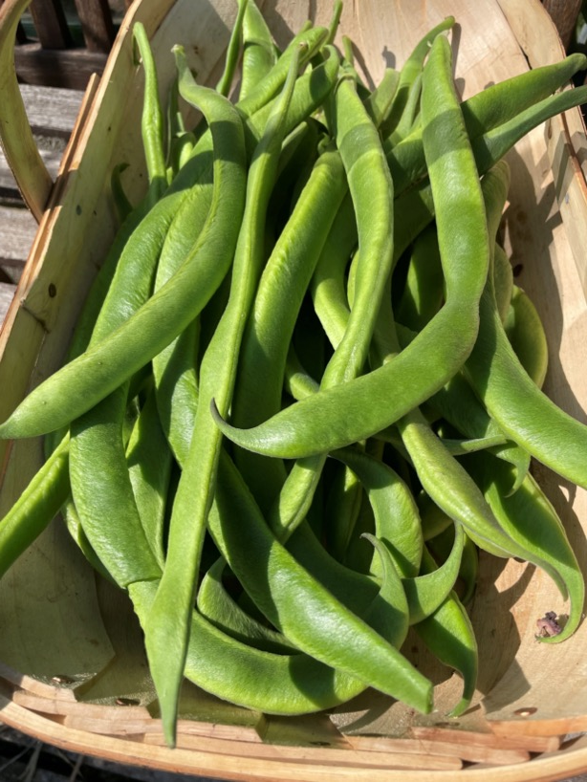
Stenner

Slide 4

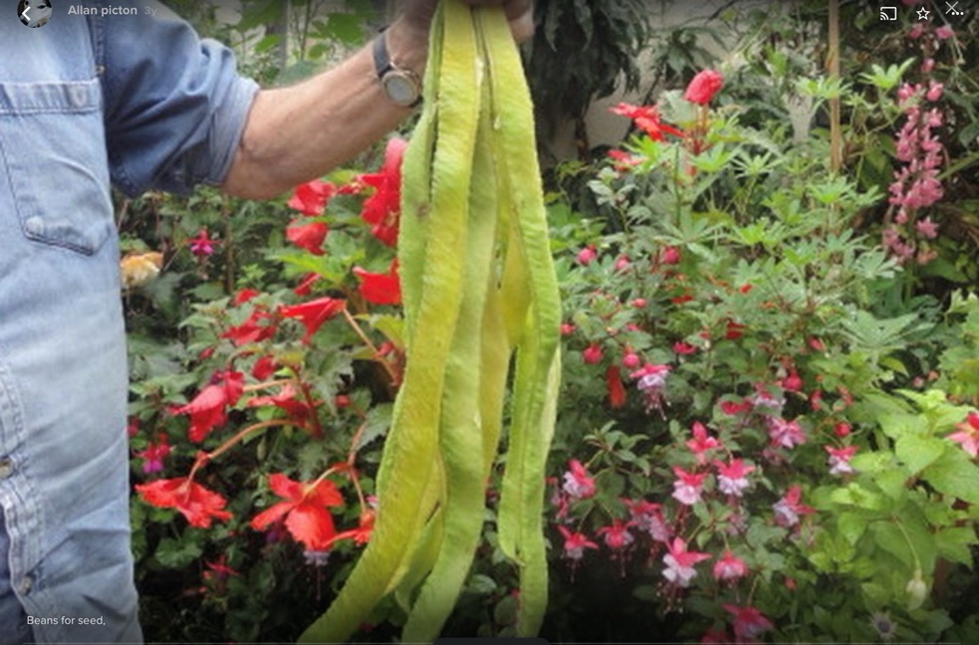
Stenner
Rhondda Black

Slide 5
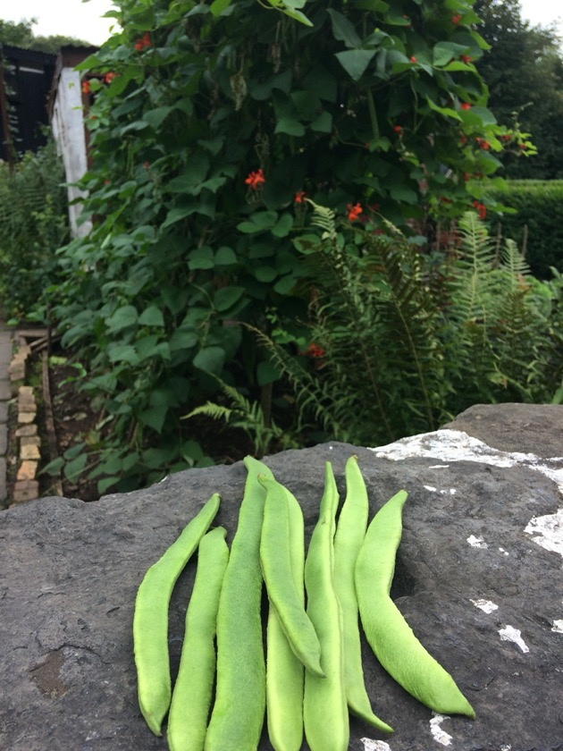
Brecon Black
Stenner
Rhondda Black

Slide 6
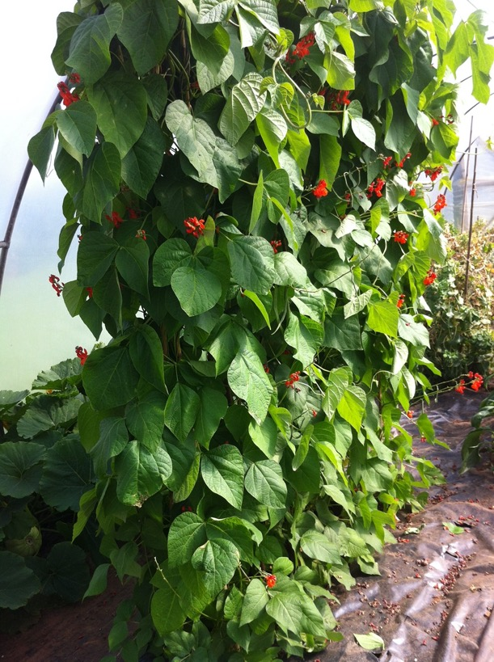
Brecon Black
Yardstick
Stenner
Rhondda Black

Slide 7
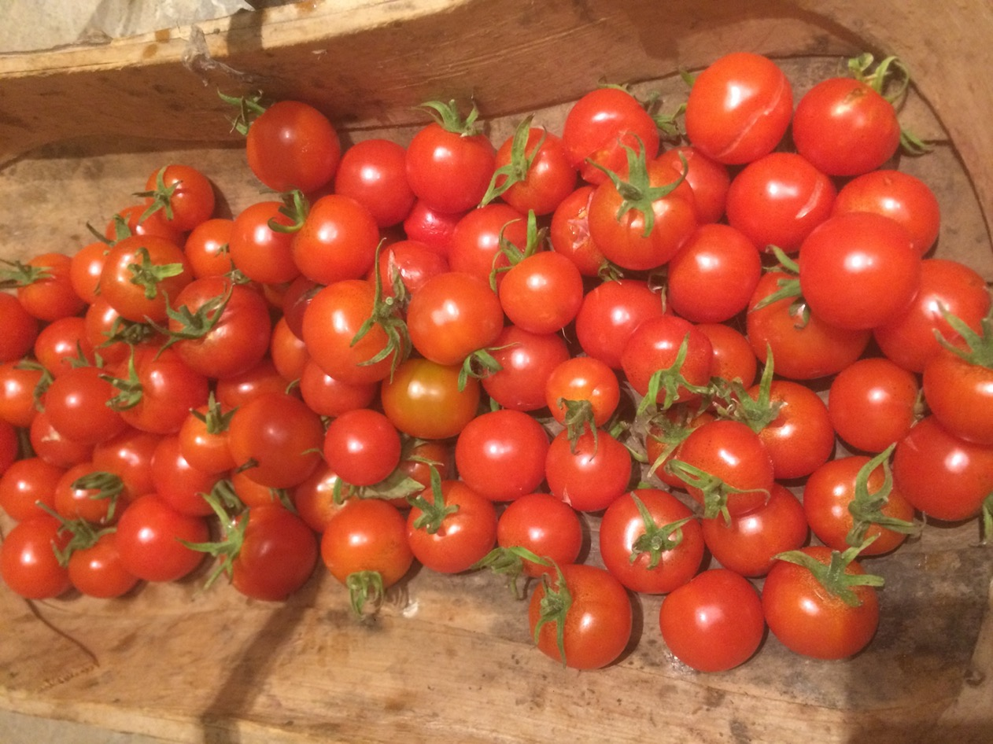
Graham’s Tom Thumb

Slide 8
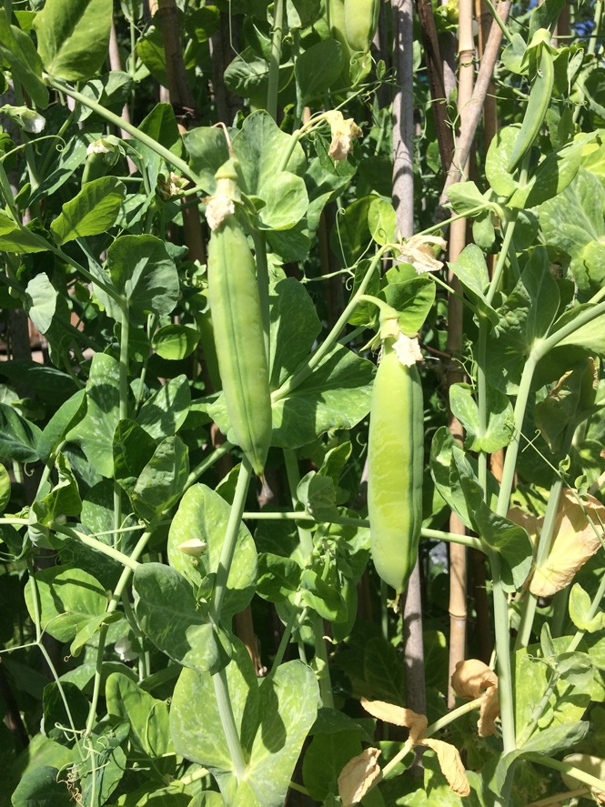
Llanover pea
Graham’s Tom Thumb

Slide 9

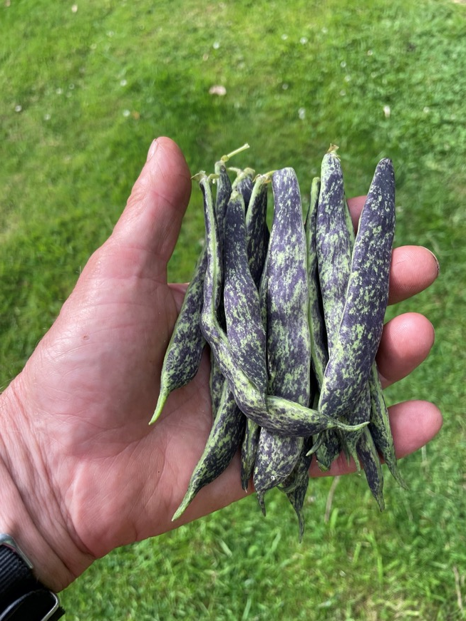
Llanover pea
District Nurse
Graham’s Tom Thumb

Slide 10

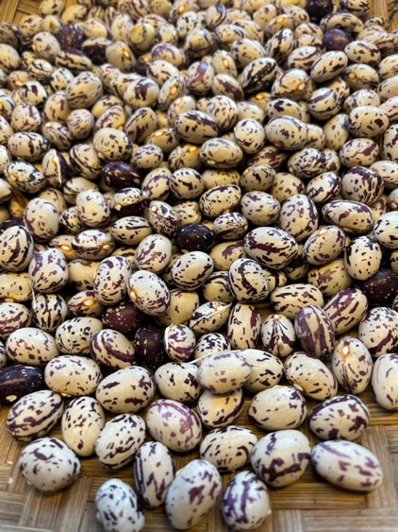
Llanover pea
District Nurse
Graham’s Tom Thumb

