Slide 1
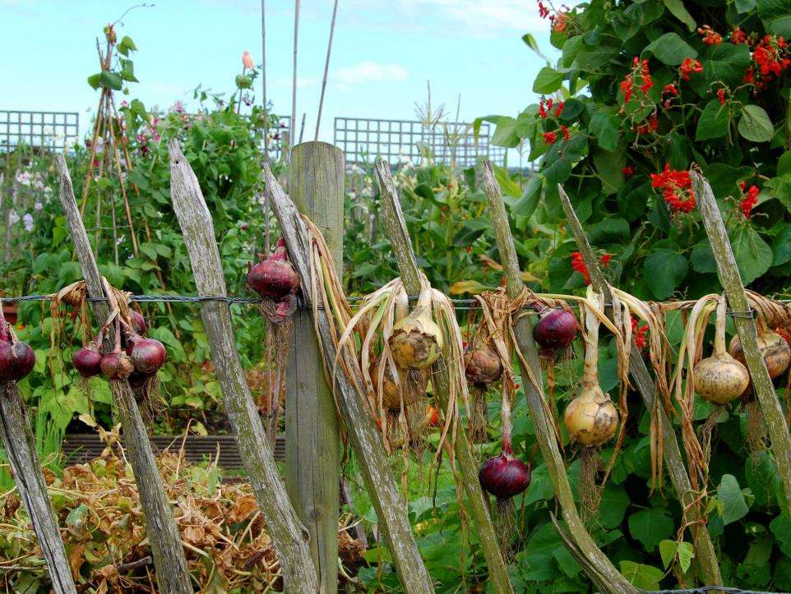
Opportunities for community growing in the UK Jeremy Iles

Slide 2
Presentation overview
Development of community growing in the UK
Where does community growing meet farming?
Recent and possible developments
www.farmgarden.org.uk

Slide 3
Population growth
Food security and sovereignty
Sustainable and local food
Climate change, water, peak oil, other issues
www.farmgarden.org.uk

Slide 4
Can we all Think globally, Act locally?
Can we re-learn simple living, respect and humanity?
www.farmgarden.org.uk

Slide 5
A national opportunity?
People should be more connected with real food
www.farmgarden.org.uk

Slide 6
Social convenience and social conditioning
are excuses for profit and bad produce
www.farmgarden.org.uk

Slide 7
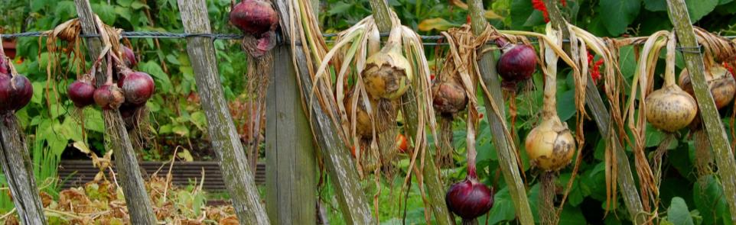
Community growing in the UK –background
Industrial revolution
Allotments, school farming and Dig for Victory
1950s - austerity and rationing
1960’s – consumer boom, optimism, away with the past, unbridled development
1970s > disconnection
www.farmgarden.org.uk

Slide 8
Community growing in the UK –
the early days
1972 – first city farm opens its gates
Rapid expansion and development of community gardens
Federation of City Farms and Community Gardens established 1980
www.farmgarden.org.uk

Slide 9
What’s it all about then?
Empowering communities
Education, play, young people
Hands on, making connections
Responsibility and care for others
Nurturing, responsive, co-operative
Proportionate – simple
A hub for the whole community
www.farmgarden.org.uk

Slide 10
Growing people
new opportunities to reach even further into the local community
become a true ‘community centre’ for learning, activity, and enterprise
developments will allow the farm to involve more volunteers
skills for young people and local adults
forge expanded links with local producers
provide new growing spaces for local people in a supportive atmosphere
www.farmgarden.org.uk

Slide 11
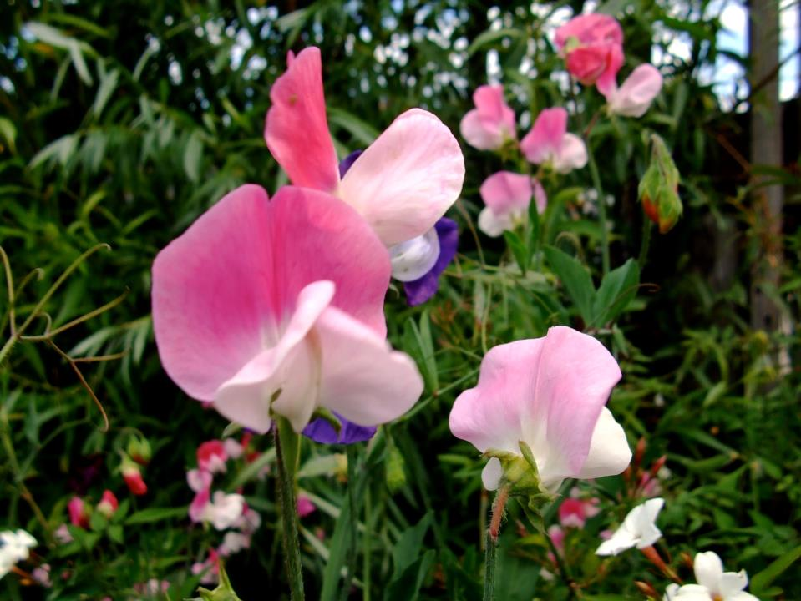
Developments since the early days
www.farmgarden.org.uk
Notes:
Help shape context – e.g. lottery, Govt policy, HRH, Care Farming, SFN, ARI etc

Slide 12

Diversification and partnership working
City farms
Community gardens
Allotments regeneration
Local Food and Community Spaces
School farms
Care farming
www.farmgarden.org.uk
Notes:
Help shape context – e.g. lottery, Govt policy, HRH, Care Farming, SFN, ARI etc

Slide 13
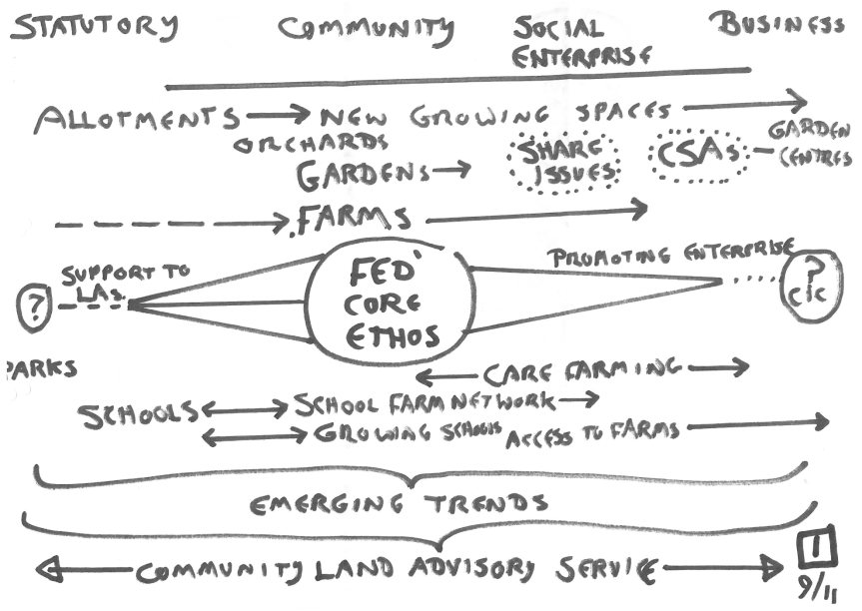

Slide 14
Recent political and economic context
Banking crisis
Budget cuts and austerity
Unemployment and pessimism
Less government funding available
Limited access to land and allotment waiting lists
www.farmgarden.org.uk
Notes:
Help shape context – e.g. lottery, Govt policy, HRH, Care Farming, SFN, ARI etc

Slide 15
Other developments
Land initiatives
Guerrilla gardening
New community growing initiatives
Community Supported Agriculture (CSAs)
Impact of social media
Austerity
www.farmgarden.org.uk
Notes:
Help shape context – e.g. lottery, Govt policy, HRH, Care Farming, SFN, ARI etc

Slide 16
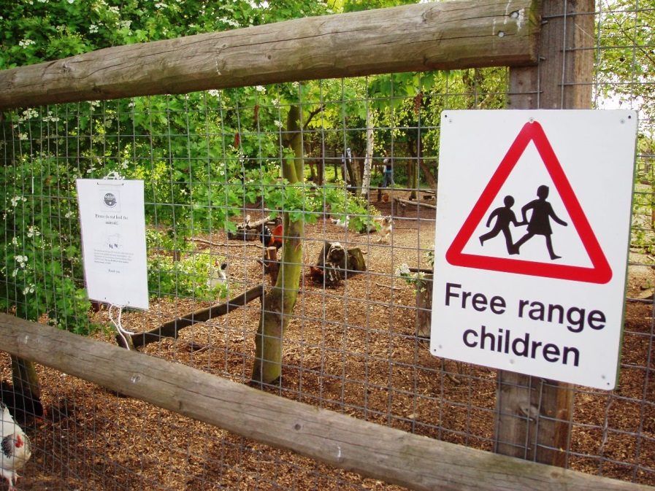
Our response
www.farmgarden.org.uk
Notes:
Help shape context – e.g. lottery, Govt policy, HRH, Care Farming, SFN, ARI etc

Slide 17
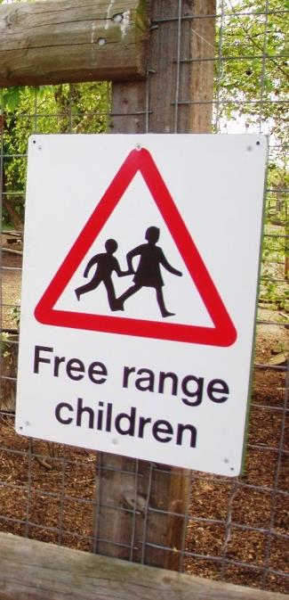
Our response
Tracking and promoting emerging trends
Co-operation and brokerage on land deals
Investigating alternative finance models - community shares, crowdfunding
www.farmgarden.org.uk
Notes:
Help shape context – e.g. lottery, Govt policy, HRH, Care Farming, SFN, ARI etc

Slide 18
Our response
Community Land Advisory Service
Impartial and collaborative
Works with community groups, landowners and land managers
Aiming to increase community access to land across the UK
Growing Together
Power to Change
Synergy - CRF
www.farmgarden.org.uk

Slide 19
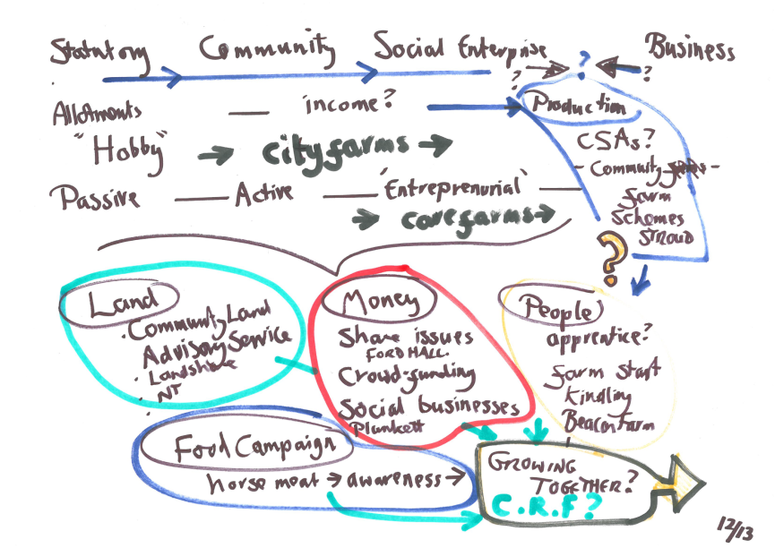

Slide 20
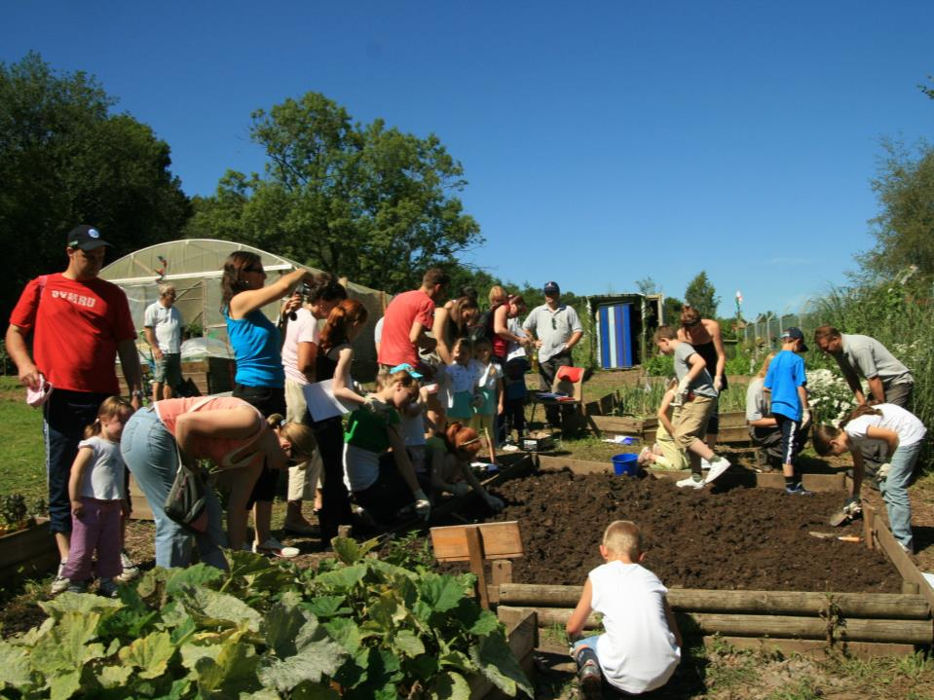
Growing Together
www.farmgarden.org.uk

Slide 21
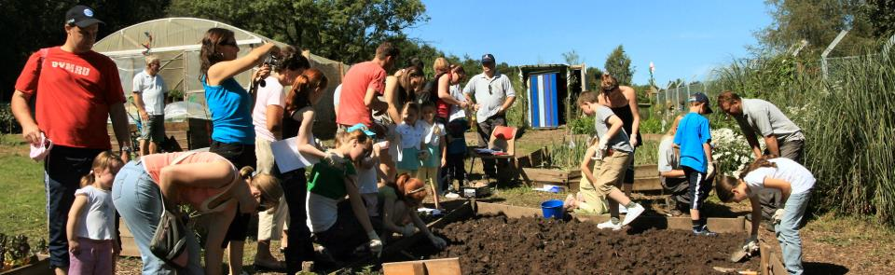
Growing Together
Reducing dependency on government funding
From passive to active
Empowering, optimistic, co-operative
Community investment and ownership
Moving to enterprise?
www.farmgarden.org.uk

Slide 22
Translating words into action
Get together
Explore aspirations and common threads
Park differences
Work together to achieve top priorities
Problem solve and bust barriers
www.farmgarden.org.uk

Slide 23
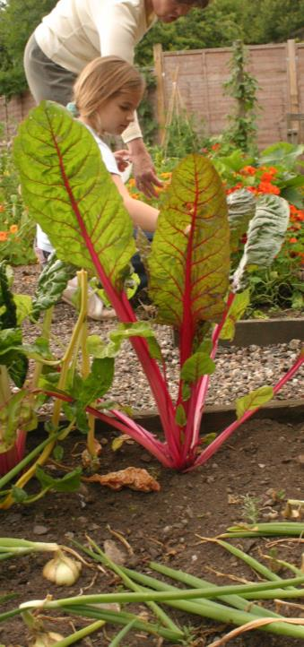
Our message
Community growing is alive and kicking in the UK
Grow food, grow together, grow communities
But can we grow more?
www.farmgarden.org.uk

Slide 24
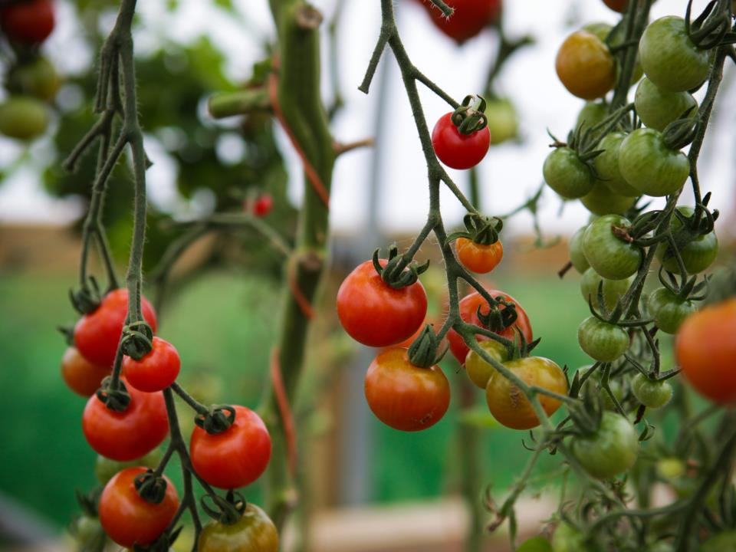
Thank you
www.farmgarden.org.uk
UK office: The GreenHouse, Bristol BS3 4NA
Tel. 0117 923 1800 Email. admin@farmgarden.org.uk

