Slide 1
Lobbying…Advocacy…Politics???
Oxford Real Farming Conference 2014

Slide 2
Lobbying = politically selling your idea
What is the appropriate level of governance for you to address?
Who is the person responsible for this brief?
Who will support you?
What is the most effective form of action?
What is/are the most effective medium?

Slide 3
Levels of government
What | Level of government
Local planning issues and land use | Local Authorities (Council…)
Allocation of grants and subsidies | Regional Government
National laws and policies | National Government
European policy (seeds, CAP…) | European Authorities
International Guidelines/policy | United Nations

Slide 4
What kind of action is appropriate?
Individual or collective?
Use of social media?
Article or press release?
Public demonstration?
Civil disobedience?

Slide 5
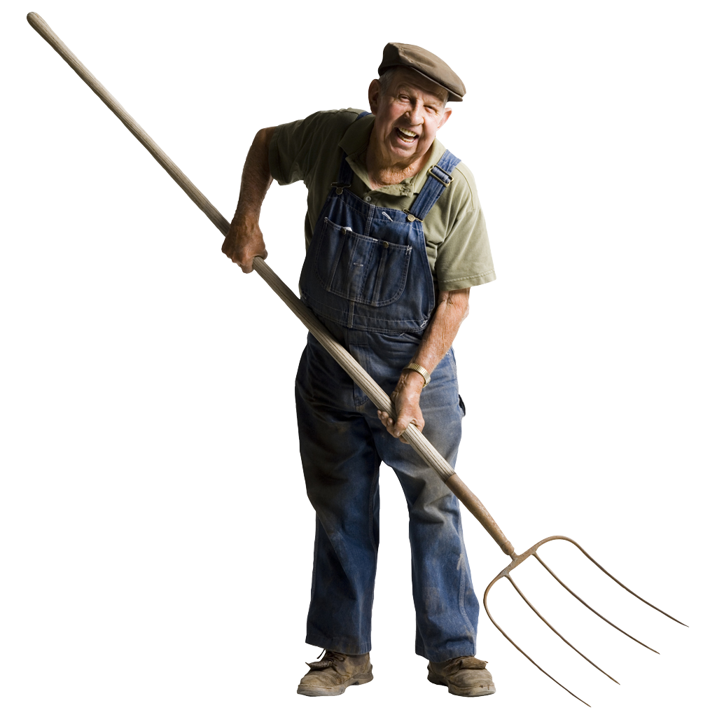
We’re lobbying the local council to ask them to resurface the road so I can drive my tractor safely

Slide 6
Tweet to the European Commissioners today!
Example tweets: Protect people and planet, #stopthecrop: reject toxic GM maize #GMO
Protect Europe’s #nature + butterflies by rejecting new toxic GM maize! #stopthecrop
Would you really give green light to a GM maize that your safety experts say will harm nature? #stopthecrop Twitter accounts of European Commissioners: @borgton @MimicaEU @JanezPotocnikEU @DacianCiolos @VivianeRedingEU @LaszloAndorEU @JHahnEU @APiebalgsEU @AntonioTajaniEU @MariaDamanakiEU @MBarnierEU @KGeorgievaEU @VassiliouEU @ASemetaEU @BarrosoEU @EU_Commission
Spread and share this action via www.facebook.com/stopthecrop

Slide 7
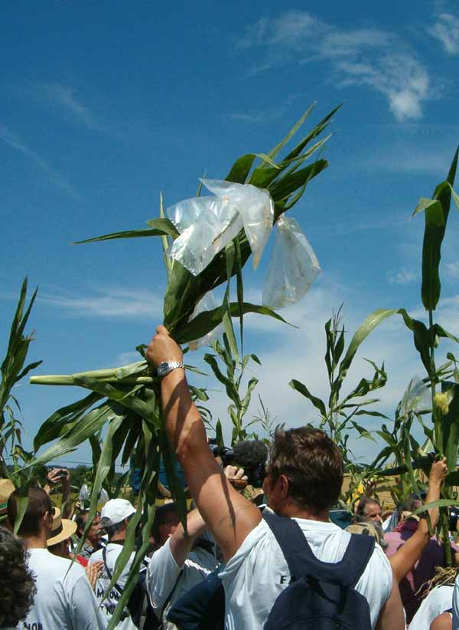

Slide 8
Advocacy: Marketing for social movements
Promoting concepts and ideas
Agroecology, CSA as an alternative form of consumption…
The importance of networks and allies

Slide 9
Tweeting Farmers
@Tweetingfarmers
A different Irish farmer each week tweeting about life on their farm! This week Sarah and William from Tynedale goat and suckler farm in Antrim. @Hillfield21
Ireland · farmersfeedfamilies.ie

Slide 10
Where and how to advocate
Parliamentary groups and lobbies
(national and European)
United Nations (FAO and CFS (Committee on World Food Security and Nutrition) via the CSM (Civil Society Mechanism)

Slide 11
Some of the CSM success stories
Global Strategic Framework
Voluntary Guidelines on Responsible Governance of Tenure of Land, Fisheries and Forests
Responsible Agricultural Investment…

Slide 12
How to link UN-level with what’s happening on the ground? A 2-way process
Constituency outreach and consultation
Using the existing documents at local level

