Slide 1
Tall Grass Grazing

Slide 2
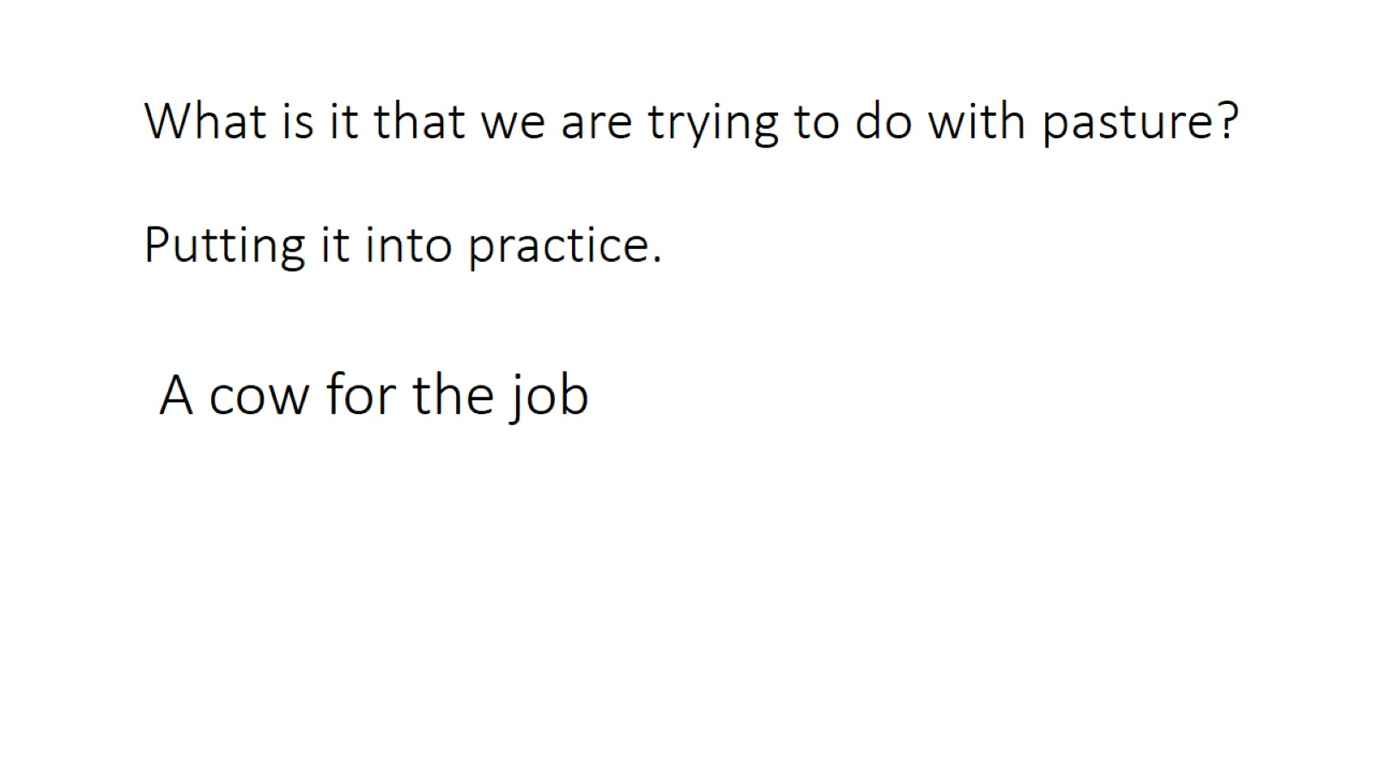
What is it that we are trying to do with pasture? Putting it into practice.

Slide 3
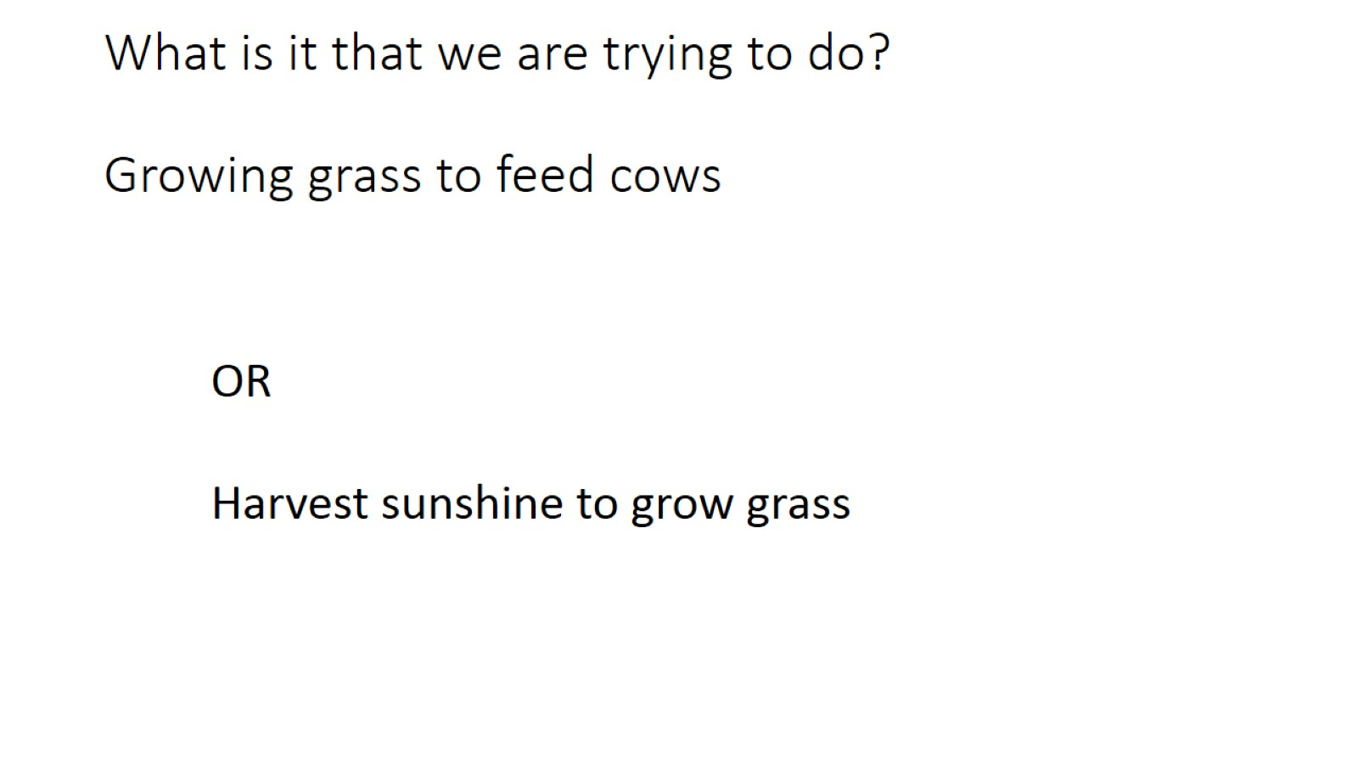
What is it that we are trying to do? Growing grass to feed cows

Slide 4
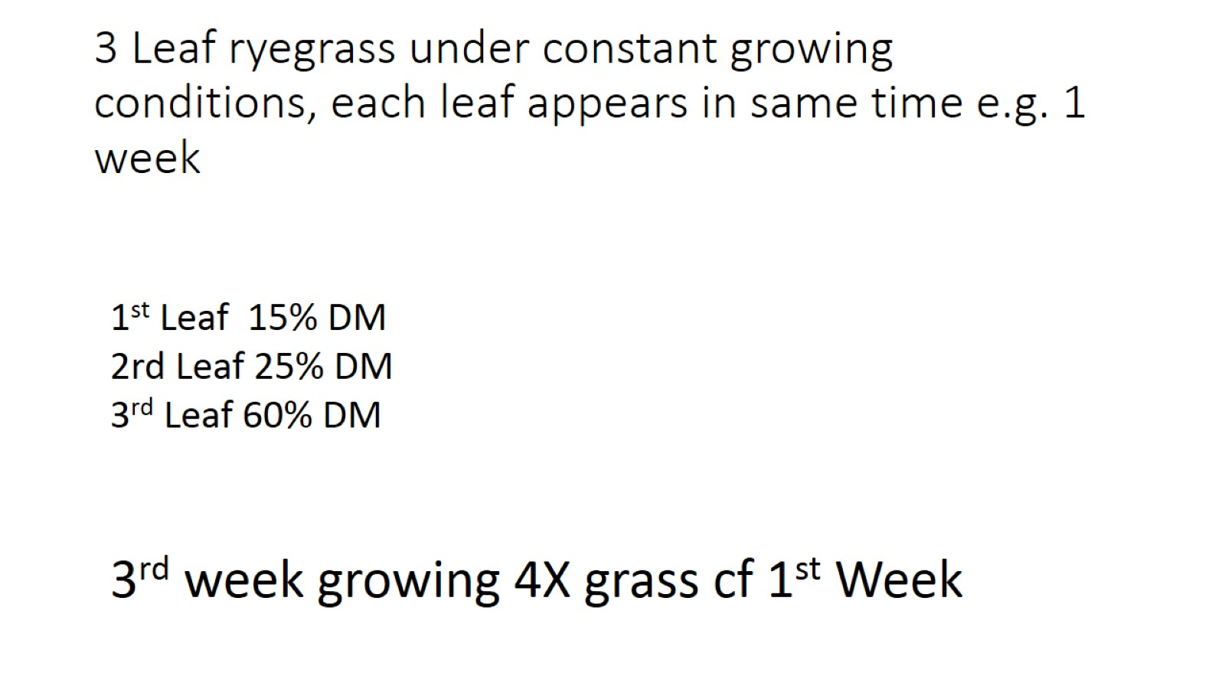
3 Leaf ryegrass under constant growing conditions, each leaf appears in same time e.g. 1 week

Slide 5
Growing grass

Slide 6
Photosynthesis absorbs energy from the sun. It stores it in the C-H bond in glucose

Slide 7
Larger leaf area

Slide 8
Build soil organic matter

Slide 9
PUTTING IT INTO PRACTICE

Slide 10
Grazing management

Slide 11
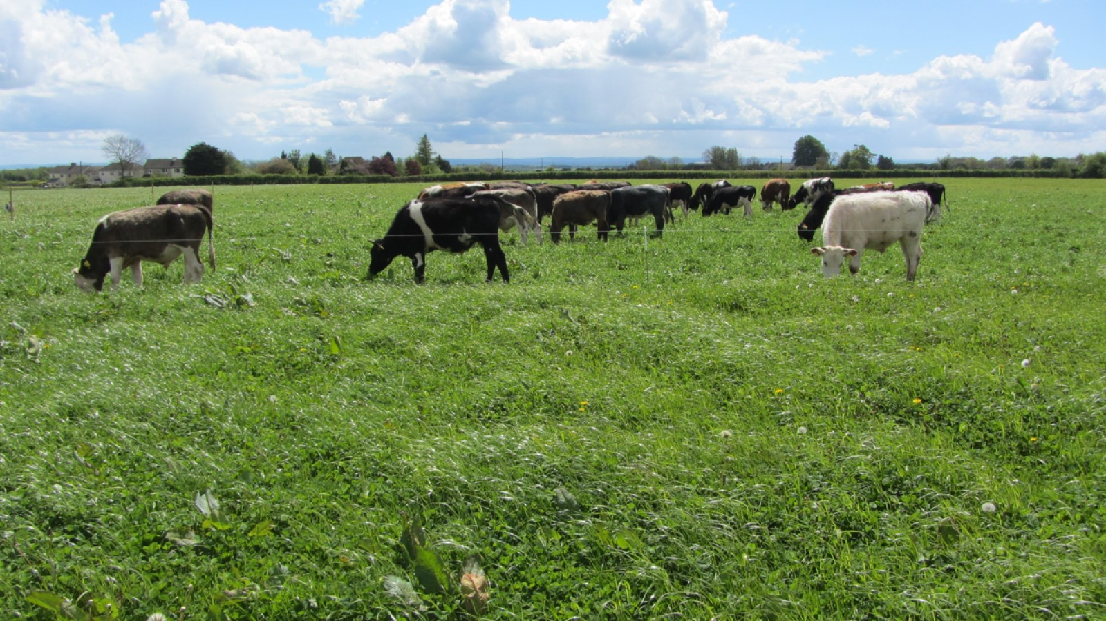
Photos Laines Estate

Slide 12
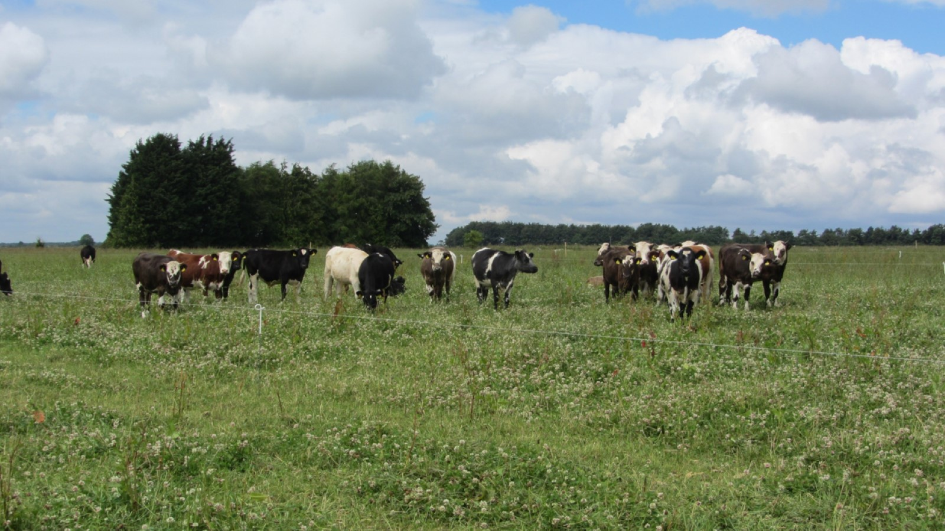

Slide 13
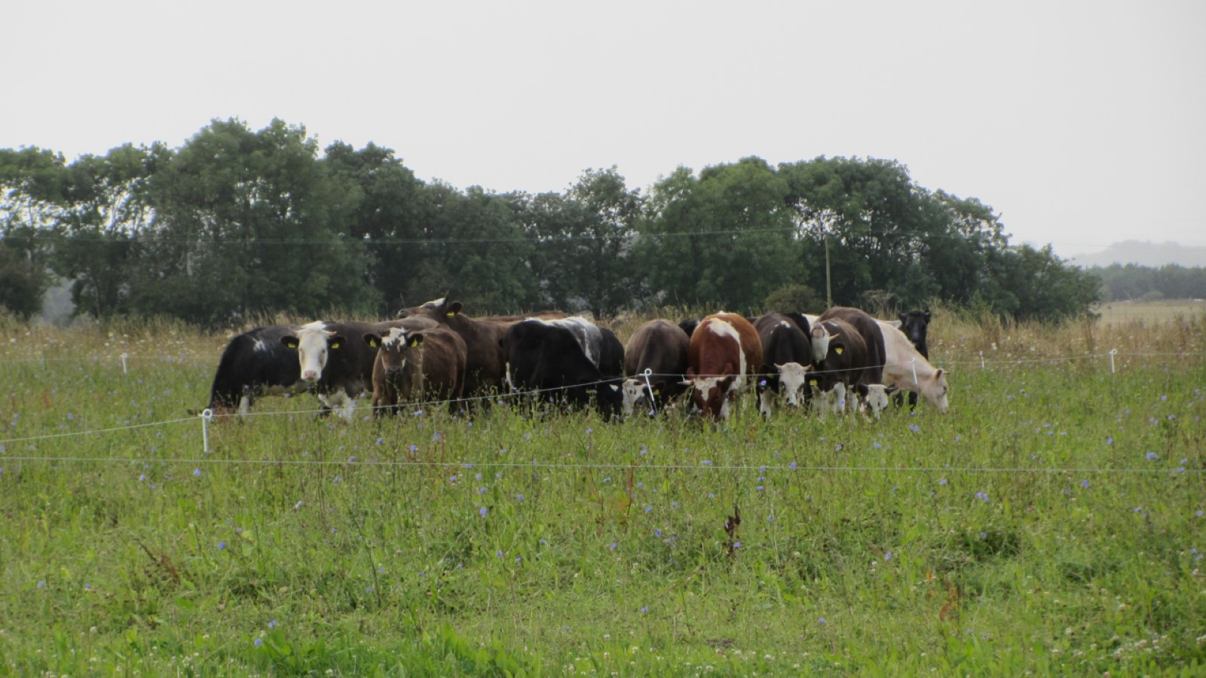

Slide 14
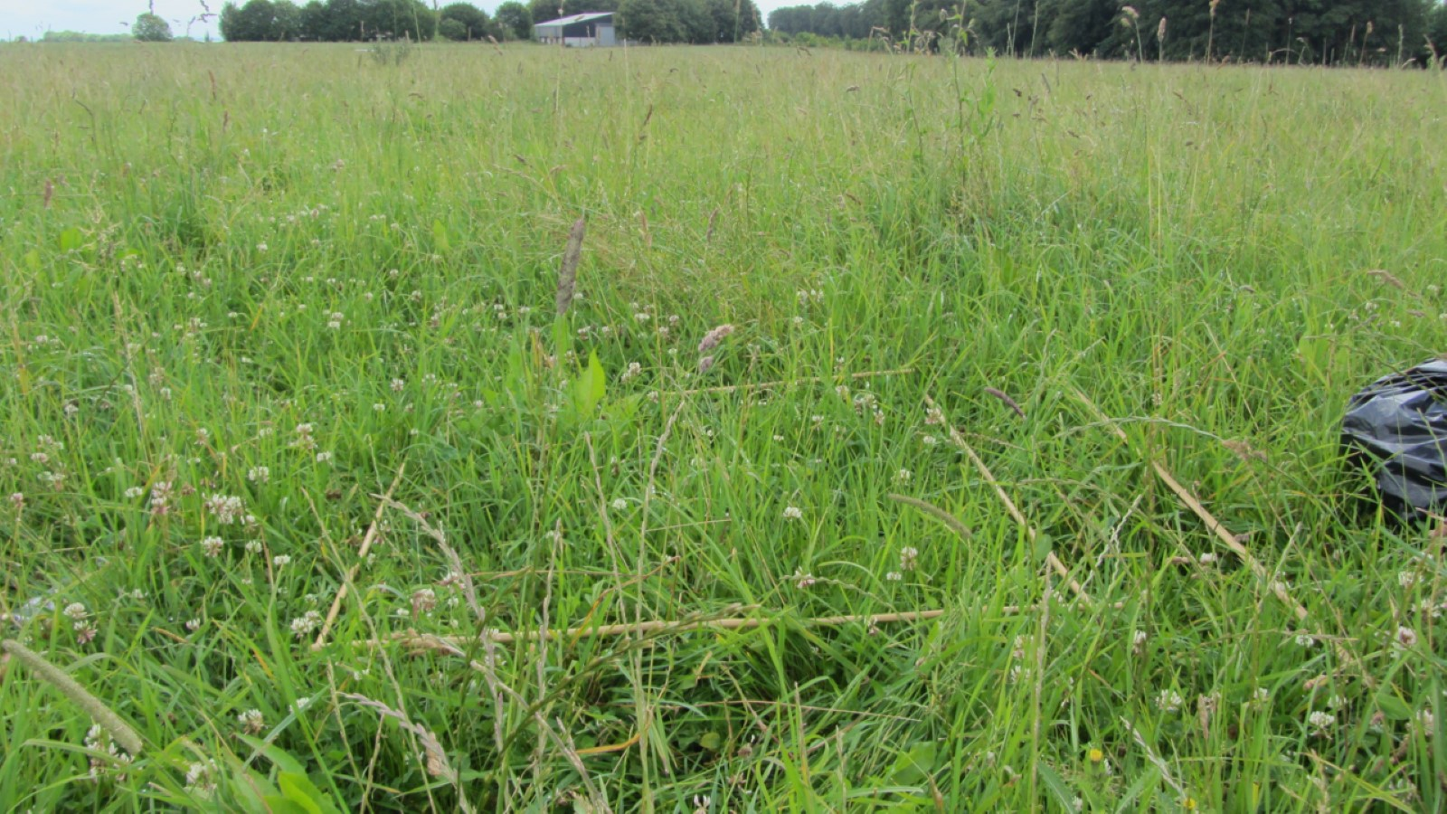

Slide 15
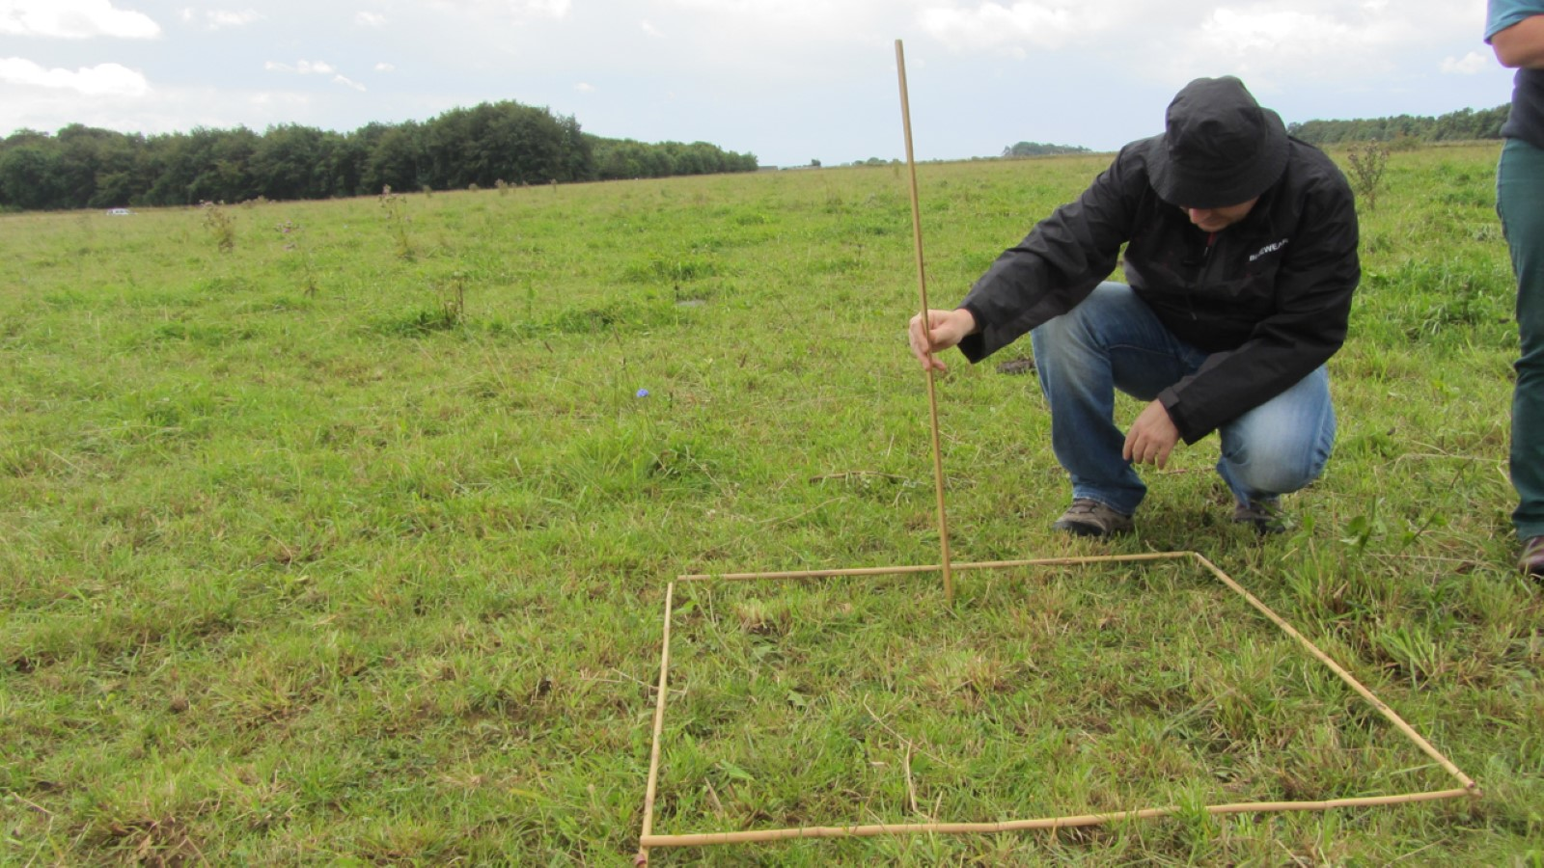

Slide 16
Compost

Slide 17
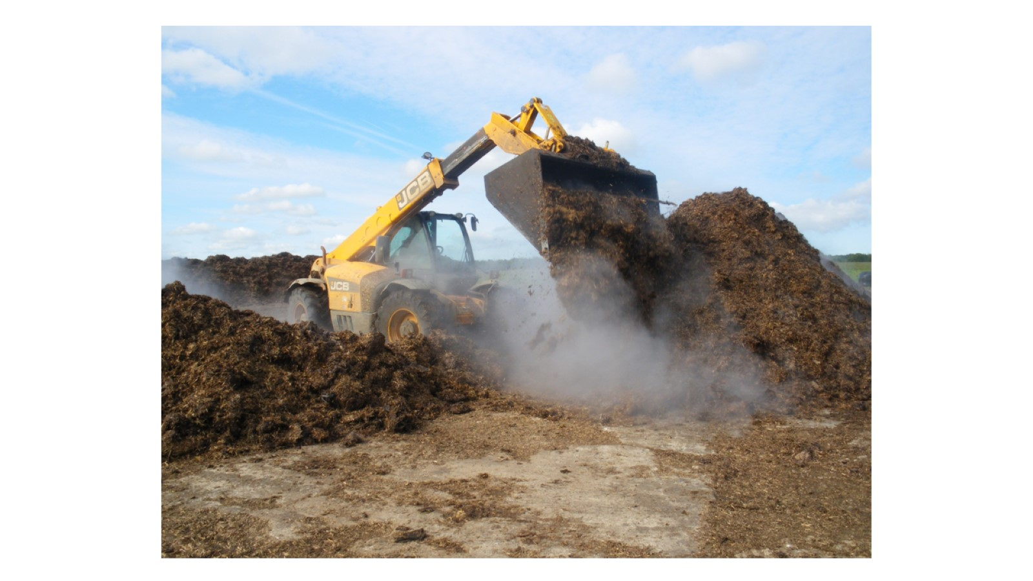

Slide 18
A cow for the system

Slide 19
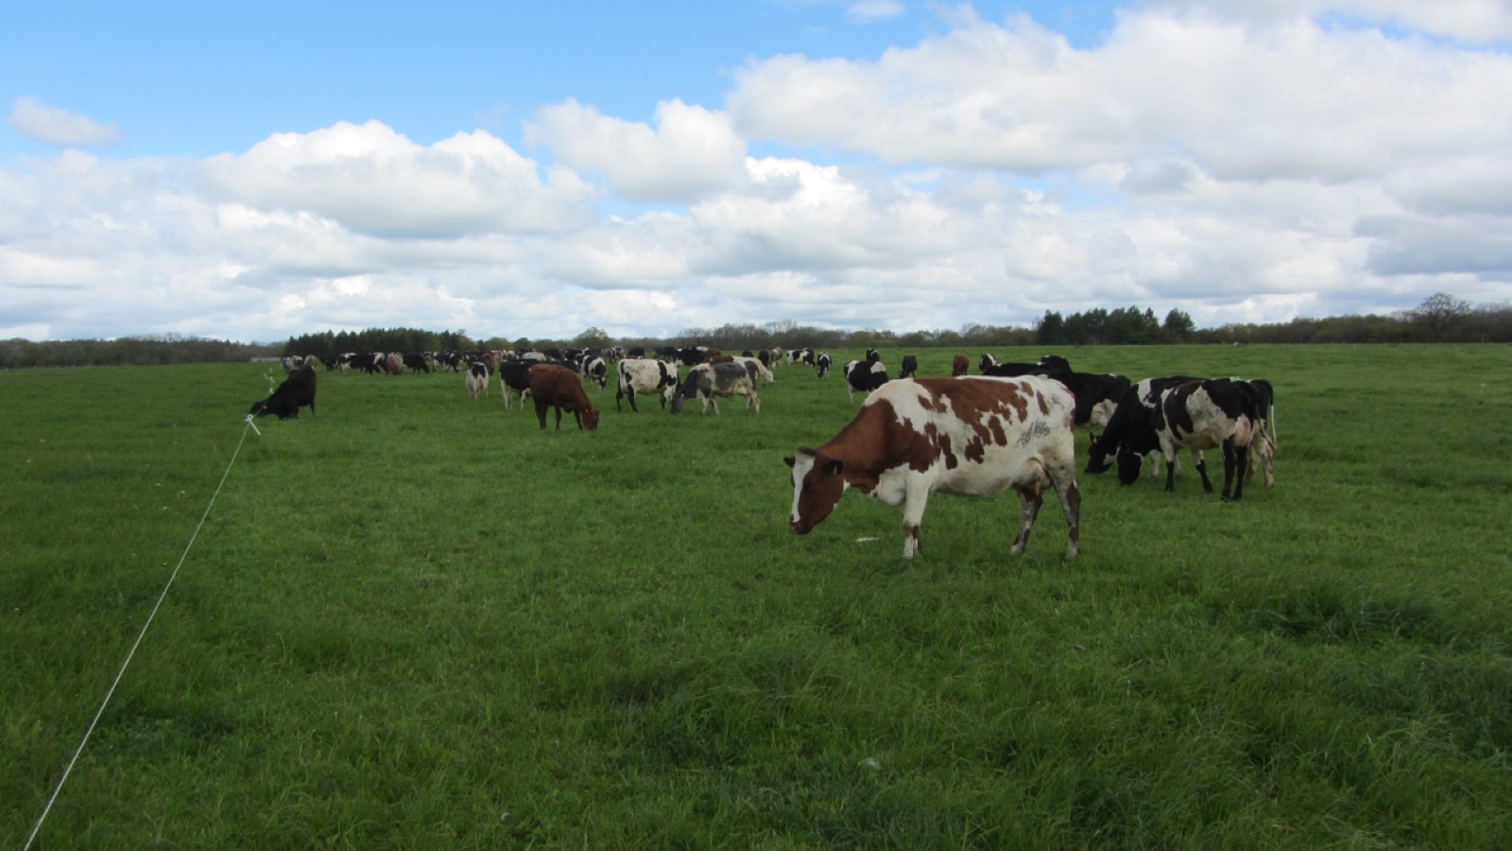

Slide 20
Conclusions
Tall grass grazing
Maximises leaf area/use of sunlight
Enables the plant to feed both cow and soil
Builds soil organic matter
Improves resilience and productive capacity of soil

