Slide 1
Life in the Soil
Elaine Ingham, B.A., M.S., Ph.D.
President, Soil Foodweb Inc.
soilfoodweb@aol.com

Slide 2
Elaine Ingham, B.A., M.S., Ph.D.
Soil Microbiologist
St. Olaf College, Double Major in Biology and Chemistry
Master’s, Texas A&M, Marine Microbiology
Ph.D., Colorado State University, Soil Microbiology
Research Fellow, University of Georgia
Assistant, Associate Professor, Oregon State University (1986 – 2001)
  Rodale Institute, Chief Scientist 2011 - 2013
President, Soil Foodweb Inc., 1996 – present
  New York, Australia, New Zealand,
  South Africa, Canada East and West, England,

Slide 3
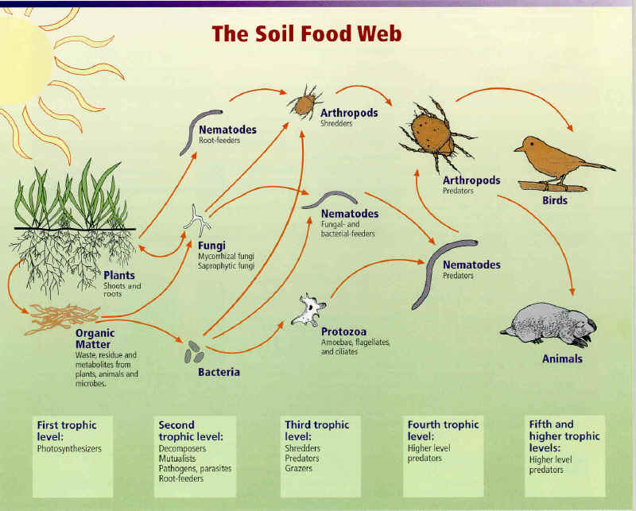
.llllllllllllllllllllllllllllllllllllllllllll

Slide 4
A Healthy Food Web Will:
Suppress Disease (competition, inhibition, consumption; no more pesticides!)
Retain Nutrients (stop run-off, leaching)
Nutrients Available at rates plants require (eliminate fertilizer) leading to flavor and nutrition for animals and humans
Decompose Toxins
Build Soil Structure –(reduce water use, increase water holding capacity, increase rooting depth)

Slide 5
Minerals in soil (Sparks 2003)
Element | Soils (mg/kg) Median Range |  | In the Earth’s crust (mean) | In Sediments (mean)
O | 490,000 | - | 474,000 | 486,000
Si | 330,000 | 250,000-410,000 | 277,000 | 245,000
Al | 71,000 | 10,000-300,000 | 82,000 | 72,000
Fe | 40,000 | 2,000-550,000 | 41,000 | 41,000
C (total) | 20,000 | 7,000-500,000 | 480 | 29,400
Ca | 15,000 | 700-500,000 | 41,000 | 66,000
Mg | 5,000 | 400-9,000 | 23,000 | 14,000
K | 14,000 | 80-37,000 | 21,000 | 20,000
Na | 5,000 | 150-25,000 | 23,000 | 5,700
Mn | 1,000 | 20-10,000 | 950 | 770
Zn | 90 | 1-900 | 75 | 95
Mo | 1.2 | 0.1-40 | 1.5 | 2
Ni | 50 | 2-750 | 80 | 52
Cu | 30 | 2-250 | 50 | 33
N | 2,000 | 200-5,000 | 25 | 470
P | 800 | 35-5,300 | 1,000 | 670
S (total) | 700 | 30-1,600 | 260 | 2,200

Slide 6
Nutrient Pools in Soil
Total – everything
Without organisms to retain the soluble nutrients that a plant does not take up, or to change plant-not-available forms in plant-available forms, no new soluble nutrients will occur. Plants will suffer.
What biomass of each organism is needed so the plant gets the nutrients it needs?
Exchangeable - easily pulled off surfaces; easy to make soluble
Bacteria, Fungi, Protozoa, Nematodes
Microarthropods
Soluble – dissolved in soil solution; potentially available to plants

Slide 7
Soil Chemistry: Nutrient Pools
Total Nutrients – not normally reported
  Grind, complete digestion and combustion
Exchangeable Nutrients (Melick 3, Ammonium Acetate 1N)
  Strong extracting agents, but not ALL nutrients
Soluble Nutrients
  Extracts soil solution or water soluble nutrients
  Available nutrients – made available how?
Plant Tissue Tests
  Total chemical components….. Balanced?

Slide 8
Availability of Minerals Relative to pH
Without biology, you are stuck with pH as the sole arbiter of what is available to plant roots, as indicated to the left. But add organisms, and plant nutrition is no longer ruled by chemistry alone.

Slide 9

Soil vs Dirt: Clean water?
no organisms,
no structure
-Nutrients move
with the water
Water not held in soil pores, moves rapidly thru soil
Leaching, erosion and run-off are problems
Rainfall
Organisms
build structure
Nutrients held
Water is
retained
and moves
slowly thru
the soil
Soil
Dirt
Clean Water
Water moves clay,
silt and inorganic chemicals so no “cleaning” process

Slide 10
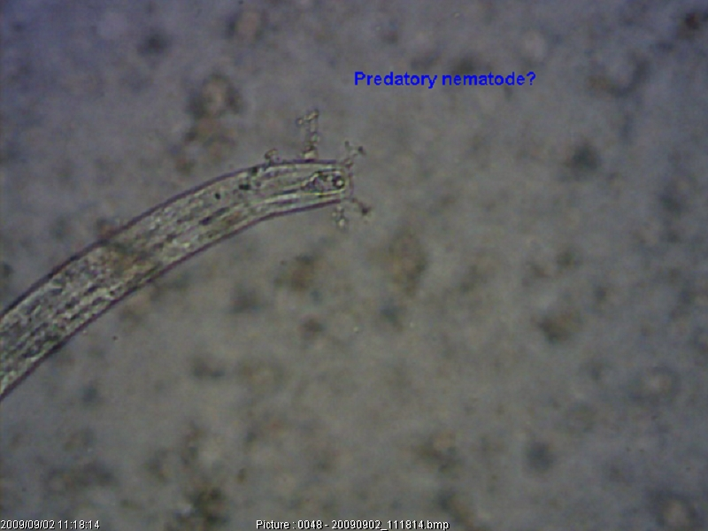
Who is in the soil?
Hi! I’m Alaimus!
I’m from the town of Vegetable Roots!
I eat aerobic bacteria and don’t like bad-tasting anaerobic bacteria at all. My job is to turn nutrients in bacteria into plant-available forms.

Slide 11
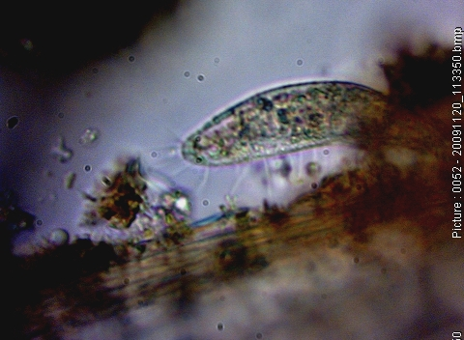
400X Total Mag

Slide 12
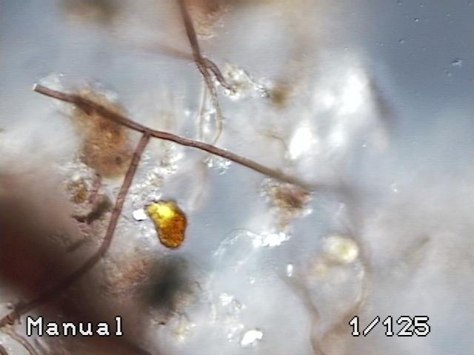
Bacteria, fungi, humus, aggregates: microscope view

Slide 13
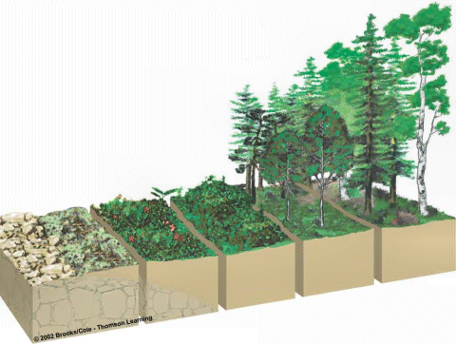
Soil biological succession causes plant succession
Bacteria …A few Fungi……Balanced ……..More Fungi…… Fungi
Bacteria: 10 µg 100 µg 500 600 µg 500 µg 700 µg
Fungi: 0 µg 10 µg 250 600 µg 800 µg 7000 µg

Slide 14
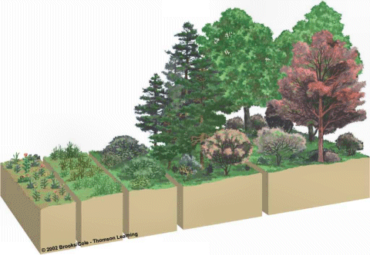
Forms of nutrients:
Critical to understand
NO₃………..…...balanced………………..NH₄
NO₃ and NH₄
Protozoa.....B-f…..F-f…..Predatory…..Microarthropods
Nematodes

Slide 15
What does your plant need?
Cyanobacteria
True Bacteria
Protozoa
Fungi
Nematodes
Microarths
F:B = 0.01
Bare Parent
Material
100% bacterial
“Weeds”
- high NO3
- lack of oxygen
F:B = 0.1
Soil Foodweb Structure
Through Succession,
And Increasing Productivity
Early Grasses
Bromus, Bermuda
F:B = 0.3
Conifer, old-
growth forests
F:B = 100:1 to
1000:1
Mid-grasses, vegetables
F:B = 0.75
Deciduous
Trees
F:B = 5:1 to 100:1
Shrubs, vines,
Bushes
F:B = 2:1 to 5:1
Late successional
grasses, row crops
F:B = 1:1

Slide 16
Volcano!
Bare Parent
Material
100% bacterial
Foodweb
Development
F:B = 0.01
“Weeds”
F:B 0.1
Disturbance Pushes
Systems “Backwards”,
But How Far?
Depends on Intensity,
Frequency
Insects
Early Annuals
F:B = 0.3
Old- growth
F:B = 100:1 to
1000:1
Mid-grass, vegies
F:B = 0.75
FIRE!!!
Flood
Bushes
F:B = 2:1 to 5:1
Pasture, row crops
F:B = 1:1
Deciduous Trees
F:B = 5:1 to 100:1
Cattle
Humans?

Slide 17
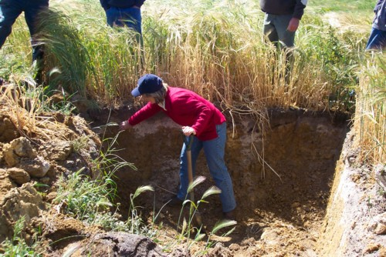
Lawns , trees, gardens or crops, the story is the same. Soil biology is being destroyed by human management. Roots are not going as deep as they should, and water, fertility and disease protection are lost.

Slide 18
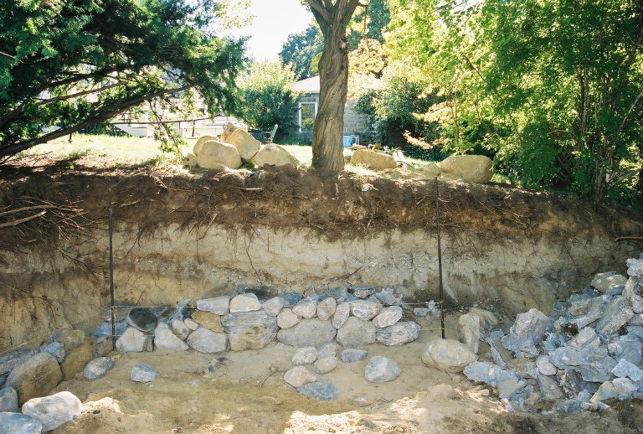
Peter M. Wild, Boston Tree Preservation
Just because we see this all the time, does it mean this is how plants grow?
18

Slide 19
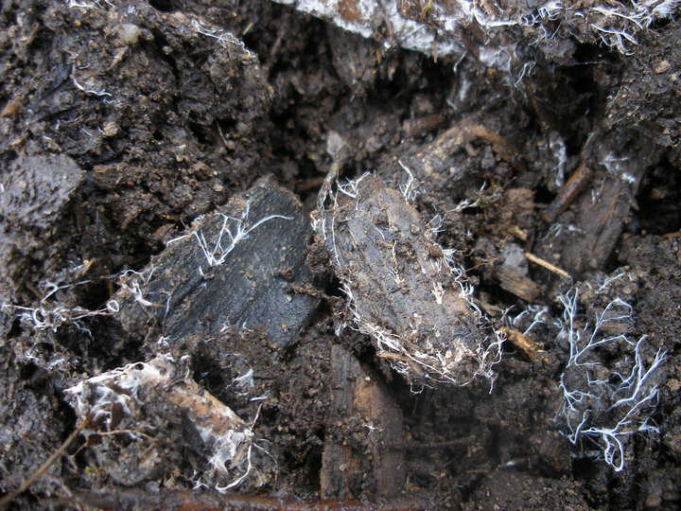
Josh Webber: Portmore Golf Course,
North Devon, UK

Slide 20
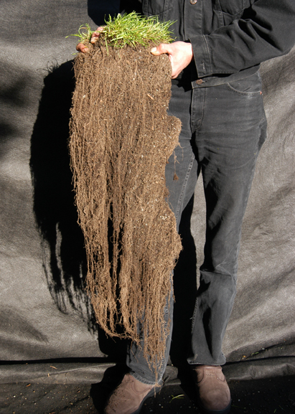
Without compaction roots can go deep
Hendrikus Schraven holding ryegrass planted July 15, 2002
Harvested Nov 6, 2002
Mowed through the summer
70% Essential Soil,
30% Compost/organic fertilizer
Compost tea once
No weeds, no disease
www.soildynamics.com

Slide 21
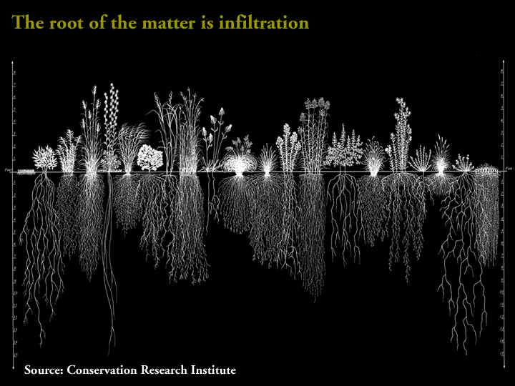
Oxygen? Disease? Microbes?
Source: Conservation Research Institute

Slide 22
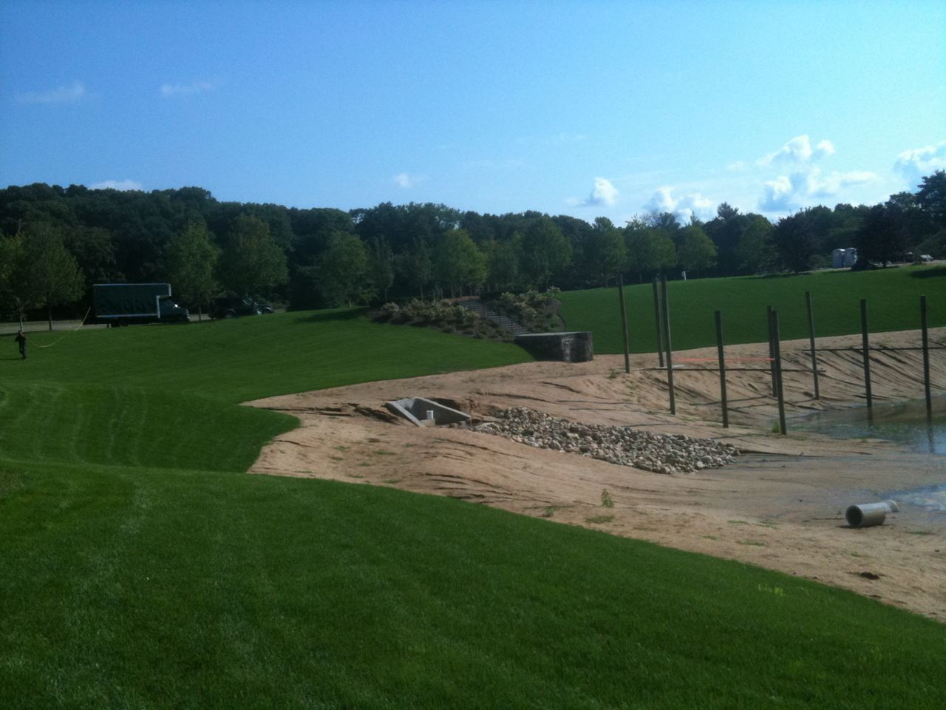
Sod installed around new pond just after installation and one compost tea spray

Slide 23
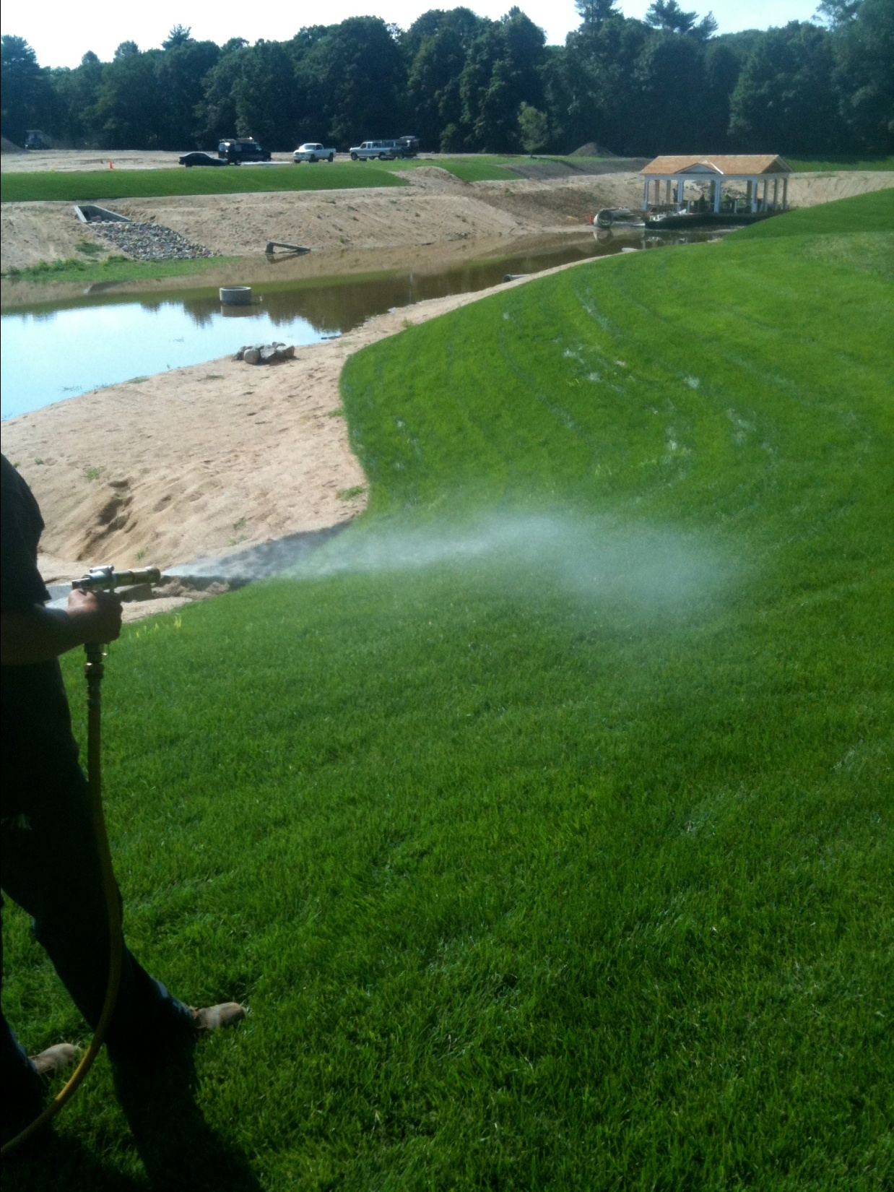

Slide 24
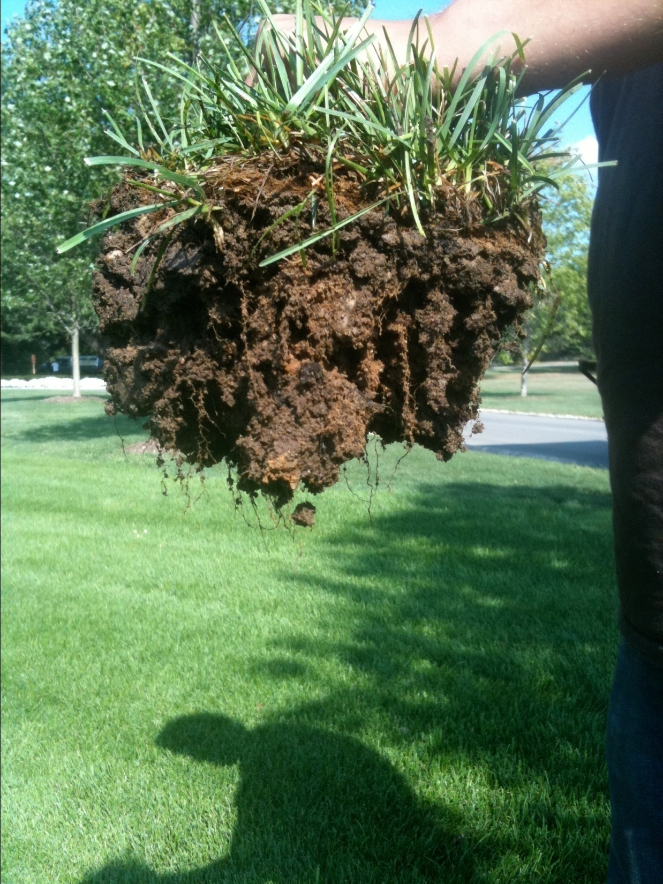
6 weeks after sod was laid with compost tea below and on the sod.
Roots were less than ½ inch, now 6 inches deep into the soil.
No erosion, no weeds, no disease

Slide 25
Biological V’s Conventional
Approach to Soil Management
Compost Tea Test Trial
Summer 2003
by Abron New Zealand
Russell Snodgrass, SFI Advisor

Slide 26
Background
Trial area consists of two plots fenced off from stock and the pasture harvested every 20-30 days using a mower
Trial was carried out on a conventional dairy farm in the Bay of Plenty, New Zealand
All testing is done by Hill Laboratories and the Soil Foodweb Institute NZ
Trial overseen by Mark Macintosh of Agfirst Consultants
Trial started 1 October 2003
Trial finished 24 February 2004

Slide 27
Treatment
Compost Tea Plot
  Three applications of compost tea and foods at 150L/ha applied every 4 weeks starting in October 2003
  No fertiliser had been applied to the compost tea trial plot for the 12 months prior or throughout the trial
Control Plot
  Conventionally fertilised with urea at an application rate of 75kg/ha every 6-8 weeks (450kg/ha per year)
  Phosphate Sulphur Magnesium applied at industry maintenance levels

Slide 28
Total Dry Matter Grown
Is it true that lower yields occur in Organic Agriculture?
If you get the life in the soil correct, that is not true.

Slide 29
Average Clover % in Pasture Sward
No clover was sown in these fields. Where did the clover come from? There all along, just needed to NOT have the urea used.

Slide 30
Herbage Mineral Levels Improved

Slide 31
Biological Soil Test Results
Soil Foodweb test done 4 weeks after 3rd application - Dec 2003
Biomass Data | Control | Compost Tea
Active Bacteria (ug/g) Total Bacteria (ug/g) | 64.2 348 | 30.4 257
Active Fungi (ug/g) Total Fungi (ug/g) | 0.5 113 | 144 227
Fungi to Bacteria Ratio | 0.32 | 0.88
Fungi Hyphal Diameter (um) | 2.5 | 3
Protozoa (per gram) Flagellates Amoebae Ciliates | 8395 8395 4046 | 58730 5873 1767
Mycorrhizal fungi root colonisation (%) | 0 | 4

Slide 32
Nematodes
Numbers per gram fresh soil
Type | Control | Compost Tea | Variance
Bacteria feeders | 1.98 | 4.52 | 128%
Fungal feeders | 0.99 | 1.58 | 60%
Fungal / Root feeders | 1.09 | 0.24 | 78%
Root feeders | 0.99 | 0.12 | - 87%
Predatory Nematodes | 0 | 0 | 0

Slide 33
Key Results
11.78% increase in total dry matter grown over the control
$307/ha increased milk income from the extra dry matter grown
Big increases in herbage mineral levels, resulting in reduced animal health costs; recovery from facial eczema
780% increase in clover content giving the soil access to more free nitrogen
Huge reductions in root feeding nematodes, providing a better environment for increased clover growth
Reduce costs by $200,000 on a 300 acre farm in the first growing season

Slide 34
There is hope…..
We can return the soil to health in a short time, and for little cost
It will not cost billions, or even millions of dollars
It will not take years
Within one growing season, you can get the increased yields, decrease your costs and improve nutrition in the food you produce
IF you get the biology right for your plant
IF you get the WHOLE FOOD WEB back
34

Slide 35
Contact Information…..
Dr. Elaine Ingham, B.S., M.S., Ph.D.
Soil Foodweb Inc. soilfoodweb@aol.com
  2864 NW Monterey Pl, Corvallis, Oregon
Soil Life Consultants soillifeconsultants.com
35

