Slide 1
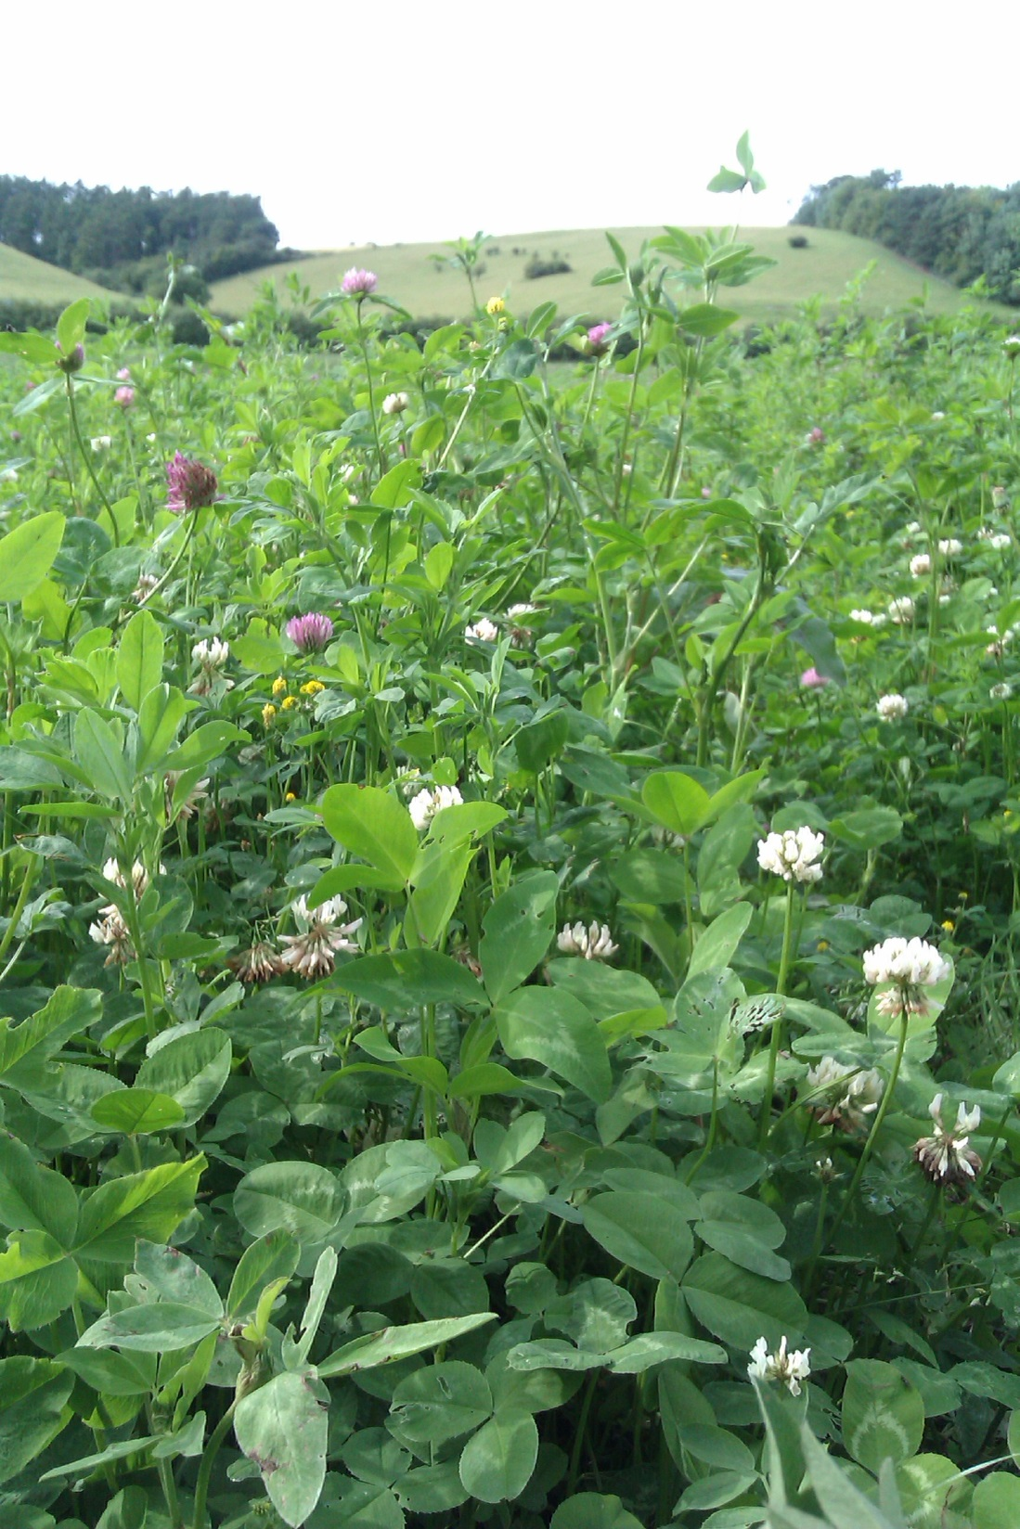
Grassroots r&D Why it matters more than ever and where you can find support
Tom MacMillan

Slide 2
GLOBAL AGRICULTURAL R&D
= £12 billion per year
Includes:
Machinery,
Pesticides,
Seeds
Breeding and
Processing industries…
…but not farming
$31 bn
$18 bn
(c. 3-11% of revenue)
Public
Business

Slide 3
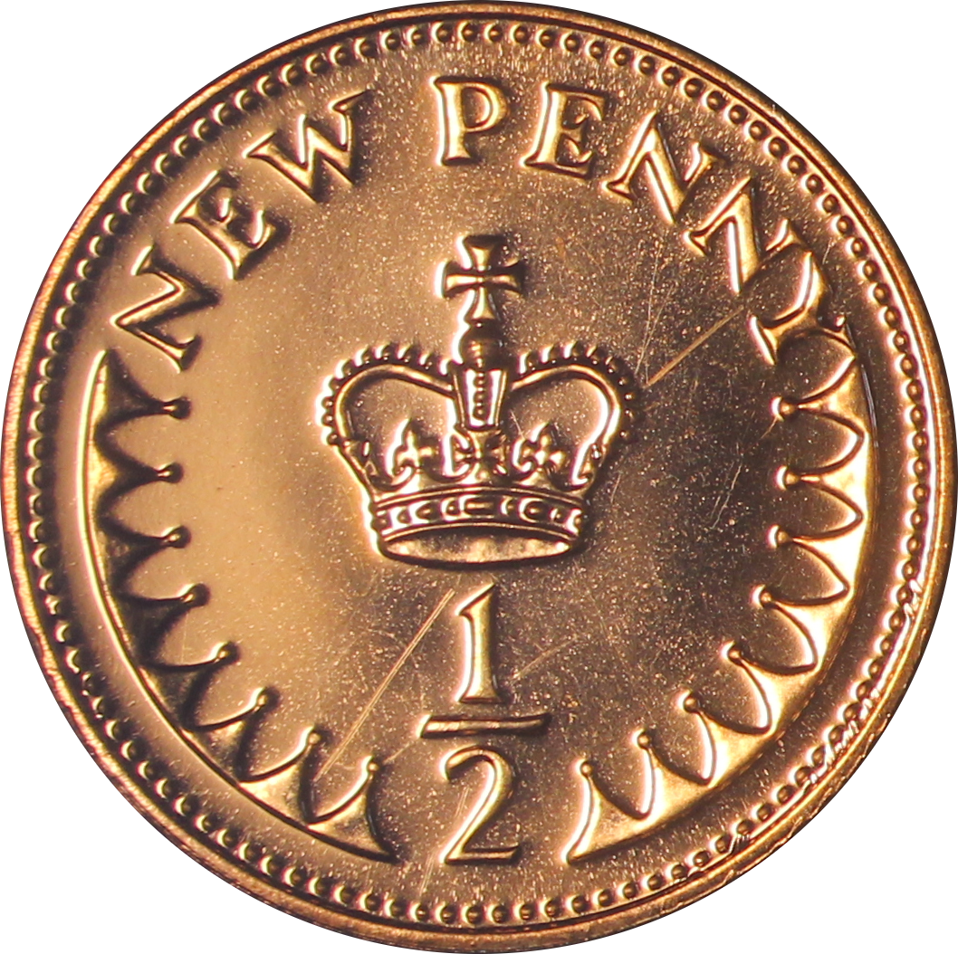

Slide 4
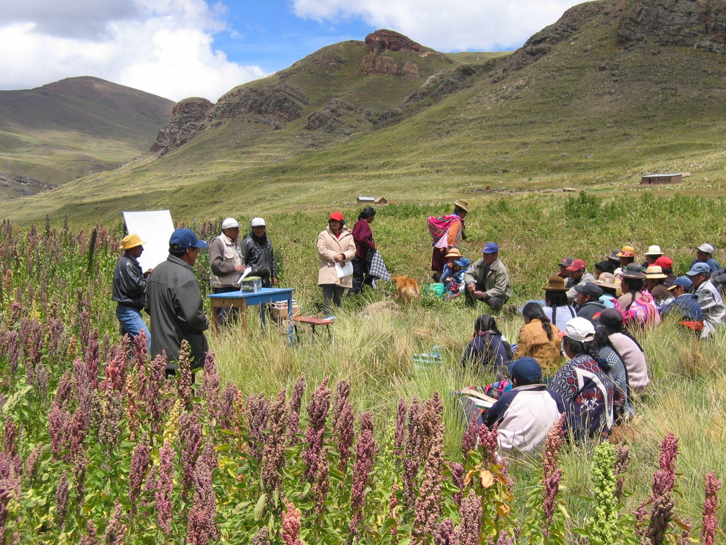
Image: Crops for the Future
Notes:
Quinoa growers in Peru

Slide 5
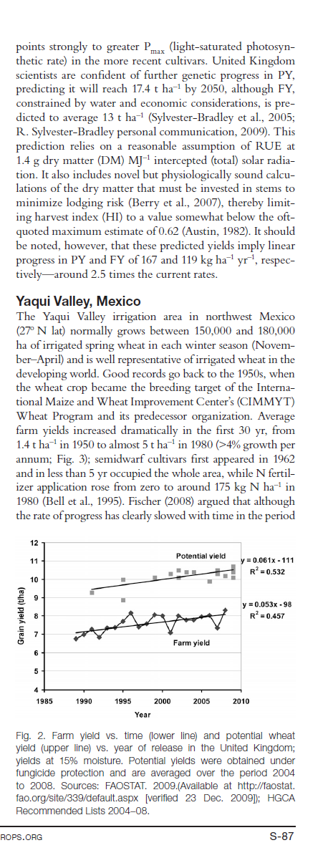
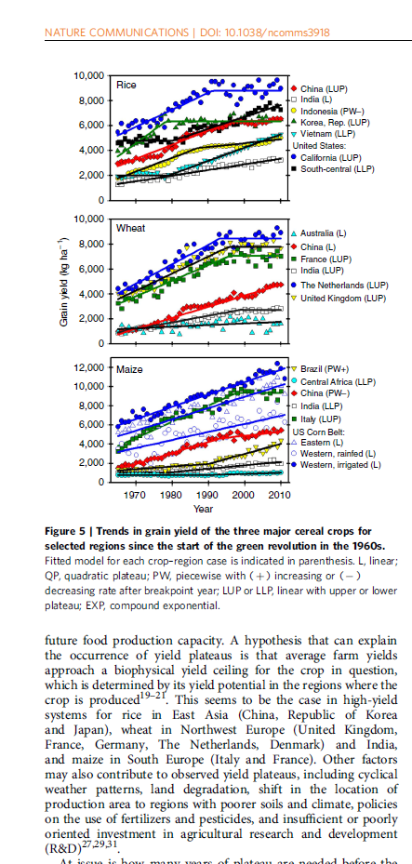
Fischer & Edmeades (2010)
Notes:
Nw eu for wheat, east asia for rice

Slide 6
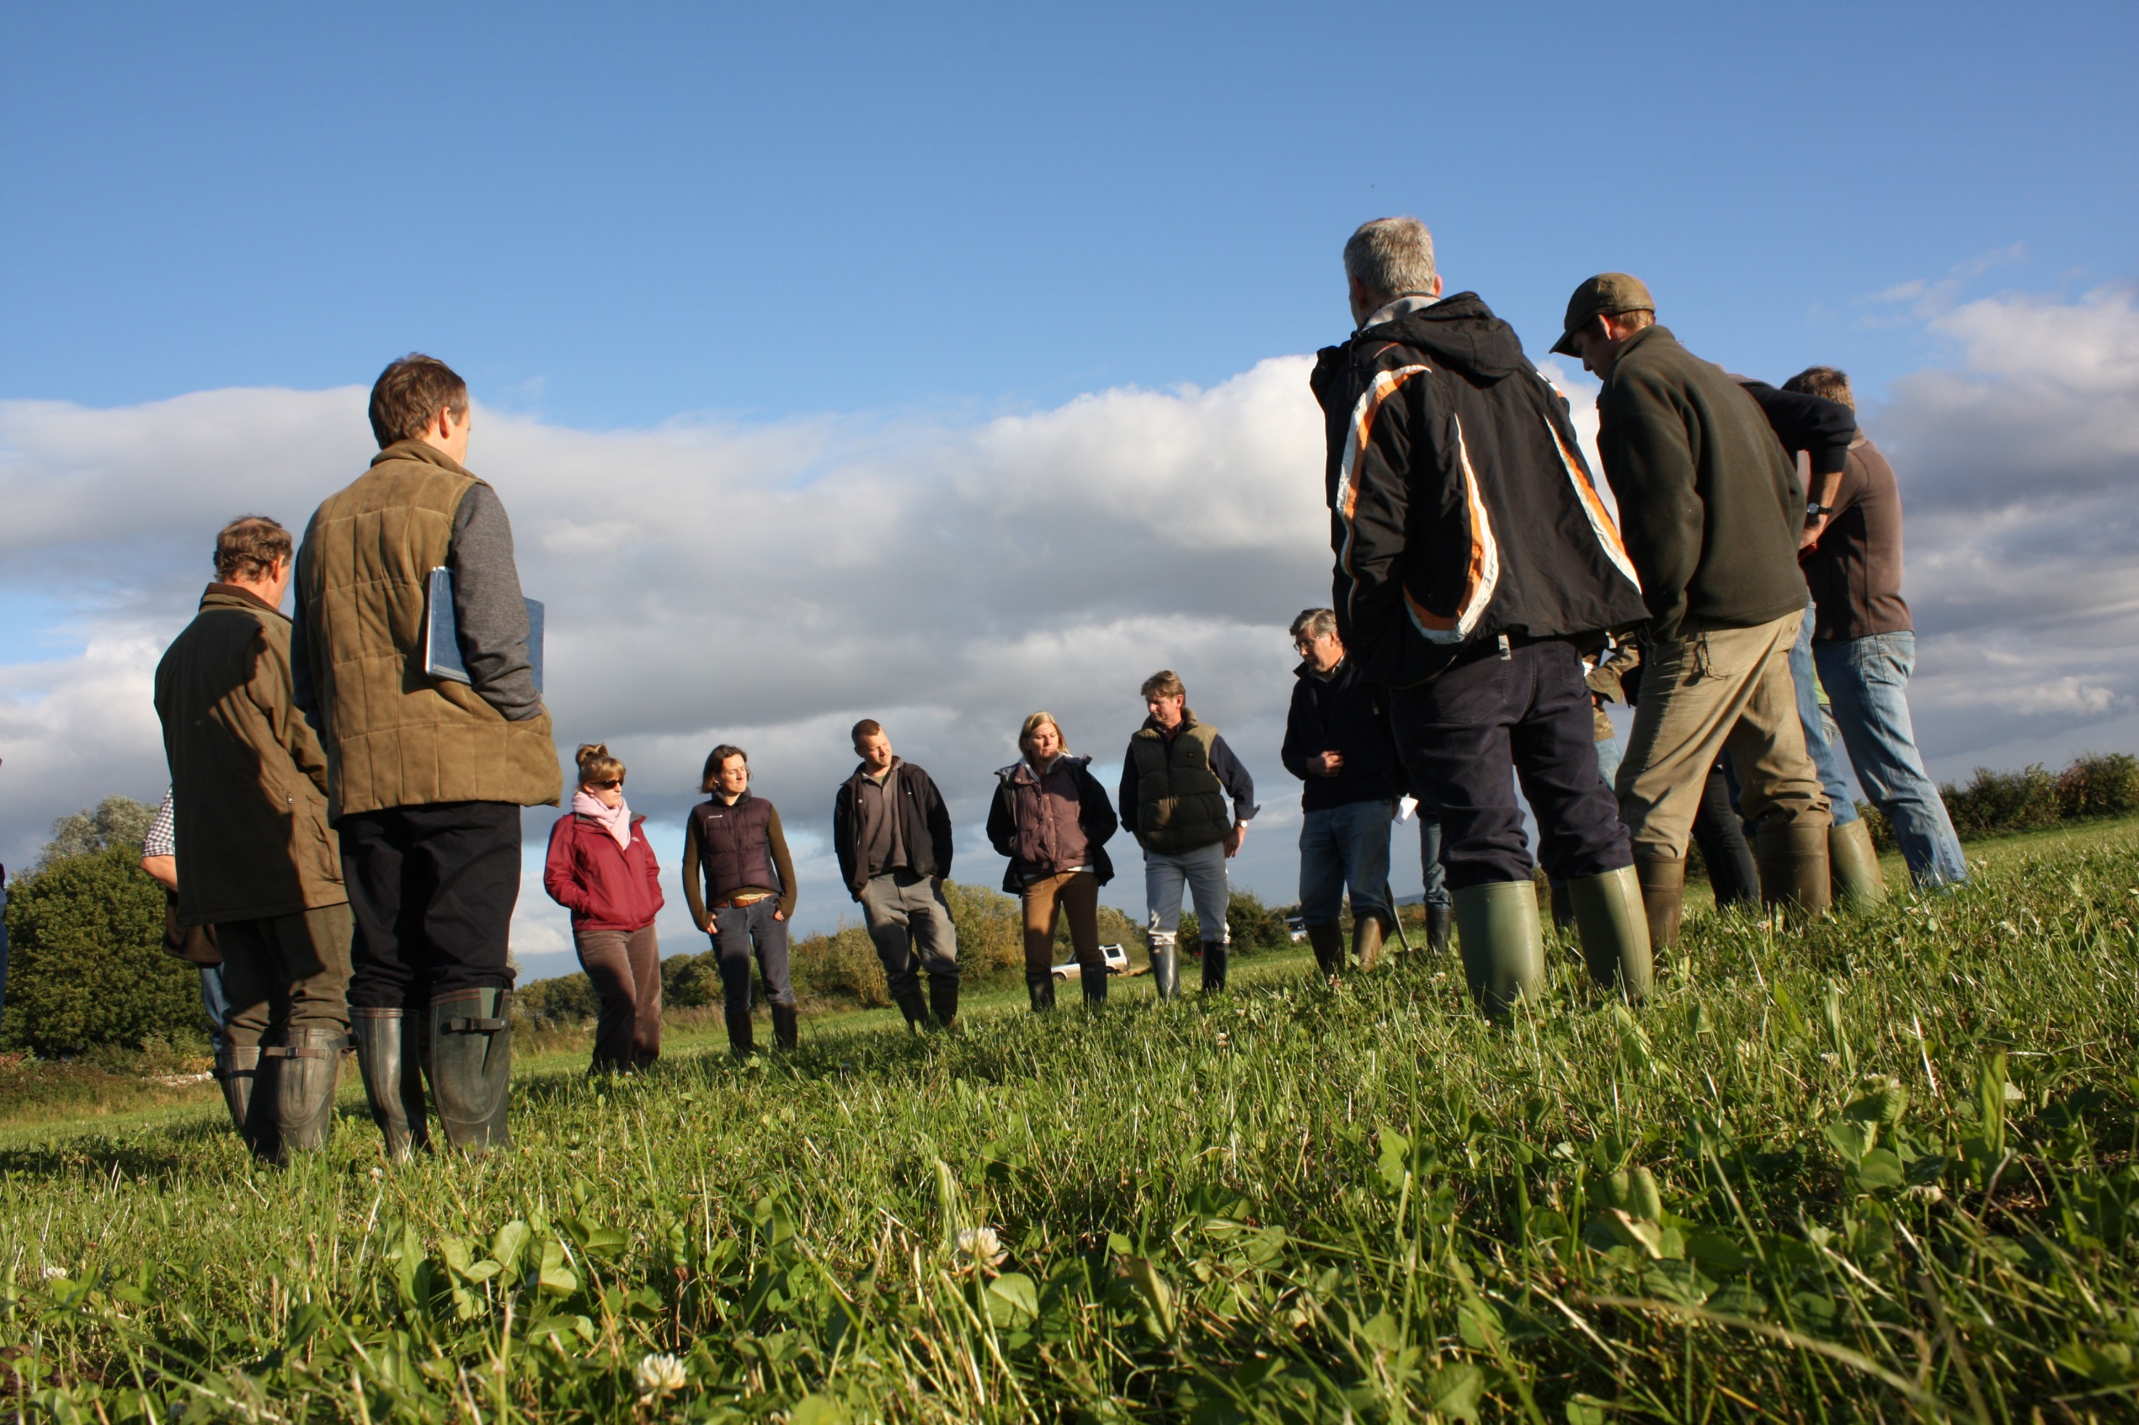
DUCHY ORIGINALS FUTURE FARMING PROGRAMME

Slide 7
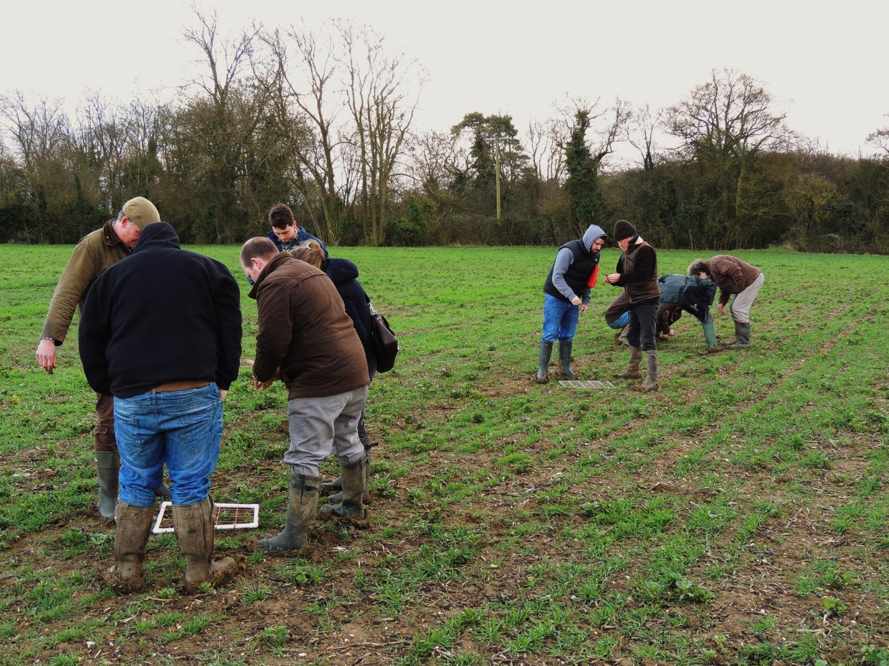
Field labs
“from advice takers to advice makers”
650 farmers
80% of farmers we surveyed made practical improvements because of their field lab
28 topics

Slide 8
Farmer-led
Funding
£16K average grant

Slide 9
Opportunities in 2015
?
Innovation clubs:
- Field labs
- MATCHMAKING farmers WITH RESEARCHERS
- Help applying for grants
- Plus Our own RESEARCH FUND
Interested? Email atoner@soilassociation.org

